Slide 1
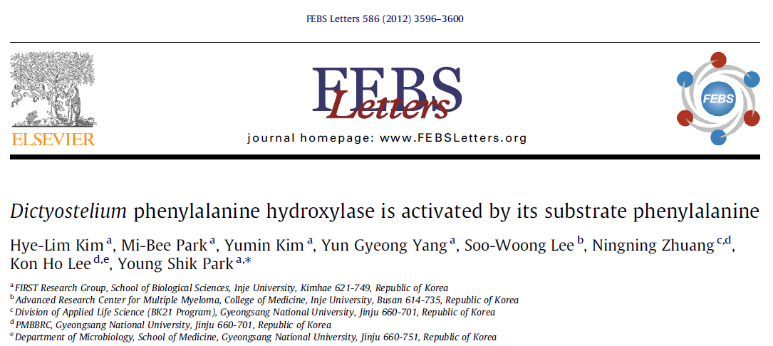
Look beyond what you see

Slide 2
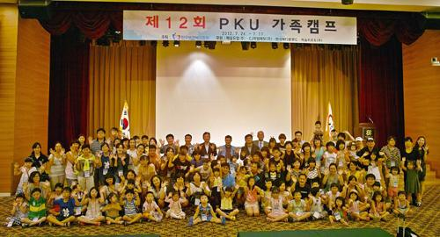
Phenylketonuria

Slide 3
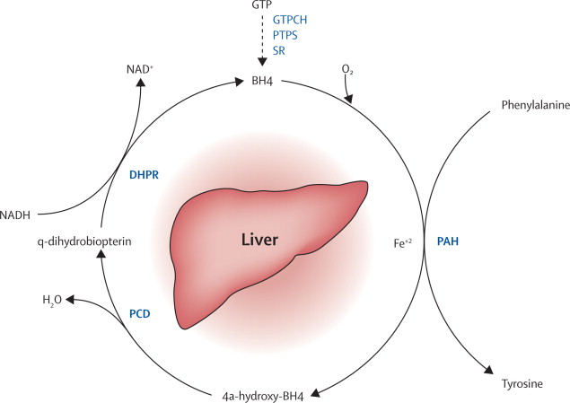
Phenylalanine hydroxylating system

Slide 4
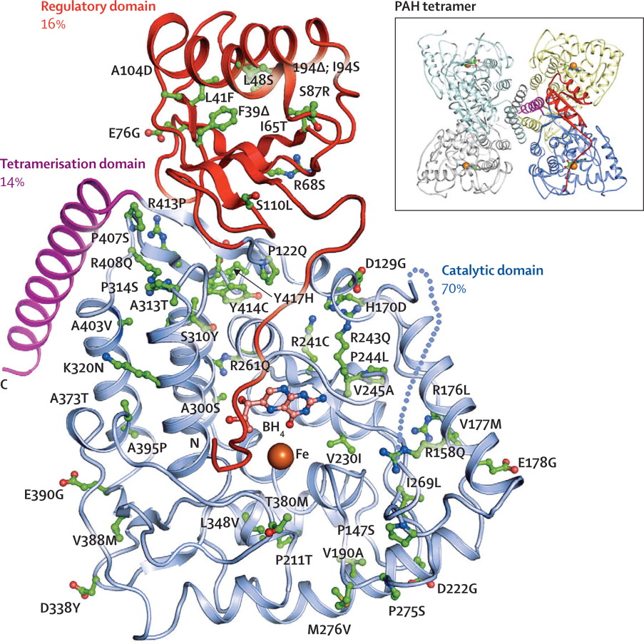
Phenylalanine hydroxylase structure

Slide 5
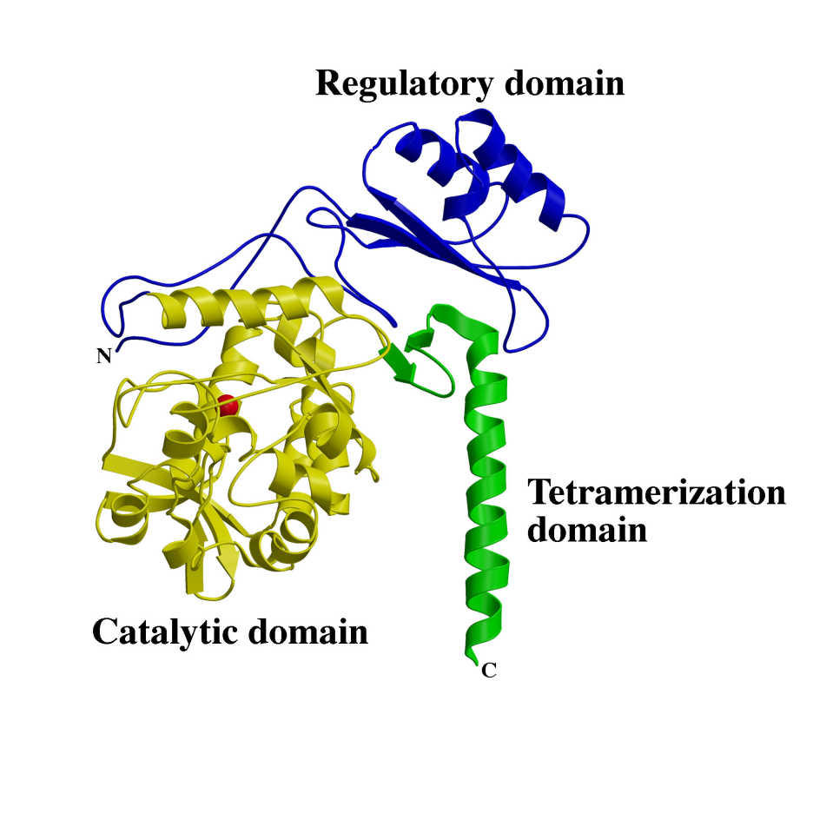
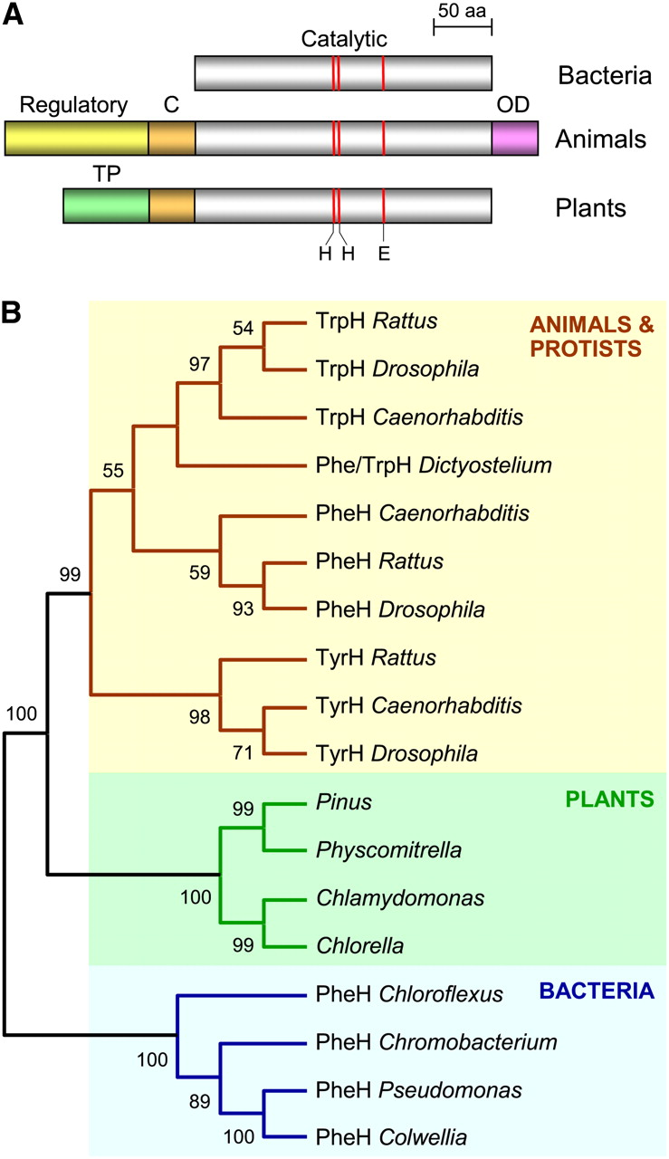
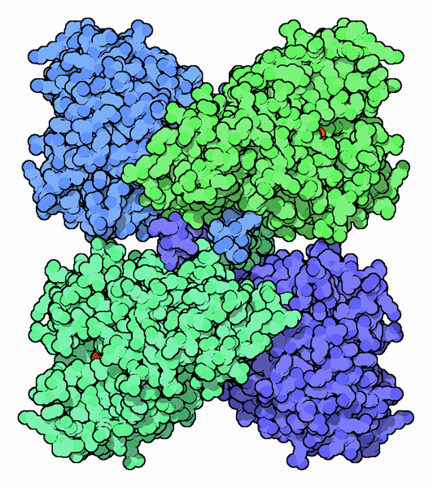

Slide 6
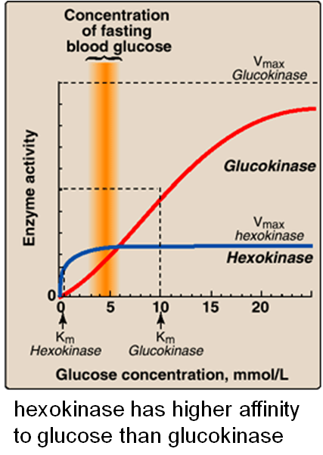
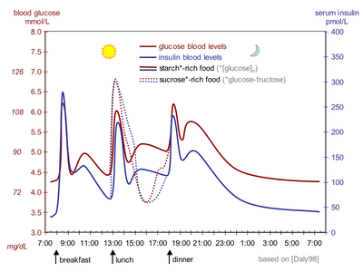
Enzymatic kinetics: K_{m}, k_{cat} (V_{max})

Slide 7
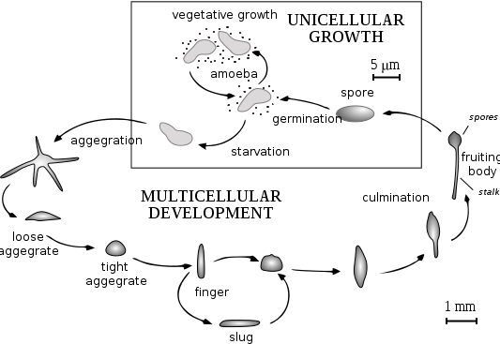
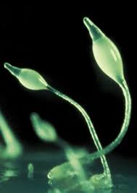
Dictyostelium development

Slide 8
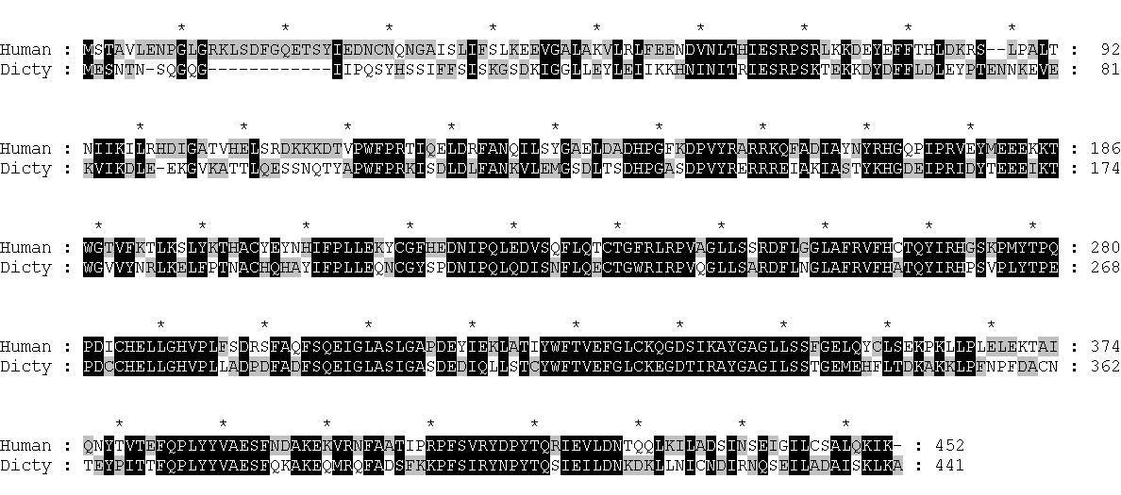
Protein sequence alignment of the human and Dictyostelium PAHs.
91
Catalytic domain
415
Dimerization motif
Tetramerization domain
Dimerization
motif
tetramerization
Regulatory
Catalytic
91
415

Slide 9
Schematic diagram of the recombinant dicPAHs prepared for kinetic study
Dimerization motif
Tetramerization
WT
Regulatory
Catalytic
91
415
441
RC
CT
C

Slide 10
Size-exclusion chromatography of recombinant dicPAHs
A
B
mAU
60
WT
kDa
M WT RC CT C
RC
50
CT
C
40
66
Absorbance (280 nm)
30
45
36
20
29
10
0
0
5
10
15
20
25
Volume (ml)
WT RC CT C

Slide 11
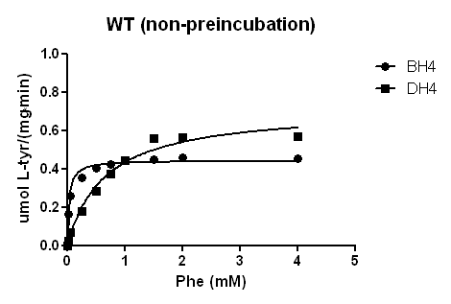
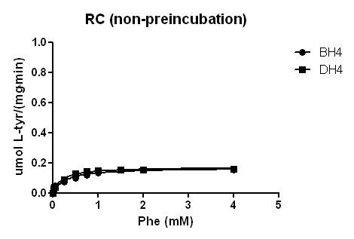
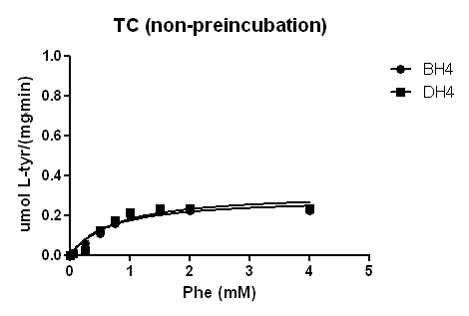
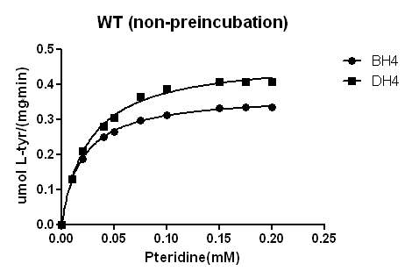
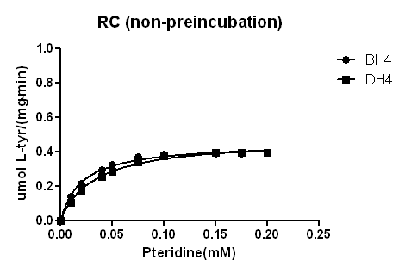
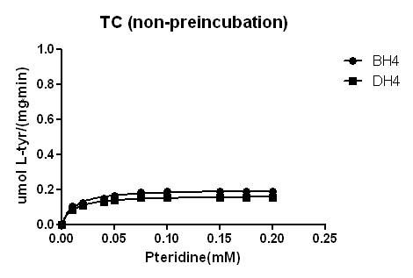
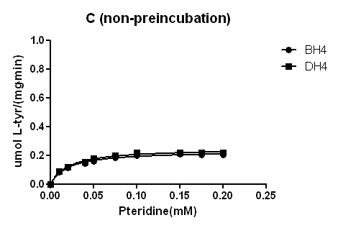
Enzyme kinetics study of recombinant dicPAHs

Slide 12
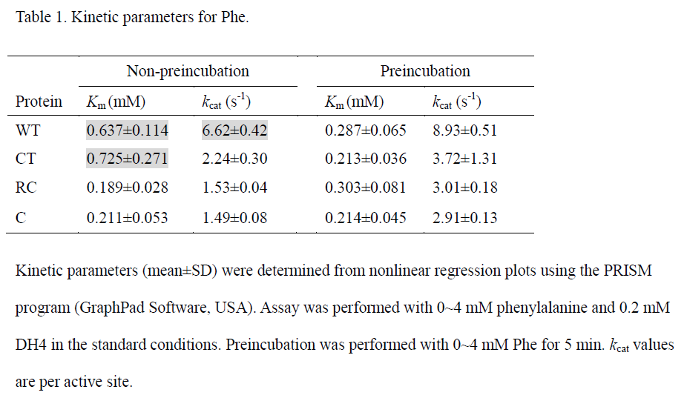

Slide 13
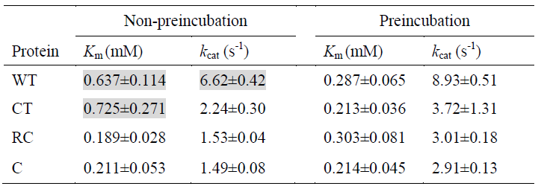
Structural interpretation
(shape, Km; color, kcat)
WT
Comparison of Km
The dimeric/monomeric forms were relieved from structural constraints of substrate-binding in tetrameric forms.
Comparison of kcat
The regulatory domain contributes to enhancing kcat in association with the catalytic domain. Since RC is also poor in kcat, the regulatory domain may be functional only in the tetrameric forms.
Preincubation with Phe
Decreased Km values of WT and CT: Phe-induced activation of the tetrameric forms, putatively via a mechanism involving conformational changes, which is not mediated by the regulatory domain, because the domain is absent in CT.
General stimulatory effect on kcat not only for WT (1.3-fold) but also for others (1.7- to 2.0-fold). This seemingly non-specific stimulatory effect supports once again that the function of regulatory domain might be independent from the activation by Phe.
High Km, High kcat
Low Km, High kcat
CT
High Km, Low kcat
Low Km, Low kcat
RC
Low Km, Low kcat
Low Km, Low kcat
C
Low Km, Low kcat
Low Km, Low kcat

