Slide 1
융합과학 연구론
What is the difference between Science and Technology?
http://www.kyosu.net/news/articleView.html?idxno=28577

Slide 2
Make a story

Slide 3
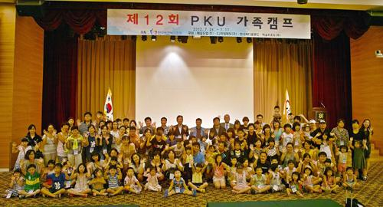
Phenylketonuria

Slide 4
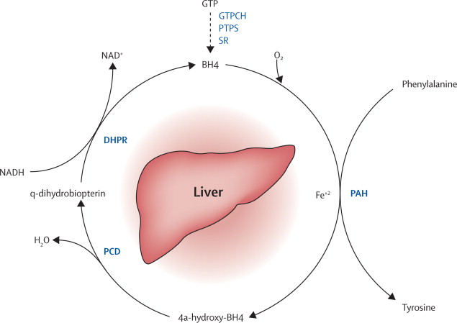
Phenylalanine hydroxylating system

Slide 5
Biosynthesis & regeneration of BH4
Guanosine triphosphate
DAHP
GTPCH
GFRP
Neopterin
Dihydroneopterin triphosphate
Tetrahydrofolate
in plant and bacteria
PTPS
AR
6-pyruvoyl tetrahydropterin
CR/AKR1C3
1’-oxo-H₄-pterin
2’-oxo-H₄-pterin
O₂
NAS
SR
Sepiapterin
CR
AR
BH4
Arginine, O₂
SR/CR
DHFR
Tetrahydrobiopterin (BH4)
H₂-biopterin
NOS
BH4 radical
BH2
MTX
AAAH
AGMO
DHPR
Citruline, NO
PCD
Biopterin
q-Dihydrobiopterin
Pterin-4a-carbinolamine

Slide 6
Guanosine triphosphate
GTPCH
Dihydroneopterin triphosphate
PTPS
6-pyruvoyl tetrahydropterin
AR
SR
1’-oxo-H₄-pterin
2’-oxo-H₄-pterin
SR
SR
Tetrahydrobiopterin (BH4)

Slide 8
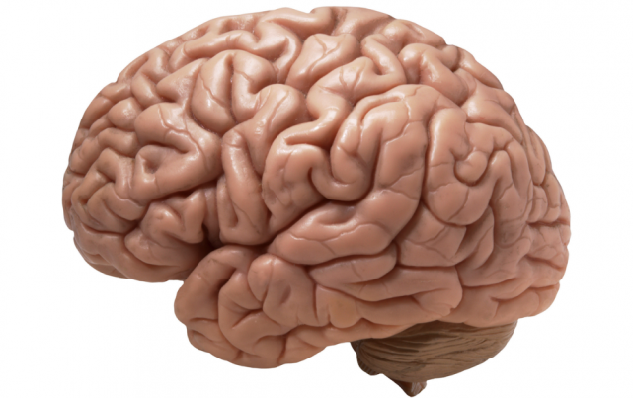
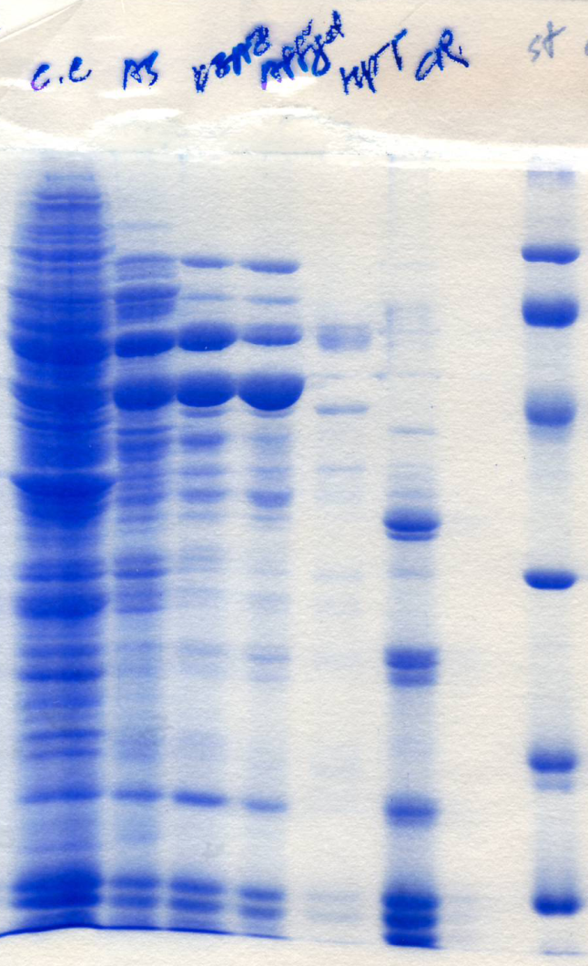
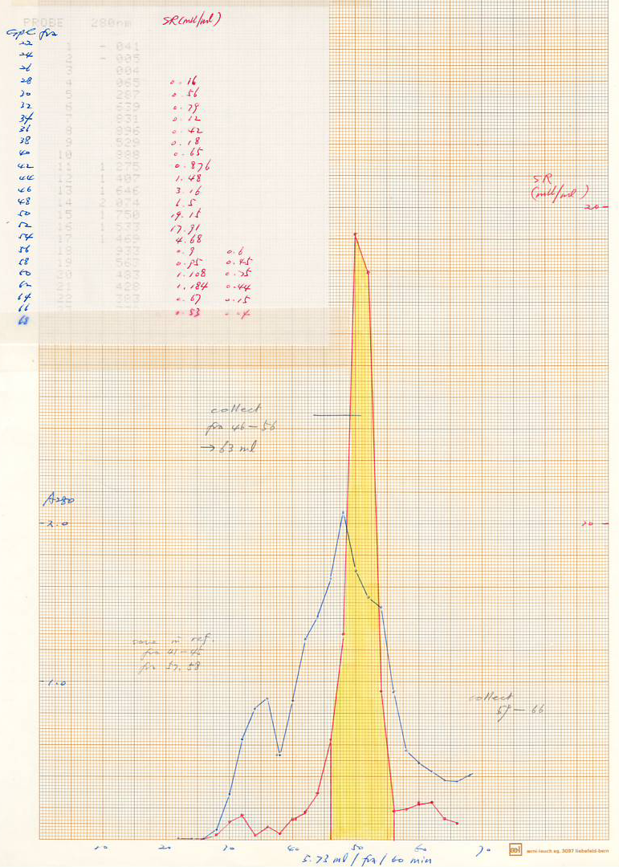

Slide 9
Guanosine triphosphate
GTPCH
Dihydroneopterin triphosphate
PTPS
6-pyruvoyl tetrahydropterin
AR
SR
CR
1’-oxo-H₄-pterin
2’-oxo-H₄-pterin
CR
SR
SR
AR
Tetrahydrobiopterin (BH4)
Hypothesis: there are alternative enzymes involved in the synthesis of BH4 from PPH4

Slide 10
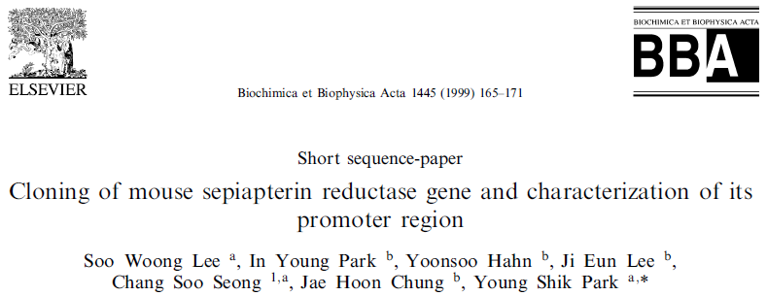
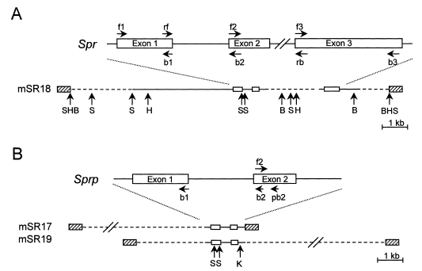

Slide 11
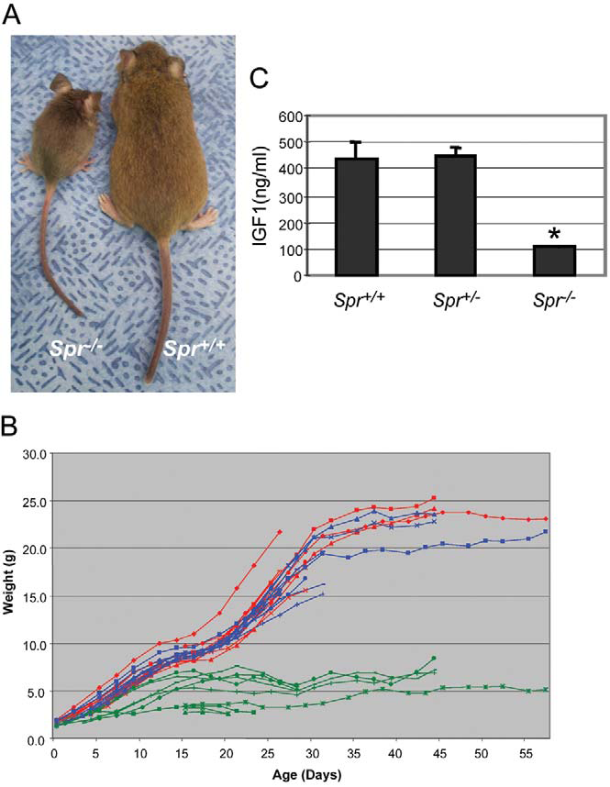
The American Journal of Human Genetics Volume 78 April 2006

Slide 12
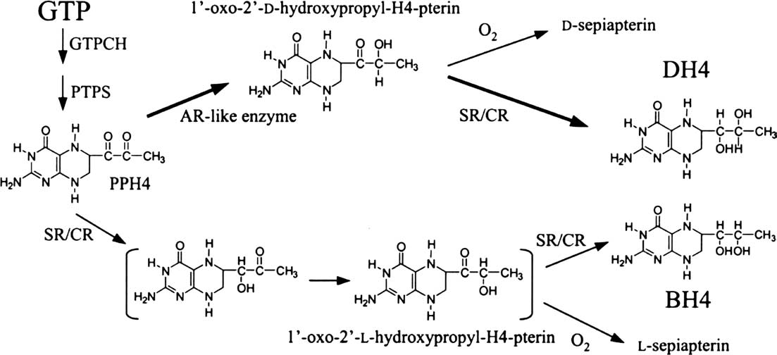

Slide 13
