Slide 1
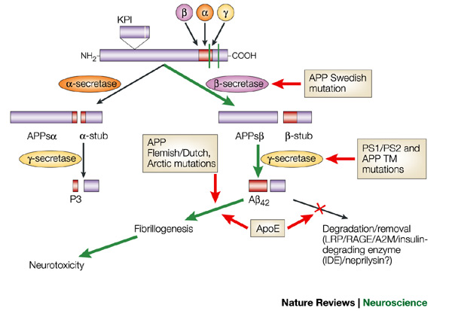
Schematic of the proteolytic events and cleavage products that are generated during the processing of APP
The amyloid precursor protein (APP) Swedish mutation makes APP a more favoured substrate for β-secretase (β -site APP-cleaving enzyme, or BACE) cleavage, thereby increasing the flux of APP down the β -secretase–γ-secretase cleavage pathway to generate amyloid-β (Aβ) (wild-type APP is predominantly processed by the α-secretase pathway). The mutations in presenilin 1 (PS1) and PS2 alter γ-secretase cleavage and promote the overproduction of A42. Similarly, mutations within the transmembrane (TM) domain of APP (for example, APPV717I) serve as an improved substrate for γ-secretase, leading to the overproduction of A42. The APP Flemish/Dutch and Arctic mutations seem to alter the propensity of A fibril formation. Apolipoprotein 4 (ApoE4) might have several effects, including competing with A for clearance through the low-density-lipoprotein-related protein 1 (LRP1) receptor, and enhancing aggregation and fibrillogenesis of extracellular A. In addition, because of the role of ApoE in lipid metabolism and repair mechanisms, it is conceivable that the 4 allele might not support these functions as well in response to various noxious stimuli when compared with ApoE3 or ApoE2. APPs, -secretase-derived secreted APP; KPI, Kunitz protease inhibitor domain. Nature Reviews Neuroscience 3, 281-290 (April 2002)

Slide 2
Alpha secretase
Alpha secretases are a family of proteolytic enzymes that cleave amyloid precursor protein (APP) in its transmembrane region. Specifically, alpha secretases cleave within the fragment that gives rise to the Alzheimer's disease-associated peptide amyloid beta when APP is instead processed by beta secretase and gamma secretase. The alpha-secretase pathway is the predominant APP processing pathway. Thus, alpha-secretase cleavage precludes amyloid beta formation and is considered to be part of the non-amyloidogenic pathway in APP processing. Alpha secretases are members of the ADAM ('a disintegrin and metalloprotease domain') family, which are expressed on the surfaces of cells and anchored in the cell membrane. Several such proteins, notably ADAM10, have been identified as possessing alpha-secretase activity. Upon cleavage by alpha secretases, APP releases its extracellular domain - a fragment known as APPsα - into the extracellular environment in a process known as ectodomain shedding.
ADAM10 consists of two protein domains, a disintegrin domain and a prodomain; however, only the prodomain is required for APP processing. Other ADAM proteins, ADAM17 (also called TACE, tumor necrosis factor-α converting enzyme), ADAM9, and ADAM19 have also been identified as alpha secretases; extracellular expression of mutant ADAM9 (also known as MDC9 or meltrin gamma) lacking the membrane anchor domain has been suggested as one of many possible means of Alzheimer's prevention and treatment exploiting the alpha secretase pathway. Two distinct modalities of alpha-secretase activity have been observed in cells; constitutive activity occurs mainly at the cell surface and is independent of regulatory mechanisms inside the cell, while regulated activity occurs mainly in the golgi and is dependent on the activity of protein kinase C. Alpha-secretase activity in the golgi is thought to compete directly with the beta-secretase pathway for APP substrates during membrane protein maturation. Cell-surface cleavage by alpha secretase is very rapid after APP reaches the cell surface.
The activity of alpha secretases has been implicated in the regulation of learning and memory formation. Release of the APPsα ectodomain has neurotrophic effects that counteract apoptotic signaling and promote synapse formation, processes that are upregulated when ADAM10 is overexpressed. Alpha secretase activity has also been observed to be upregulated in response to the signaling peptide PACAP.
Related alpha-secretases, including ADAM10, have also been implicated in similar maturation events for other transmembrane proteins such as MHC class I proteins. Recent evidence suggests that some such proteins are first processed to ectodomains by alpha secretases and subsequently cleaved by another Alzheimer's-associated protease complex, gamma secretase in its presenilin-complexed form. The Notch pathway bears many similarities to APP processing and is also regulated in part by ADAM10.[

Slide 3
Beta-secretase
Beta-secretase 1 (BACE1) also known as beta-site APP cleaving enzyme 1 (beta-site amyloid precursor protein cleaving enzyme 1), memapsin-2 (membrane-associated aspartic protease 2), and aspartyl protease 2 (ASP2) is an enzyme that in humans is encoded by the BACE1 gene.
β-Secretase is an aspartic-acid protease important in the formation of myelin sheaths in peripheral nerve cells. The transmembrane protein contains two active site aspartate residues in its extracellular protein domain and may function as a dimer.
Unlike APP and the presenilin proteins important in γ-secretase, no known mutations in the gene encoding BACE cause early-onset, familial Alzheimer's disease, which is a rare form of the disorder. However, levels of this enzyme have been shown to be elevated in the far more common late-onset sporadic Alzheimer's. The physiological purpose of BACE's cleavage of APP and other transmembrane proteins is unknown.
Drugs to block this enzyme (BACE inhibitors) in theory would prevent the build up of beta-amyloid and may help slow or stop Alzheimers disease. Several companies are in the early stages of development and testing of this new potential class of treatment. In March 2008 phase I results were reported for CTS-21166. In April 2012 Merck reported phase I results for MK-8931. Merck began a Phase II/II trial of MK-8931 in December, 2012.
Tests in mice have indicated that BACE proteases, specifically BACE1, is necessary for the proper function of muscle spindles. These results raise the possibility that BACE inhibiting drugs currently being investigated for the treatment of Alzheimer's may have significant side effects related to impaired motor coordination.

Slide 4
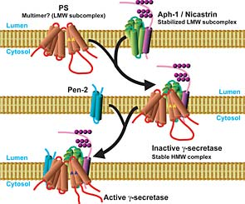
Gamma secretase
Gamma secretase can cut APP at several points within a small region of the protein, which results in Aβ of various lengths (39~42 residues). The lengths associated with Alzheimer's disease are 40 and 42 amino acids long. Aβ 42 is more likely to aggregate to form plaques in the brain than Aβ 40.
Presenilin mutations lead to an increase in the ratio of Aβ 42 produced compared to Aβ 40, although the total quantity of Aβ produced remains constant. This can come about by various effects of the mutations upon gamma secretase. Presenilins are also implicated in the processing of notch, an important developmental protein. Mice that have the PS1 gene knocked out die early in development from developmental abnormalities similar to those found when notch is disrupted.
The gamma secretase complex has not yet been fully characterized but minimally consists of four individual proteins: presenilin, nicastrin, APH-1 (anterior pharynx-defective 1), and PEN-2 (presenilin enhancer 2). Recent evidence suggests that a fifth protein, known as CD147, is a non-essential regulator of the complex whose absence increases activity.
The proteins in the gamma secretase complex are heavily modified by proteolysis during assembly and maturation of the complex; a required activation step is in the autocatalytic cleavage of presenilin to N- and C-terminal fragments. Nicastrin's primary role is in maintaining the stability of the assembled complex and regulating intracellular protein trafficking. PEN-2 associates with the complex via binding of a transmembrane domain of presenilin and, among other possible roles, helps to stabilize the complex after presenilin proteolysis has generated the activated N-terminal and C-terminal fragments. APH-1, which is required for proteolytic activity, binds to the complex via a conserved alpha helix interaction motif and aids in initiating assembly of premature components.
Recent research has shown that interaction of the gamma secretase complex with the γ-secretase activating protein facilitates the gamma cleavage of amyloid precursor protein into β-amyloid.

Slide 5
Presenilins
A family of related multi-pass transmembrane proteins that function as a part of the gamma-secretase intramembrane protease complex.
Presenilin, an aspartyl protease, is the catalytic subunit. In humans, two forms of presenilin and two forms of APH-1 have been identified in the genome; one of the APH homologs can also be expressed in two isoforms via alternative splicing, leading to at least six different possible gamma secretase complexes that may have tissue- or cell type specificity.
presenilin works with an enzyme called GSK-3ß to control how fast materials -- like proteins needed for cell survival -- move through the cells (http://www.sciencedaily.com/releases/2013/10/131028114422.htm)
Intramembrane protease complex (Wikipedia)
All known intramembrane proteases are themselves integral membrane proteins with multiple transmembrane domains, and they have their active sites buried within the lipid bilayer of cellular membranes. Three major classes of intramembrane proteases have been discovered. The Site-2 protease (S2P) family are intramembrane metalloproteases. Presenilin, the active subunit of gamma secretase, and the signal peptide peptidase (SPP) and SPP-like group (which are distantly related to presenilin but have opposite membrane orientation) are intramembrane aspartyl proteases. The rhomboid protease family are serine proteases.
Intramembrane proteases are not evolutionarily related to classical soluble proteases, having evolved their catalytic sites by convergent evolution.
Although only recently discovered, intramembrane proteases are the focus of intense interest because of their major biological functions and their implication in many human diseases.

Slide 6
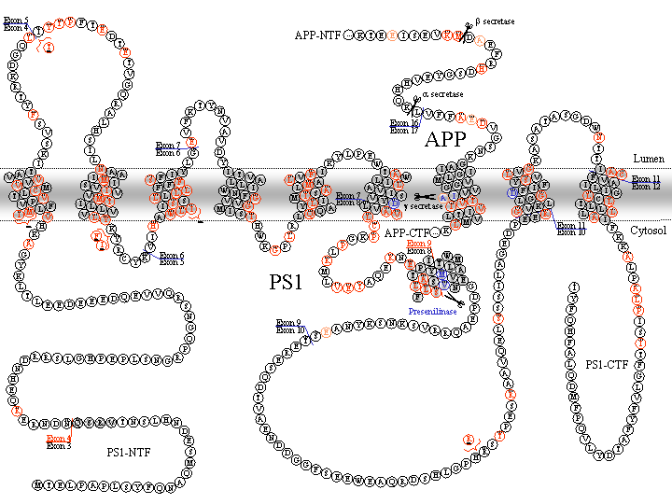
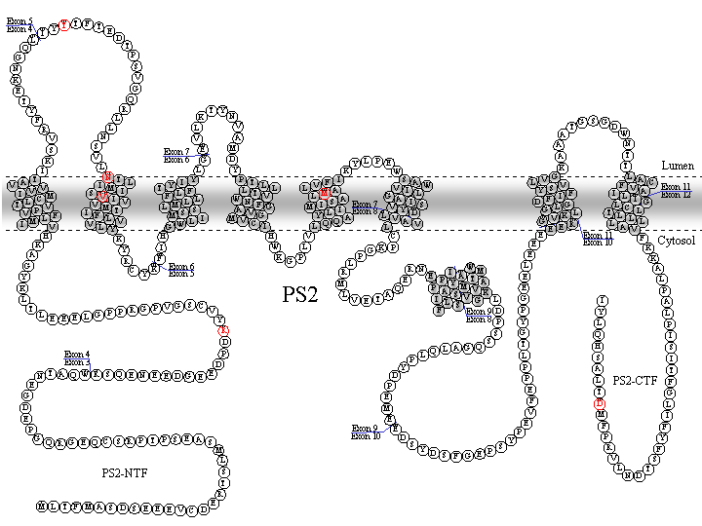
Two presenilin genes in vertebrates:
PSEN1 (chr14 in humans): presenilin-1 (PS-1)
PSEN2 (chr1 in humans): presenilin-2 (PS-2)
PS-1 mutations
PS-2 mutations
http://www.alzforum.org/res/com/mut/pre/

Slide 7
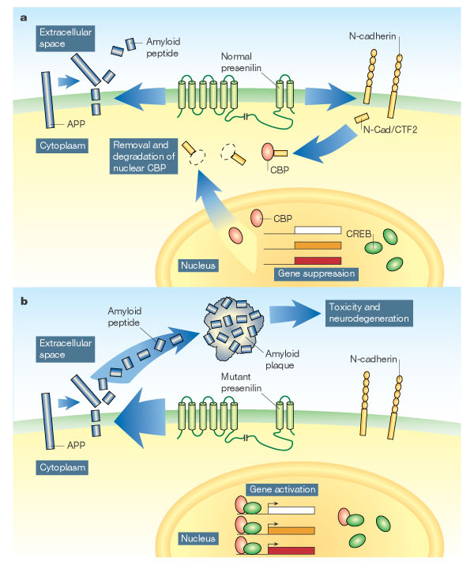
Two functions of presenilin
a, The presenilin protein, embedded in the outer membrane of neurons, is part of the γ-secretase complex, which snips fragments off amyloid precursor protein (APP), releasing amyloid peptide into the extracellular space. Marambaud et al. show that presenilin also snips off the intracellular portion of the membrane protein N-cadherin. The released fragment, N-Cad/CTF2, binds to the protein CBP and targets it for destruction. In the absence of CBP, the nuclear protein CREB cannot activate genes. b, Mutated forms of presenilin that are associated with Alzheimer's disease are thought to accelerate the production of toxic amyloid plaques. These presenilin mutants also fail to cleave N-cadherin, increasing levels of CBP, and increasing the activity of genes regulated by CREB2. So, as well as provoking amyloid-related neurotoxicity, presenilin mutations might cause Alzheimer's disease by inappropriately activating genes associated with neuronal function and memory formation. Nature 425, 565-566(9 October 2003) Neurobiology: Double trouble for neurons

Slide 8
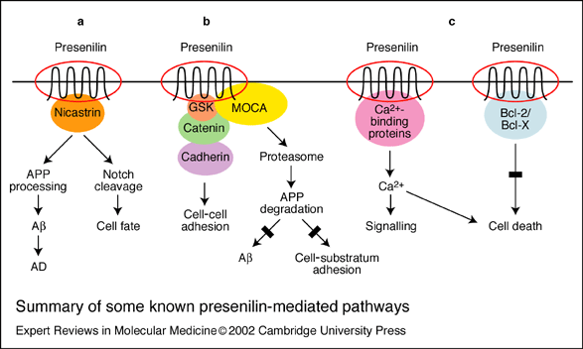
(a) Interaction of presenilin (PS) with nicastrin and Notch regulates amyloid precursor protein (APP) processing and cell fate decisions. (b) Interaction of PS with b-catenin, cadherin and MOCA (‘modifier of cellular adhesion’) mediates b-amyloid (Ab) production and cellular adhesion. (c) Interaction of PS with calcium-binding proteins and with Bcl-2 and Bcl-X alters calcium signalling and cell death pathways. AD, Alzheimer’s disease; GSK, glycogen synthase kinase

Slide 9
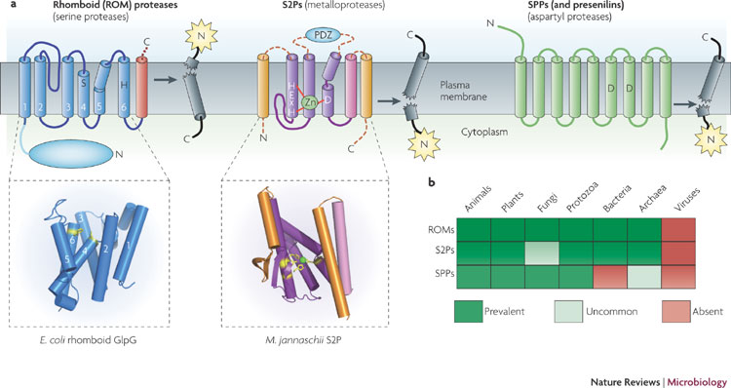
The three families of intramembrane proteases (I-CLip)
a | A schematic of the general topology of each intramembrane protease. Active site residues are indicated, and the zinc ion of site 2 protease (S2P) is shown in green. Generic substrates are in grey, an arrow depicts the proteolytic event and the activated effector domain is shown as a yellow star. The core six transmembrane segments of rhomboid are in blue, and the additional transmembrane segment and cytosolic domain that are present in many homologues are depicted in red and light blue, respectively. The conserved three transmembrane core of S2P is depicted in purple, the variable transmembrane segments are in orange and the extramembrane domain (frequently a PDZ domain) of some S2P members is in light blue. The insets show the crystal structures of the Escherichia coli rhomboid (protein data bank code 2NRF) and Methanocaldococcus jannaschii S2P (protein data bank code 3B4R) membrane core domains. Signal peptide peptidase (SPP) is shown in green (note that presenilins also have nine transmembrane segments but have the opposite membrane orientation).
b | The conservation of each intramembrane protease in different forms of life is depicted. Presenilins are conserved only in multicellular organisms (not shown). Making the cut: central roles of intramembrane proteolysis in pathogenic microorganisms: Nature Reviews Microbiology 7, 411-423 (June 2009)

Slide 10
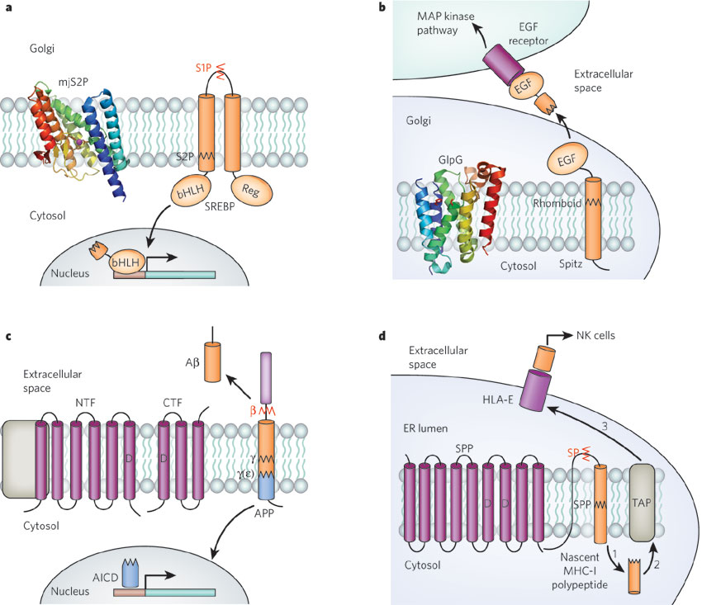
I-CLiP families and their signalling-related functions
NCT, Aph-1, Pen-2 complex
a, Transcriptional activation by the cleavage of sterol regulatory element-binding protein (SREBP) by site-2 protease (S2P). When the cellular level of sterols drops, the SREBP precursor protein is transported to the Golgi apparatus, where it is first cleaved by site-1 protease (S1P) (red zigzag line) and then by S2P (black zigzag line). The liberated transcription-factor domain (bHLH) travels to the nucleus and directs the transcription of target genes. mjS2P, crystal structure of the Methanocaldococcus jannaschii S2P. b, Activation of the epidermal growth factor (EGF) receptor by the rhomboid-dependent release of its ligand in Drosophila. The EGF receptor ligand Spitz is transported to the Golgi apparatus, where it is cleaved by rhomboid. The luminal product is secreted and activates EGF receptors on neighbouring cells. GlpG, crystal structure of Escherichia coli rhomboid55. c, Release of amyloid β-peptide (A) by γ-secretase (γ). The catalytic component of γ-secretase, presenilin, is found in complex with three other proteins (nicastrin (NCT), anterior pharynx defective 1 (Aph-1) and presenilin enhancer 2 (Pen-2); complex shown schematically in grey on the left of the figure). Presenilin undergoes endoproteolytic cleavage to create an amino(N)-terminal fragment (NTF) and a carboxy (C)-terminal fragment (CTF). Amyloid precursor protein (APP) on the plasma membrane is first cleaved by β-secretase (red zigzag line and ) at an extracellular domain, and then by γ-secretase (black zigzag line and ) to release Aβ, which is secreted from cells. The remnant is further cleaved by γ-secretase at the site (black zigzag line and to create APP intracellular domain (AICD), which is thought to have a role in transcription regulation. d, Generation of human lymphocyte antigen E (HLA-E) epitopes by signal peptide peptidase (SPP)-catalysed intramembrane cleavage. During biosynthesis, the signal sequence of a major histocompatibility complex class I (MHC-I) molecule is first cleaved by signal peptidase (SP) (red zigzag line) and then by SPP (black zigzag line). The resultant fragment is released to the cytosol (step 1) where it is further cleaved (not shown) and transported back to the lumen of the endoplasmic reticulum (ER) by the transporter associated with antigen processing (TAP) (step 2). The epitope-containing fragment is then loaded onto the HLA-E molecule and transported to the cell surface for presentation to natural killer (NK) cells (step 3). D, aspartates in active site. Nature 459, 371-378(21 May 2009)

Slide 11
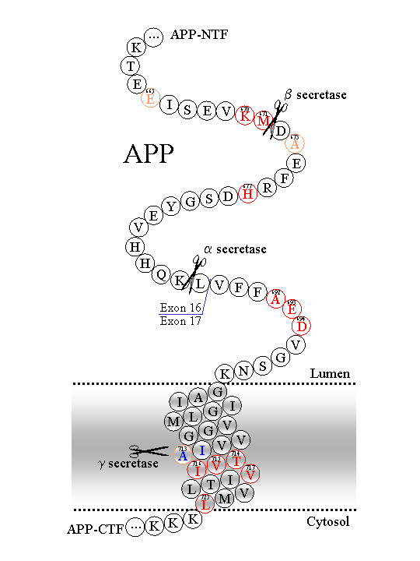
APP mutations
http://www.alzforum.org/res/com/mut/app/default.asp

Slide 12
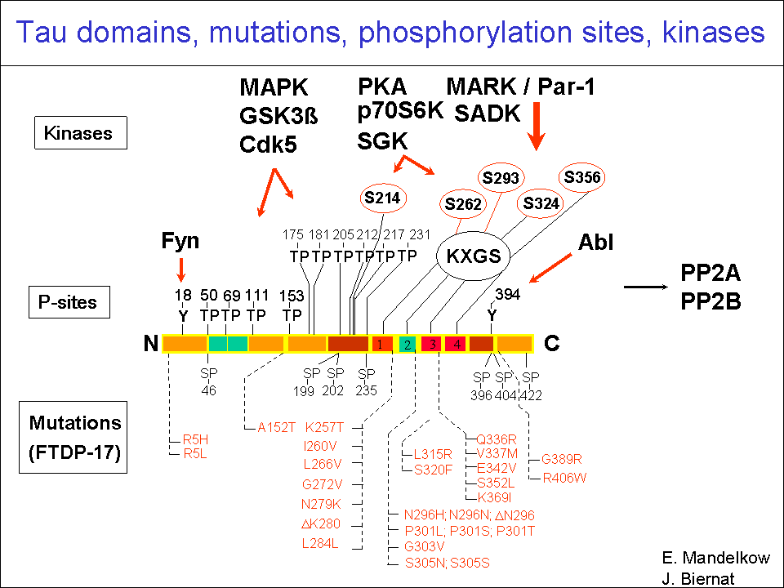
Tau mutations and polymorphisms: Familial frontotemporal dementia (FTD)
http://www.alzforum.org/res/com/mut/tau/default.asp
Polymorphism Identified in the MAPT Gene in Individuals with FTD http://www.alzforum.org/res/com/mut/tau/taupolytable.asp

Slide 13
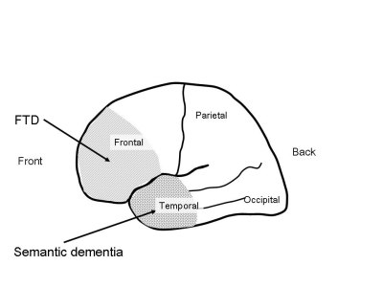
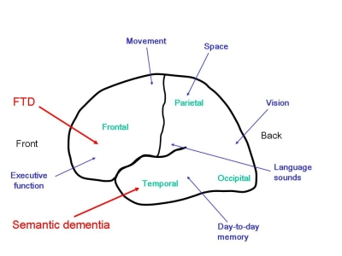
Fronto-temporal dementia and semantic dementia form part of the same disease, known as ‘fronto-temporal lobar degeneration’. The underlying disease process is the same. It is the location of the disease that determines the symptoms and the corresponding name that is given to the dementia. As you can see in the earlier picture, in fronto-temporal dementia, the disease primarily affects the frontal lobes, whereas in semantic dementia the disease selectively affects the temporal lobes.
Fronto-temporal dementia
Fronto-temporal dementia (FTD) typically affects people below the age of 65. About half of the patients that we see report a family history of similar problems, and in a small proportion of these cases, there is a specific genetic fault associated with developing the disease. However, FTD also occurs in people who have no other affected family members.
Symptoms Patients are typically physically fit. Initial changes are apparent in mental function only. As the disease progresses, reduced activity and physical slowing may occur.
Symptoms arise gradually, making it difficult to pinpoint the very beginning of the disease. Carers often report with hindsight that their relative showed signs of depression, anxiety, over-sentimentality, or hyperchondriasis even before they noticed clear changes in behaviour. Commonly, referral to doctors occurs following difficulties at work, or social problems within the family.
FTD principally affects personality and behaviour. Below are some of the behavioural changes that can occur:
Semantic Dementia
Semantic dementia (SD) is another clinical manifestation of frontotemporal lobar degeneration, associated with shrinkage of the temporal lobes. SD is a relatively rare disorder and is much less common than FTD. However, like FTD, people with SD tend to be affected at a relatively young age, generally between the ages of 50 and 65. Relatives report a history of a similar disorder in the family in about a quarter of cases.
Symptoms In SD, people progressively lose their ability to remember the meaning of words, objects and faces. Changes may also occur in people’s behaviour, although these are qualitatively different from those observed in FTD.
http://www.cerebralfunctionunit.co.uk/ftld_overview.html

