Slide 1
ApoE4 and Alzheimer’s disease (AD)
Apolipoprotein E (ApoE) is 299 amino acids long and transports lipoproteins, fat-soluble vitamins, and cholesterol into the lymph system and then into the blood.
ApoE is a class of apolipoprotein found in the chylomicron and Intermediate-density lipoprotein (IDLs) that is essential for the normal catabolism of triglyceride-rich lipoprotein constituents. In peripheral tissues, ApoE is primarily produced by the liver and macrophages, and mediates cholesterol metabolism in an isoform-dependent manner. In the central nervous system, ApoE is mainly produced by astrocytes, and transports cholesterol to neurons via ApoE receptors, which are members of the LDL receptor gene family.
Papers
1. Apolipoprotein E and Apolipoprotein E Receptors: Normal Biology and Roles in
Alzheimer Disease
2. The Genetics of Alzheimer Disease
3. Proteolytic Degradation of Amyloid β-Protein

Slide 2
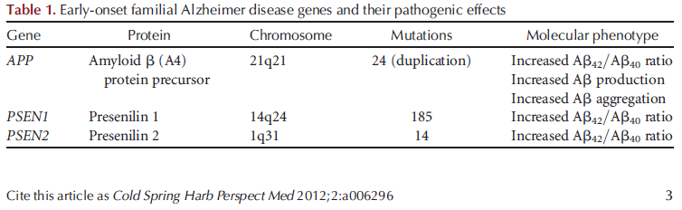
The genetics of AD
Early onset AD (EO-FAD): before 65, ~5%
mostly dominant, except one
Late onset AD (LO-FAD): ApoE genotype is the strongest genetic factor

Slide 3
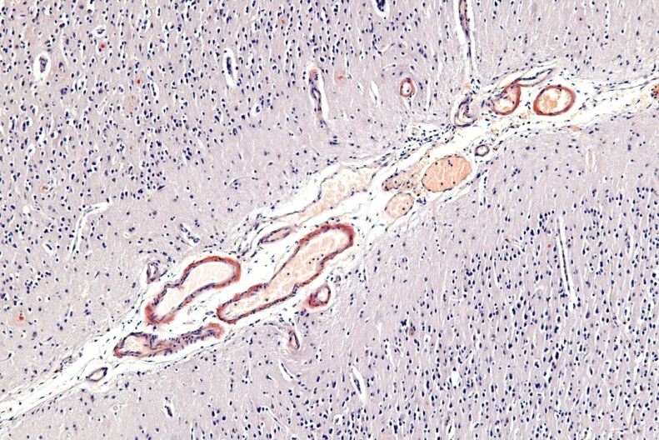
The E4 variant is the largest known genetic risk factor for late-onset sporadic AD in a variety of ethnic groups
Estimated worldwide human allele frequencies of ApoE
Allele | ε2 | ε3 | ε4
General Frequency | 8.4% | 77.9% | 13.7%
AD Frequency | 3.9% | 59.4% | 36.7%
Increased risk with one and two E4 allele is ~3x and ~12x, respectively.
Cerebral amyloid angiopathy (CAA)
a form of angiopathy in which amyloid deposits form in the walls of the blood vessels of the central nervous system

Slide 4
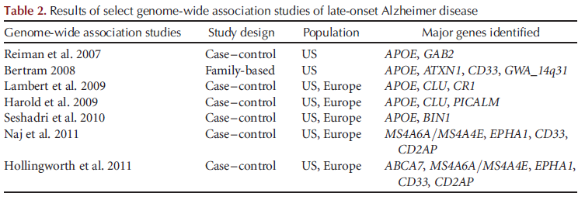
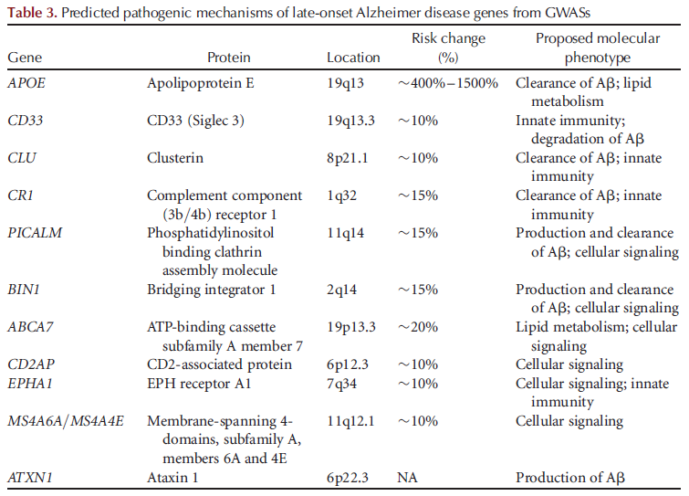

Slide 5
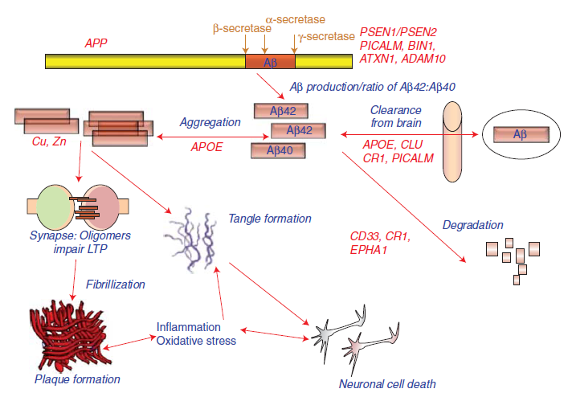
Potential roles of select Alzheimer disease (AD) genes in Aβ-related pathogenesis of AD. (Modified from Bertram and Tanzi 2008; reprinted with permission from the author.) Cold Spring Harbor Perspectives in Medicine (2012)

Slide 6
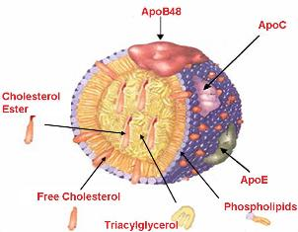
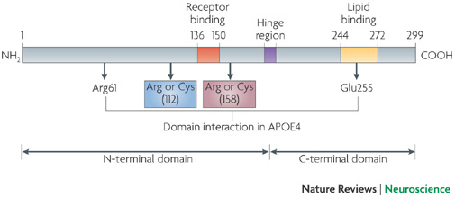
Apolipoproteins
2 major classes: ApoB form LDL, while others form HDL
6 classes and several subgroups
  A: apo A-1, apo A-II, apo A-IV, apo A-V
  B: apo B48, apo B100
  C: apo C-I, apo C-II, apo C-III, apo C-IV
  D:
  E: polymorphic with 3 major isoforms
  H:
ApoE polymorphism
ApoE2 (cys112, cys158), ApoE3 (cys112, arg158), and ApoE4 (arg112, arg158). Although these allelic forms differ from each other by only one or two amino acids at positions 112 and 158, these differences alter apoE structure and function. These have physiological consequences:
E2 is found in approximately 7 percent of the population. E3 is found in approximately 79 percent of the population. E4 is found in approximately 14 percent of the population.
6 genotypes: E2/2, E3/3, E4/4, E2/3, E2/4, E3/4

Slide 7
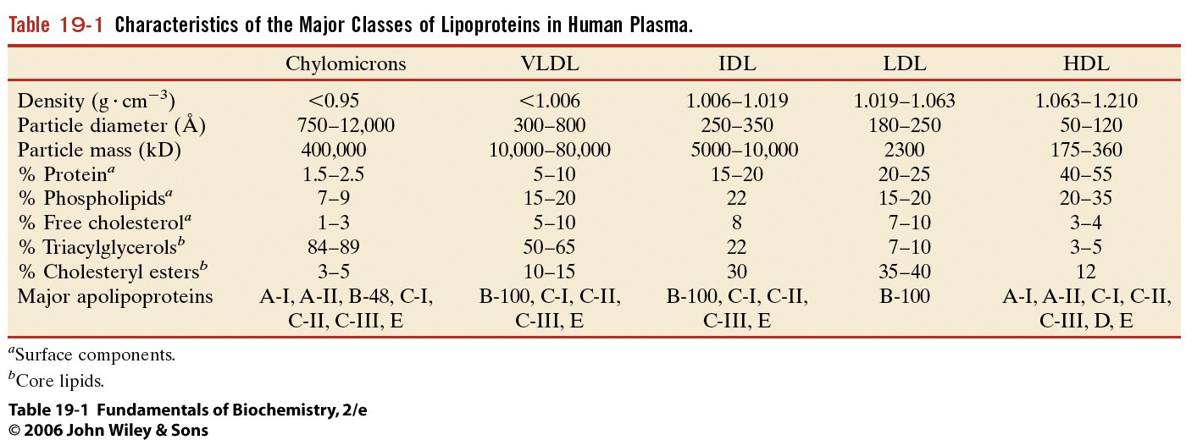
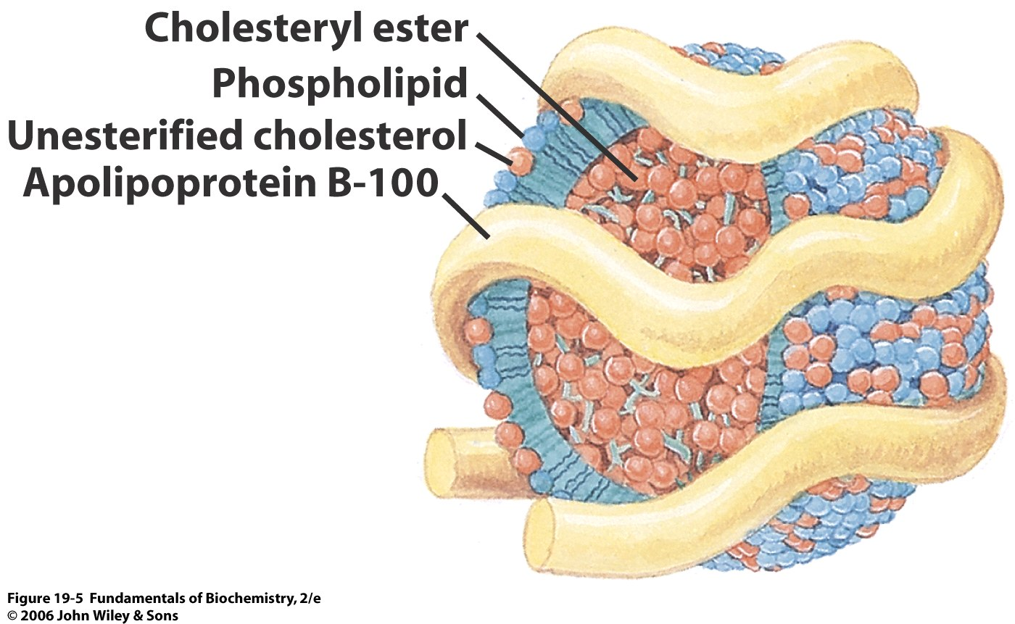
Lipid transport
in complex with proteins: lipoproteins
nonpolar core of triacylglycerols and cholesteryl esters
surrounded by an amphiphilic coating of protein, phospholipid, and cholesterol
Apolipoproteins: at least nine are known
LDL

Slide 8
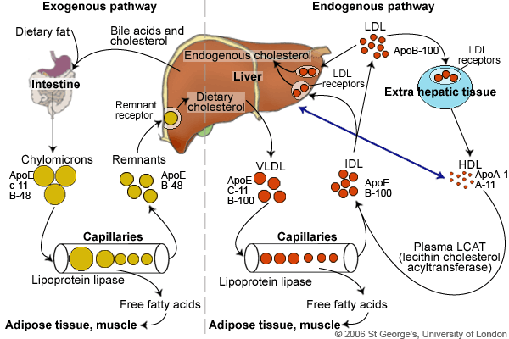
Lipoprotein metabolism
Liver has a central role in lipid metabolism. It provides the bile salts to facilitate fat digestion. It synthesises and secretes lipoproteins to deliver triglyceride and cholesterol to tissues and mops up the remnants after extrahepatic tissues have extracted what lipids they need.

Slide 9
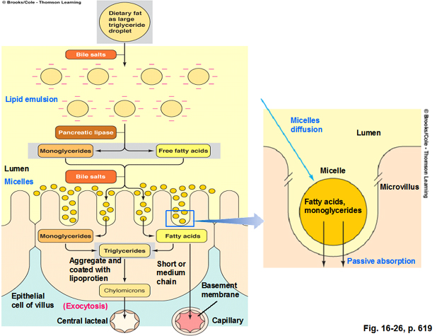
thoracic duct and left jugular vein
Portal vein to liver

Slide 10
Effects of ApoE on fibrillogenesis & clearance
ApoE colocalize with amyloid plaques
  Supporting results from mouse studies: APP transgenic mouse
  Cross APP Tg mouse with apoE^{-/-} : less Aβ deposition (ApoE deficient human has no sign of cognitive defects)
  Expression of human ApoE in APP Tg mouse: Aβ accumulation was E4>E3>E2
What’s the underlying mechanism of ApoE influence on Aβ aggregation and accumulation?
  ApoE may influence Aβ seeding and fibrillogenesis, as well as soluble Aβ clearance
  Interaction of Aβ with lipid-free and lipidated forms of ApoE in vitro (E2>E3>E4)
  Higher ABCA1 (ATP-binding cassette A1) increases ApoE lipidation but decreases amyloid deposition
Differential influence of ApoE isoforms on both the transport and clearance of soluble Aβ in the brain
  but not Aβ production (slower Aβ clearance with ApoE4)
  In vitro study: ApoE facilitates the binding and internalization of soluble Aβ by cells
  or its clearance via enzymes such as neprilysin
  In vivo study: ApoE retards Aβ clearance from the brain, possibly via an effect at the BBB
Amyloid
plaques
HSPG
ApoE
ApoE receptor
ABCA1
Aβ
Lipidated ApoE
Proteolytic
digestion
Neuronal
trafficking
(E2>E3>E4)
Endocytosis
transport to blood circulation via BBB

Slide 11
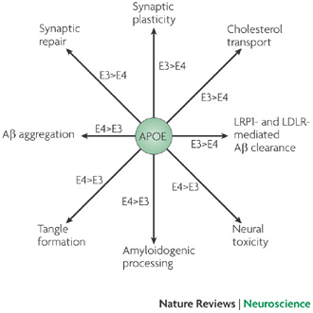
Roles of APOE isoforms in the healthy brain and AD pathogenesis
potentially mediated by their receptors
Summary of apolipoprotein E (APOE) functions in normal brain function and the pathogenic processes of Alzheimer's disease (AD). Differential regulations by APOE3 and APOE4 are indicated. Aβ, amyloid-β; LDLR, low density lipoprotein receptor; LRP1, LDLR-related protein 1. Nature Reviews Neuroscience 10, 333-344 (May 2009)

Slide 12
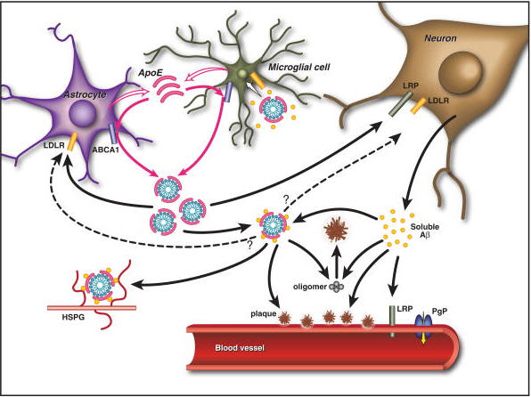
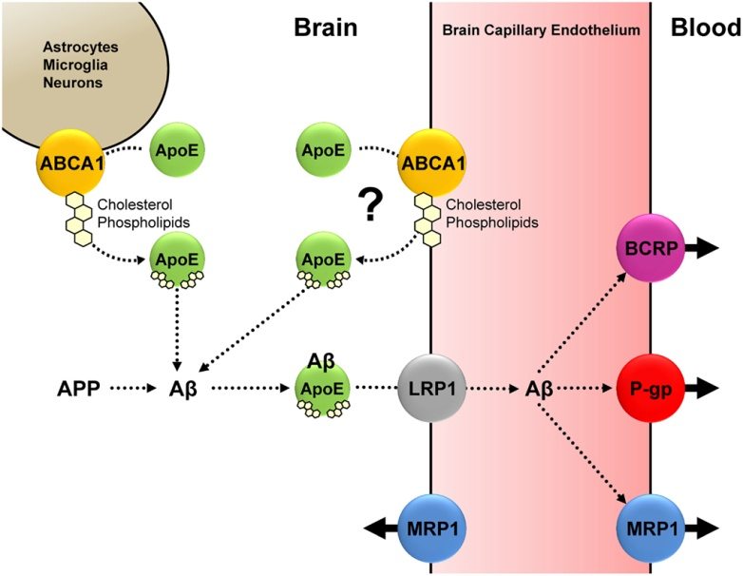
ApoE expression
Highest in liver and CNS (expressed predominantly by astrocytes and microglia)
Most abundant HDL-like particles as a ligand in receptor-mediated endocytosis
Under normal physiological conditions, ABCA1-mediated cholesterol and phospholipid efflux from astrocytes, microglia, neurons (and possibly endothelial cells) facilitates ApoE lipidation. doi: 10.3389/fpsyt.2012.00054
Pathways by which apoE and Aβ interact in the brain. ApoE is primarily produced by both astrocytes and microglia and is subsequently lipidated by ABCA1 to form lipoprotein particles. In the extracellular space, lipidated apoE binds to soluble Aβ in an isoform-dependent pattern (E2>E3>E4) and influences the formation of parenchymal amyloid plaques and transport of Aβ within the CNS. ApoE is endocytosed into various cell types within the brain by different members of the LDL receptor family, including LDLR and LRP1. ApoE may also facilitate the cellular uptake of Aβ through the endocytosis of a complex of apoE-containing lipoprotein particles bound to Aβ in a manner that likely depends on the isoforms and its level of lipidation. Furthermore, apoE has been shown to directly enhance both the degradation of Aβ within microglial cells and the ability of astrocytes to clear diffuse Aβ deposits (Koistinaho et al. 2004; Jiang et al. 2008). Aβ associated with apoE-containing lipoprotein particles may also be retained within the CNS through their binding to heparin sulfate proteoglycan (HSPG) moieties present in the extracellular space (Mahley and Rall 2000). At the blood–brain barrier (BBB), soluble Aβ is predominantly transported from the interstitial fluid into the bloodstream via LRP1 and P-glycoprotein (Cirrito et al. 2005; Zlokovic 2008). ApoE has been shown to slow the transport of Aβ across the BBB in an isoform-dependent manner (E4>E3>E2) (Bell et al. 2007; Ito et al. 2007; Deane et al. 2008). In addition, apoE can influence the pathogenesis of cerebral amyloid β-protein angiopathy (CAA) in an amyloid protein precursor (APP)-transgenic mouse model, with apoE4 increasing the amount of vascular plaques in comparison to apoE3 (Fryer et al. 2005b). (From Kim et al. 2009; reprinted, with permission, from Elsevier # 2009.)

Slide 13
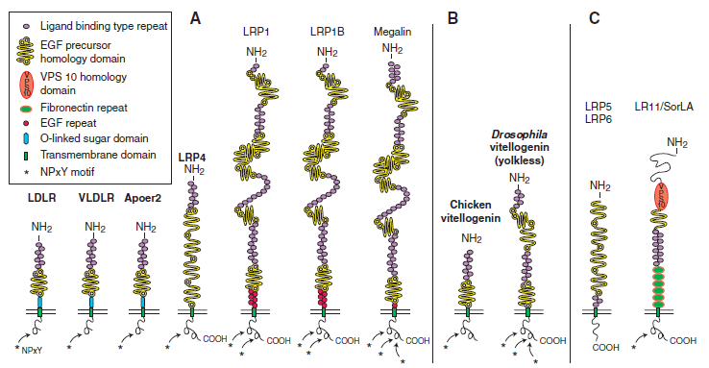
Association of ApoE receptors with LO-AD
Signal transduction
Brain development, tau phosphorylation, synaptic function, neurodegeneration
The low-density lipoprotein (LDL) receptor gene family. (A) The core LDL receptor gene family as it exists in mammalian species. These family members are characterized by one or more ligand-binding domains, epidermal growth factor (EGF), homology domains consisting of EGF repeats and YWTD propeller (b-propeller) domains involved in pH-dependent release of ligands in the endosomes, a single transmembrane
domain and a cytoplasmic tail containing at least one NPxY motif. The latter represents both the endocytosis signal as well as a binding site for adaptor proteins linking the receptor to intracellular signaling pathways. Furthermore, LDLR, VLDLR, and Apoer2 carry an O-linked sugar domain. (B) Equivalent receptors that are structurally and functionally distinct family members in nonmammalian species. (C) A subgroup of functionally important, but more distantly related family members that share some, but not all, of the structural requirements of the “core members.” In addition, they could also contain domains, e.g., vacuolar protein sorting (VPS) domains, which are not present in the core family.

Slide 14
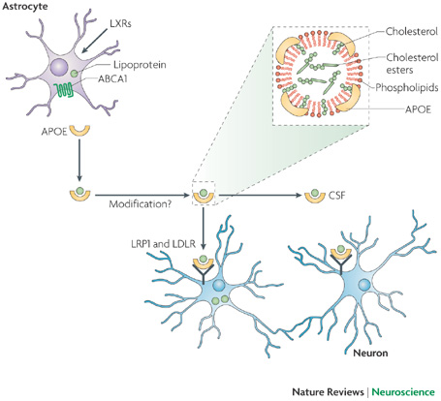
Normal function of ApoE receptors
Synapse formation and repair depend on cholesterol transport from astrocytes to neurons by the ApoE–ApoE receptor pathway.
Apolipoprotein E (APOE) that is secreted by astrocytes assembles cholesterol and other lipids into lipoprotein particles. The plasma membrane transporter ABCA1 loads lipids onto APOE. Liver X receptors (LXRs) increase the expression of both ABCA1 and APOE. APOE–lipoprotein particles can undergo modifications such as recruitment of oligodendrocyte-specific lipids and additional APOE molecules before binding to the neuronal APOE receptors LDL receptor (LDLR) and LDLR-related protein 1 (LRP1) or being transported to the cerebrospinal fluid (CSF). Cholesterol and other lipids transported to neurons have important roles in synapse formation and repair (see main text for details). The inset shows the main components of APOE–lipoprotein particles: cholesterol, cholesterol esters and phospholipids. Nature Reviews Neuroscience 10, 333-344 (May 2009)

Slide 15
LRP1 & LDLR: key metabolic receptors for ApoE/lipoprotein in the brain
LRP1 expression: neurons>glia
LDLR expression: neurons<glia
apoE-lipoprotein particles secreted by astrocytes have higher affinity for LDLR than LRP1
▪ Trafficking
APP retained at the cell surface: subject to nonamyloidogenic proteolysis by α-protease
APP trafficking and processing: accelerated by APP and LRP1 interaction, leading to increased Aβ
▪ Clearance
Two major pathways
a. Receptor-mediated clearance: partially mediated by ApoE receptors
Aβ clearance is increased in LDLR-Tg mouse
Along with interstitial fluid drainage pathway or through BBB
Direct interaction of ApoE with Aβ, compromising its lipid-binding function and binding to apoE receptor
Recent study suggests that ApoE-Aβ complex can be cleared by VLDLR (ApoE2-Aβ & ApoE3-Aβ > ApoE4-Aβ)
b. Endopeptidase-mediated proteolytic degradation
Via autophagy in glial cells and neurons?
However, intraneural accumulation of Aβ may contribute to lysosomal dysfunction and neural toxicity

Slide 16
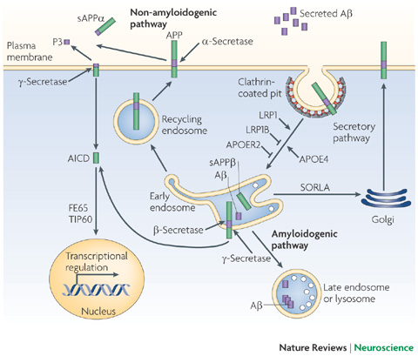
APP processing pathways regulated by LDL receptor family members and ApoE
Newly synthesized amyloid precursor protein (APP) traffics through the secretory pathway to the plasma membrane, where it is primarily cleaved by the α-secretase in the non-amyloidogenic pathway to produce a minimally toxic peptide called P3. When APP is internalized through the clathrin-mediated pathway it is delivered to endosomes, where it is cleaved first by the β-secretase BACE1 and then by the γ-secretase to generate highly toxic amyloid-β (A). Although most Aβ peptides are secreted to the extracellular space, some can aggregate in the late endosomes or lysosomes and contribute to intraneuronal Aβ accumulation. The fast endocytosis of LDLR-related protein 1 (LRP1) enhances APP endocytosis and processing to Aβ, whereas the slow endocytosis of LRP1B and APOE receptor 2 (APOER2; also known as LRP8) contributes to retaining APP at the cell surface and promotes non-amyloidogenic processing. Sortilin-related receptor with A-type repeats (SORLA; also known as SORL1 and LR11) probably shuttles APP to the Golgi compartments and reduces its processing by β-secretase in the early endosomes, thus decreasing Aβ production. Apolipoprotein E4 (APOE4) promotes APP amyloidogenic processing in a manner that depends on LRP1 function. APP's intracellular domain (AICD), a product of both non-amyloidogenic and amyloidogenic processing, interacts with FE65 (also known as APBB1) and TIP60 (also known as KAT5) and regulates gene transcription in the nucleus. sAPP, soluble APP. Nature Reviews Neuroscience 10, 333-344 (May 2009)

Slide 17
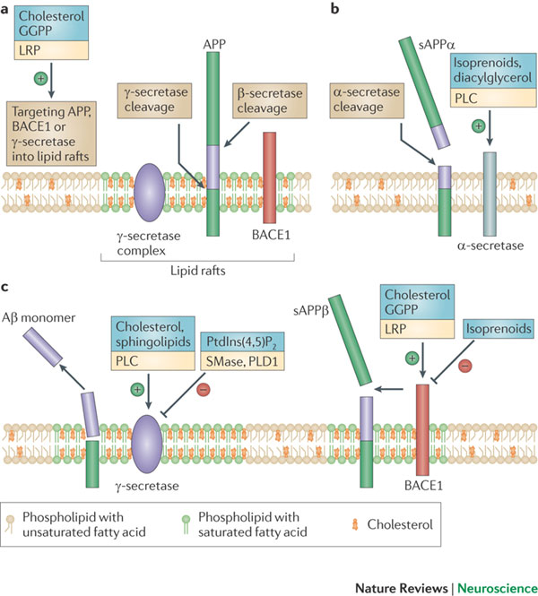
Modulation of proteolytic processing of amyloid precursor protein (APP) by lipids
Several lipids (shown in blue boxes) and lipid metabolizing proteins (shown in yellow boxes) influence APP processing through a variety of mechanisms. a | The amyloid precursor protein (APP; also known as amyloid-β A4 protein) undergoes amyloidogenic processing mediated either by β- and γ-secretases to yield amyloid-β (Aβ) peptide (shown by purple rectangles). Amyloidogenic processing of APP largely occurs in lipid rafts. Cholesterol and low-density lipoprotein (LDL) receptor-related protein (LRP), an apolipoprotein E (APOE) receptor, promote the localization of β-site APP cleavage enzyme 1 (BACE1) to lipid rafts. GGPP (geranylgeranyl pyrophosphate, a short chain isoprenoid) has been shown to promote the association of the γ-secretase complex with lipid rafts. b | APP is also subjected in neurons to a non-amyloidogenic pathway mediated by α-secretase. Localization of APP to non-lipid raft compartments favours processing by α-secretase. Isoprenoids, diaglycerol and phospholipase C (PLC) have been shown to promote the non-amyloidogenic pathway. c | The relative abundance or absence of the lipids listed (shown in the blue boxes) directly influences the activity of BACE1 or γ-secretase. Increased levels of cholesterol or ceramide enhance the activity of BACE1. Cholesterol and sphingolipids are positive modulators of γ-secretase activity, whereas sphingomyelinase (SMase) and phospholipase D1 (PLD1) have been identified as negative modulators of γ-secretase activity. PLC-mediated hydrolysis of PtdIns(4,5)P₂ promotes amyloidogenesis by stimulating γ-secretase activity and PtdIns(4,5)P₂ has been shown to directly inhibit γ-secretase activity.

Slide 18
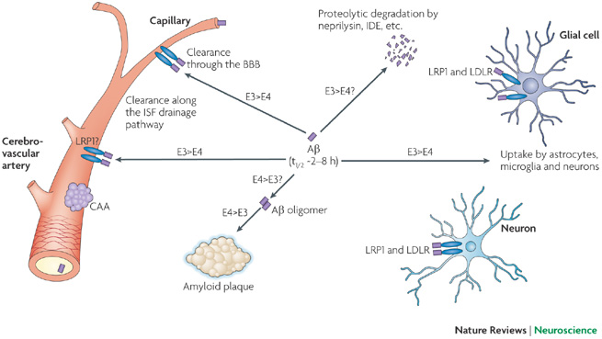
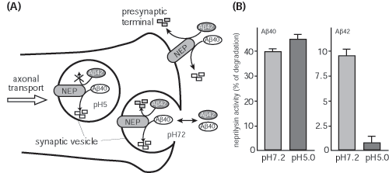
Major Aβ clearance pathways in the brain: role of ApoE isoforms
Amyloid-β (Aβ) accumulation in the brain parenchyma leads to the formation of Aβ oligomers and amyloid plaques, which are toxic to neurons, whereas its accumulation in the perivascular region leads to cerebral amyloid angiopathy (CAA), which disrupts vessel function and is associated with cerebral haemorrhage. Aβ has a relatively short half-life (t1/2) in the brain: 2–4 h in mice and 8 h in humans. Major Aβ clearance pathways include receptor-mediated clearance by cells in the brain parenchyma (neurons and glia), along the interstitial fluid (ISF) drainage pathway and through the blood–brain barrier (BBB), and proteolytic degradation by endopeptidases. The comparative effects of apolipoprotein E3 (APOE3) and APOE4 are indicated. In all major cellular Aβ clearance pathways, LDLR-related protein 1 (LRP1) is involved and is likely to clear Aβ either directly or when Aβ binds to its chaperones, which are also LRP1 ligands (for example, APOE and 2-macroglobulin). LDL receptor (LDLR) function in Aβ clearance is likely to involve Aβ–APOE complexes. VLDL receptor also has a role in the clearance of Aβ–APOE complexes at the BBB. IDE, insulin-degrading enzyme. Nature Reviews Neuroscience 10, 333-344 (May 2009)
***Neprilysin is a membrane metallo-endopeptidase. Neprilysin-deficient knockout mice show both Alzheimer's-like behavioral impairment and amyloid-beta deposition in the brain. http://www.brain.riken.go.jp/bsi-news/bsinews31/no31/research3e.html

Slide 19
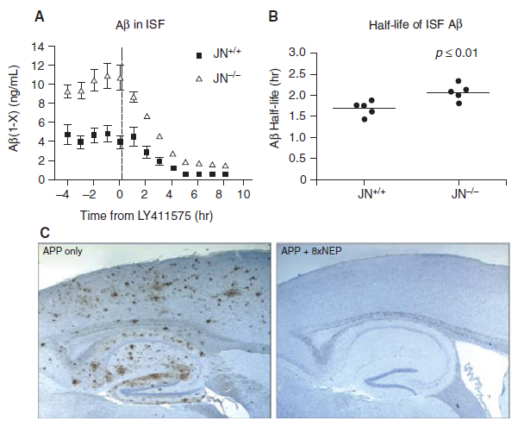
Aβ clearance by proteolytic degradation
(Cold Spring Harb Perspect Med 2012;2:a006379)
Aβ levels are potentially regulated by proteolytic degradation
Figure 1. Aβ degradation is a potent determinant of brain Aβ levels and amyloid pathology. (A) Effects of genetic deletion of NEP on Aβ levels in the interstitial fluid (ISF) of the J9 line of APP transgenic mice monitored by in vivo microdialysis before and after blockade of Aβ production with the γ-secretase inhibitor, LY411575. Note that steady-state levels of Aβ are approximately doubled in J9 mice lacking NEP (JN-/-). (Panel A is adapted from Farris et al. 2007; reprinted, with permission, from the authors.) (B) The half-life of ISF Aβ determined from the data in (A). Note that deletion of NEP results in a statistically significant (P , 0.01) 23% increase in the half-life of ISF Aβ, from 1.7 to 2.1 hours. (C) Transgenic overexpression of NEP by eightfold results in the complete prevention of amyloid plaque formation in the J20 line of APP transgenic mice up to 14 months of age. (Panel B is adapted from Leissring et al. 2003; reprinted, with permission, from the author.)

Slide 20
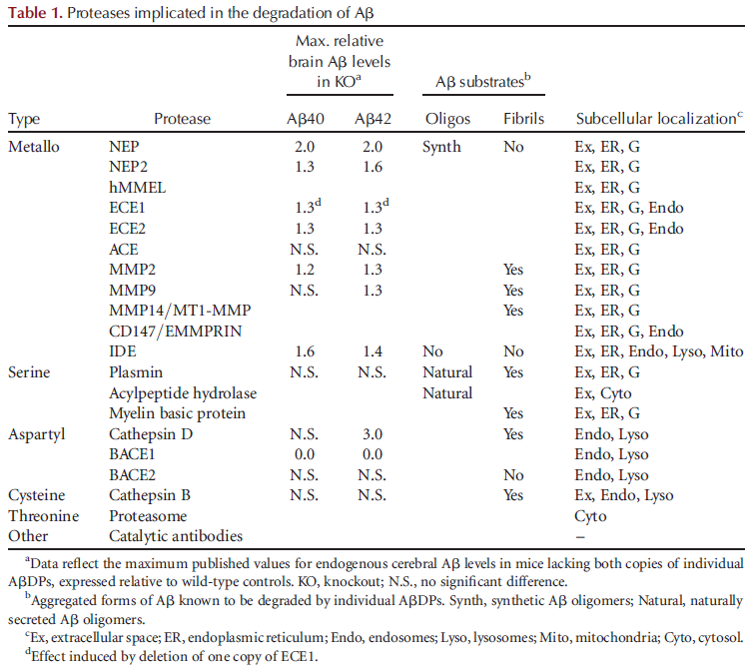

Slide 21
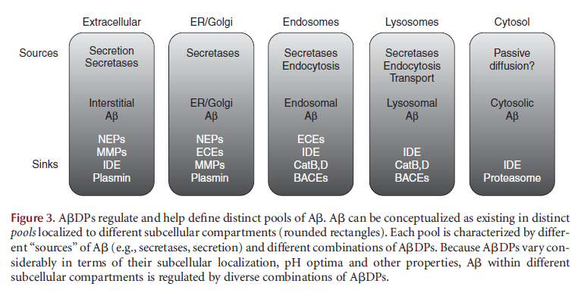

Slide 22
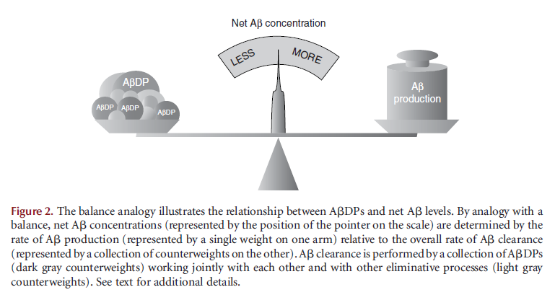
Balance of Aβ production and proteolytic degradation

