Slide 1
APP processing and autophagy

Slide 2
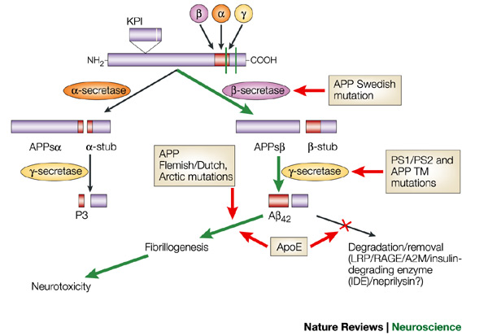
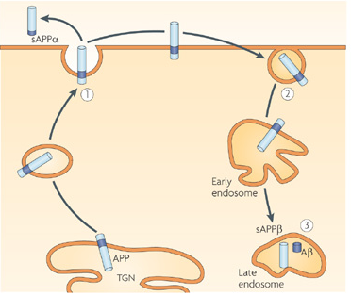
Schematic of the proteolytic events and cleavage products that are generated during the processing of APP
trafficking
The amyloid precursor protein (APP) Swedish mutation makes APP a more favoured substrate for β-secretase (β -site APP-cleaving enzyme, or BACE) cleavage, thereby increasing the flux of APP down the β-secretase–γ-secretase cleavage pathway to generate amyloid-β (Aβ) (wild-type APP is predominantly processed by the α-secretase pathway). The mutations in presenilin 1 (PS1) and PS2 alter γ-secretase cleavage and promote the overproduction of A42. Similarly, mutations within the transmembrane (TM) domain of APP (for example, APPV717I) serve as an improved substrate for γ-secretase, leading to the overproduction of A42. The APP Flemish/Dutch and Arctic mutations seem to alter the propensity of A fibril formation. Apolipoprotein 4 (ApoE4) might have several effects, including competing with A for clearance through the low-density-lipoprotein-related protein 1 (LRP1) receptor, and enhancing aggregation and fibrillogenesis of extracellular A. In addition, because of the role of ApoE in lipid metabolism and repair mechanisms, it is conceivable that the 4 allele might not support these functions as well in response to various noxious stimuli when compared with ApoE3 or ApoE2. APPsβ, β-secretase-derived secreted APP; KPI, Kunitz protease inhibitor domain. Nature Reviews Neuroscience 3, 281-290 (April 2002)

Slide 3
Alpha secretase
Alpha secretases are a family of proteolytic enzymes that cleave amyloid precursor protein (APP) in its transmembrane region. Specifically, alpha secretases cleave within the fragment that gives rise to the Alzheimer's disease-associated peptide amyloid beta when APP is instead processed by beta secretase and gamma secretase. The alpha-secretase pathway is the predominant APP processing pathway. Thus, alpha-secretase cleavage precludes amyloid beta formation and is considered to be part of the non-amyloidogenic pathway in APP processing. Alpha secretases are members of the ADAM ('a disintegrin and metalloprotease domain') family, which are expressed on the surfaces of cells and anchored in the cell membrane. Several such proteins, notably ADAM10, have been identified as possessing alpha-secretase activity. Upon cleavage by alpha secretases, APP releases its extracellular domain - a fragment known as APPsα - into the extracellular environment in a process known as ectodomain shedding.
ADAM10 consists of two protein domains, a disintegrin domain and a prodomain; however, only the prodomain is required for APP processing. Other ADAM proteins, ADAM17 (also called TACE, tumor necrosis factor-α converting enzyme), ADAM9, and ADAM19 have also been identified as alpha secretases; extracellular expression of mutant ADAM9 (also known as MDC9 or meltrin gamma) lacking the membrane anchor domain has been suggested as one of many possible means of Alzheimer's prevention and treatment exploiting the alpha secretase pathway. Two distinct modalities of alpha-secretase activity have been observed in cells; constitutive activity occurs mainly at the cell surface and is independent of regulatory mechanisms inside the cell, while regulated activity occurs mainly in the golgi and is dependent on the activity of protein kinase C. Alpha-secretase activity in the golgi is thought to compete directly with the beta-secretase pathway for APP substrates during membrane protein maturation. Cell-surface cleavage by alpha secretase is very rapid after APP reaches the cell surface.
The activity of alpha secretases has been implicated in the regulation of learning and memory formation. Release of the APPsα ectodomain has neurotrophic effects that counteract apoptotic signaling and promote synapse formation, processes that are upregulated when ADAM10 is overexpressed. Alpha secretase activity has also been observed to be upregulated in response to the signaling peptide PACAP.
Related alpha-secretases, including ADAM10, have also been implicated in similar maturation events for other transmembrane proteins such as MHC class I proteins. Recent evidence suggests that some such proteins are first processed to ectodomains by alpha secretases and subsequently cleaved by another Alzheimer's-associated protease complex, gamma secretase in its presenilin-complexed form. The Notch pathway bears many similarities to APP processing and is also regulated in part by ADAM10.[

Slide 4
Beta-secretase
Beta-secretase 1 (BACE1) also known as beta-site APP cleaving enzyme 1 (beta-site amyloid precursor protein cleaving enzyme 1), memapsin-2 (membrane-associated aspartic protease 2), and aspartyl protease 2 (ASP2) is an enzyme that in humans is encoded by the BACE1 gene.
β-Secretase is an aspartic-acid protease important in the formation of myelin sheaths in peripheral nerve cells. The transmembrane protein contains two active site aspartate residues in its extracellular protein domain and may function as a dimer.
Unlike APP and the presenilin proteins important in γ-secretase, no known mutations in the gene encoding BACE cause early-onset, familial Alzheimer's disease, which is a rare form of the disorder. However, levels of this enzyme have been shown to be elevated in the far more common late-onset sporadic Alzheimer's. The physiological purpose of BACE's cleavage of APP and other transmembrane proteins is unknown.
Drugs to block this enzyme (BACE inhibitors) in theory would prevent the build up of beta-amyloid and may help slow or stop Alzheimers disease. Several companies are in the early stages of development and testing of this new potential class of treatment. In March 2008 phase I results were reported for CTS-21166. In April 2012 Merck reported phase I results for MK-8931. Merck began a Phase II/II trial of MK-8931 in December, 2012.
Tests in mice have indicated that BACE proteases, specifically BACE1, is necessary for the proper function of muscle spindles. These results raise the possibility that BACE inhibiting drugs currently being investigated for the treatment of Alzheimer's may have significant side effects related to impaired motor coordination.

Slide 5
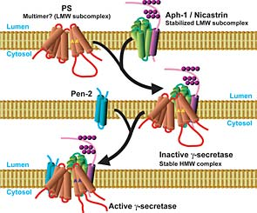
Gamma secretase
Gamma secretase can cut APP at several points within a small region of the protein, which results in Aβ of various lengths (39~42 residues). The lengths associated with Alzheimer's disease are 40 and 42 amino acids long. Aβ 42 is more likely to aggregate to form plaques in the brain than Aβ 40.
Presenilin mutations lead to an increase in the ratio of Aβ 42 produced compared to Aβ 40, although the total quantity of Aβ produced remains constant. This can come about by various effects of the mutations upon gamma secretase. Presenilins are also implicated in the processing of notch, an important developmental protein. Mice that have the PS1 gene knocked out die early in development from developmental abnormalities similar to those found when notch is disrupted.
The γ-secretase complex has not yet been fully characterized but minimally consists of four individual proteins: presenilin, nicastrin, APH-1 (anterior pharynx-defective 1), and PEN-2 (presenilin enhancer 2). Recent evidence suggests that a fifth protein, known as CD147, is a non-essential regulator of the complex whose absence increases activity.
The proteins in the γ-secretase complex are heavily modified by proteolysis during assembly and maturation of the complex; a required activation step is in the autocatalytic cleavage of presenilin to N- and C-terminal fragments. Nicastrin's primary role is in maintaining the stability of the assembled complex and regulating intracellular protein trafficking. PEN-2 associates with the complex via binding of a transmembrane domain of presenilin and, among other possible roles, helps to stabilize the complex after presenilin proteolysis has generated the activated N-terminal and C-terminal fragments. APH-1, which is required for proteolytic activity, binds to the complex via a conserved alpha helix interaction motif and aids in initiating assembly of premature components.
Recent research has shown that interaction of the γ-secretase complex with the γ-secretase activating protein facilitates the gamma cleavage of amyloid precursor protein into β-amyloid.
The γ-secretase complex is thought to assemble and mature via proteolysis in the early ER. The complexes are then transported to the late ER where they interact with and cleave their substrate proteins.

Slide 6
Presenilins
A family of related multi-pass transmembrane proteins that function as a part of the gamma-secretase intramembrane protease complex.
Presenilin, an aspartyl protease, is the catalytic subunit. In humans, two forms of presenilin and two forms of APH-1 have been identified in the genome; one of the APH homologs can also be expressed in two isoforms via alternative splicing, leading to at least six different possible gamma secretase complexes that may have tissue- or cell type specificity.
Intramembrane protease complex (Wikipedia)
All known intramembrane proteases are themselves integral membrane proteins with multiple transmembrane domains, and they have their active sites buried within the lipid bilayer of cellular membranes. Three major classes of intramembrane proteases have been discovered. The Site-2 protease (S2P) family are intramembrane metalloproteases. Presenilin, the active subunit of gamma secretase, and the signal peptide peptidase (SPP) and SPP-like group (which are distantly related to presenilin but have opposite membrane orientation) are intramembrane aspartyl proteases. The rhomboid protease family are serine proteases.
Intramembrane proteases are not evolutionarily related to classical soluble proteases, having evolved their catalytic sites by convergent evolution.
Although only recently discovered, intramembrane proteases are the focus of intense interest because of their major biological functions and their implication in many human diseases.

Slide 7
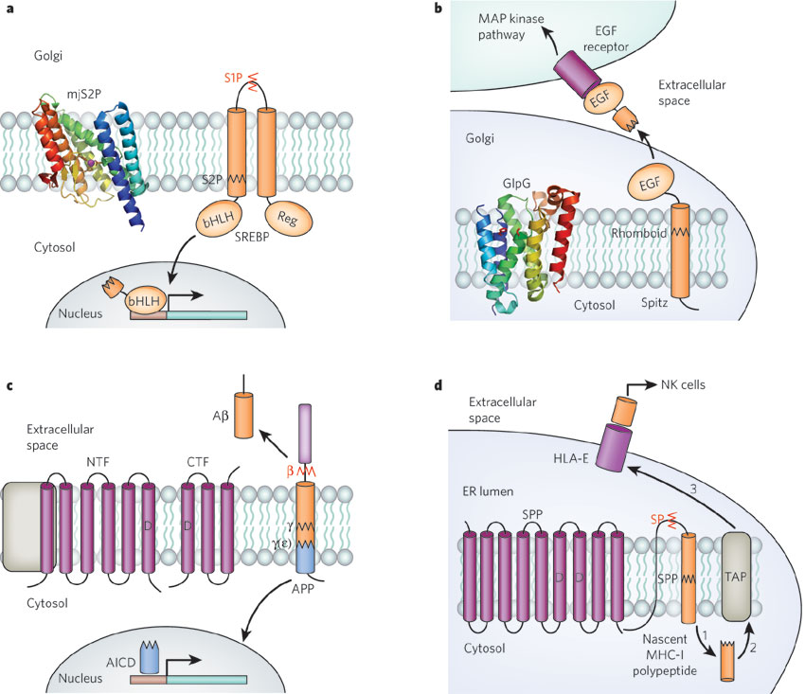
Intramembrane proteases (I-CLiP families) and their signalling-related functions
NCT, Aph-1, Pen-2 complex
a, Transcriptional activation by the cleavage of sterol regulatory element-binding protein (SREBP) by site-2 protease (S2P). When the cellular level of sterols drops, the SREBP precursor protein is transported to the Golgi apparatus, where it is first cleaved by site-1 protease (S1P) (red zigzag line) and then by S2P (black zigzag line). The liberated transcription-factor domain (bHLH) travels to the nucleus and directs the transcription of target genes. mjS2P, crystal structure of the Methanocaldococcus jannaschii S2P. b, Activation of the epidermal growth factor (EGF) receptor by the rhomboid-dependent release of its ligand in Drosophila. The EGF receptor ligand Spitz is transported to the Golgi apparatus, where it is cleaved by rhomboid. The luminal product is secreted and activates EGF receptors on neighbouring cells. GlpG, crystal structure of Escherichia coli rhomboid55. c, Release of amyloid β-peptide (A) by γ-secretase (γ). The catalytic component of γ-secretase, presenilin, is found in complex with three other proteins (nicastrin (NCT), anterior pharynx defective 1 (Aph-1) and presenilin enhancer 2 (Pen-2); complex shown schematically in grey on the left of the figure). Presenilin undergoes endoproteolytic cleavage to create an amino(N)-terminal fragment (NTF) and a carboxy (C)-terminal fragment (CTF). Amyloid precursor protein (APP) on the plasma membrane is first cleaved by β-secretase (red zigzag line and ) at an extracellular domain, and then by γ-secretase (black zigzag line and ) to release Aβ, which is secreted from cells. The remnant is further cleaved by γ-secretase at the site (black zigzag line and to create APP intracellular domain (AICD), which is thought to have a role in transcription regulation. d, Generation of human lymphocyte antigen E (HLA-E) epitopes by signal peptide peptidase (SPP)-catalysed intramembrane cleavage. During biosynthesis, the signal sequence of a major histocompatibility complex class I (MHC-I) molecule is first cleaved by signal peptidase (SP) (red zigzag line) and then by SPP (black zigzag line). The resultant fragment is released to the cytosol (step 1) where it is further cleaved (not shown) and transported back to the lumen of the endoplasmic reticulum (ER) by the transporter associated with antigen processing (TAP) (step 2). The epitope-containing fragment is then loaded onto the HLA-E molecule and transported to the cell surface for presentation to natural killer (NK) cells (step 3). D, aspartates in active site. Nature 459, 371-378(21 May 2009)

Slide 8
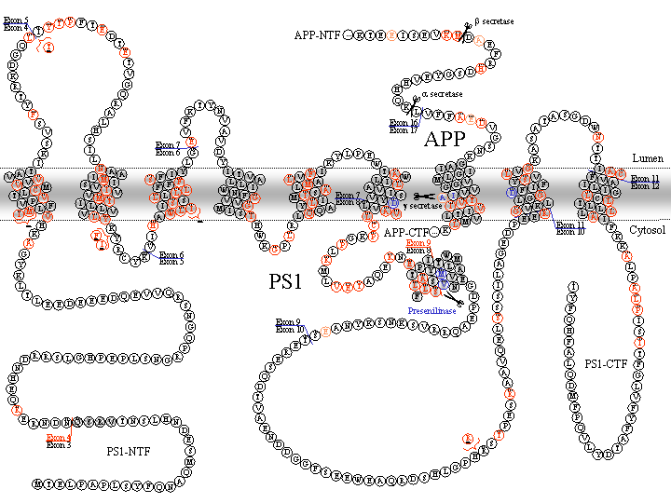
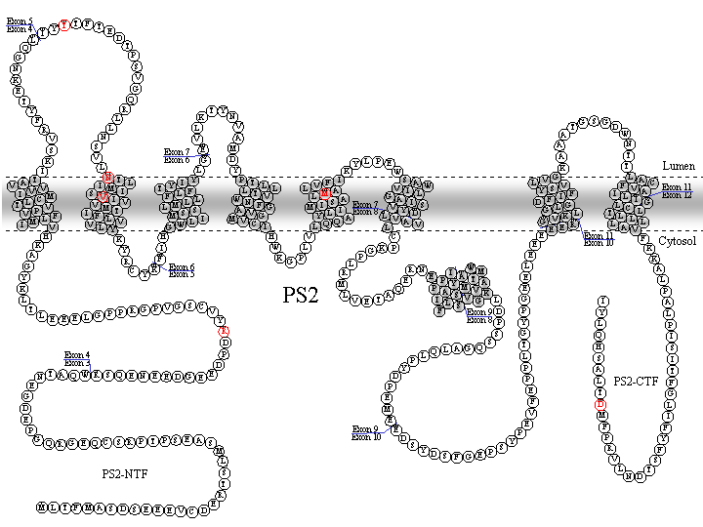
Two presenilin genes in vertebrates:
PSEN1 (chr14 in humans): presenilin-1 (PS-1)
PSEN2 (chr1 in humans): presenilin-2 (PS-2)
PS-1 mutations
PS-2 mutations
http://www.alzforum.org/res/com/mut/pre/

Slide 9
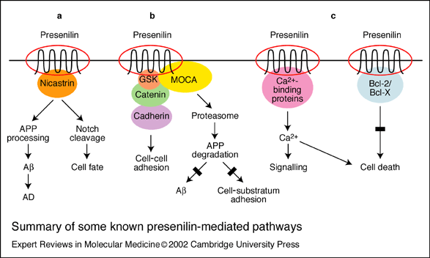
Presenilins may have multiple functions
(a) Interaction of presenilin (PS) with nicastrin and Notch regulates amyloid precursor protein (APP) processing and cell fate decisions. (b) Interaction of PS with b-catenin, cadherin and MOCA (‘modifier of cellular adhesion’) mediates b-amyloid (Ab) production and cellular adhesion. (c) Interaction of PS with calcium-binding proteins and with Bcl-2 and Bcl-X alters calcium signalling and cell death pathways. AD, Alzheimer’s disease; GSK, glycogen synthase kinase

Slide 10
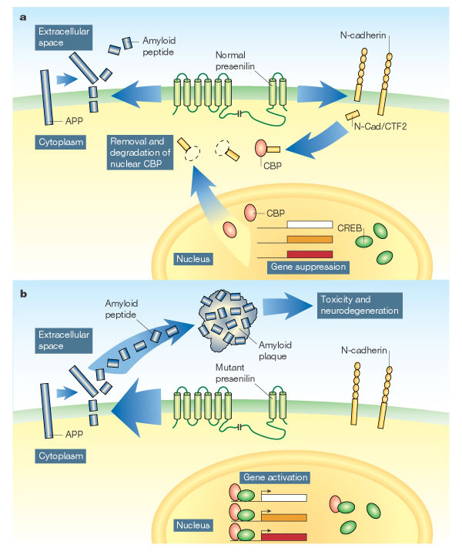
Two functions of presenilin
a, The presenilin protein, embedded in the outer membrane of neurons, is part of the γ-secretase complex, which snips fragments off amyloid precursor protein (APP), releasing amyloid peptide into the extracellular space.
Marambaud et al. show that presenilin also snips off the intracellular portion of the membrane protein N-cadherin. The released fragment, N-Cad/CTF2, binds to the protein CBP and targets it for destruction. In the absence of CBP, the nuclear protein CREB cannot activate genes.
b, Mutated forms of presenilin that are associated with Alzheimer's disease are thought to accelerate the production of toxic amyloid plaques. These presenilin mutants also fail to cleave N-cadherin, increasing levels of CBP, and increasing the activity of genes regulated by CREB2. So, as well as provoking amyloid-related neurotoxicity, presenilin mutations might cause Alzheimer's disease by inappropriately activating genes associated with neuronal function and memory formation. Nature 425, 565-566(9 October 2003) Neurobiology: Double trouble for neurons

Slide 11
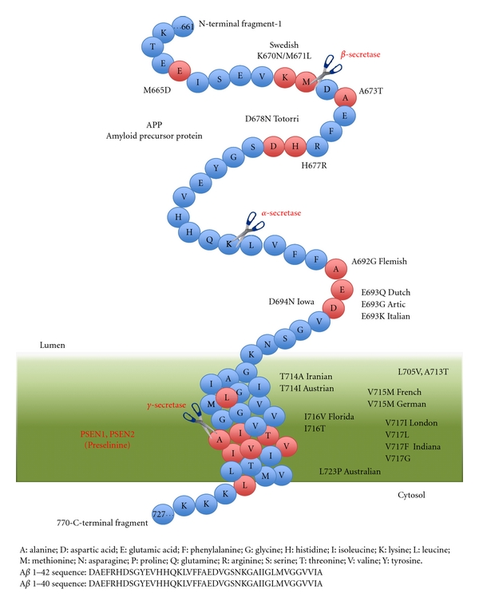
APP mutations
Amyloid precursor protein (APP, 770 aa) cleavage and mutation. The present diagram represent APP, a transmembrane protein precursor of Aβ peptide, with the three principal cleavage site (β-secretase or BACE, α-secretase, and γ-secretase) and several known mutations.
http://www.hindawi.com/journals/ijad/2011/929042/fig1/

Slide 12
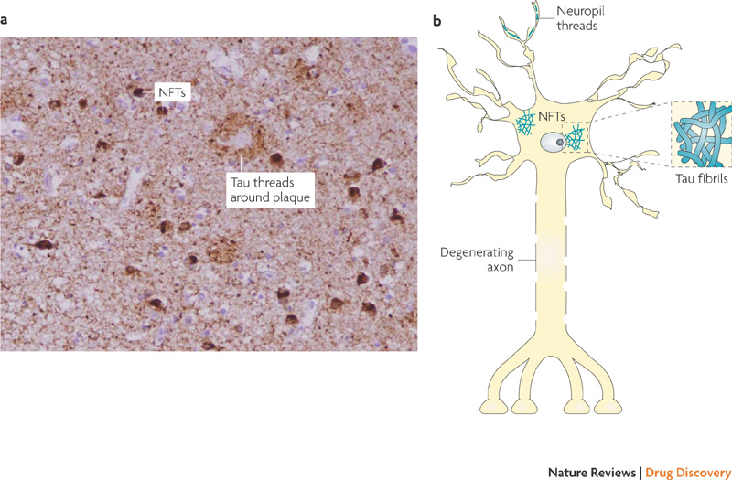
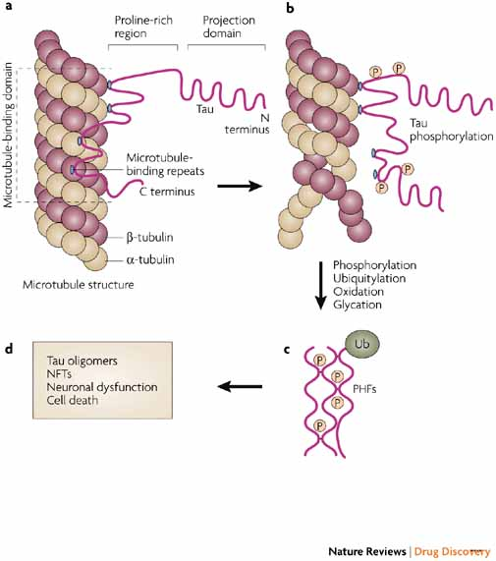
Tau mutations and polymorphisms: Familial frontotemporal dementia (FTD)
▪ There has been a debate on whether Tau is causal to the disease or just a byproduct of some disease process. For the case of AD the case is still open, and changes in Tau are mostly viewed as a consequence of Ab pathology.
▪ However, the discovery of mutations in the Tau gene causing frontotemporal dementias has confirmed a causative role of Tau in neurodegeneration, as well as the identification of Tau as one of the risk factors in PSP, PD and others. (Polymorphism Identified in the MAPT Gene in Individuals with FTD, http://www.alzforum.org/res/com/mut/tau/taupolytable.asp)
▪ Even in the context of AD, the active contribution of Tau was highlighted by animal models, suggesting that Tau is required for the induction of Ab-induced toxicity
Nature Reviews Drug Discovery 6, 464-479 (June 2007)

Slide 13
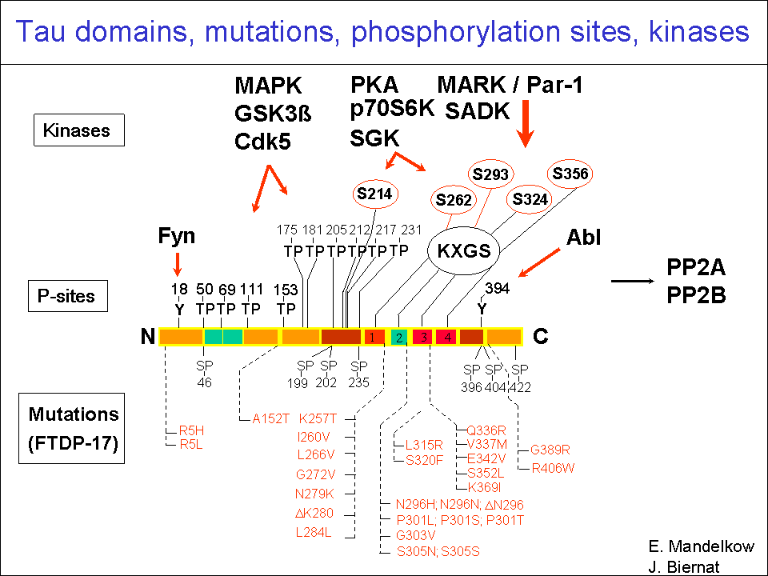
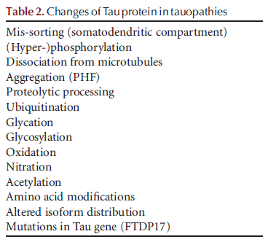
Tau modifications
http://www.alzforum.org/res/com/mut/tau/default.asp

Slide 14
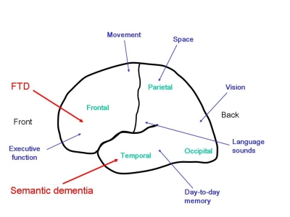
Fronto-temporal dementia and semantic dementia: fronto-temporal lobar degeneration.
In fronto-temporal dementia, the disease primarily affects the frontal lobes, whereas in semantic dementia the disease selectively affects the temporal lobes.
Fronto-temporal dementia (FTD): typically affects people below the age of 65. About half of the patients that we see report a family history of similar problems, and in a small proportion of these cases, there is a specific genetic fault associated with developing the disease. However, FTD also occurs in people who have no other affected family members.
FTD principally affects personality and behaviour. Patients are typically physically fit. Initial changes are apparent in mental function only. As the disease progresses, reduced activity and physical slowing may occur. Symptoms arise gradually, making it difficult to pinpoint the very beginning of the disease.
Semantic Dementia (SD): is associated with shrinkage of the temporal lobes. SD is a relatively rare disorder and is much less common than FTD. However, like FTD, people with SD tend to be affected at a relatively young age, generally between the ages of 50 and 65. Relatives report a history of a similar disorder in the family in about a quarter of cases.
In SD, people progressively lose their ability to remember the meaning of words, objects and faces. Changes may also occur in people’s behaviour, although these are qualitatively different from those observed in FTD.
http://www.cerebralfunctionunit.co.uk/ftld_overview.html

Slide 16
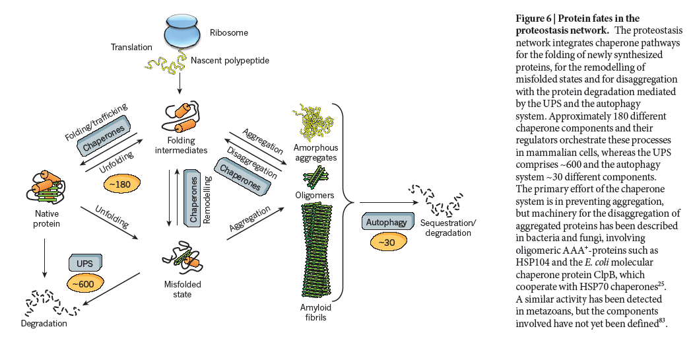
Autophagy in AD

Slide 17
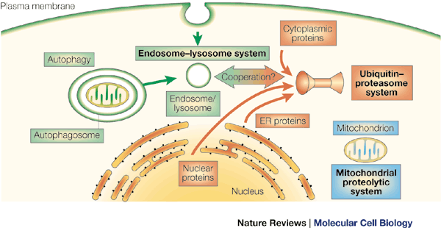
Intracellular proteolysis: Lysosome (autophagy) & UPS
The endosome–lysosome pathway (green) degrades extracellular and cell-surface proteins, such as receptors and their ligands. Intracellular organelles also enter this pathway through double-membraned autophagosomes. The ubiquitin–proteasome pathway (red) degrades proteins from the cytoplasm, nucleus and endoplasmic reticulum (ER). Evidence is now emerging that the two pathways cooperate. Finally, the mitochondrion has its own proteolytic system (blue), similar to that in prokaryotes. Nature Reviews Molecular Cell Biology 1, 145-148 (November 2000)

Slide 18
Etiology of cell death
Major Factors
Accidental Genetic
Necrosis Apoptosis
Necrosis: unexpected cell death
The sum of the morphologic changes that follow cell death in a living tissue or organ
Apoptosis: programmed cell death (PCD)
a physiological process that includes specific suicide signals leading to cell death
Autophagic PCD: may be a survival mechanism?

Slide 19
Distinct modalities of cell death
Cell death mode | Morphological features | Notes
Apoptosis | Rounding-up of the cell Retraction of pseudopodes Reduction of cellular and nuclear volume (pyknosis) Nuclear fragmentation (karyorrhexis) Minor modification of cytoplasmic organelles Plasma membrane blebbing Engulfment by resident phagocytes, in vivo | ‘Apoptosis’ is the original term introduced by Kerr et al.¹⁴ to define a type of cell death with specific morphological features. Apoptosis is NOT a synonym of programmed cell death or caspase activation.
Autophagy | Lack of chromatin condensation Massive vacuolization of the cytoplasm Accumulation of (double-membraned) autophagic vacuoles Little or no uptake by phagocytic cells, in vivo | ‘Autophagic cell death’ defines cell death occurring with autophagy, though it may misleadingly suggest a form of death occurring by autophagy as this process often promotes cell survival.¹⁵,¹⁶
Cornification | Elimination of cytosolic organelles Modifications of plasma membrane Accumulation of lipids in F and L granules Extrusion of lipids in the extracellular space Desquamation (loss of corneocytes) by protease activation | ‘Cornified envelope’ formation or ‘keratinization’ is specific of the skin to create a barrier function. Although apoptosis can be induced by injury in the basal epidermal layer (e.g., UV), cornification is exclusive of the upper layers (granular layer and stratum corneum).¹⁷,¹⁸
Necrosis | Cytoplasmic swelling (oncosis) Rupture of plasma membrane Swelling of cytoplasmic organelles Moderate chromatin condensation | ‘Necrosis’ identifies, in a negative fashion, cell death lacking the features of apoptosis or autophagy.⁴ Note that necrosis can occur in a regulated fashion, involving a precise sequence of signals.
Cell Death Differ. 2009, 16(1): 3–11

Slide 20
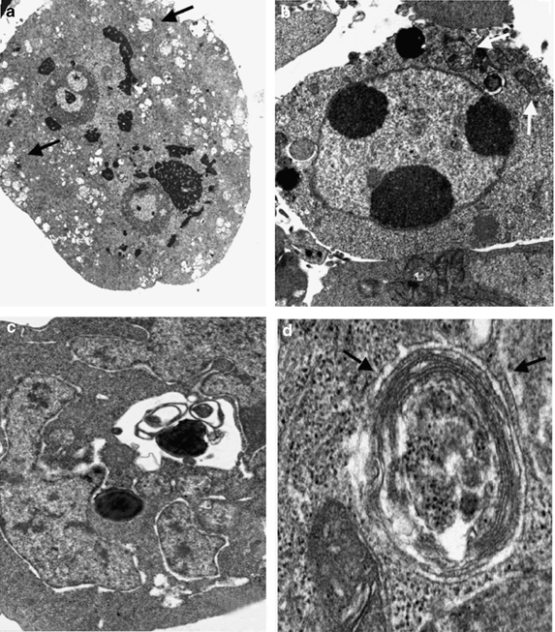
Classification of cell death
necrosis
apoptosis
Morphological ultrastructural appearance of cell death by transmission electron microscopy. (a) Human epithelial cell undergoing necrosis after oxidative stress. Note the plasma membrane rupture, intracellular vesicle swelling and loss of mitochondrial ultrastructure (arrows). Magnification: x4000. (b) Human epithelial cell undergoing apoptosis induced by radiation. Note the chromatin clumping and the integrity of mitochondria (arrow). Magnification x4000. (c, d) Human epithelial cell undergoing autophagic vacuole formation after tamoxifen treatment. Note in (c) the normal morphology of the nucleus, the dilation of the perinuclear endoplasmic reticulum and the presence of some large vacuoles containing digested materials and in (d) the typical double membrane (arrows) characterizing the autophagic vacuoles. Magnifications: (c) x8000 and (d) x16000
Cell Death and Differentiation (2005) 12, 1463–1467. doi:10.1038/sj.cdd.4401724
normal
autophagy

Slide 21
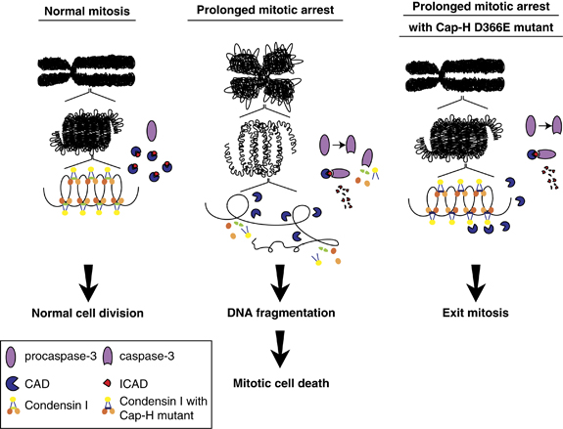
Mitotic cell death (mitotic catastrophe)
An event in which a cell is destroyed during mitosis. This is believed by some to occur as a result of an attempt at aberrant chromosome segregation early in mitosis, or as a result of DNA damage later.
The term ‘mitotic catastrophe’ is used to explain a mechanism of a delayed mitotic-linked cell death, a sequence of events that results from premature or inappropriate entry of cells into mitosis that can be caused by chemical or physical stresses. It can be triggered with agents influencing the stability of microtubule, various anticancer drugs and mitotic failure caused by defective cell cycle checkpoints. Mitotic catastrophe is the main form of cell death induced by ionizing radiation.
Model illustrating the link between caspase activation, chromosomal integrity and mitotic death. In normal mitotic cells, chromosomes are tightly condensed. Caspases are not activated and the cell proceeds through mitosis (left panel). In mitosis-arrested cells, caspase-3 is activated and cleaves a subunit of condensin I, Cap-H. This results in the loss of condensin I at the chromosomes and chromosomal integrity is altered. Subsequently, the chromosomal DNA is more susceptible to fragmentation by CAD and the cell dies during mitosis (middle panel). In the presence of a caspase-resistant form of Cap-H, the chromosomal integrity remains intact. This makes the DNA less accessible for fragmentation by CAD. The mitosis-arrested cells are more likely to exit mitosis to form aneuploid cells (right panel). Cell death and differentiation (2011) 18, 996-1004.

Slide 22
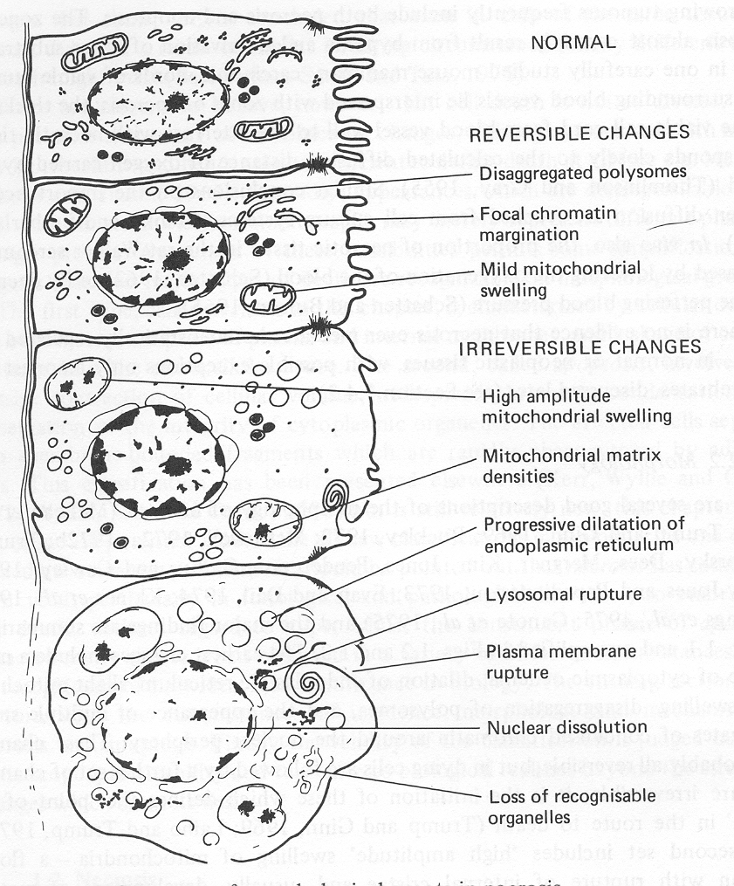
Necrosis: consequences of irreversible cell injury
Homeostatic ‘steady state’
Cellular adaptations
Reversible cell injury
Irreversible cell injury
Cell death Necrosis

Slide 23
Apoptosis as a physiologically important process
In embryonic and fetal development: | Tissue developmental programs which control sculpting of embryonic form Developmental organization of the nervous system Elimination of self-reactive components of the immune system
In the adult: | On stimulation by T-lymphocytes In response to DNA damage or abnormality, e.g. by radiation, viral infection or transformation In certain organs and tissues, on withdrawal of supporting hormones
In addition, there are often apoptotic centers in tumors, accounting for the paradox of slow gross enlargement in the face of rapid cell proliferation, and the rare spontaneous remission.
www.chembio.uoguelph.ca

Slide 24
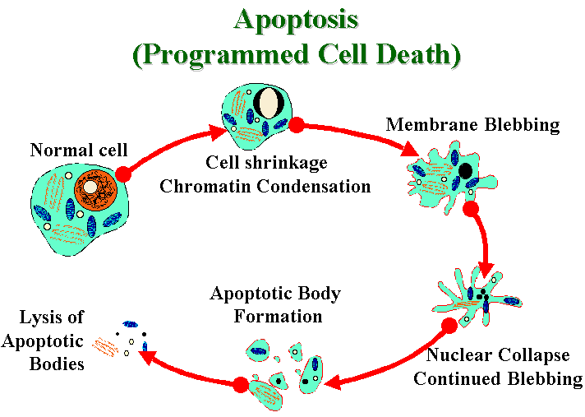

Slide 25
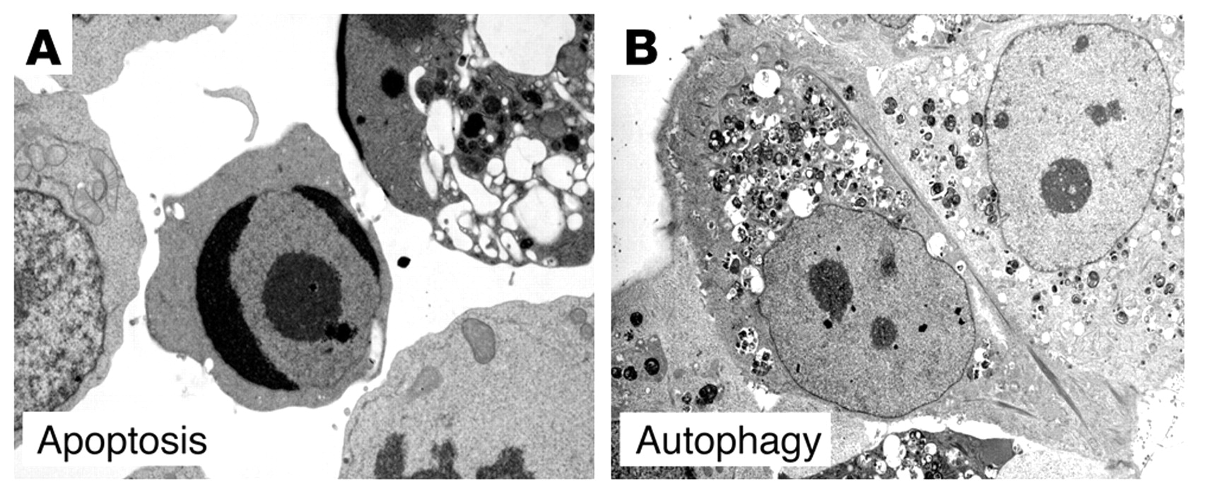
Comparison of morphological features of apoptosis and necrosis
Apoptosis | Necrosis
Single cells or small clusters of cells | Often contiguous cells
Cell shrinkage and convolution | Cell swelling
Pyknosis and karyorrhexis | Karyolysis, pyknosis, and karyorrhexis
Intact cell membrane | Disrupted cell membrane
Cytoplasm retained in apoptotic bodies | Cytoplasm released
No inflammation | Inflammation usually present
Ultrastructural examples of apoptotic and autophagic cell death. Electron micrographs of a FasL-treated Jurkat cell undergoing cell death with apoptotic features (A) and of a tamoxifen-treated MCF7 human breast carcinoma cell undergoing cell death with autophagic features (B). In A, note chromatin condensation (cell in center) and cytoplasmic vacuolization (cell in upper right). In B, note absence of chromatin condensation and presence of numerous autophagosomes. Images in A and B reproduced with permission from Nature Cell Biology (98) and Landes Bioscience (90), respectively.

Slide 26
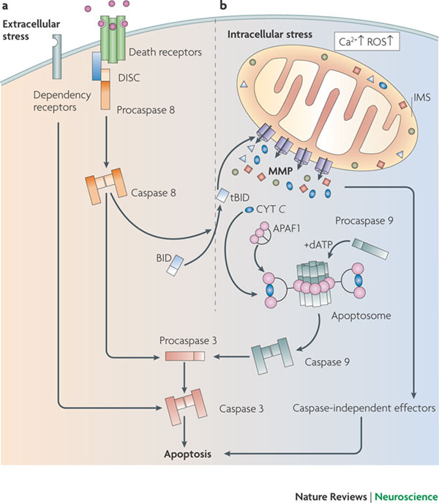
The extrinsic and intrinsic (mitochondrial) pathways of apoptosis
Apoptosis can result from the activation of two biochemical cascades, which are known as the extrinsic (part a) and the intrinsic (or mitochondrial, part b) pathways. The extracellular apoptotic pathway is initiated at the plasma membrane by specific transmembrane receptors, whereas mitochondrial apoptosis is triggered by intracellular stimuli such as Ca2+ overload and overgeneration of reactive oxygen species (ROS). In both pathways, initiator caspases (caspase 8 and 9, respectively) are activated within specific supramolecular platforms and so can catalyse the proteolytic maturation of executioner caspases, such as caspase 3, which mediate (at least part of) the catabolic processes that characterize end-stage apoptosis. Mitochondrial membrane permeabilization (MMP) marks a point of no return in the mitochondrial pathway (see also Figs 2, 3), by activating both caspase-dependent and caspase-independent mechanisms that eventually execute cell death. For example, following MMP the mitochondrial intermembrane space (IMS) protein cytochrome c (CYT C) is released into the cytosol and interacts with the adaptor protein apoptotic peptidase activating factor 1 (APAF1) as well as with procaspase 9 to form the apoptosome. This results in the sequential activation of caspase 9 and executioner caspases, such as caspase 3, a process that is known as the caspase cascade. One of the major links between extrinsic and mitochondrial apoptosis is provided by the BCL-2 homology domain 3 (BH3)-only protein BID, which can promote MMP following caspase-8-mediated cleavage. dATP, deoxyadenosine triphosphate; DISC, death-inducing signalling complex; tBID, truncated BID. Nature Reviews Neuroscience 10, 481-494 (July 2009)

Slide 27
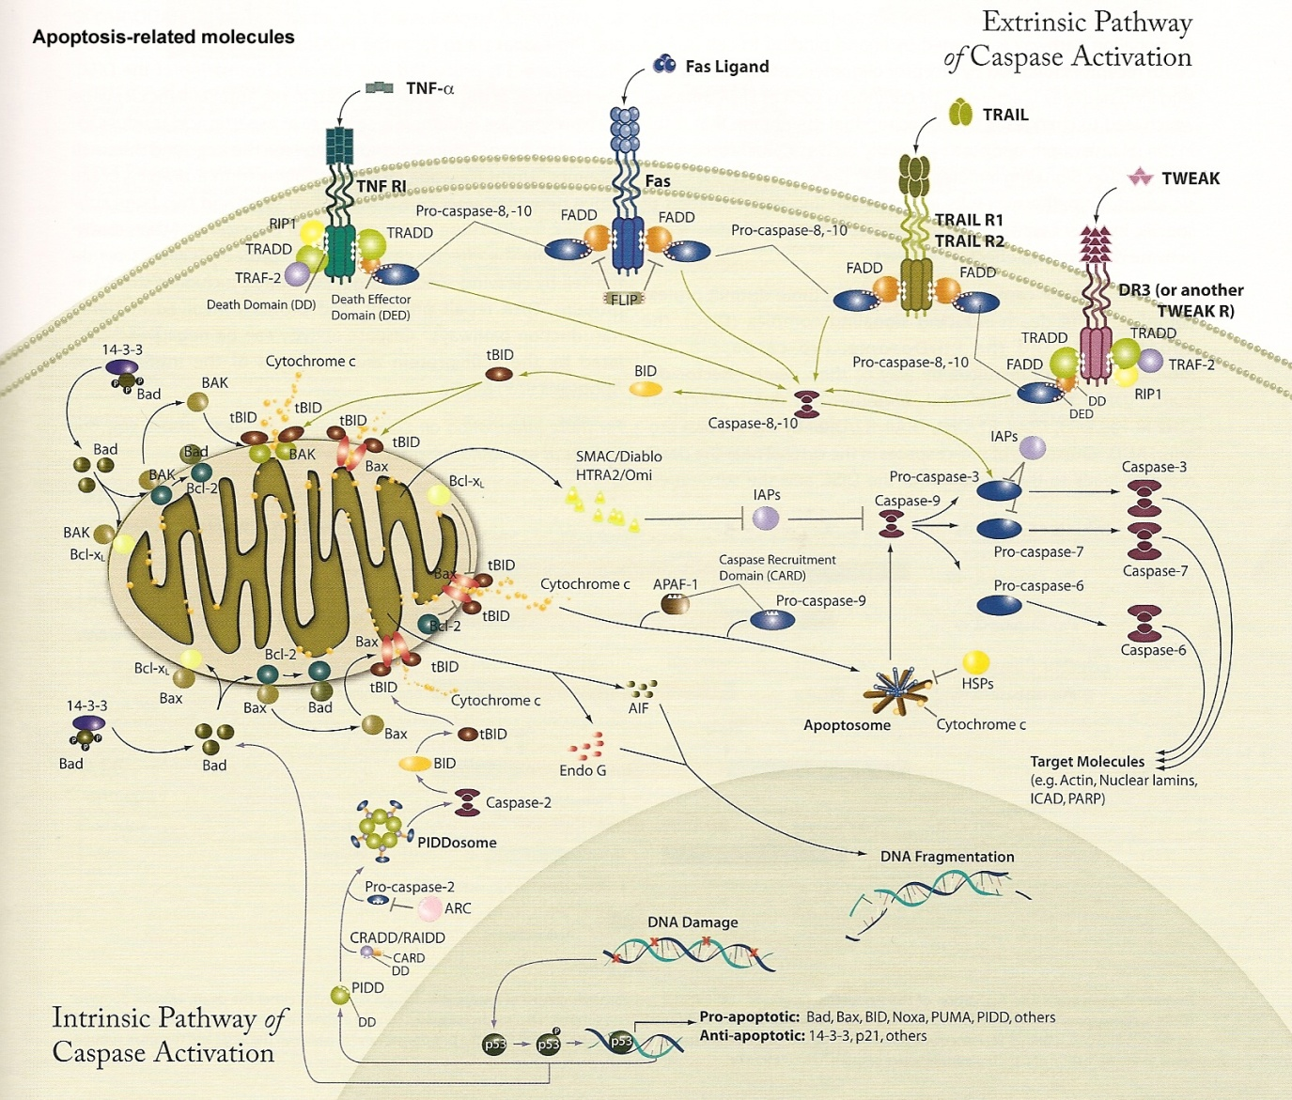

Slide 28
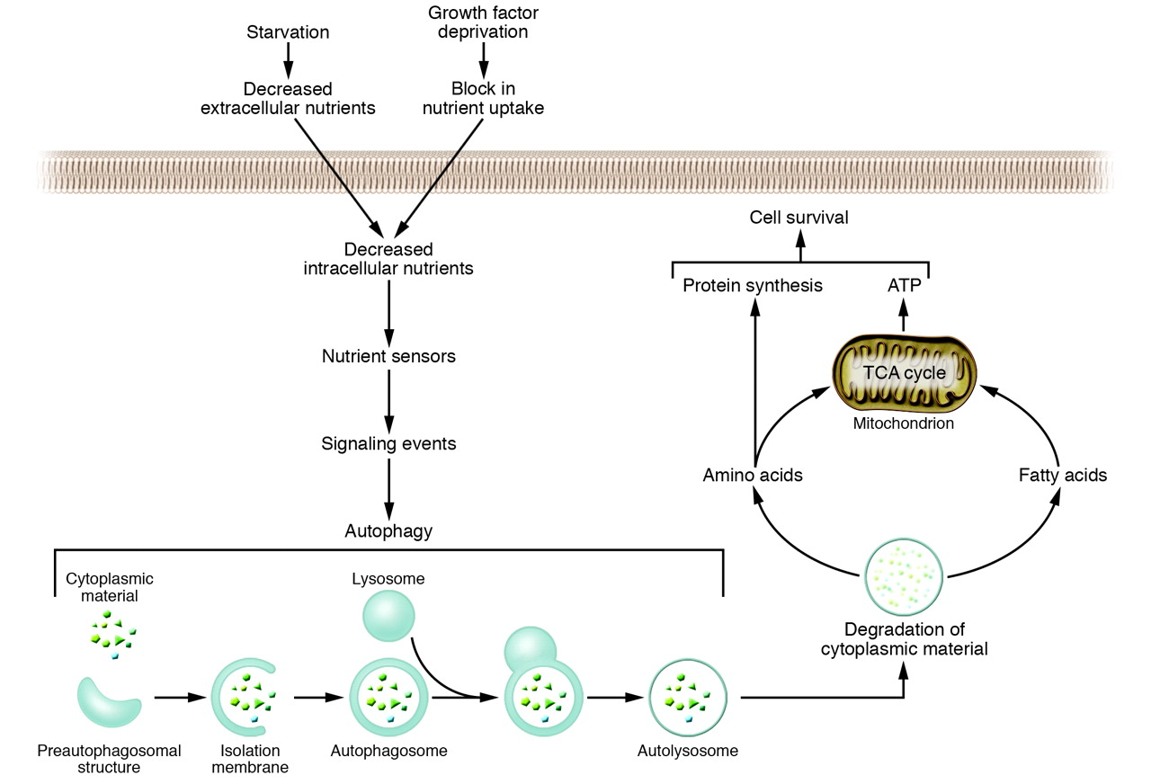
The autophagy pathway and its role in cellular adaptation to nutrient deprivation
Autophagy has roles in both normal cellular homeostasis and disease states.
Autophagy is induced in a response to nutrient stress to maintain adequate internal levels of nutrients(self-cannabilization).
In nutrient-rich conditions, autophagy promotes cell death in response to other types of stress.
Levine, B. et al. J. Clin. Invest. 2005;115:2679-2688

Slide 29
Autophagic cell death:
instances of cell death that are accompanied by a massive cytoplasmic vacuolization
In response to stress and during development, eukaryotic cells often activate autophagy, a mechanism whereby organelles and portion of the cytoplasm are sequestered in double-membraned vesicles (autophagosomes) that are delivered to lysosomes for degradation. Stress-induced autophagy most often exerts cytoprotective functions and favors the re-establishment of homeostasis and survival (a). In this setting, pharmacological or genetic inhibition of autophagy accelerates cell death. On the contrary, these interventions frequently inhibit developmental cell death, indicating that autophagy also constitutes a lethal mechanism that mediates ‘autophagic cell death’ (b)
Galluzzi et al.
Cell Death & Differentiation (2012) 19, 107–120

Slide 30
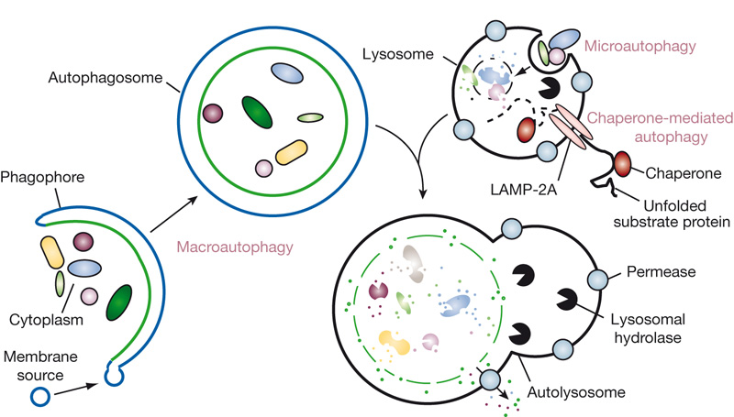
Types of autophagy in mammals
Microautophagy refers to the sequestration of cytosolic components directly by lysosomes through invaginations in their limiting membrane. The function of this process in higher eukaryotes is not known, whereas microautophagy-like processes in fungi are involved in selective organelle degradation. In the case of macroautophagy, the cargoes are sequestered within a unique double-membrane cytosolic vesicle, an autophagosome. Sequestration can be either nonspecific, involving the engulfment of bulk cytoplasm, or selective, targeting specific cargoes such as organelles or invasive microbes. The autophagosome is formed by expansion of the phagophore, but the origin of the membrane is unknown. Fusion of the autophagosome with an endosome (not shown) or a lysosome provides hydrolases. Lysis of the autophagosome inner membrane and breakdown of the contents occurs in the autolysosome, and the resulting macromolecules are released back into the cytosol through membrane permeases. CMA involves direct translocation of unfolded substrate proteins across the lysosome membrane through the action of a cytosolic and lysosomal chaperone hsc70, and the integral membrane receptor LAMP-2A (lysosome-associated membrane protein type 2A). Nature 451, 1069-1075(28 February 2008)

Slide 31
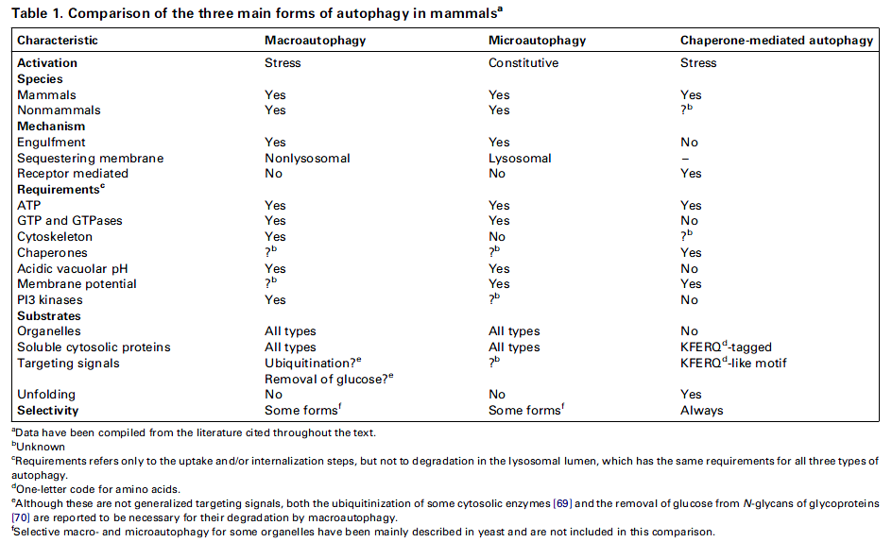

Slide 32
Control of autophagy
In addition to its response to nutrient availability, a growing body of evidence indicates that autophagy is involved in an array of normal physiological processes as well as pathological conditions, such as development, cell death, aging, antigen presentation, bacterial
degradation, and tumor suppression.
Damaging cytoplasmic components: e.g., during oxidative stress, infection, and accumulation of protein aggregates
Nutritional status, hormonal factors, and other cues like temperature, oxygen concentrations, and cell density

Slide 33
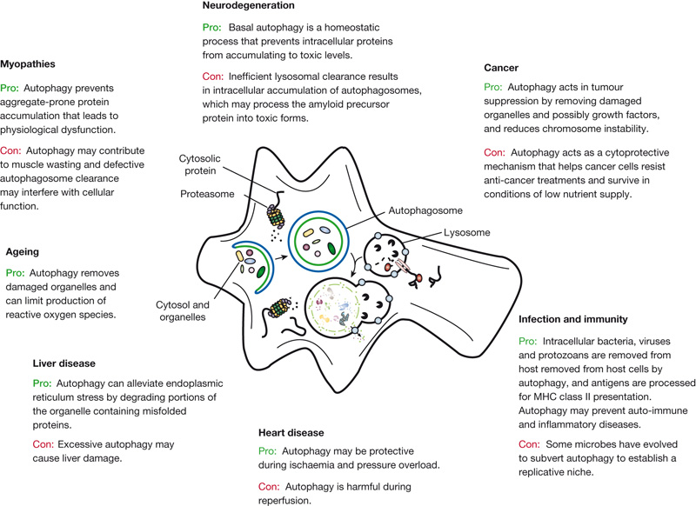
Autophagy fights disease through cellular self-digestion
Degradation, in particular through autophagy and the proteasome, is important in cellular physiology. Autophagy can act as a cytoprotective mechanism to prevent various diseases, and dysfunctional autophagy leads to pathology. In some cases, however, autophagy can be deleterious; for example, some microbes subvert autophagy for replication, and the cytoprotective action can allow cancer cells to resist anti-cancer treatments. Nature 451, 1069-1075(28 February 2008)

Slide 34
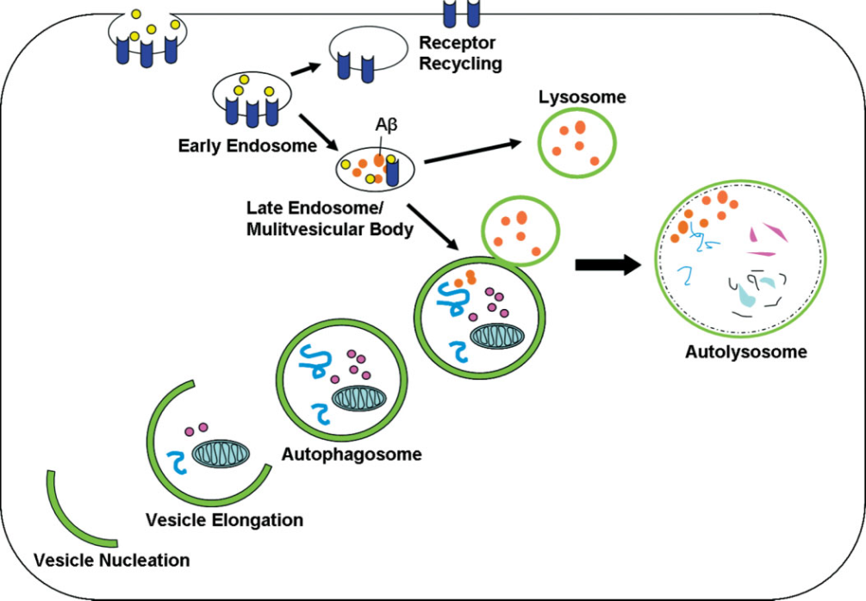
Autophagy & AD: due to dysfunctional autophagy?
Processing of APP: endosomal-lysosomal pathway as an important regulator of the processing
Early AD brain: abnormalities in endocytic and lysosomal pathways
increased number or volume
As AD pathogenesis progresses, lysosomal dysfunction leads to the buildup of vacuolar structures and the accumulation of Aβ. The compromised neurons release the structures into the extracellular space, where they associate with deposits of Aβ.
The endosomal-lysosomal pathway merges with the autophagic pathway. The autophagic pathway is used for organelle and protein turnover. Upon the induction of autophagy, a doublemembraned structure, which is called the isolation membrane, forms by vesicle nucleation around cytoplasmic contents and becomes an autophagosome. Cytoplasmic substrates are then degraded
after fusion of the autophagosome with the lysosome, and this results in the autolysosome. The endosomal pathway, which is important for the uptake and recycling of nutrients and transmembrane receptors, merges with the autophagic pathway. Aβ is generated in multivesicular bodies of the endosomal pathway and may also be generated in autophagosomes. Abbreviation:
Aβ, amyloid-β. MOUNT SINAI JOURNAL OF MEDICINE 77:59–68, 2010

Slide 35
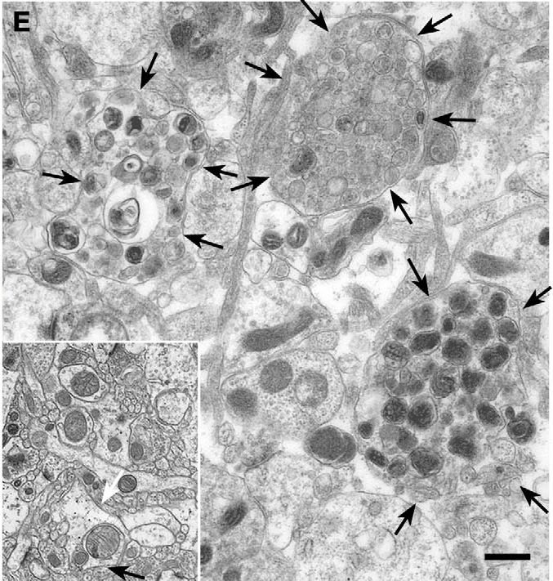
APP processing in the autophagy pathway
A characteristic feature of the AD brain: granulovascular structures in swollen neurites
a lysosome-dense bodies
These are autophagosomes and autophagolysosomes (early and late autophagic vacuoles (Avs)),
which contain the components for Aβ generation, APP, and its processing enzymes.
γ-secretase is highly active in accumulated AVs.
Aβ generated in AVs is presumably delivered principally to lysosomes and degraded by cathepsins.
Aβ generated in AVs is released extracellularly.
Dystrophic neurites (arrows) are grossly enlarged compared with neurites in normal brain (inset) by electron microscopy.
Abnormal swollen neurites contain predominantly AVs of varying morphologies. By contrast, AVs are rare in normal brain (inset). J Cell Sci (2007) 120, 4081.

Slide 36
Presenilin 1 studies
In FAD, the most common mutations are found in PS1 and PS2. These mutations cause increased production of Aβ peptide leading to the accumulation of this protein and the formation of Aβ plaques.
A possible link between PS1 and AD through autophagy.
In the PS1/APP mouse model of β-amyloidogenesis, there was an accumulation of AVs containing APP, PS1, and other proteins.
Telencephalin (TLN), a neural intercellular adhesion molecule (ICAM) with which PS1 interacts, has also
been shown to accumulate in autophagic-like vacuoles in PS1-null hippocampal neurons. However, the prolonged half-life and enrichment of TLN were not a result of abnormal γ -secretase cleavage because TLN is not a substrate of γ-secretase. Rather, the authors hypothesized that the deficiency in PS1 caused a failure of autophagy to clear TLN by possibly disallowing proper vacuole and lysosome fusion.
These evidence supports the proposition that impaired presenilin function translates into possible autophagic dysfunction either causing or exacerbating protein accumulation and, therefore, perhaps playing a significant role in the pathogenesis of neurodegenerative diseases such as AD.

Slide 37
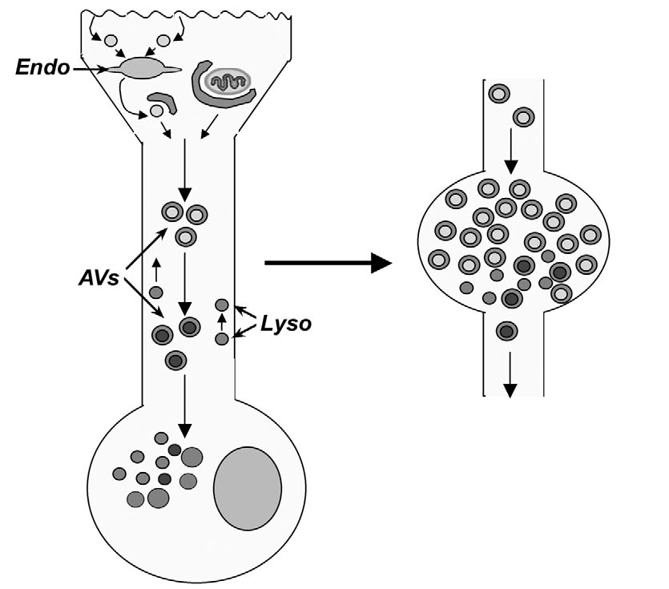
Macroautophagy is impaired in the PS1-APP mouse model of AD.
Development of neuritic dystrophy in AD brain. Endocytic trafficking and autophagy are both normally active in neuronal processes. Nascent AVs mature to autophagolysosomes during their retrograde transport, fusing with anterogradely transported lysosomes. Pathological AV accumulation is associated with inhibited retrograde AV transport and impaired autophagosome-lysosome fusion. Fusion of some accumulated AV compartments with the plasma membrane may contribute to local membrane expansion. J Cell Sci 120:4081-4091

Slide 38
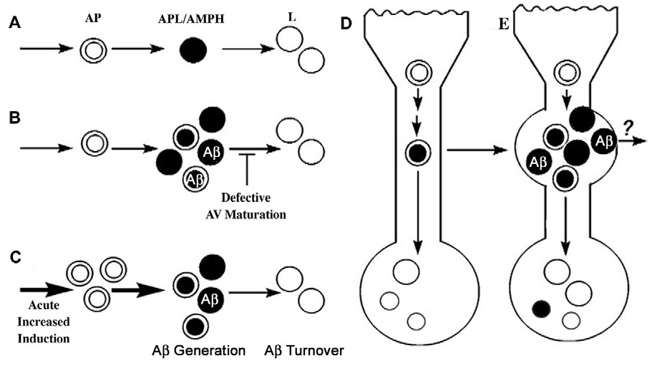
Proposed models of AV (autophagic vacuole) accumulation leading to elevated Aβ levels.
(A) Usual progression from autophagosomes (AP) to autophagolysosomes (APL) to lysosomes (L). Conditions that result in AV build up are expected to promote Aβ generation and accumulation. (B,C) These conditions include impaired and delayed maturation of autophagosomes to (B) lysosomes or (C) acute induction of autophagy. (D,E) Within neurons, AVs normally mature to lysosomes efficiently as they reach the perikaryon and are usually rare (D). In AD, however, AVs in neurites fail to mature completely to lysosomes either as a cause or consequence of disrupted proteolytic clearance and/or retrograde transport of AVs, thereby promoting the accumulation of Avs capable of generating Aβ and the delayed degradation of A by lysosomes (E). The continued capacity of immature AVs to fuse with other membranous structures, including possibly the plasma membrane, is a possible basis for slow exocytic release of AV contents, including A, from the dystrophic neurite. J Cell Sci (2007) 120:4081-4091.

Slide 39
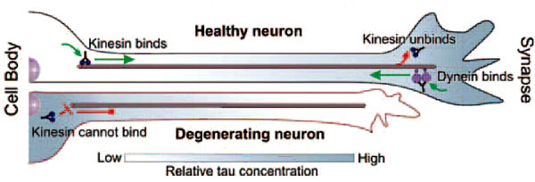
Presenilin influences glycogen synthase kinase-3 b (GSK-3b) for kinesin-1 and dynein function during axonal transport.
(2013) Human Molecular Genetics (paper No.5)
Within axons, molecular motors transport essential components required for neuronal growth and viability. Although many levels of control and regulation must exist for proper anterograde and retrograde transport of vital proteins, little is known about these mechanisms. We previously showed that presenilin (PS), a gene involved in Alzheimer’s disease (AD), influences kinesin-1 and dynein function in vivo. Here, we show that these PS-mediated effects on motor protein function are via a pathway that involves glycogen synthase kinase-3b (GSK-3b). PS genetically interacts with GSK-3b in an activity-dependent manner. Excess of active GSK-3b perturbed axonal transport by causing axonal blockages, which were enhanced by reduction of kinesin-1 or dynein. These GSK-3b-mediated axonal defects do not appear to be caused by disruptions or alterations in microtubules (MTs). Excess of non-functional GSK-3b did not affect axonal transport. Strikingly, GSK-3b activity-dependent axonal transport defects were enhanced by reduction of PS. Collectively, our findings suggest that PS and GSK-3b are required for normal motor protein function. Our observations propose a model, in which PS likely plays a role in regulating GSK-3b activity during transport. These findings have important implications for our understanding of the complex regulatory machinery that must exist in vivo and how this system is coordinated during the motility of vesicles within axons.
http://bric.postech.ac.kr/trend/news/view_kisti.php?id=235102
http://www.sciencedaily.com/releases/2013/10/131028114422.htm

