Slide 1
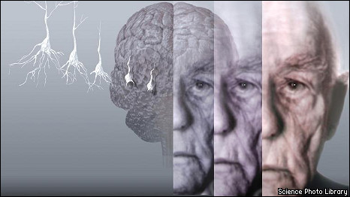
Dementia

Slide 2
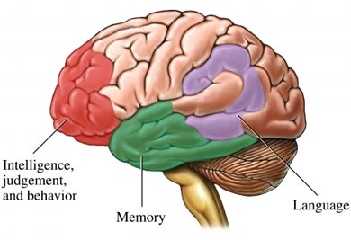
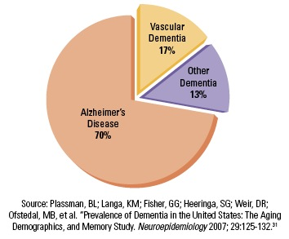
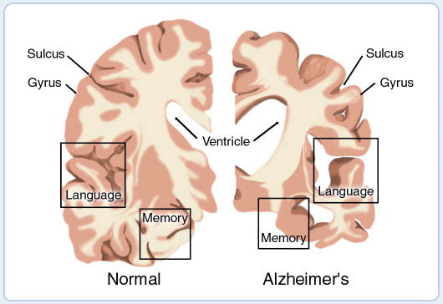
Types of dementia
http://www.topnews.in/health/diseases/dementia
http://cadc.ucsf.edu/cadc/resources/dementia

Slide 3
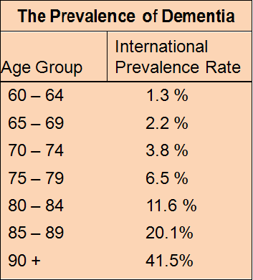
http://www.dementiaguide.com/aboutdementia/typesofdementia/alzheimers/

Slide 4
Female Life Expectancy in Developed Countries: 1840-2009
http://www.nia.nih.gov/research/publication/global-health-and-aging/living-longer

Slide 5
Alzheimer’s disease (AD)
AD is an insidious neurodegenerative disorder and the primary cause of dementia in the elderly. There is presently no treatment to stop the disease progression. The primary clinical features of AD are characterized by deterioration of memory and cognitive function, progressive impairment of activities of daily living, and several neuropsychiatric symptoms (Cummings, 2004). At the cellular and molecular levels, the pathological features of AD are characterized by two distinctive hallmarks: amyloid plaques primarily comprised of a small protein Aβ (Bertram and Tanzi, 2008; Gandy, 2005; Hardy and Selkoe, 2002), and neurofibrillary tangles composed of hyperphosphorylated protein tau. While Aβ42 and Aβ40 are the two primary Aβ species, Aβ42 is more prevalent than Aβ40 in amyloid plaques (Bertram and Tanzi, 2008; Gandy, 2005; Hardy and Selkoe, 2002).
AD is a genetically complex and heterogeneous disorder. Based on the age of onset, it has two primary forms: early-onset and late-onset AD. More than 200 fully penetrant mutations in the amyloid β-protein precursor (APP), presenilin 1 (PSEN1), and presenilin 2 (PSEN2) have been linked to early-onset familial AD (<60 years old; 5-10% cases) (Bertram and Tanzi, 2008; Tanzi and Bertram, 2005), whereas 90-95% cases are late-onset AD (>60 years old) and a variant (ε4) of the gene encoding apolipoprotein E (APOE) has been associated with this disease type (Strittmatter et al., 1993). All of these four confirmed AD genes increase the cerebral Aβ levels, with the majority of early-onset familial AD mutations increasing the ratio of Aβ42 to Aβ40, which enhances the oligomerization of Aβ into neurotoxic assemblies (Hardy and Selkoe, 2002; Tanzi and Bertram, 2005). To date approximately 80% of the late-onset AD genetic variance still remains elusive (Gatz et al., 2006). Recently several genome-wide association studies have identified several novel AD candidate genes (Bertram et al., 2010) and functional characterization of these AD candidate genes has provided insights into the pathogenesis of AD (Zhang et al., 2010a).
Considerable evidence from genetics, biochemistry, and molecular biology supports the “amyloid-cascade hypothesis,” which states that Aβ production and excessive accumulation are the principal pathogenetical events leading to AD (Hardy and Selkoe, 2002; Tanzi and Bertram, 2005). Specifically, Aβ accumulation and aggregation induce a series of “gain-of-function” activities, e.g., inflammatory and oxidative activities, followed by tau hyperphosphorylation, fibrillary tangle formation, and apoptotic reaction potentiation (Bertram and Tanzi, 2008; Hardy and Selkoe, 2002). In parallel, these gained and often toxic activities contribute to “loss-of-function” activities in proteasomes and lysosomes (Zhang and Saunders, 2009), as well as mitochondria (Bertram and Tanzi, 2008; Selkoe, 2004). Ultimately, these abnormal and usually unbalanced functional activities lead to neuronal dysfunction and cell death (Bertram and Tanzi, 2008; Selkoe, 2004).

Slide 6
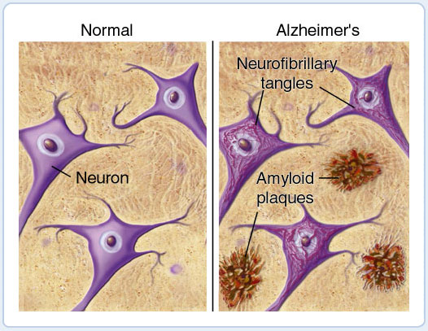
Aβ Hypothesis

Slide 7
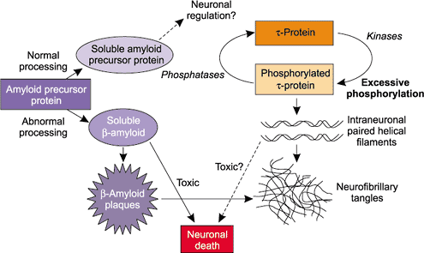

Slide 8
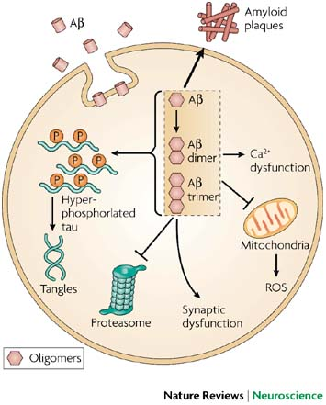
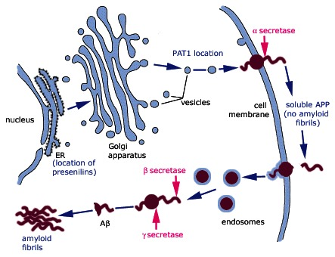

Slide 9
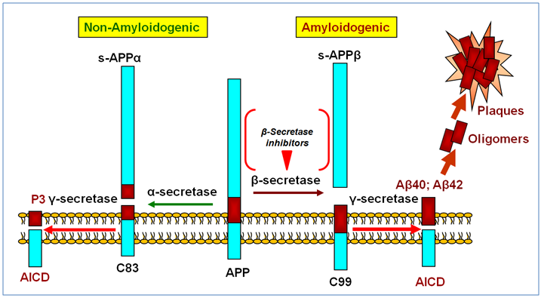
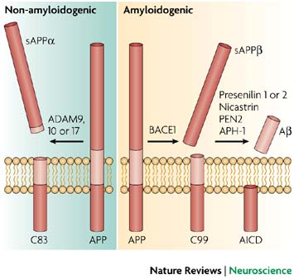
BACE1: beta-secretase 1 (beta-site amyloid precursor protein cleaving enzyme 1)
ADAM: a disintegrin and metalloproteinase domain
ADAM9: ADAM-containing protein 9, membrane protein structurally related to snake venome disintegrins
γ-secretase: a multi-subunit proteases containing presenilin 1, nicastrin, PEN2, APH-1
(an integral membrane protein that cleaves single-pass transmembrane proteins)
AICD: amyloid precursor protein intracellular domain
APPsβ: a soluble NH2-terminal fragment of amyloid precursor protein

Slide 10
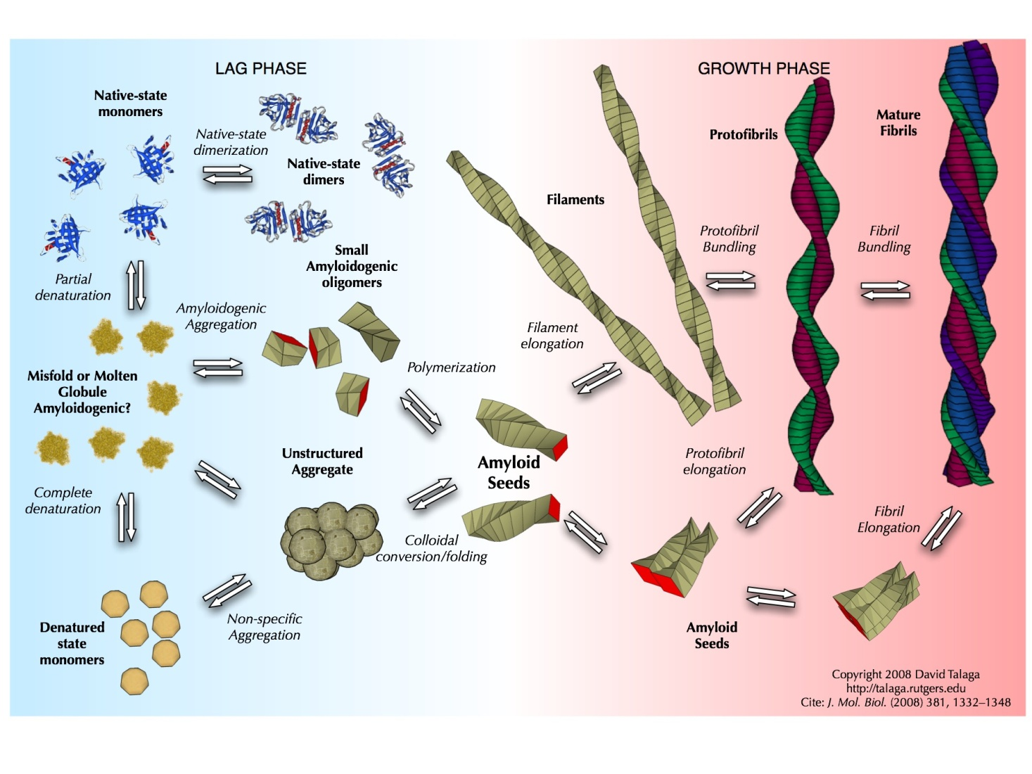

Slide 11
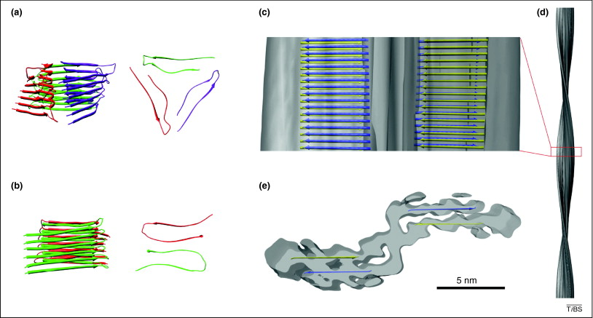
Recent progress in understanding Alzheimer's β-amyloid structures
TIBS Volume 36, Issue 6, June 2011, Pages 338–345
Figure 4. Structural models of Aβ fibrils. Previous structural models deviate significantly for the most highly resolved Aβ fibril structures, which were obtained by cryo-EM. Hence, the latter encompass a different peptide assembly. (a,b) Structural models assuming a U-shaped peptide fold; side views and top views shown; only residues 9–40 modeled. (a) Three Aβ(1–40) molecules per cross-sectional layer [29]. (b) Two Aβ(1–40) molecules per cross-sectional layer [24]. (c,d) Cryo-EM structure of an Aβ(1–40) fibril (0.8 nm). (c,d) side views, (e) cross-section. Images in (c,e) are superimposed with a β-sheet model, which is derived from these cryo-EM data, and highlights the peptides forming the cross-β regions in yellow or blue (the lines are not meant to imply continuous β-strands over their entire length; these regions might instead contain several shorter strands). Images in (a–c) and (e) are displayed with the same scale.

Slide 12
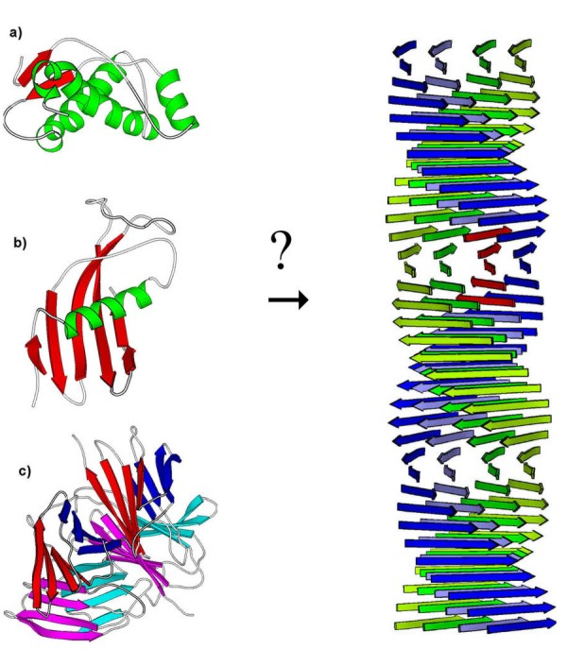
Amyloid fibrils
There are at least 21 distinct human diseases that are associated with amyloid fibril formation
Three different proteins, (a) prion protein, (b) cystatin C and c) transthyretin, with three different three-dimensional structures which are known to form amyloid fibres in vivo. On the right is a proposed model for the structure of an amyloid fibril.

Slide 13
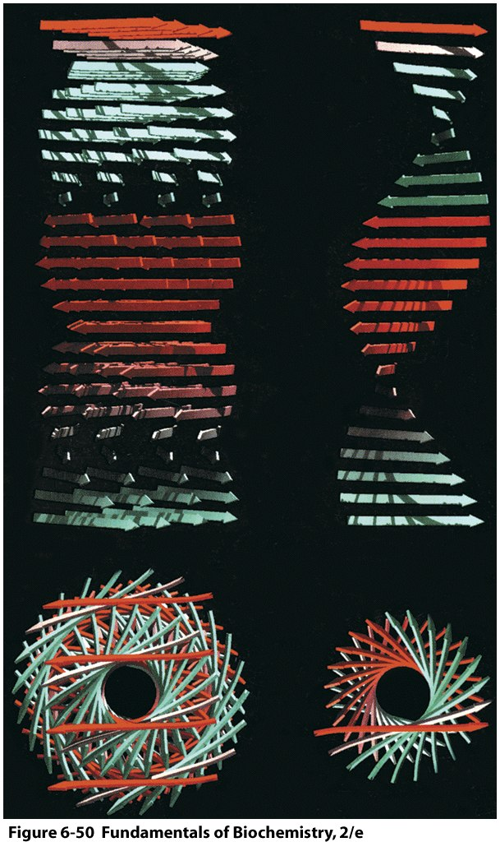
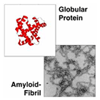
Amyloidoses
mutant forms of normally occurring proteins
amyloid fibrils are beta sheet structures
extension of partial beta domains
Under the appropriate conditions
almost any protein can be induced to aggregate
It seems likely that protein folding pathways have
evolved not only to allow polypeptides to assume
stable native structures but also to avoid forming
interchain H bonds that would lead to fibril
formation
A model, based on X-ray fiber diffraction measurements, of an amyloid fibril

Slide 14
Alzheimer's disease and amyloid: culprit or coincidence?
Alzheimer's disease (AD) is the largest unmet medical need in neurology today. This most common form of irreversible dementia is placing a considerable and increasing burden on patients, caregivers, and society, as more people live long enough to become affected. Current drugs improve symptoms but do not have profound neuroprotective and/or disease-modifying effects. AD is characterized by loss of neurons, dystrophic neurites, senile/amyloid/neuritic plaques, neurofibrillary tangles, and synaptic loss. Beta-amyloid (Aβ) peptide deposition is the major pathological feature of AD. Increasing evidence suggests that overexpression of the amyloid precursor protein and subsequent generation of the 39-43 amino acid residue, Aβ, are central to neuronal degeneration observed in AD patients possessing familial AD mutations, while transgenic mice overexpressing amyloid precursor protein develop AD-like pathology. Despite the genetic and cell biological evidence that supports the amyloid hypothesis, it is becoming increasing clear that AD etiology is complex and that Aβ alone is unable to account for all aspects of AD. The fact that vast overproduction of Aβ peptides in the brain of transgenic mouse models fails to cause overt neurodegeneration raises the question as to whether accumulation of Aβ peptides is indeed the culprit for neurodegeneration in AD. There is increasing evidence to suggest that Aβ/amyloid-independent factors, including the actions of AD-related genes (microtubule-associated protein tau, polymorphisms of apolipoprotein E4), inflammation, and oxidative stress, also contribute to AD pathogenesis. This chapter reviews the current state of knowledge on these factors and their possible interactions, as well as their potential for neuroprotection targets.

