Slide 1
Capstone design
Capstone Design is a culminating course offered to undergraduate students in several disciplines.
Students work in teams to design, build, and test prototypes with real world applications.
http://capstone.gatech.edu/

Slide 2
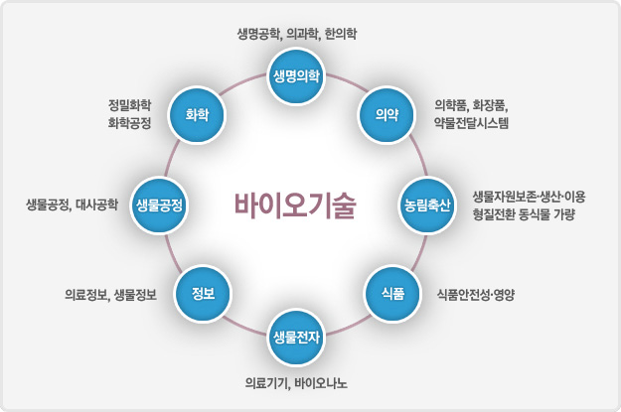
What is biotechnology?
전통 생물학에 공학적인 개념과 기술을 적용하여 동식물을 포함한 모든 생명체의 생명현상을 밝히고, 그 정보와 기능 및 물질을 인류에게 유용하게 활용하기 위한 연구 및 산업분야이다. http://isaaa-korea.or.kr/gmo/gmolistC1.do
Heal the World/Fuel the World/Feed the World https://www.bio.org/what-biotechnology
Source: Healing, Fueling, Feeding: How Biotechnology is Enriching Your Life

Slide 3
Heal the World
Biotech is helping to heal the world by harnessing nature's own toolbox and using our own genetic makeup to heal and guide lines of research by:
Reducing rates of infectious disease;
Saving millions of children's lives;
Changing the odds of serious, life-threatening conditions affecting millions around the world;
Tailoring treatments to individuals to minimize health risks and side effects;
Creating more precise tools for disease detection; and
Combating serious illnesses and everyday threats confronting the developing world.

Slide 4
Fuel the World
Biotech uses biological processes such as fermentation and harnesses biocatalysts such as enzymes, yeast, and other microbes to become microscopic manufacturing plants. Biotech is helping to fuel the world by:
Streamlining the steps in chemical manufacturing processes by 80% or more;
Lowering the temperature for cleaning clothes and potentially saving $4.1 billion annually;
Improving manufacturing process efficiency to save 50% or more on operating costs;
Reducing use of and reliance on petrochemicals;
Using biofuels to cut greenhouse gas emissions by 52% or more;
Decreasing water usage and waste generation; and
Tapping into the full potential of traditional biomass waste products.

Slide 5
Feed the World
Biotech improves crop insect resistance, enhances crop herbicide tolerance and facilitates the use of more environmentally sustainable farming practices. Biotech is helping to feed the world by:
Generating higher crop yields with fewer inputs;
Lowering volumes of agricultural chemicals required by crops-limiting the run-off of these products into the environment;
Using biotech crops that need fewer applications of pesticides and that allow farmers to reduce tilling farmland;
Developing crops with enhanced nutrition profiles that solve vitamin and nutrient deficiencies;
Producing foods free of allergens and toxins such as mycotoxin; and
Improving food and crop oil content to help improve cardiovascular health.

Slide 6
What to do?
https://prezi.com/5dw-sqivqu9_/presentation/
축적의 시간 1,2편 감상

