Slide 1
Depression & SSRI
제약공학과
20092935 박시원

Slide 2
INDEX
1. Depression
2. Serotonin
3. Antidepressants
4. Mechanism of action of SSRI

Slide 3
1. Depression
Depression is a state of low mood and aversion to activity or apathy that can affect a person's thoughts, behavior, feelings and sense of well-being.
Depression might be caused by decreased 5-HT and NE neurotransmission.

Slide 4
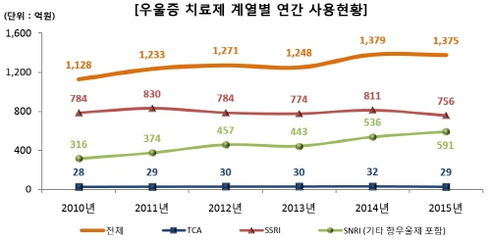

Slide 5
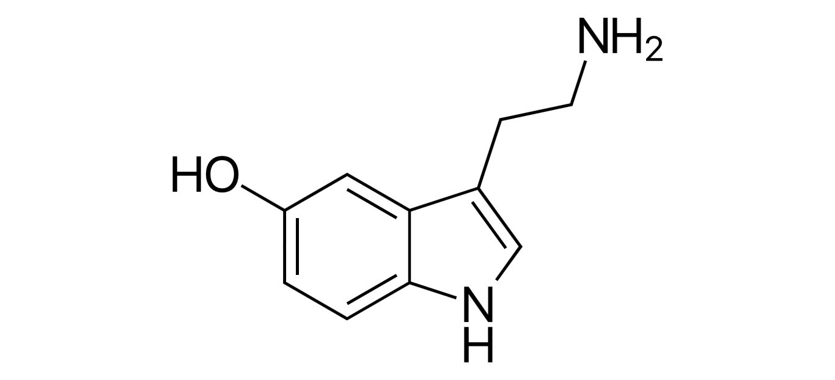
2. Serotonin
Serotonin or 5-hydroxytryptamine (5-HT) is a monoamine neurotransmitter.
Biochemically derived from tryptophan.
It is popularly thought to be a contributor to feelings of well-being and happiness.

Slide 7
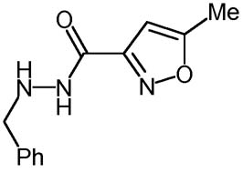
3. Antidepressants
Monoamine oxidase inhibitors (MAOIs) are chemicals that inhibit the activity of the monoamine oxidase enzyme family.
Isocarboxazid (Marplan)

Slide 8
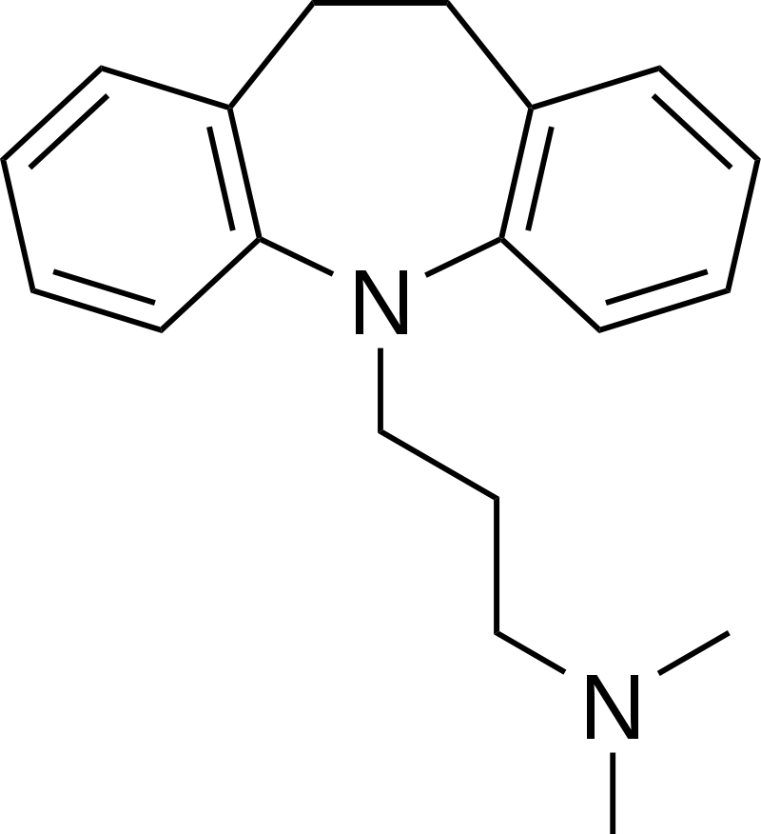
Tricyclic antidepressants (TCAs)
Tricyclic antidepressants (TCAs) were first
discovered in the early 1950s and
marketed later in the decade.
Side effects are relatively
common and may include
dry mouth, dry nose, blurry vision, lowered gastrointestinal motility or constipation,
urinary retention, cognitive and/or memory
impairment, and increased body temperature.

Slide 9
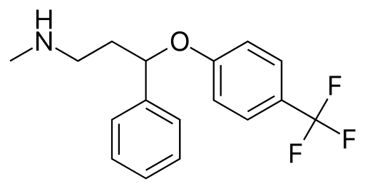
SSRI
Selective serotonin reuptake inhibitor
SSRIs are the most widely prescribed antidepressants in many countries
Skeletal formula of fluoxetine (original trade name Prozac)

Slide 10
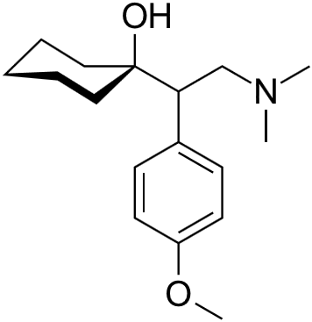
SNRI
Serotonin–norepinephrine reuptake inhibitors (SNRIs)
venlafaxine

Slide 11
4.Mechanism of SSRI

Slide 12
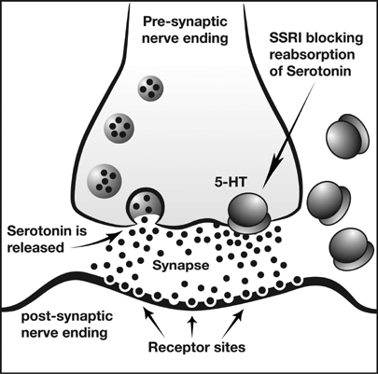

Slide 13
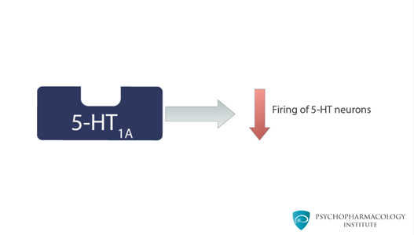
5HT1A receptor downregulation
When this receptor is stimulated it inhibits firing of serotonergic neurons, this means that it works as an autoreceptor that inhibits serotonergic activity.

Slide 14
An autoreceptor is a type of receptor located in the membranes of presynaptic nerve cells. It is only sensitive to the neurotransmitters or hormones released by the neuron on which the autoreceptor sits.
A heteroreceptor is sensitive to neurotransmitters and hormones that are not released by the cell on which it sits

Slide 15
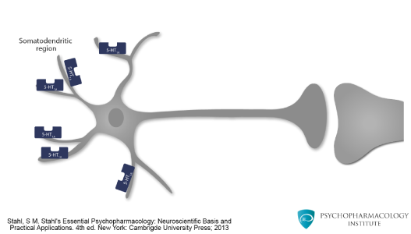

Slide 16
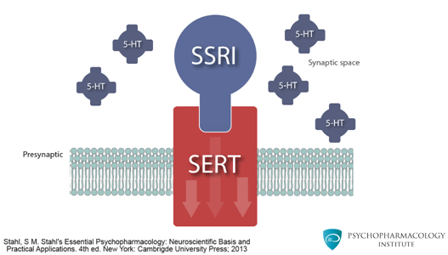
Serotonin transporter (SERT)
The serotonin transporter (SERT) is a monoamine transporter protein.
This is a membrane protein that transports serotonin from synaptic spaces into presynaptic neurons.

Slide 17
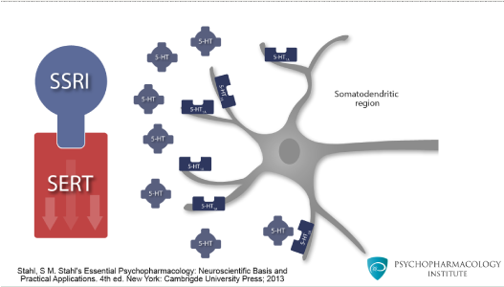
Increased availability of serotonin in the synaptic space.

Slide 18
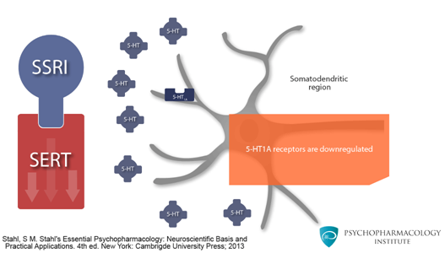
5HT1A receptors are downregulated
Downregulation is mediated by genomic mechanisms.

Slide 19
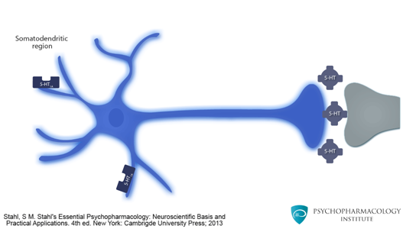
The neuron is disinhibited to release more serotonin in the synaptic space.

Slide 20
Differences between TCAs and SNRIs
Tricyclic antidepressants (TCAs)
Serotonin norepinephrine reuptake inhibitor activity
An anticholinergic-antimuscarinic activity,
an alfa1-adrenergic antagonist activity,
an antihistamine (H1) activity
→Side effects

Slide 22
감사합니다

