Slide 1
20132670
Hyun-Chul Ryu

Slide 2
Contents
Dangers of marijuana abuse
Components of marijuana
Cannabinoids receptor
Cannabinoids signaling pathway
Marijuana addiction & dopamine
Marijuana & anti-cancer therapy

Slide 3
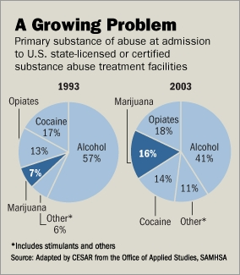
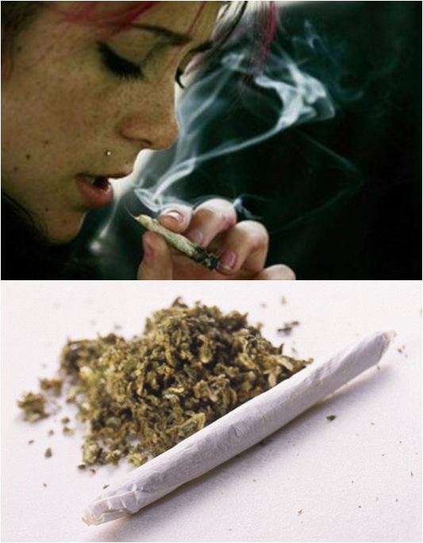
Dangers of marijuana abuse

Slide 4
Dangers of marijuana abuse
Short-term
- Sensory distortion
- Panic
- Anxiety
- Poor coordination of movement
- Lowered reaction time
- Increased heartbeat

Slide 5
Dangers of marijuana abuse
Long-term
- Suppression of the immune system
- Increase of abnormally structured cells in the body
- Reduced ability to learn and retain information
- Personality and mood changes
- Lack of motivation
Before
After

Slide 6
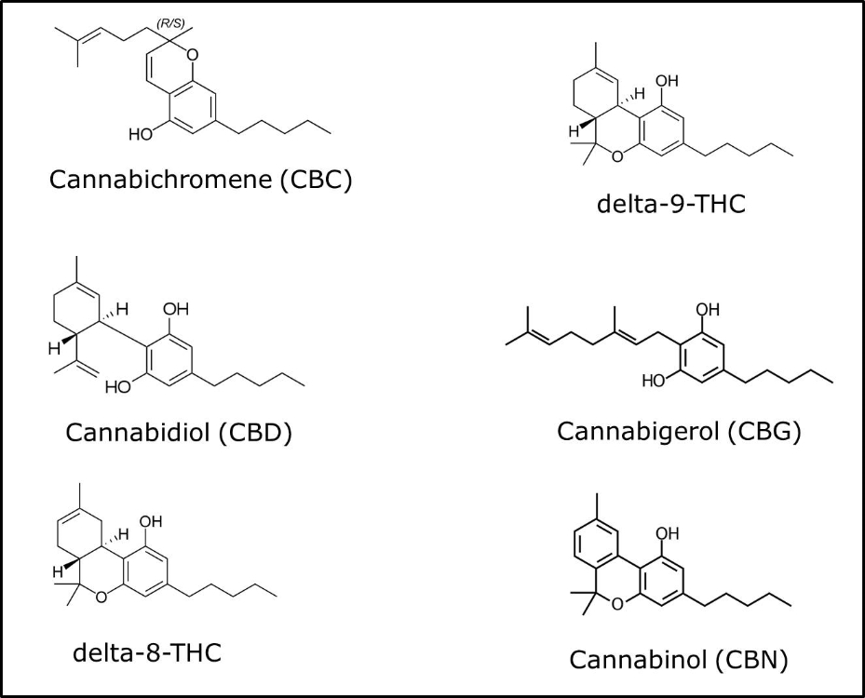
Components of marijuana
Active ingredient

Slide 7
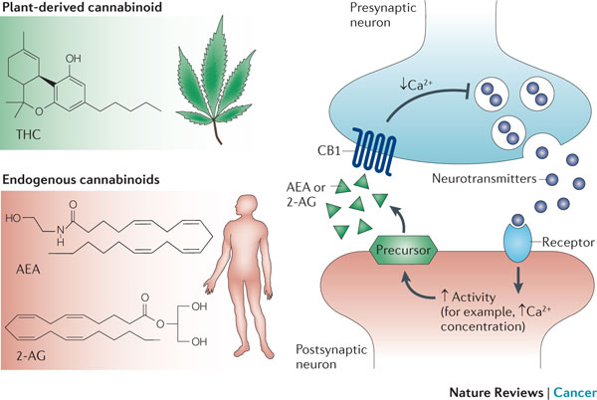
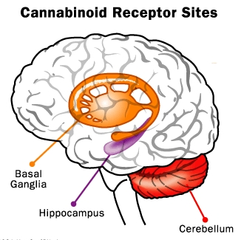
Cannabinoids receptor
※ AEA (anandamide), 2-AG (2-arachidonoylglycerol)

Slide 8
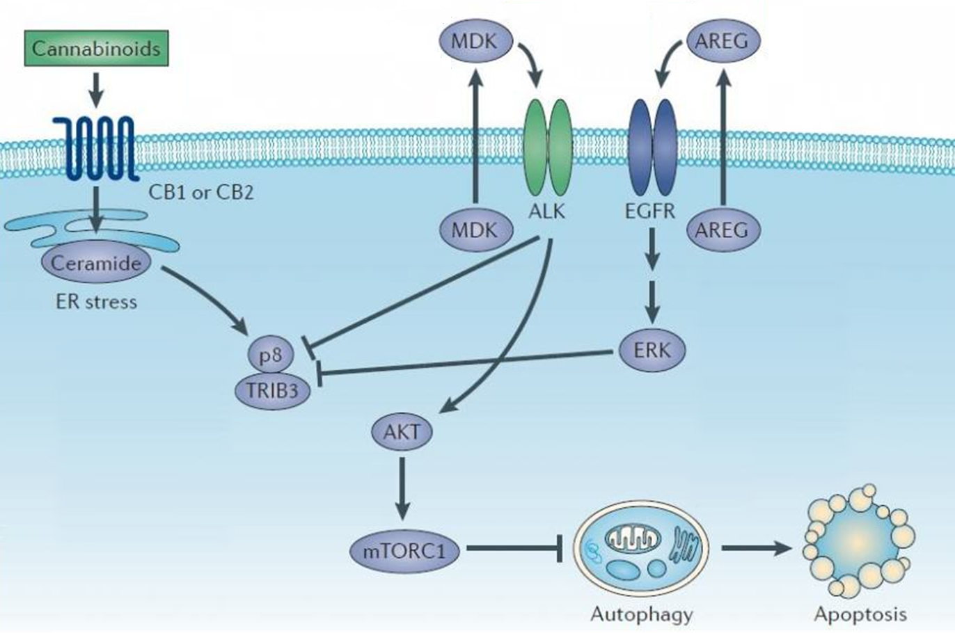
Cannabinoids signaling pathway
cell-cycle arrest
or

Slide 9
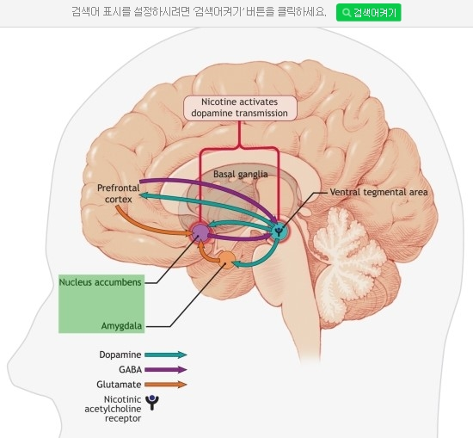
Marijuana addiction & dopamine
※ Nucleus accumbens (측좌핵), Amygdala (편도체)

Slide 10
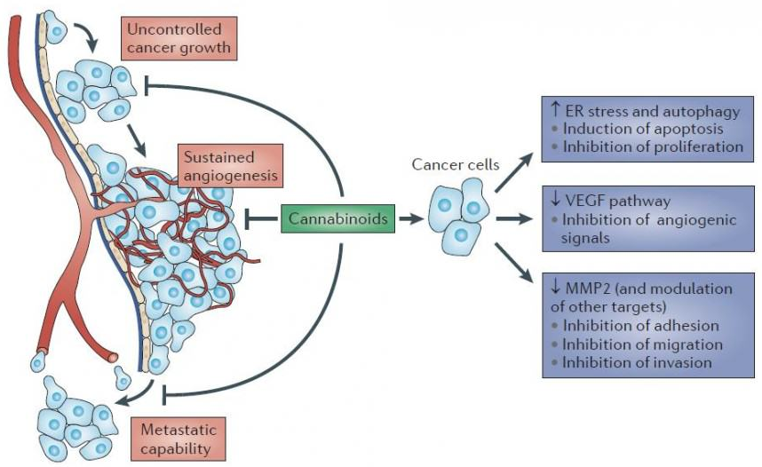
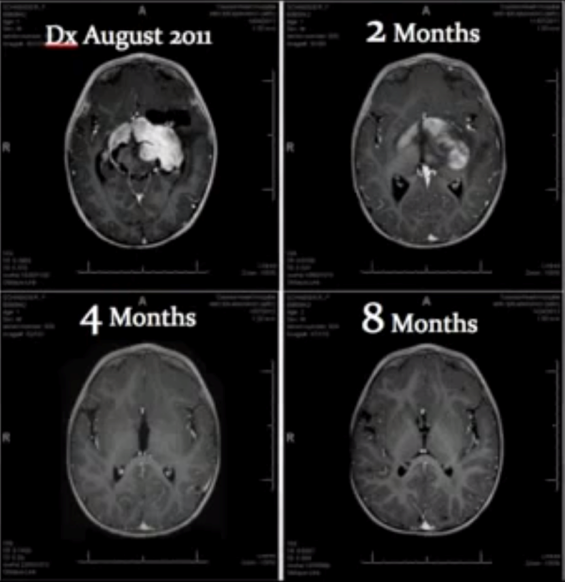
Marijuana & anti-cancer therapy

Slide 11
Thanks you for your attention
Q & A

