Slide 1
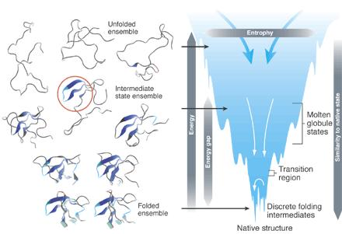
Aging and proteostasis
Young Shik Park
School of Biological Sciences, Inje University

Slide 2
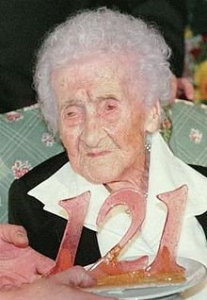
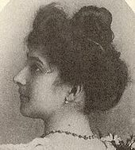
Jeanne Calment
https://en.wikipedia.org/wiki/Jeanne_Calment

Slide 3
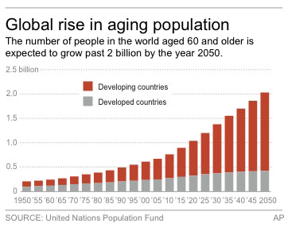
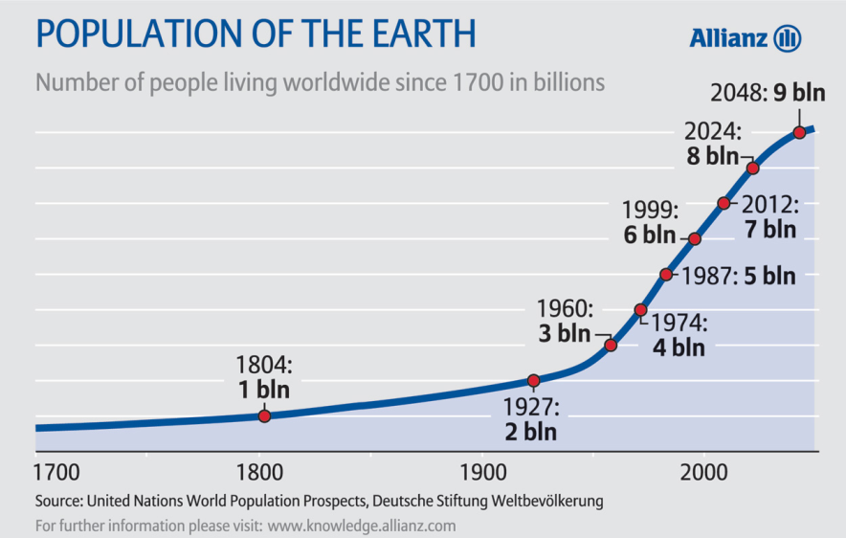
Aging population

Slide 4
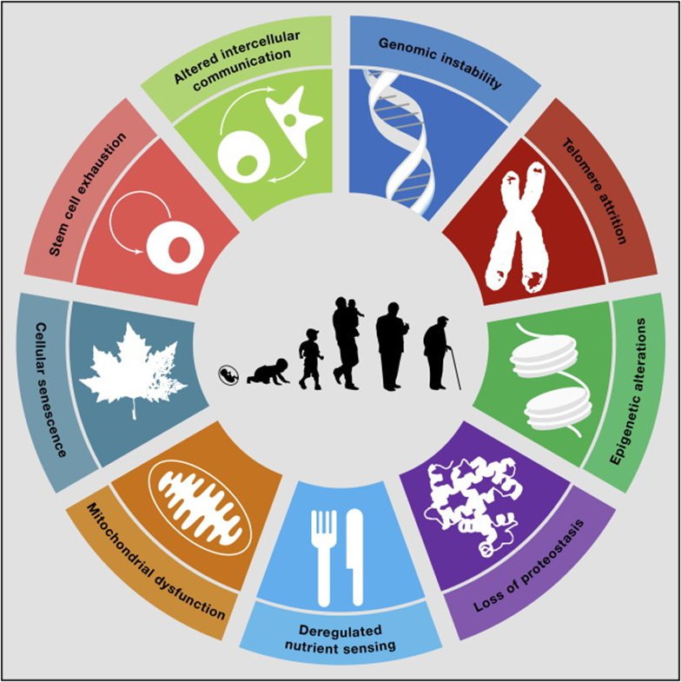
The Hallmarks of Aging
What is aging?
Aging is characterized by a progressive loss of physiological integrity, leading to impaired function and increased vulnerability to death.
Aging is a complex biological process that has prompted many new theories in regard to its process and origin. (programmed & non-programmed)
Many studies of aging have focused on molecular changes across the lifetime of an organism with the reasonable assumption that a series of progressive events collectively contribute to the aging process.
Cell 153, 1194-1217 (2013)

Slide 5
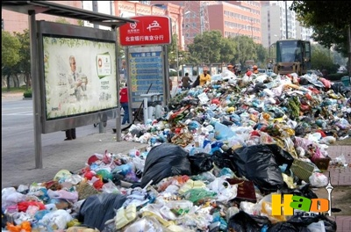

Proteostasis: protein homeostasis (through recycling)
A term coined in a landmark Science paper in 2008, is a broad concept that is relevant to all fields of study that involve protein synthesis, folding, processing, and turnover (Science 319:916–919, 2008).
The decline of proteostasis with aging
When protein homeostasis degenerates and collapses, cells get old . . . and sick.
Hallmark features of cellular aging include a buildup of proteotoxic stress, mistranslation of nascent polypeptides, and concentration of damaged, misfolded proteins and protein aggregates.
This accumulation of cellular waste is toxic to cells. That’s when things start to fall apart. http://irp.nih.gov/catalyst/v21i6/the-sig-beat

Slide 6
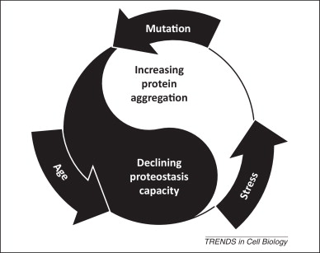
Self-propagating cycle of proteostasis decline in disease and aging
Chronic expression of aberrantly folded protein species caused by disease, aging, or external stress reduces proteostasis capacity by sequestering or otherwise inhibiting proteostasis network (PN) components. This results in misfolding and aggregation of endogenous proteins. These additional misfolded species in turn engage the PN (PN titration model), thereby further reducing the available proteostasis capacity and driving a positive feedback loop that eventually leads to proteostasis collapse. Trends in Cell Biology September 2014, Vol. 24, No. 9

Slide 7
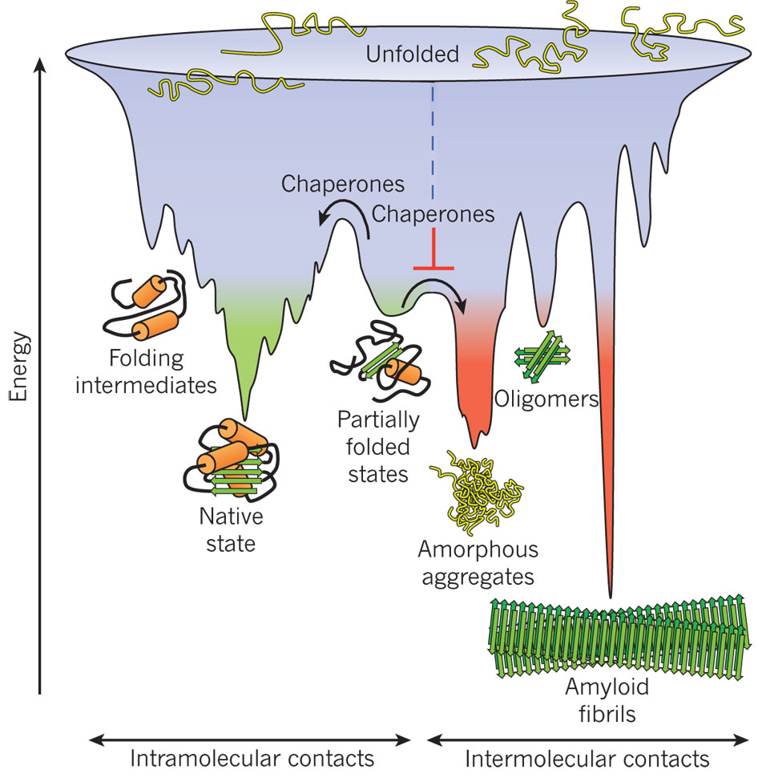
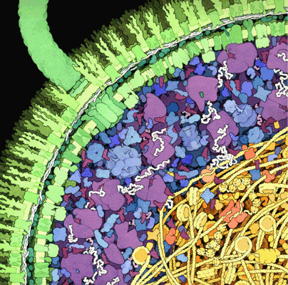
Competing reactions of protein folding and aggregation
http://www.nature.com/nature/journal/v475/n7356/full/nature10317.html

Slide 8
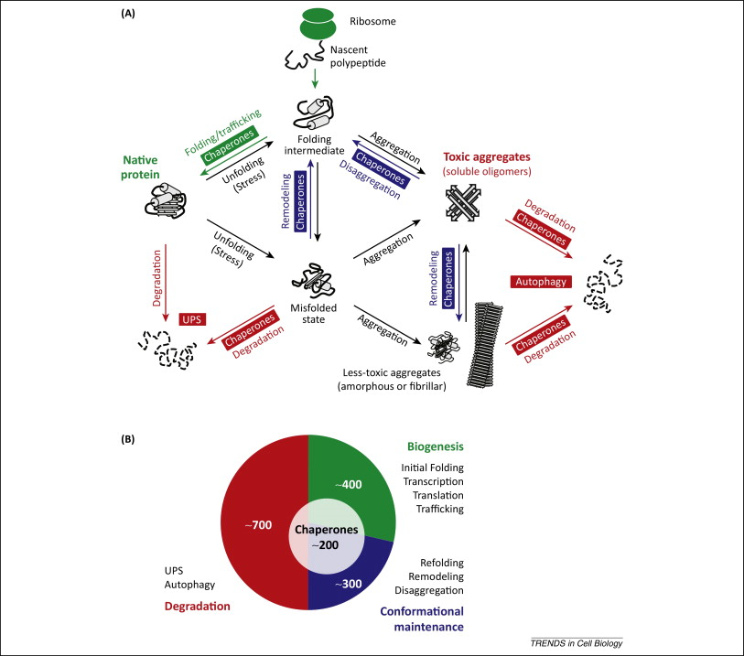
Proteostasis
network
Chaperones
UPS
Autophagy

Slide 9
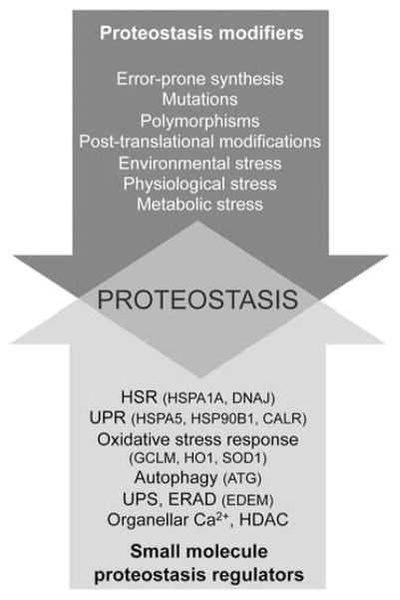
How does impaired proteostasis in one cell or tissue affect the organism?
Recent studies show that unlike thought before, stress responses and proteostasis are controlled at the organismal level by inter-tissue communication.
Can impaired proteostasis be a therapeutic target?
Pathways and modifiers influencing proteostasis. Genetic, epigenetic, physiological and environmental stressors affect proteostasis and cause the accumulation of misfunctional proteins. Small molecule modulators of the activities of the proteostasis network pathways (small molecule proteostasis regulators) facilitate chaperone-mediate refolding and/or induce the degradation of misfolded and damaged proteins therefore rebalancing cellular proteostasis. In parenthesis are indicated some of the genes responsible for proteostasis maintenance. Curr Top Med Chem. 2012; 12(22): 2623–2640.

Slide 10
Schematic of the different levels of integration of the proteostasis networks
Intracellular
cytosolic
organelle
Intercellular
organ & tissue
Organism
J Gerontol A Biol Sci Med Sci 2014 June;69(S1):S33–S38

Slide 11
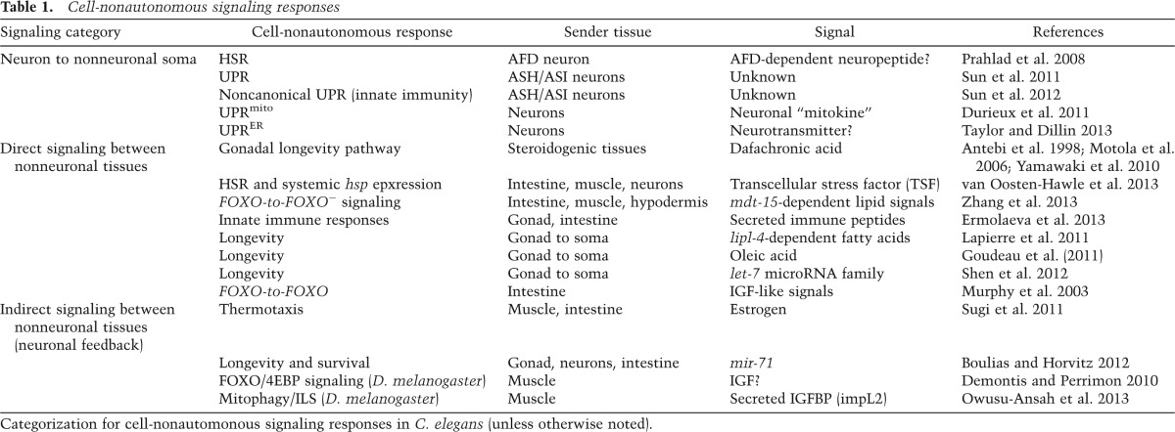
Organismal proteostasis: role of cell-nonautonomous regulation and transcellular chaperone signaling
The HSR and other cell stress responses such as the unfolded protein response (UPR) can function autonomously in single-cell eukaryotes and tissue culture cells; however, within the context of a multicellular animal, the PN is regulated by cell-nonautonomous signaling through specific sensory neurons and by the process of transcellular chaperone signaling.
These newly identified forms of stress signaling control the PN between neurons and nonneuronal somatic tissues to achieve balanced tissue expression of chaperones in response to environmental stress and to ensure that metastable aggregation-prone proteins expressed within any single tissue do not generate local proteotoxic risk. Transcellular chaperone signaling leads to the compensatory expression of chaperones in other somatic tissues of the animal, perhaps preventing the spread of proteotoxic damage. Genes Dev. 2014 Jul 15; 28(14): 1533–1543.

Slide 12
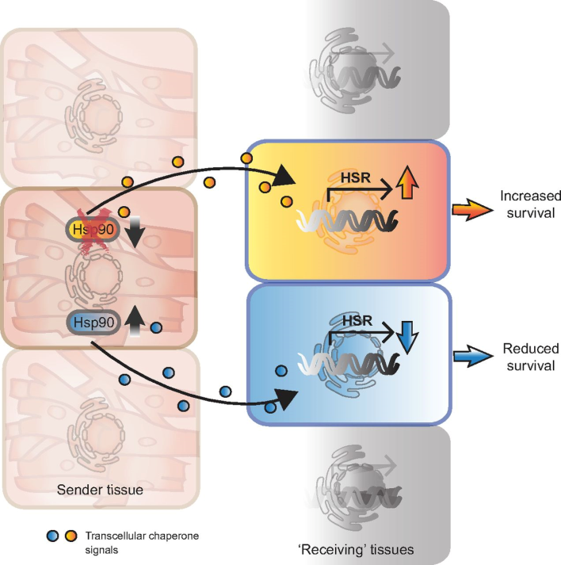
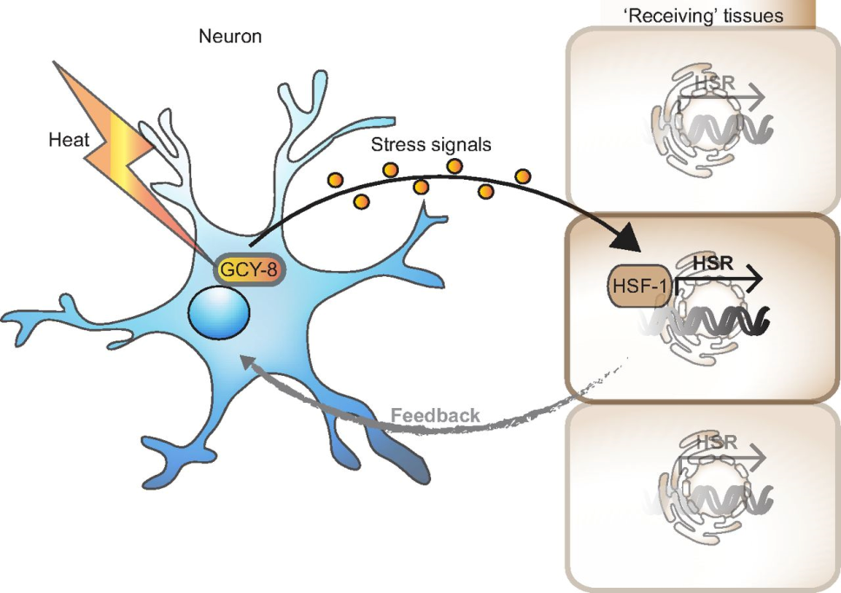
Cell non-autonomous control of the heat shock response (HSR) by neurons. Organismal control of heat shock transcription factor 1 (HSF-1) transcriptional activity in peripheral tissues by the thermosensory AFD neuron via a guanylyl cyclase GCY-8-dependent signaling cascade. A steroid signalling-dependent feedback loop from peripheral cells reports HSR activity back to the AFD neurons.
Transcellular chaperone signaling regulates the organismal HSR via tissue-to-tissue crosstalk. An imbalance of proteostasis in a single tissue, through reduced (orange) or elevated (blue) expression of Hsp90, is detected and responded to in a different tissue via transcellular chaperone signaling. Because of the key role of Hsp90 as a negative regulator of the HSF-1-dependent HSR, the HSR is either induced (orange) or repressed (blue) at a cell non-autonomous level, leading to different outcomes for organismal survival during stress conditions.
Journal of Experimental Biology 2014 217: 129-136

Slide 13
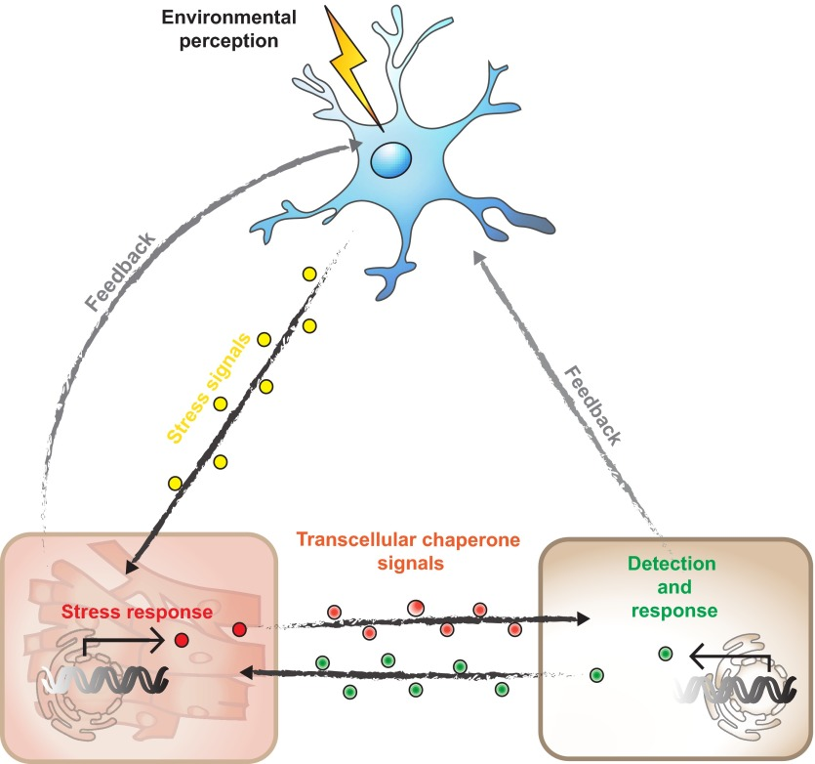
Cell non-autonomous control of proteostasis via the nervous system and transcellular chaperone signaling.
Sensory neurons perceive environmental stimuli and integrate the environmental challenge to fine-tune proteostasis in peripheral tissues. Non-neuronal tissues report altered proteostasis conditions back to the nervous system. At the same time, tissue-to-tissue signals via transcellular chaperone signaling can override the neuronal component to control cell-specific proteostasis. This allows proteostasis crosstalk between somatic cells independent of neural control.

Slide 14
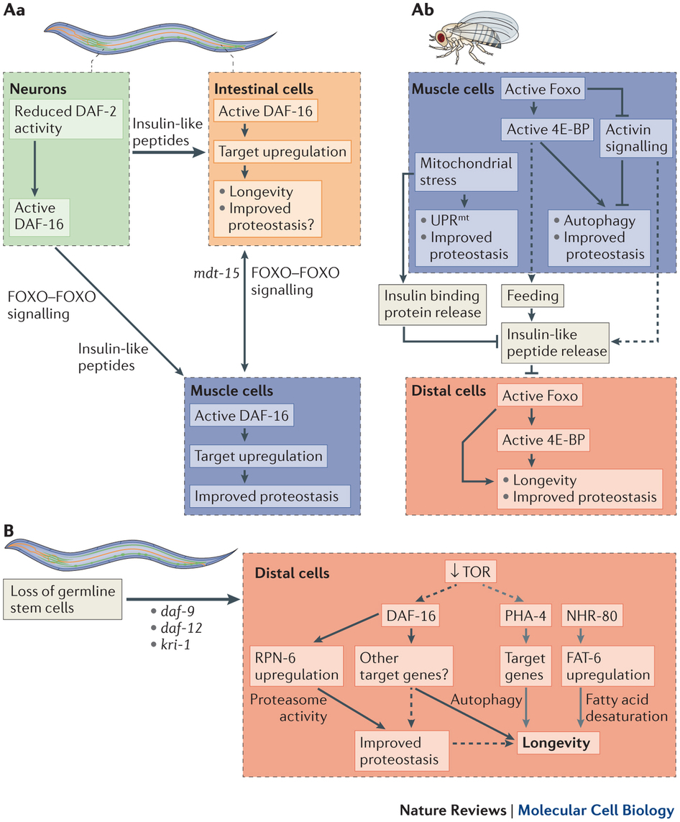
Cell non-autonomous regulation of proteostasis by insulin-like signalling and gonadal signalling

Slide 15
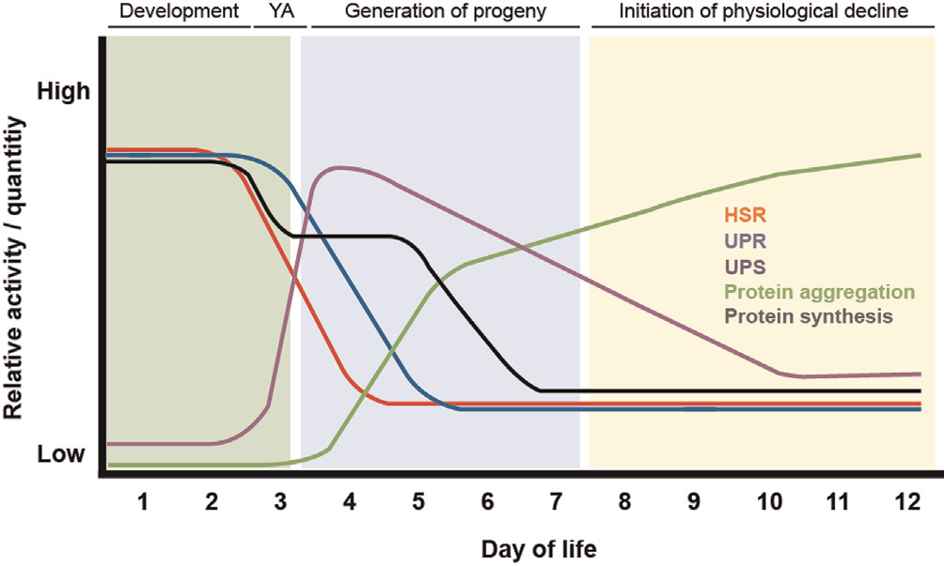
Temporal relationship between Caenorhabditis elegans
reproduction, aging, and changes in proteostasis
heat shock response
unfolded protein response
ubiquitin-proteasome system
F1000Prime Reports 2014, 6:7 (doi:10.12703/P6-7)
What is the molecular mechanism(s) responsible for PN remodeling and the upstream signals that promote these changes?

Slide 16
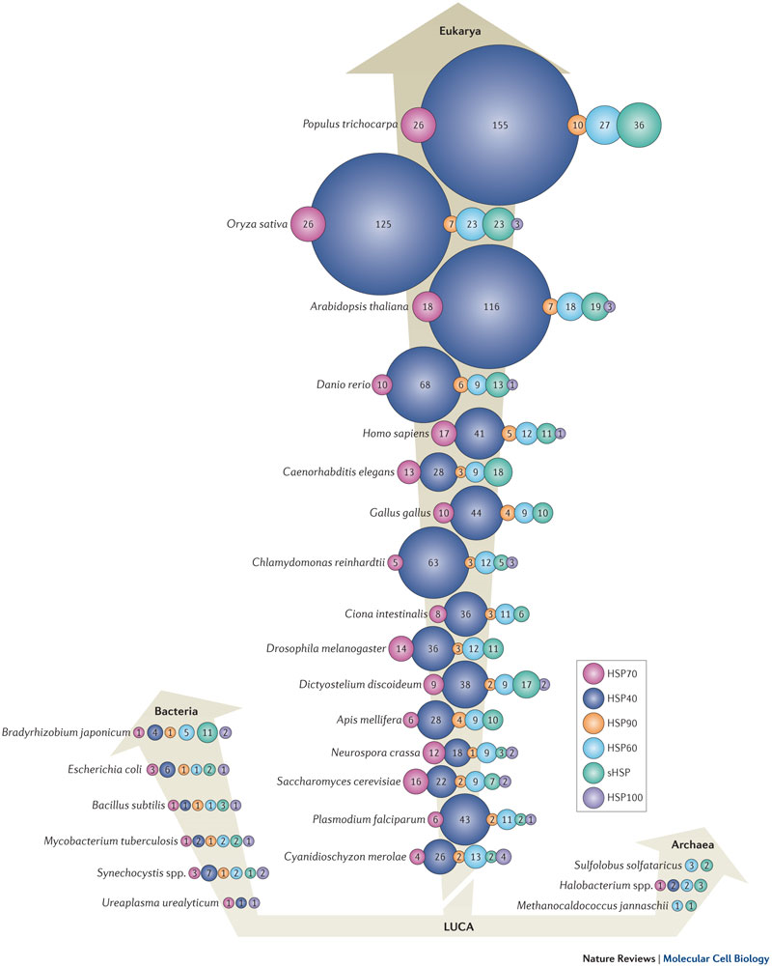
Diversity in proteostasis network components
Shown is the evolution of heat shock proteins (HSPs) among the extant three domains of life — Bacteria, Archaea and Eukarya. Vertical arrows correspond to increasing genome size and number of expressed genes. The numbers of HSP70, HSP40 and HSP90 chaperones, of HSP60 chaperonin family subunits, small HSPs (sHSPs) and of HSP100 proteins found in each species are indicated. LUCA, last universal common ancestor.

Slide 17
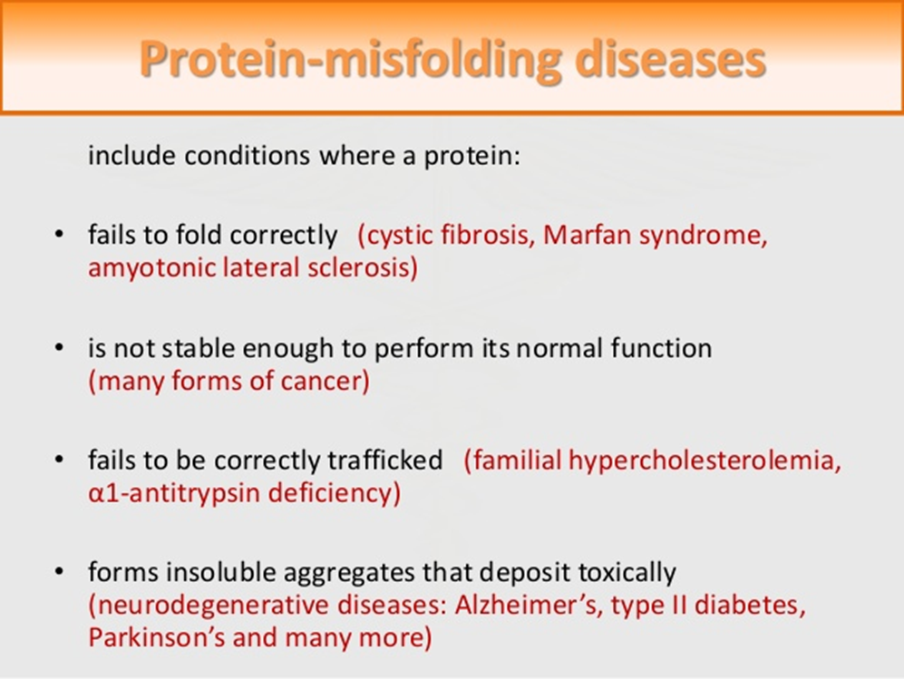
Pharmacological chaperones: a class of molecules that bind and inhibit the unstable or misfolded proteins.

Slide 18
Phenylketonuria (PKU): classified as protein-misfolding disease (PMD)
- An autosomal recessive disorder due to mutations in PAH gene
- >850 genotypes (BioPKU, http://www.biopku.org)
- >2/3 of PAH mutations: missense mutations
- Mainly causing folding defects leading to accelerated proteolytic degradation

Slide 19
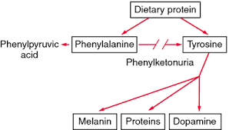
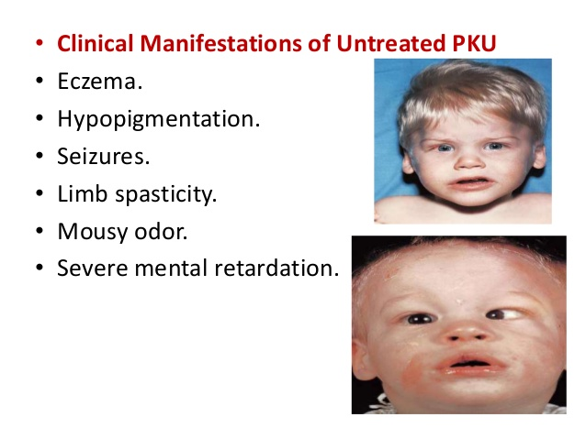
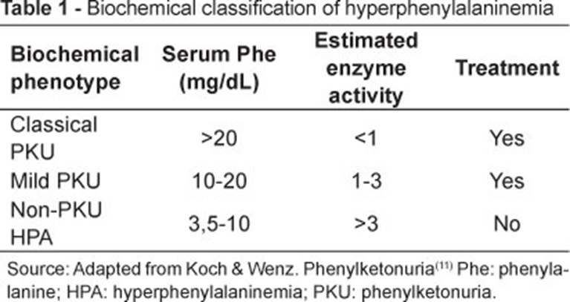
PKU phenotype

Slide 20
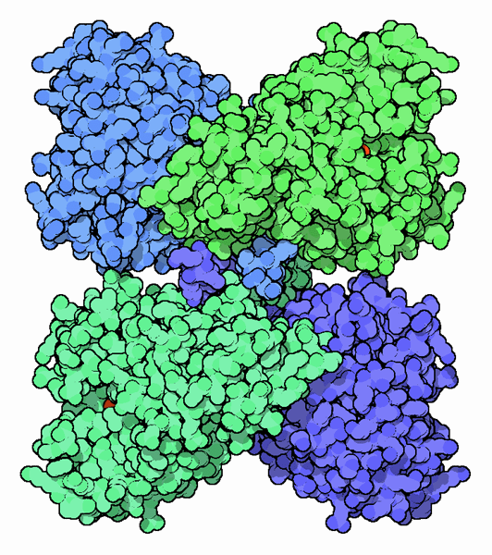
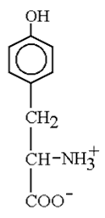
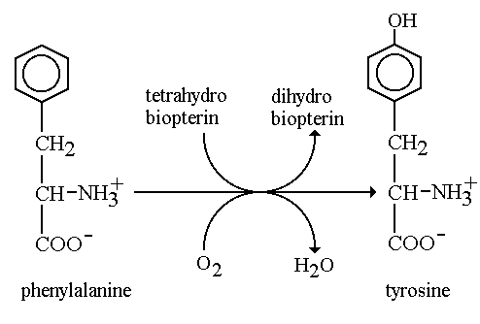
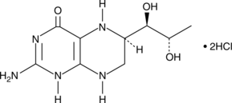
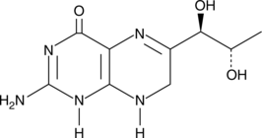
PKU treatment
Diet
Phenylalanine ammonia lyase
Neutral amino acid supplement
Tetrahydrobiopterin (BH4): pharmacological chaperone effect
Phenylalanine
hydroxylase (PAH)
O₂
H₂O
_{Catecholamines}
_{Dopamine}
_{Norepinephrine}
_{Epinephrine}
Phenylalanine
Tyrosine
H₄-biopterin (BH₄)
H₂-biopterin (BH₂)

Slide 21
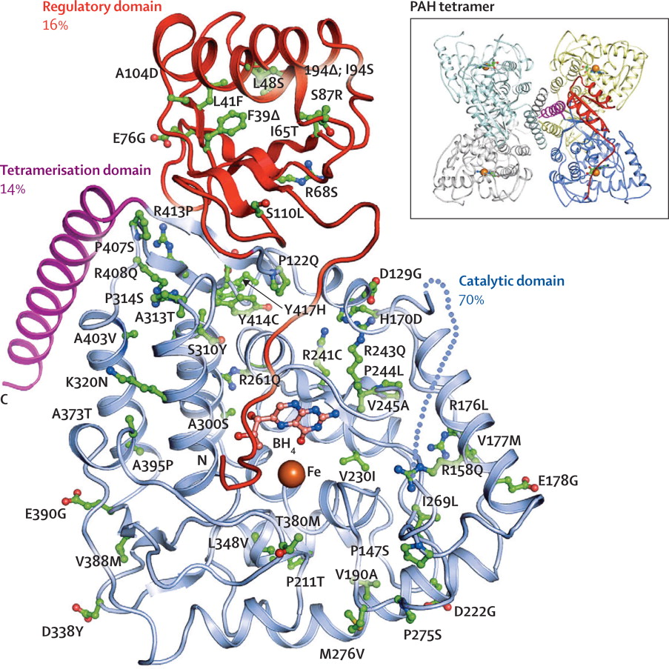
Human PAH mutation study
  Genotype-phenotype correlation
  In vitro expression and analysis
  Computational analysis

Slide 22
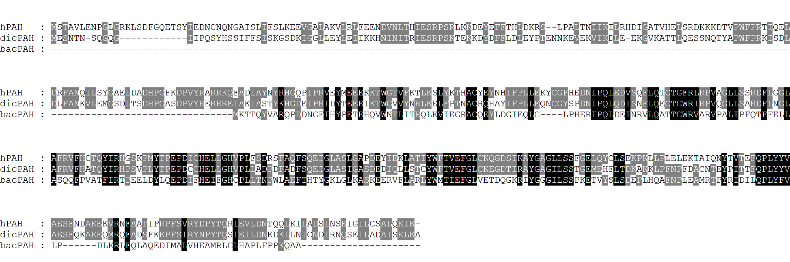
Dictyostelium PAH (dicPAH)
Regulatory domain
Catalytic domain
Tetramerization domain
vs. Dictyostelium | Regulatory domain | Catalytic domain | Tetramerization domain | Total identity
Human | 38% | 71% | 46% | 62.6%

Slide 23
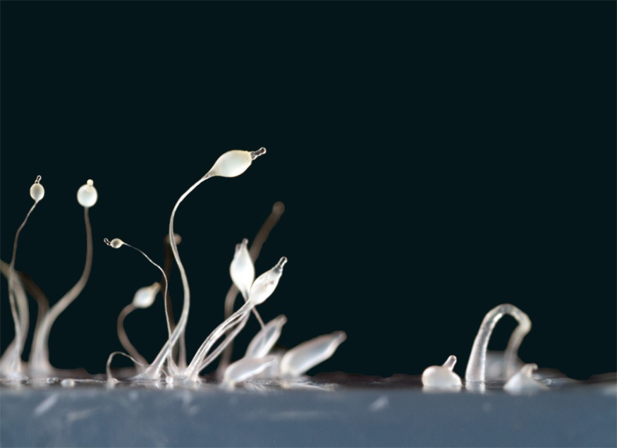
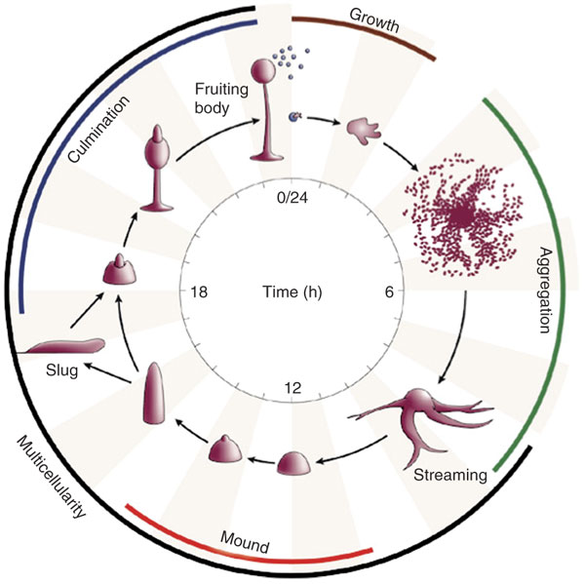
Dictyostelium discoideum Ax2
Short generation time
Easy genetic manipulation
PAH homologous to human protein
Analogy to human BH4 synthesis

Slide 24
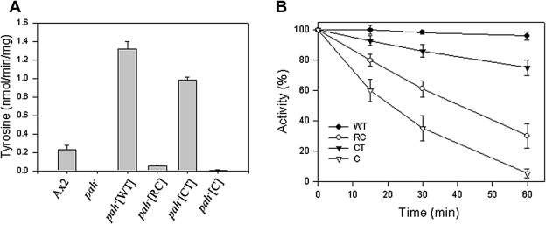
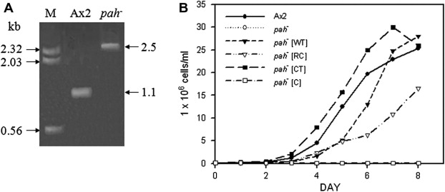
PAH study in Dictyostelium
  Creation of PAH knockout mutant
  The pah⁻ strain does not proliferate in FM medium
  Rescued by overexpression of dicPAH

Slide 25
Human PAH study in Dictyostelium
Complementary expression of human PAH in pah⁻ strain
  8 PKU mutations: F39L, K42I, L48S, I65T, R252Q, L255V, S349L, and R408W
Qualitative analysis (PAH activity)
Quantitative analysis (PAH protein using Ab)
To determine hPAH activity-dependent growth in FM medium
Simple quantitative evaluation of hPAH mutations
Cell-based assay system for pharmacological chaperone screening

Slide 26
Comparative analysis of growth rate and PAH activity of pah⁻ strains transformed with wild type and mutant hPAH cDNAs
A B

Slide 27
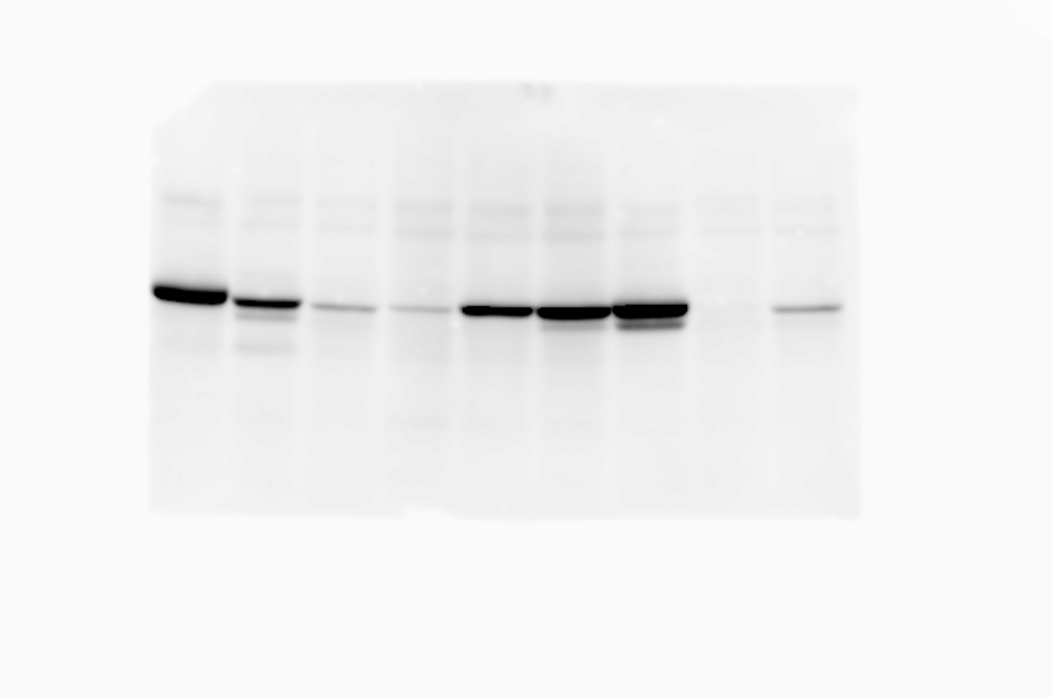
Residual protein levels of hPAHs expressed in pah⁻ cells.
WT F39L K42I L48S I65T R252Q L255V S349L R408W
A
FM medium
HL5 medium
B
C

Slide 28
Relationship between PAH activity and protein level of hPAHs expressed in pah⁻ strain.

Slide 29
Relative specific activity of mutant hPAHs
Protein | PAH activity | Protein amount | Specific activity
F39L | 0.615±0.100 | 0.579±0.044 | 1.062
K42I | 0.153±0.108 | 0.095±0.019 | 1.611
L48S | 0.165±0.065 | 0.073±0.012 | 2.260
I65T | 0.821±0.191 | 0.546±0.043 | 1.504
R252Q | 0.143±0.046 | 0.933±0.033 | 0.153
L255V | 1.187±0.090 | 0.984±0.080 | 1.206
S349L | 0.023±0.007 | 0.038±0.010 | 0.605
R408W | 0.073±0.029 | 0.139±0.026 | 0.525

Slide 30
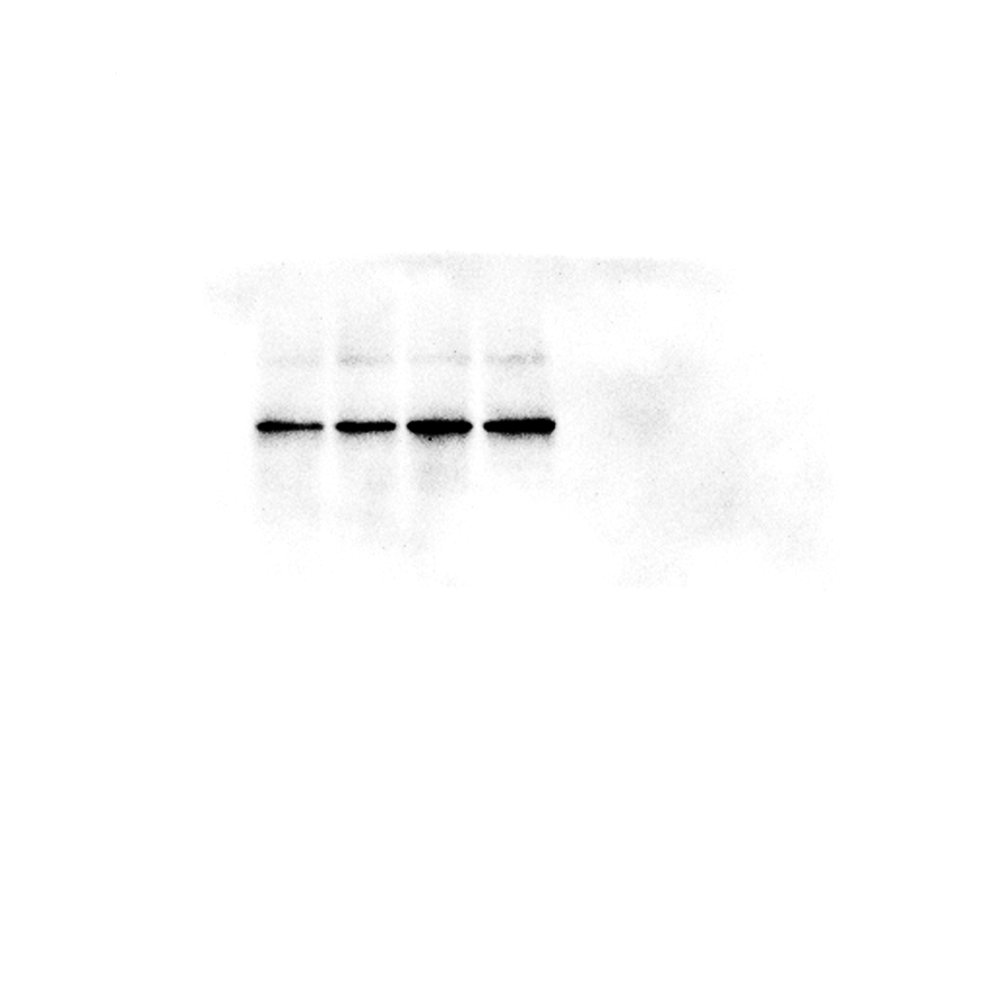
Chaperone effect of yeast extract on S349L hPAH
(1X = 5 g per liter)

