Slide 1
Screening methods for identifying pharmacological chaperones
생명과학부
20132705
장범순

Slide 2
Table of contents
What is pharmacological chaperones?
What kind of screen is pharmacological chaperones?
- In vitro functional screens
- Cell-based screens
- In silico screening
- Affinity-based screening
Conclusions

Slide 3
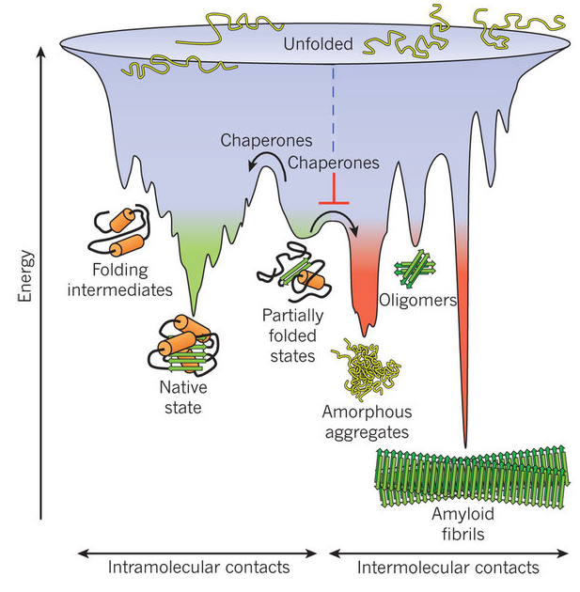
What is pharmacological chaperones?
Molecular chaperones are proteins that assist the covalent folding or unfolding and the assembly or disassembly of other macromolecular structures.

Slide 4
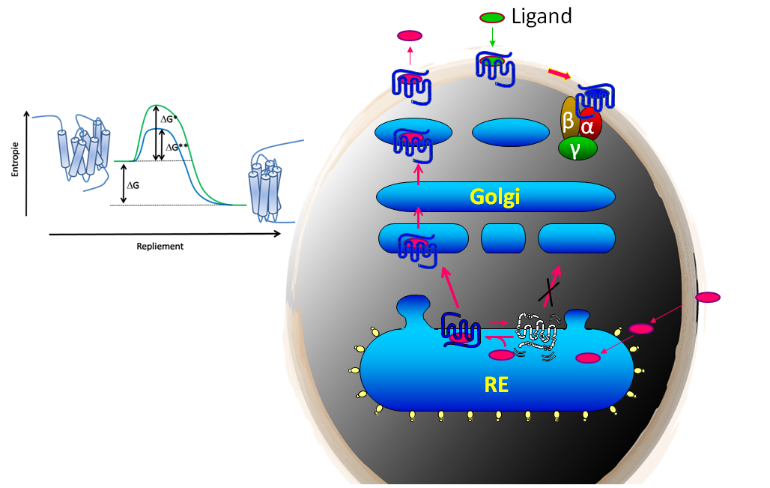
What is pharmacological chaperones?
Pharmacological chaperones is One approach to treat these devastating diseases would be to use pharmacological chaperones, which are small-molecules that bind to and stabilize misfolded proteins, thereby correcting their pathogenic misfolding and rescuing their functions.

Slide 5
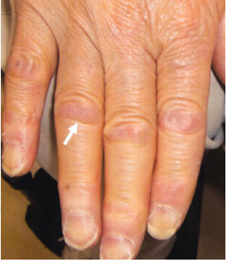
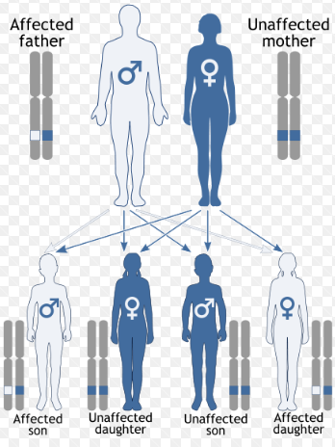
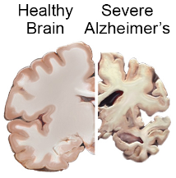
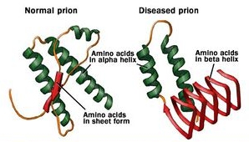
What is pharmacological chaperones?
Related to the following diseases
- Alzheimer’s disease (AD)
- amyloidosis, familial
- amyloid polyneuropathy (FAP)
- prion

Slide 6
What kind of screen is pharmacological chaperones?
In vitro functional screens
Cell-based screens
In silico screening
Affinity-based screening

Slide 7
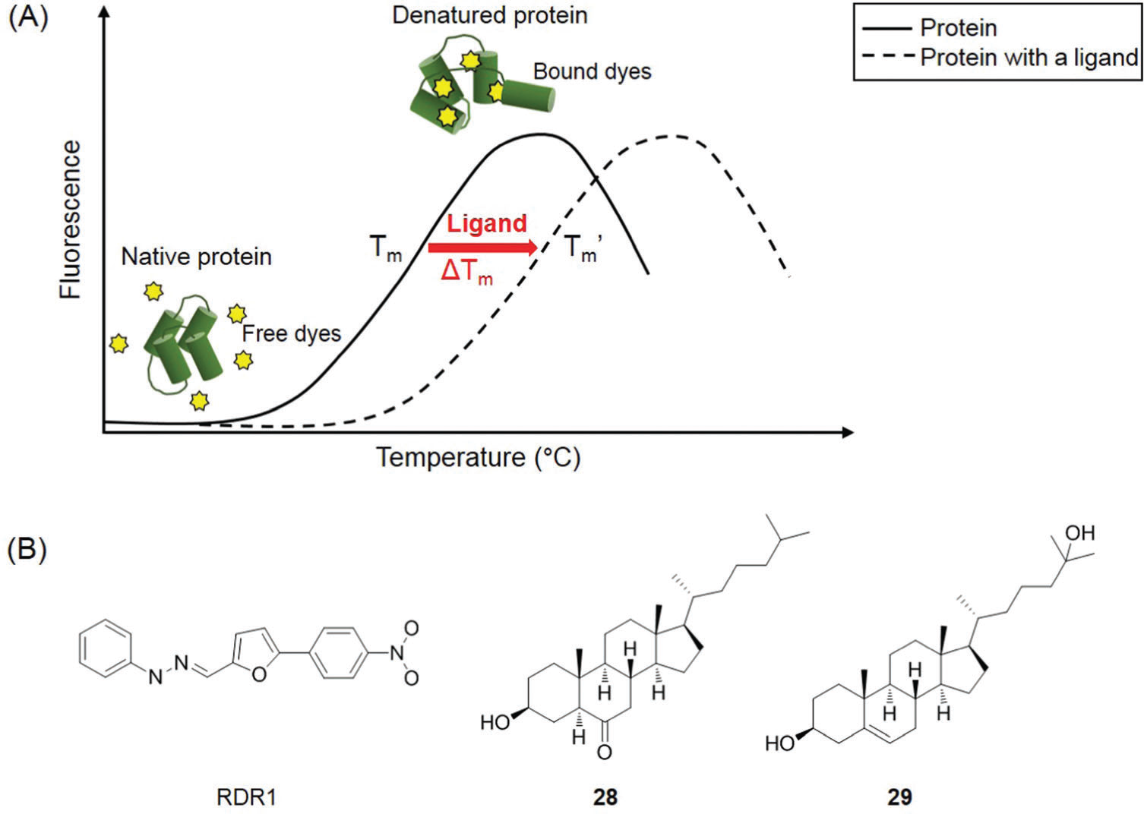
a. In vitro functional screens
(A) Ligand-induced changes in protein thermal stability as determined by DSF.
(B) Chemical structures of pharmacological chaperones for F508del-CFTR (RDR1) and a-crystallin protein (compounds 28 and 29).

Slide 8
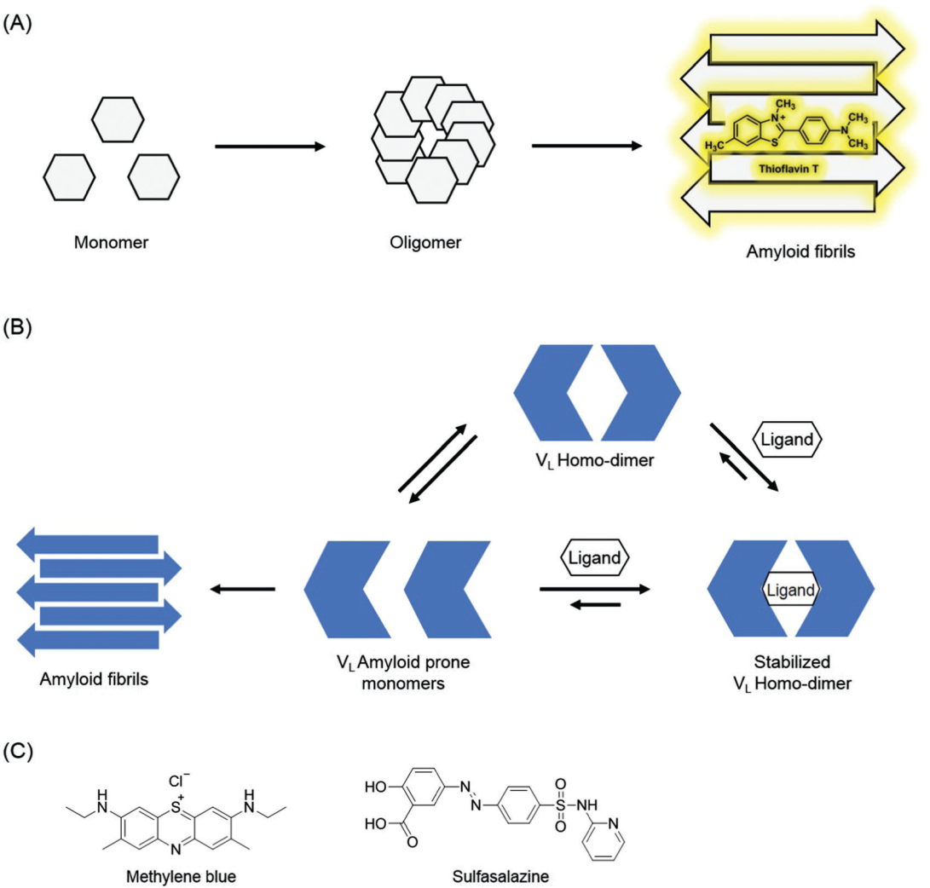
a. In vitro functional screens
Fig. 2 (A) Thioflavin T (ThT) dye fluorescence assay used to monitor amyloid fibrillation.
(B) A proposed mechanism for using ligands to hinder the aggregation of immunoglobulin VLs into amyloid fibrils.
(C) Chemical structures of pharmacological chaperones that can inhibit VL amyloid formation.

Slide 9
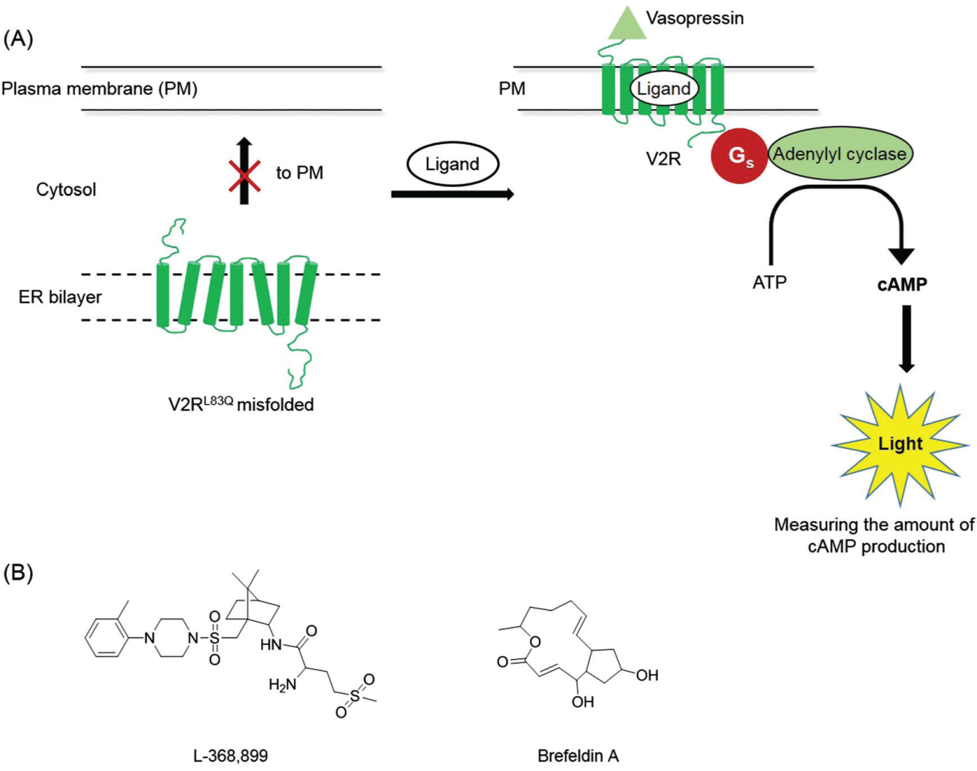
b. Cell-based screens
(A) The principle of cell-based HTS that monitors the rescue of vasopressin 2 receptor (V2R) function by a pharmacological chaperone.
(B) Chemical structures of pharmacological chaperones for V2R.

Slide 10
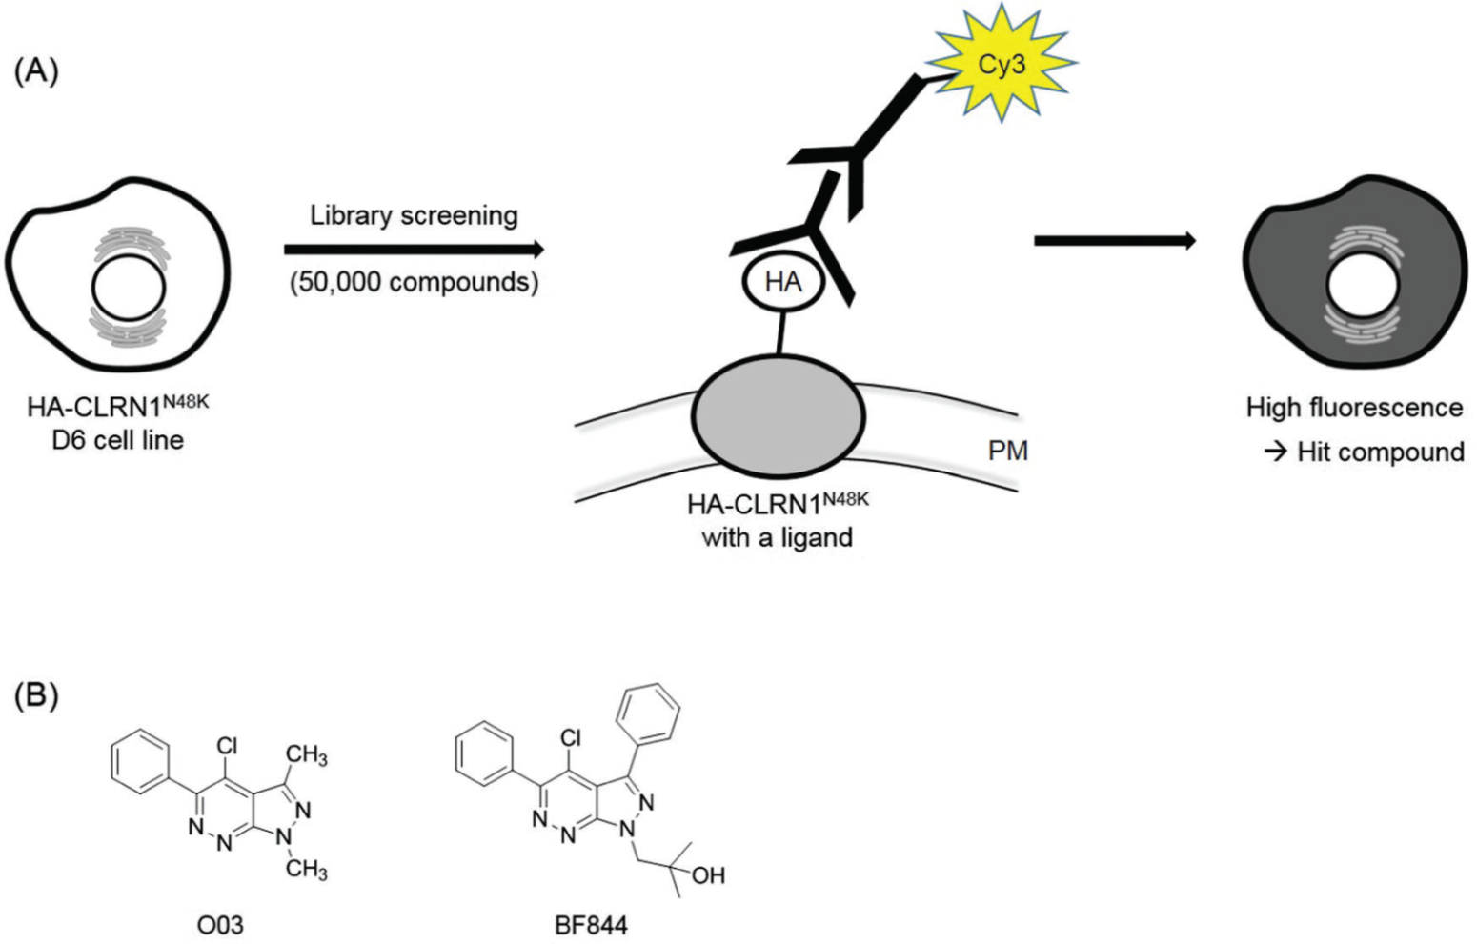
b. Cell-based screens
(A) Illustration for a cell-based screen used to identify pharmacological chaperones that promote the trafficking of CLRN1N48K to the plasma membrane as determined by immunofluorescence.
(B) Chemical structures of identified pharmacological chaperones for CLRN1N48K.

Slide 11
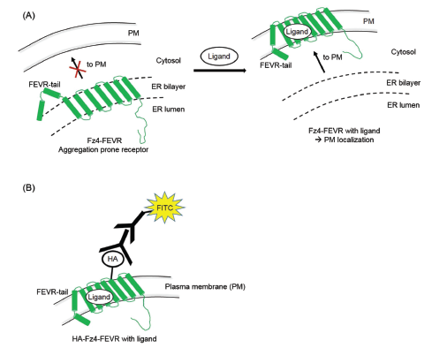
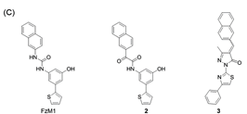
b. Cell-based screens
(A) Pharmacological chaperones may rescue defects in Fz4-FEVR membrane localization.
(B) Illustration of a cell-based assay to detect theimproved trafficking of Fz4-FEVR to the plasma membrane by pharmacological chaperones.
(C) Chemical structures of pharmacological chaperones forFz4-FEVR.

Slide 12
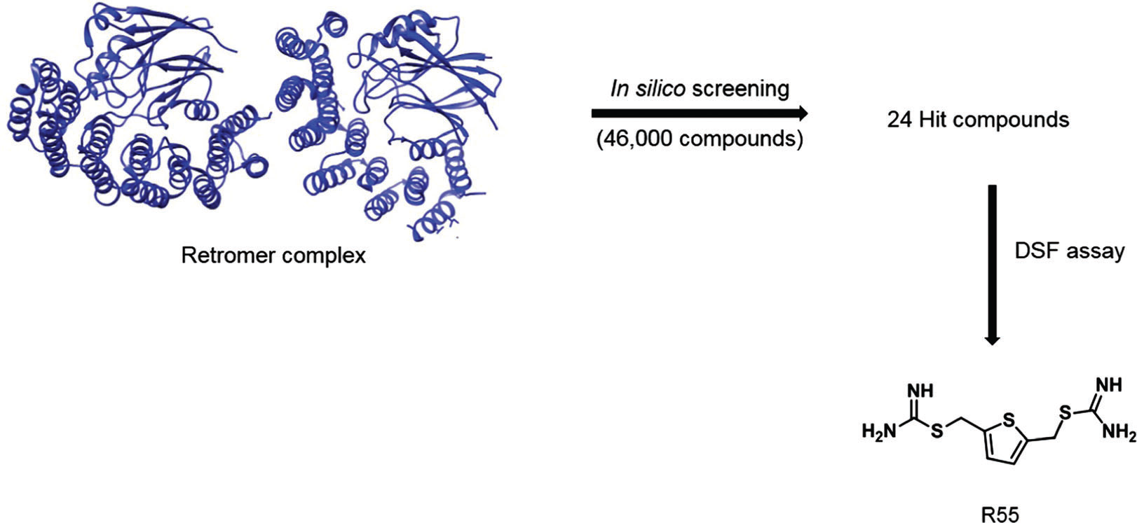
c. In silico screening
In silico virtual screening based on the crystal structure of the retromer complex (PDB ID code: 2R17) identified a pharmacological chaperone molecule, R55.

Slide 13
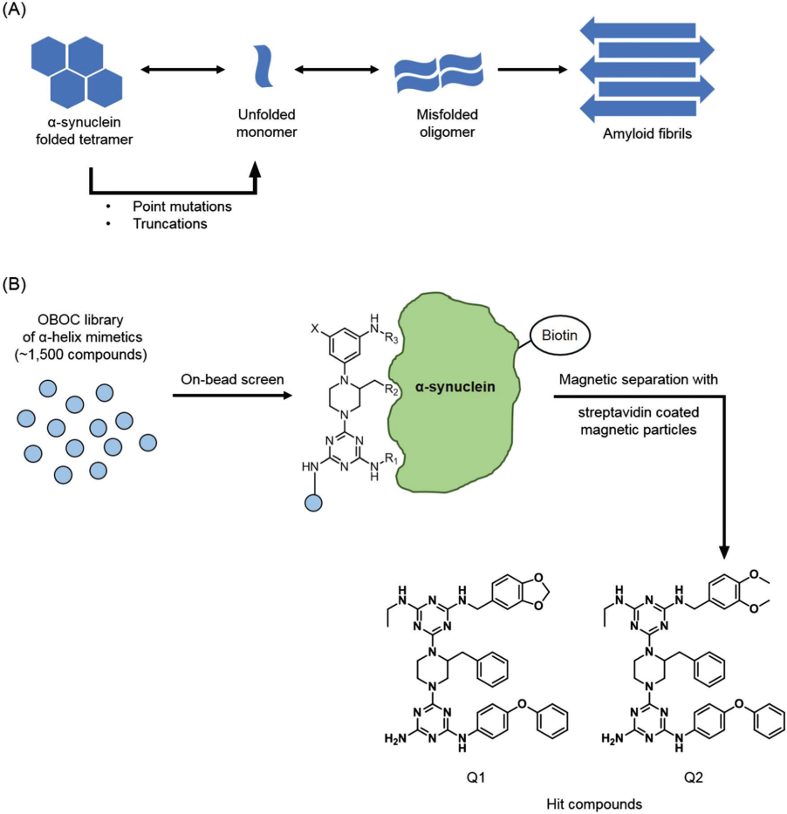
d. Affinity-based screening
(A) A proposed mechanism for the amyloid fibril formation of a-synuclein.
(B) Affinity-based screening of a one-bead one-compound combinatorial library of a-helix mimetics against a-synuclein and chemical structures of pharmacological chaperones for a-synuclein.

Slide 14
Conclusions
Protein misfolding is associated with various pathogenic conditions, leading to numerous conformational diseases.
Pharmacological chaperones have proven to rescue defects in protein misfolding and restore their function.
Here we have highlighted recent screening technologies that enables the discovery of pharmacological chaperone small-molecules, including in vitro functional screening, cell-based screening, in silico high-throughput screening, and affinity-based screening.

Slide 15
References
http://www.nature.com/nature/journal/v475/n7356/full/nature10317.html
https://translate.google.co.kr/translate?hl=ko&sl=en&u=https://en.wikipedia.org/wiki/Chaperone_(protein)&prev=search
https://en.wikipedia.org/wiki/Pharmacological_chaperone
https://sites.google.com/site/bouvierlab/research-projects/conformational-diseases
http://www.medibiztv.com/articles/amyloidosis
http://www.drugdevelopment-technology.com/projects/vyndaqel-tafamidis-for-the-treatment-of-transthyretin-familial-amyloid-polyneuropathy/vyndaqel-tafamidis-for-the-treatment-of-transthyretin-familial-amyloid-polyneuropathy2.html
Screening methods for identifying pharmacological chaperones, Min Hyeon Shin and Hyun-Suk Lim, Mol. Biosyst, 2017, 13, 638

Slide 16
Q & A
Thank you~~

