Slide 1
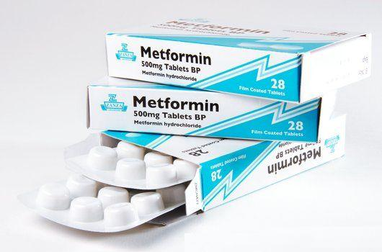
Metformin

Slide 2
contents
01
02
효능과 Mechanism
03
Metformin
부작용
제 2형 당뇨병의 1차 치료제
각 기관에서의 다양한 효과와 mechanism
Lactic acidosis 의 위험

Slide 3
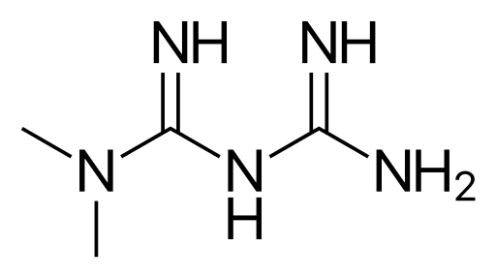
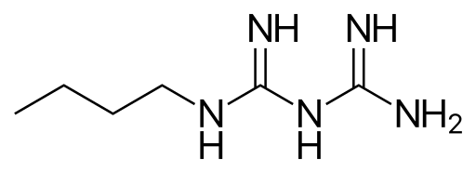
Biguanide
Metformin
phenformin
buformin

Slide 4
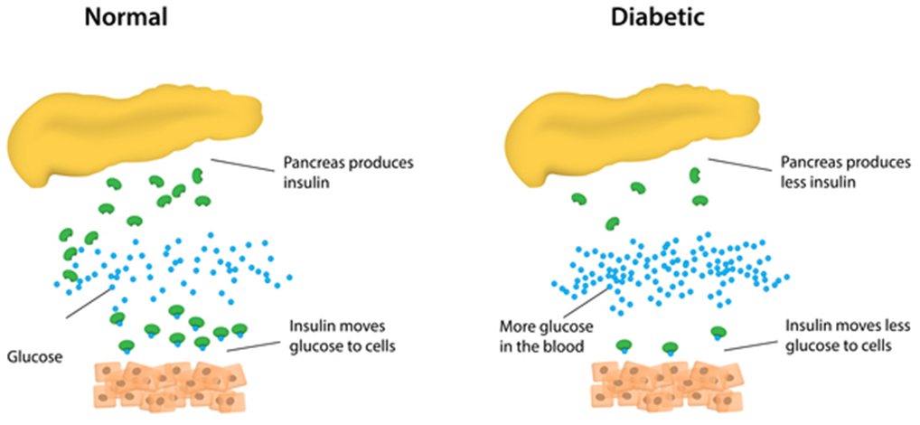
제 2형 당뇨병

Slide 5
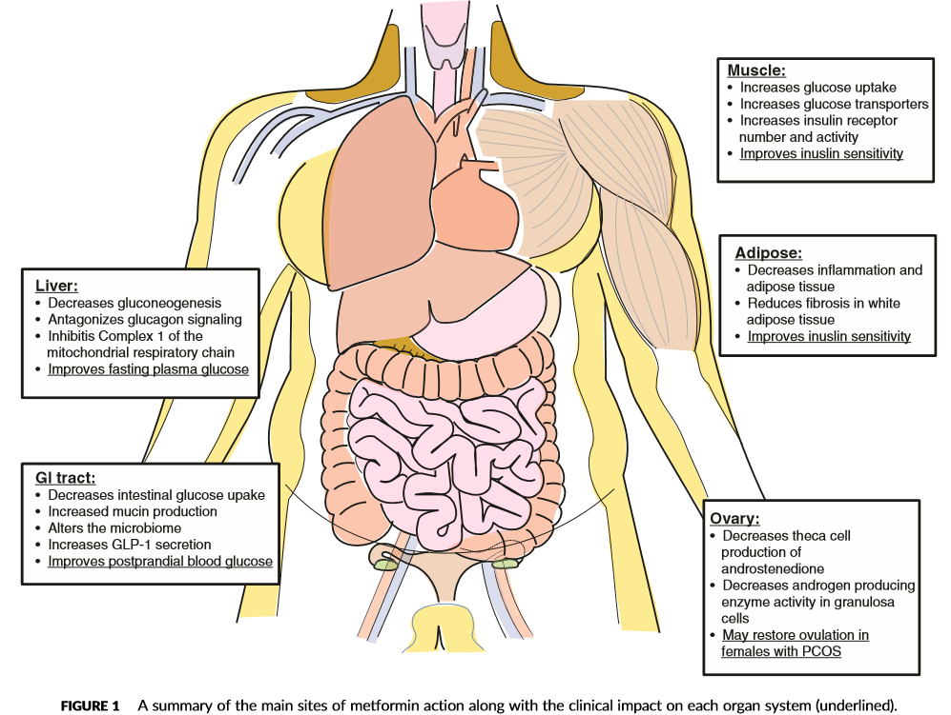

Slide 6
Liver
● Decreases gluconeogenesis
● Antagonize glucagon signaling
● Inhibits Complex1 of the mitochondrial respiratory chain
● Improve fasting plasma glucose

Slide 7
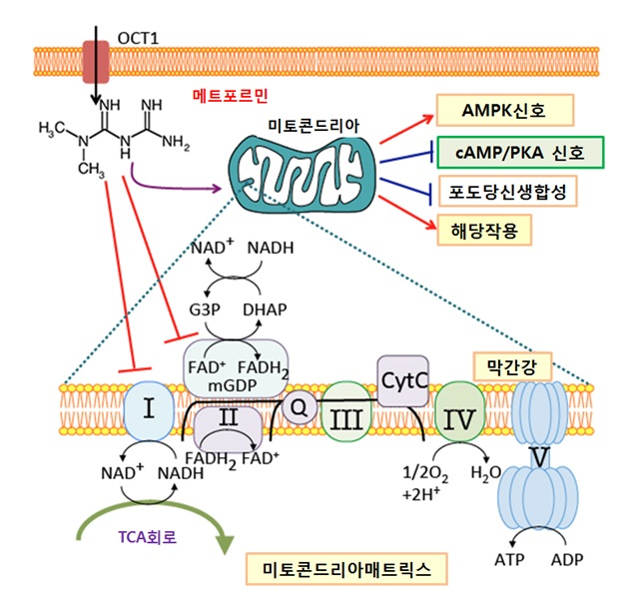
분자적 수준에서의 효과

Slide 8
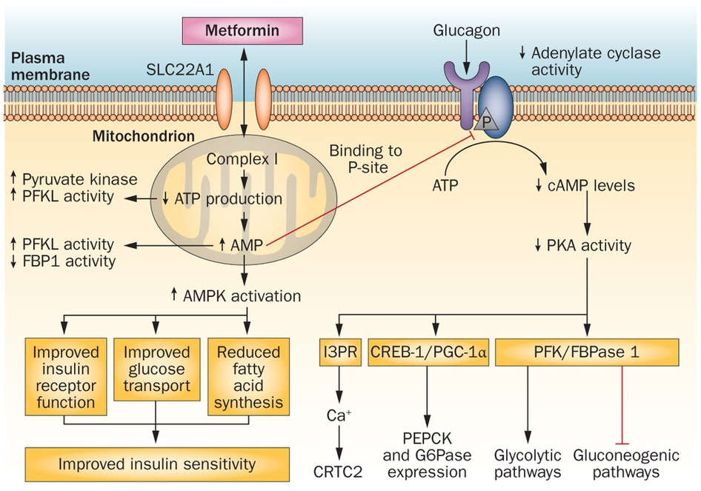

Slide 9
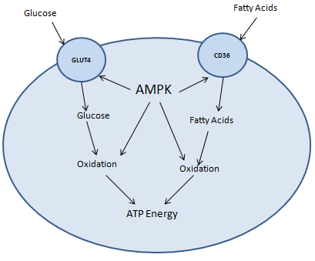
AMPK

Slide 10
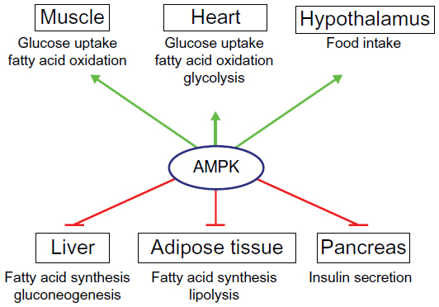
AMPK

Slide 11
Gastrointestinal tract
● Decreases intestinal glucose uptake
● Increased mucin production
● Alters the microbiome
● Increases GLP-1 secretion
● Improves postprandial blood glucose

Slide 12
Muscle
● Increases glucose uptake
●Increase glucose transporters
● Increases insulin receptor number and activity
●Improve insulin sesitivity

Slide 13
Adipose
● Decreases inflammation and adipose tissue
● Reduces fibrosis in white adipose tissue
● Improve insulin sensitivity

Slide 14
Ovary
● Decreases theca cell production of androstenedione
● Decreases androgen producing enzyme activity in granulosa cells
● May restore ovulation in females with PCOS

Slide 15
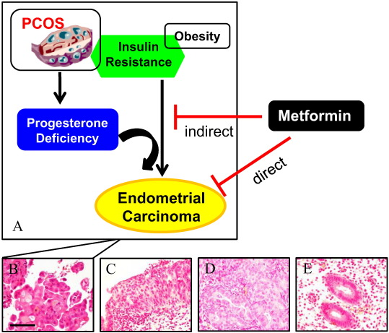
Metformin과 PCOS

Slide 16
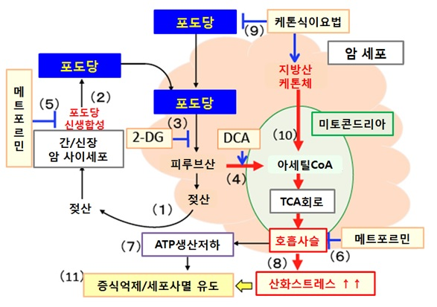
암에 대한 예방적 조치

Slide 17
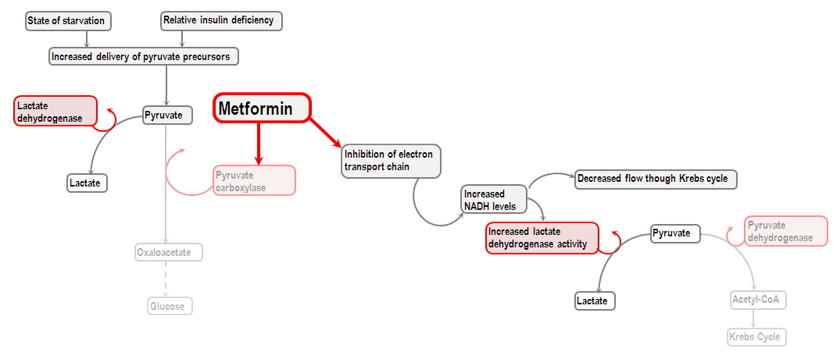
Lactic acidosis 부작용

Slide 18
Q & A

