Slide 1
Mitochondrial fatty acid oxidation and Heart diseases
20132663 김민향

Slide 2
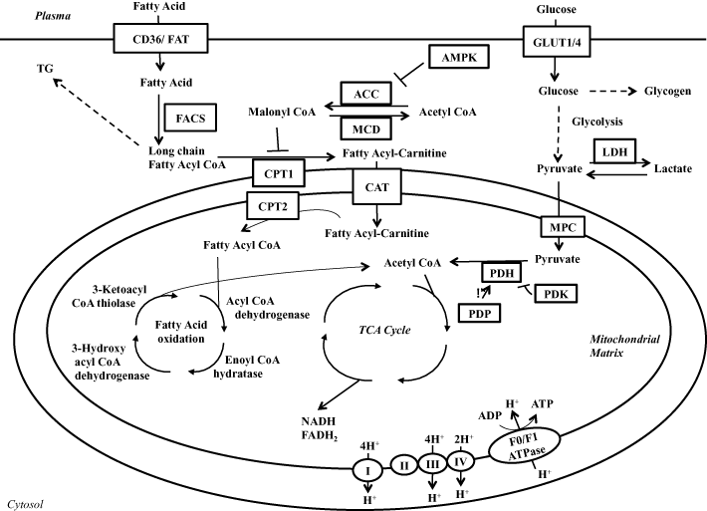
Fatty acid oxidation
Fatty acid transporter
CD36/FAT
Fatty acid binding protein(FABP)
CPT-1/CPT-2
β cycle
Acyl-CoA dehydrogenase
Enoyl-CoA hydratase
3-hydroxyacyl-CoA
β-Ketoacyl-CoA thiolase

Slide 3
Regulation of fatty acid oxidation
Acetyl CoA
ACC
Malonyl CoA
MCD
Malonyl CoA
Long chain
Fatty acyl CoA
Fatty acyl
-carnitine
CPT-1
MCD inhibition has been shown to decrease cardiac fatty acid oxidation and improve cardiac function.

Slide 4
Regulation of fatty acid oxidation
Fatty acid oxidation decreases glucose metabolism .
Increased glucose oxidation can inhibit fatty acid oxidation.
(From fatty acid oxidation)
NADH, Acetyl CoA↑
Inhibit PDH
(From PDH)
Acetyl CoA
Inhibit
3-ketoacyl CoA
thiolase
increased
Citrate level
Inhibit
PFK1, hexokinase
(From glucose oxidation)
NADH
Inhibit
3-hydroxyacyl CoA
dehydrogenase

Slide 5
Regulation of fatty acid oxidation
Fatty acid are a less efficient energy substrate than glycose.
One glycose molecule
Consumes 6 O2
Produces 31 ATP
One palmitate
Consumes 23 O2,
Produces 31 ATP
Since this mechanism only accounts for 10% of the reduction in cardiac efficiency
But elevated fatty acid oxidation can result in up to a 30% decrease in cardiac efficiency
Other mechanisms are also involved in the reduction in cardiac efficiency observed in hearts with elevated rates of fatty acid oxidation
: uncoupling proteins and increased triacylglycerol(TG) cycling

Slide 6
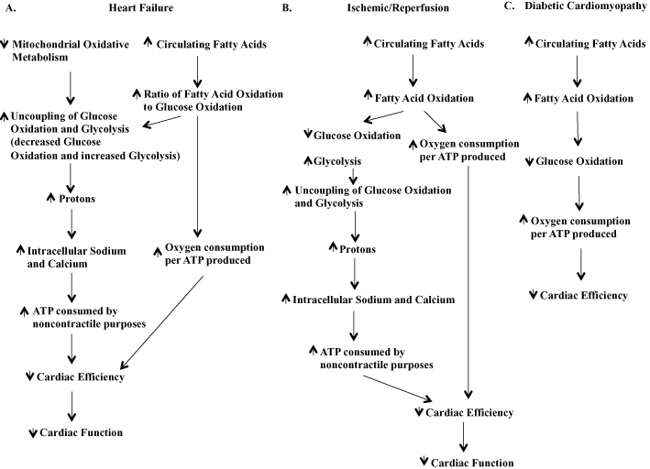
Fatty acid oxidation in Heart disease
Heart Failure
Ischemic/Reperfusion
Diabetic Cardiomyopathy

Slide 7
Heart failure
Mitochondrial metabolism is reduced 30-40% decrease in ATP levels and large decrease in phosphocreatine levels in the heart.
In hypertrophied heart due to pressure overload, this change in overall metabolic rate is accompanied by change in expression and activity of transcriptional protein.
: inducible factor-1α↑, PPARα↓, PGC-1α↓
It is also associated with a decrease in glucose and lactate oxidation rates.
: uncoupling of glycolysis , production of protons
: this can alter ionic homeostasis
AngiotensinⅡ
: Damages mitochondria in cardiomyocyte
: Affects mitochondrial oxidative phosphorylation, fatty acid oxidation
: Increasing PDK4 expression, decreased PDH activity
: Reduce APT levels

Slide 8
Ischaemia / reperfusion
ischaemia
: mitochondrial oxidative metabolism decreases in proportion to the decease in oxygen supply to the heart
reperfusion of the ischaemic heart
: cardiac fatty acid oxidation rates are elevated due to elevated circulating
Elevated levels of circulating fatty acid combined with a decrease in malonyl CoA levels
: inhibition of glucose oxidation rates with decrease in glucose oxidation rates
The decrease in glucose oxidation
: increased uncoupling of glycolysis from glucose oxidation and increase in production of lactate and protons which can decrease cardiac efficiency and impair heart function.
The mechanisms involved in removing protons
: accumulation of intracellular calcium and sodium

Slide 9
Diabetic cardiomyopathy
define : ventricular dysfunction occurring in patients with diabet mellitus
Hearts from animals or humans with DM or obesity : elevated fatty acid oxidation
The mechanism by which excessive fatty acids
: The accumulation of fatty acids in the heart, high rates of fatty acid oxidation
: Diacylglycerol and ceramides: contribute to cardiac insulin resistance and reduce cardiac function
The accumulation of lipids in the DM
: the elevated levels of circulating fatty acids
: Type 2 DM
Cardiac insulin resistance is accompanied by a persistent relocation : CD36 and FABP
Chronic elevation in fatty acid uptake in diabetic hearts
: reducing the FABP expression → decrease cardiac insulin resistance
: PPAR
: PPARα : augment expression of CD36, CPT-1, MCD, LCAD→ increase fatty acid oxidation rates

Slide 10
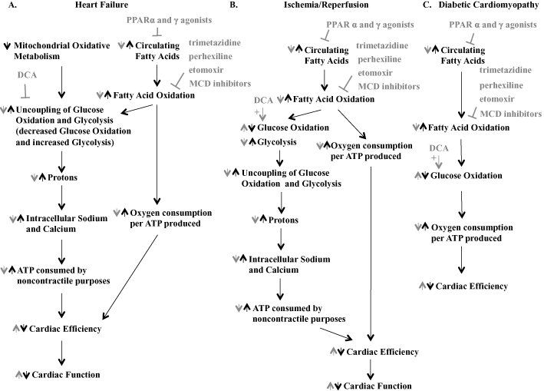
To treat cardiac disease

Slide 11
To treat cardiac disease
Inhibition of mitochondrial fatty acid oxidation
: directly inhibiting fatty acid oxidation or indirectly increasing glucose oxidation.
: MCD inhibitor (i.e. CBM-301106)
: CPT-1 inhibitor (i.e. perhexiline, etomoxir)
: mitochondrial fatty acid oxidation inhibitor (i.e. trimetazidine)
Other
: use of PPARα of PPARγ ligands
: not directly inhibiting pathways producing ATP

Slide 12
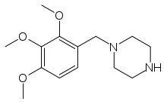
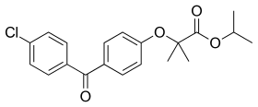
To treat cardiac disease
Trimetazidine
Directly targets mitochondrial tatty acid oxidation enzyme
Improves the function of failing hearts
Reduce rates of glycolysis and/or increases glucose oxidation
resulting in reduced proton levels
MCD inhibitor
Increased glucose oxidation, decrease fatty acid oxidation
Improved insulin sensitivity
Inhibit CPT-1 → elevated malonyl CoA levels
PPARs : Two class of drug - fibrates , TZD
TZD
: lowering circulation TG and fatty acid levels
: and increasing cardiac glucose oxidation
Fibrates
: increase PPARα activity - decreased cardiac fatty acid oxidation
: increase PPAR activity - expression of many genes, increase cardiac glucose oxidation rates
Trimetazidine
Fenofibrate

