Slide 1
Metabolic engineering
20132655
강진희

Slide 2
Contents
1. Metabolic engineering
2. Krebs Cycle
3. Citrate
4. Summary

Slide 3
What is the Metabolic engineering
Regulation of metabolic pathway
-> 세포의 활성을 증진시키는데 재조합 핵산기술을 이용하는 것
-> 변화 혹은 새로운 물질대사 경로를 만드는 기술.
The natural yield is slow or the condition of production is not suitable
for industrial scale production
To improve the production,
-> Genetic changes, environmental controls
How?
-> Metabolic engineering
Main target
-> Metabolic pathway (Flux, Enzymes etc.)
-> Genes (RNAi, Manipulation etc.)

Slide 4
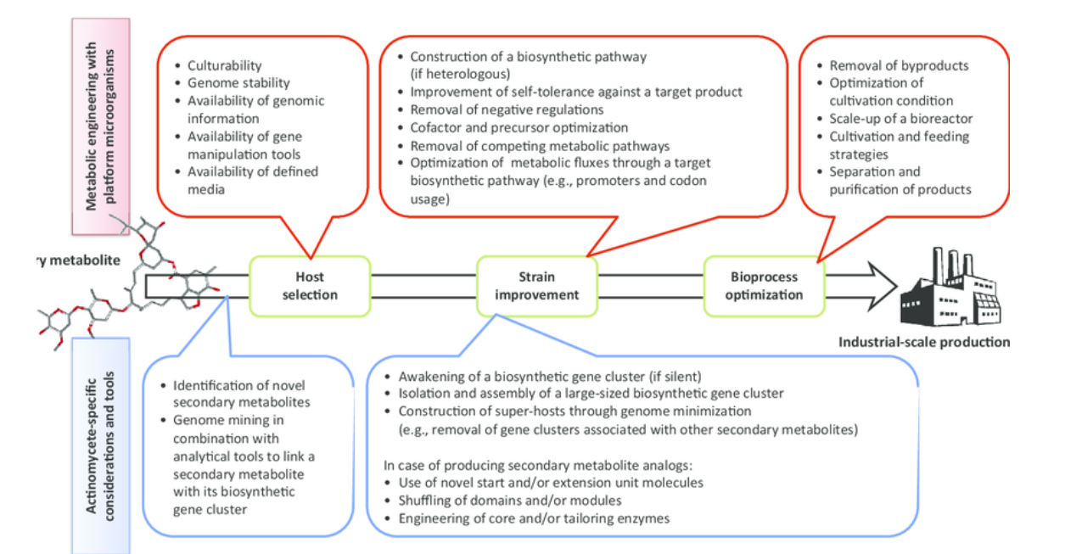

Slide 5
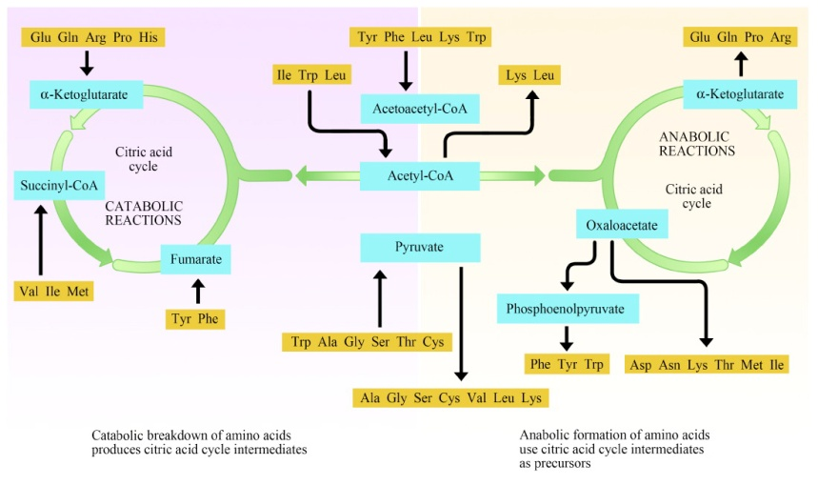
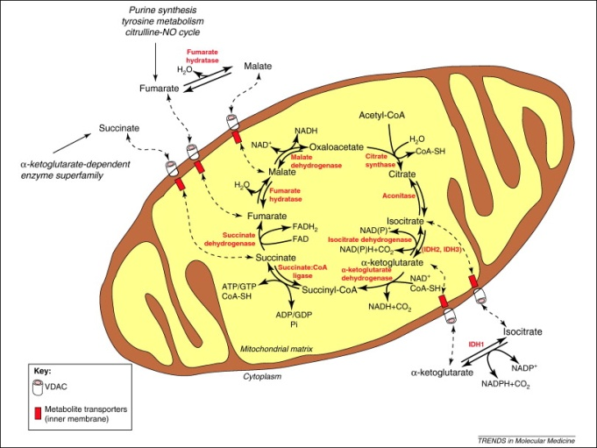
What is the KREBS Cycle?
Krebs cycle, Citric acid cycle(CAC), Tricarboxylic acid(TCA) cycle
- a series of enzyme-catalyzed chemical reactions to generate energy
and release CO2 by utilization of acetyl CoA
The central metabolic pathway and final common oxidative pathway for carbohydrates, fats, amino acids
Amphibolic pathway
- both catabolic and anabolic processes
- 해당과정, 오탄당 경로, CAC cycle
In eukaryotic cells, the cycle occurs in the matrix of the mitochondrion

Slide 6
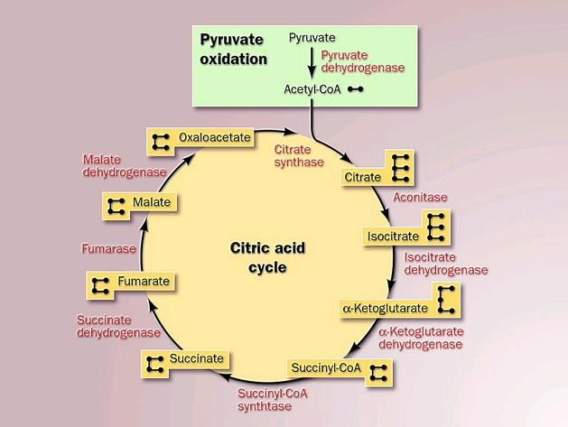
유기산 생성 in CAC

Slide 7
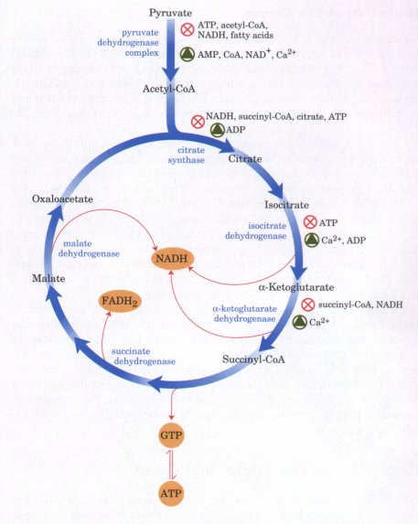
Regulation of CAC
Pathway controlled by
- Allosteric modulators
- Covalent modification of enzymes
- Supply of acetyl CoA, PDH
Inhibited by
- ATP, NADH, Citrate
-> competitive inhibitor of oxaloacetate
Fumarate
Succinate

Slide 8
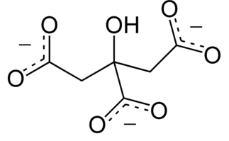
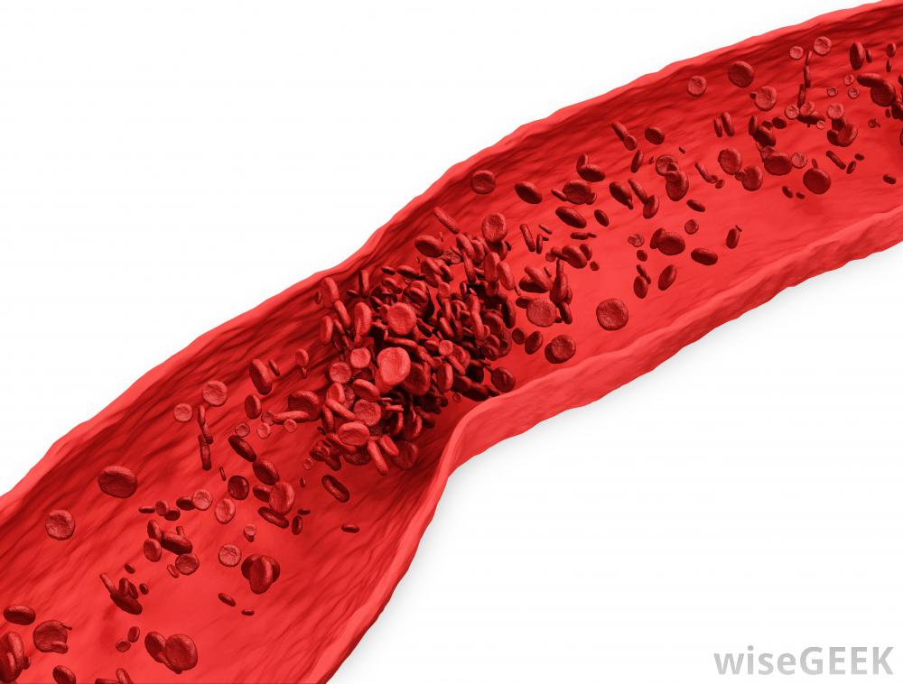
What is the citrate?
Tricarboxylic acid, 시트르산염, 구연산염
Food, Fruit
- Lemonade, Orange, Carrot juice
-> inhibit both a build up of uric acid and also stop calcium salts from forming
Efficacy - Inhibitor to stone formation
- hepatic metabolism (Inhibit clotting)

Slide 9
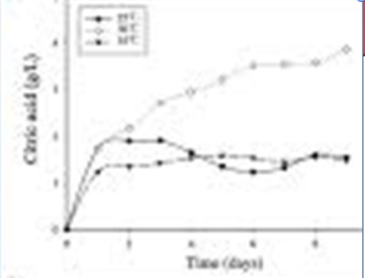
Citrate Mechanism
Temperature
- 30'C
- higher temperatures
-> rapid process
-> consuming large amounts of sugar
thus lowering the yield of citrate
- lower temperatures
-> higher yields of citrate are possible
-> by prolonging the fermentation process

Slide 10
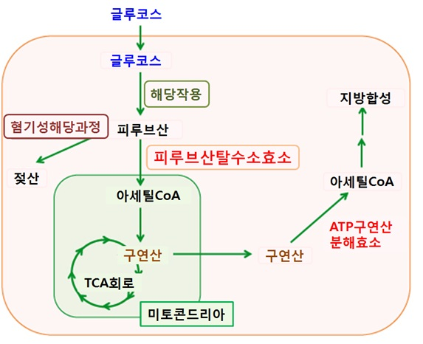
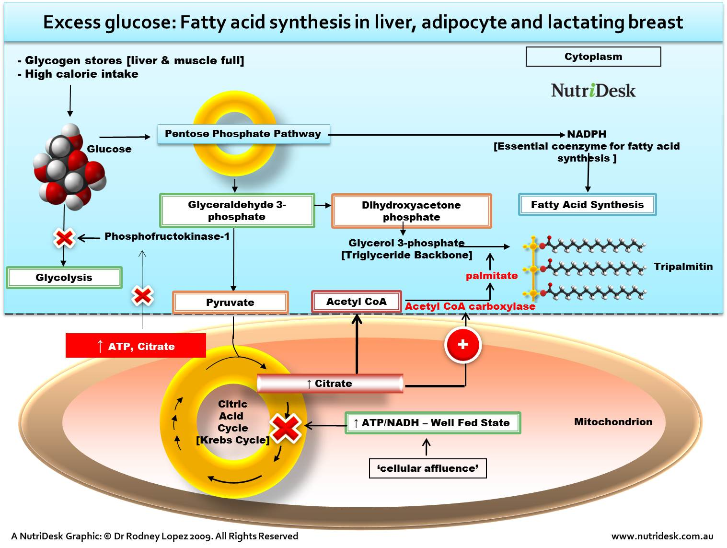

Slide 11
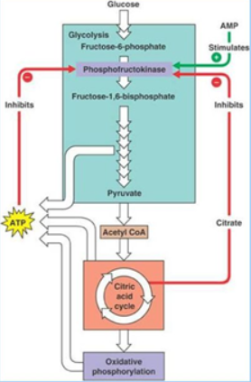
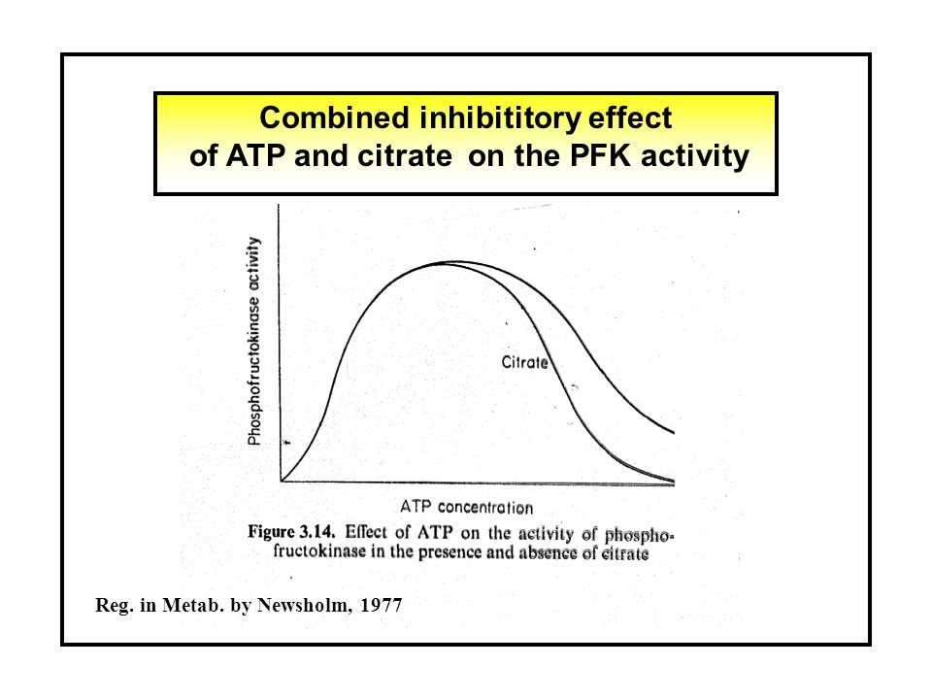
PFK

Slide 12
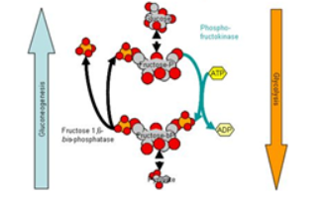
PFK
High [ATP] -> Inhibit PFK
High [ADP] -> stimulate PFK
High [AMP] -> stimulate PFK
High [citrate] -> Inhibit PFK
ATP, citrate - allosteric negative regulators
ADP, AMP - allosteric positive regulators

Slide 13
Summary
Metabolic engineerng approaches
- pathway flux (PFK)
- enzyme
Regulation
- CAC : ATP, ADP, Acetyl-CoA, NADH
Citrate
- 지방산 생합성, Clotting 억제,

Slide 14
끝

