Slide 1
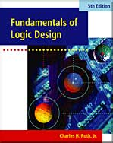
UNIT 9 MULTIPLEXERS, DECODERS, AND PROGRAMMABLE LOGIC DEVICES
This chapter in the book includes:
Objectives
Study Guide
9.1 Introduction
9.2 Multiplexers
9.3 Three-State Buffers
9.4 Decoders and Encoders
9.5 Read-Only Memories
9.6 Programmable Logic Devices
9.7 Complex Programmable Logic Devices
9.8 Field Programmable Gate Arrays
Problems

Slide 2
Objectives
Explain the function of a multiplexer and implement a multiplexer using gates.
Explain the operation of three-state buffers. Determine the resulting output when three-state buffers outputs are connected together. Use three-state buffers to multiplex signals onto a bus.
Explain the operation of a decoder and encoder and use a decoder with added gates to implement a set of logic functions. Implement a decoder or priority encoder using gates.
Explain the operation of a read-only memory (ROM) and use a ROM to implement a set of logic functions.
Explain the operation of a programmable logic array (PLA). Use a PLA to implement a set of logic functions. Given a PLA table or an internal connection diagram for a PLA, determine the logic functions realized.
Explain the operation of a programmable array logic device (PAL). Determine the programming pattern required to realize a set of logic function with a PAL.
Explain the operation of a complex programmable logic device (CPLD) and a field programmable gate array (FPGA).
Use Shannon’s expansion theorem to decompose a switching function.

Slide 3
9.1 Introduction
IC (Integrated Circuit)
SSI (Small-Scale Integration)
MSI (Medium-Scale Integration)
LSI (Large-Scale Integration)
VLSI (Very-Large-Scale Integration)
Multiplexers
Three-state Buffer
Decoders and Encoders
ROMs
PLD
PLA
CPLD
FPGA

Slide 4
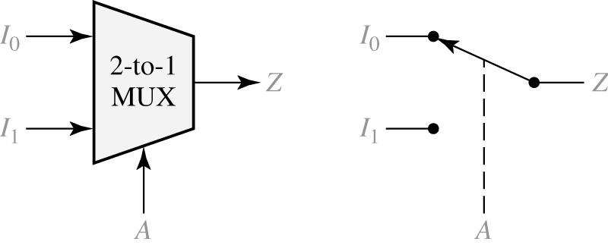
9.2 Multiplexers
Multiplexer (MUX, Data Selector)
2-to-1 Multiplexer and Switch Analog
Logic equation for the 2-to-1 MUX

Slide 5
9.2 Multiplexers
4-to-1 Multiplexer
Logic equation for the 4-to-1 MUX

Slide 6
9.2 Multiplexers
8-to-1 Multiplexer
Logic equation for the 8-to-1 MUX

Slide 7
9.2 Multiplexers
2^{n}-to-1 Multiplexer
Logic equation for the 2 ^{n} - to - 1 MUX
m_{k} : minterm of the n control variables
I_{k} : corresponding data input

Slide 8
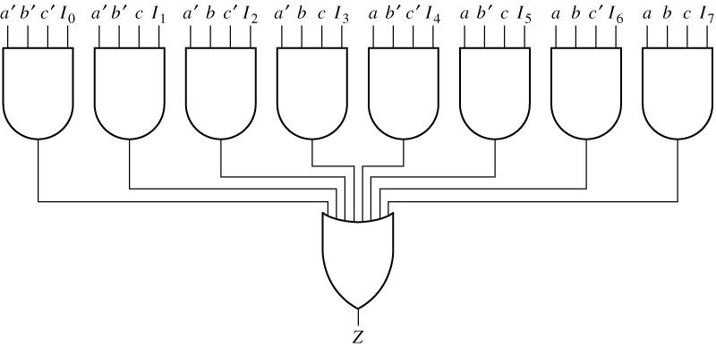
9.2 Multiplexers
Logic Diagram for 8-to-1 MUX

Slide 9
9.2 Multiplexers
Quadruple 2-to-1 Multiplexer Used to Select Data

Slide 10
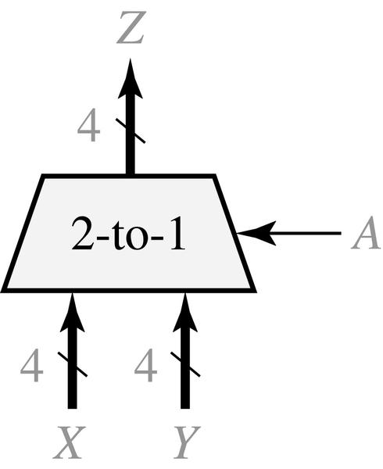
9.2 Multiplexers
Quad Multiplexer with Bus Inputs and Output
X, Y : Bus input
Z : Bus output

Slide 11
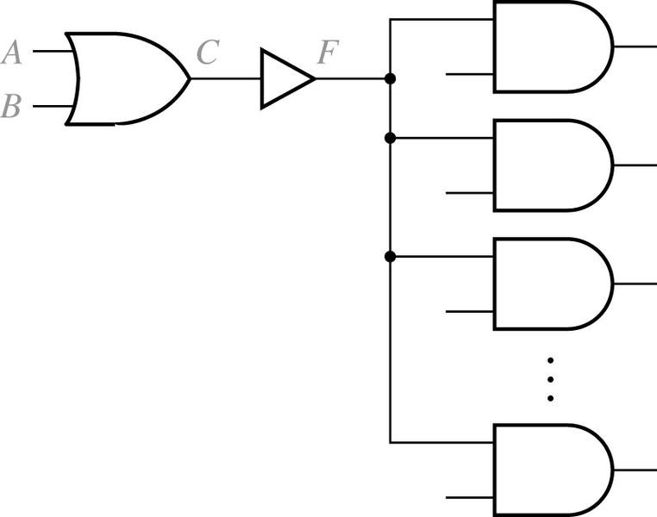
9.3 Three-State Buffers
Gate Circuit with Added Buffer
The logic of the buffer input and output are the same (F = C)
Buffer is used to increase driving capability

Slide 12
9.3 Three-State Buffers
Three-State Buffer
Tri-State Buffer
High-impedance (Hi-Z) state
The output is enabled when B = 1, disabled when B = 0

Slide 13
9.3 Three-State Buffers
Four Kinds of Three-State Buffers
B A | C
0 0 0 1 1 0 1 1 | Z Z 0 1
B A | C
0 0 0 1 1 0 1 1 | Z Z 1 0
B A | C
0 0 0 1 1 0 1 1 | 0 1 Z Z
B A | C
0 0 0 1 1 0 1 1 | 1 0 Z Z
(a)
(b)
(c)
(d)

Slide 14
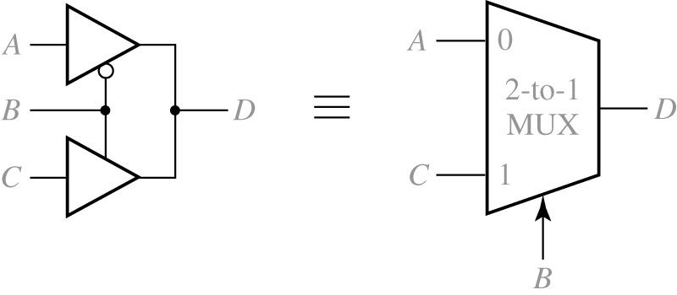
9.3 Three-State Buffers
Data Selection Using Three-State Buffers

Slide 15
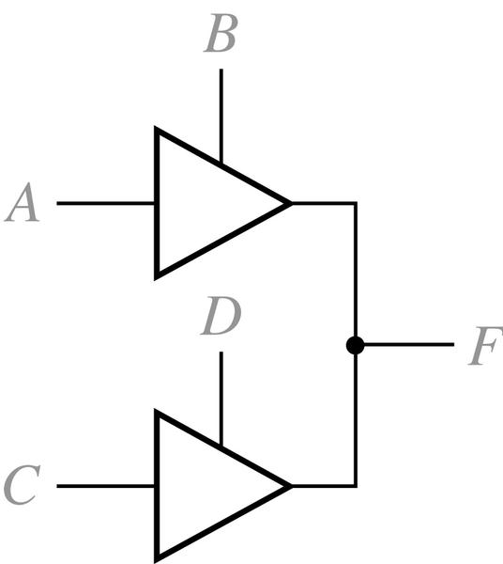
9.3 Three-State Buffers
Circuit with Two Three-State Buffers
S1
S1 | X | S2 0 | 1 | Z
X 0 1 Z | X X X X | X 0 X 0 | X X 1 1 | X 0 1 Z
S2
X = Unknown

Slide 16
9.3 Three-State Buffers
4-Bit Adder with Four Sources for One Operand
Four Sources

Slide 17
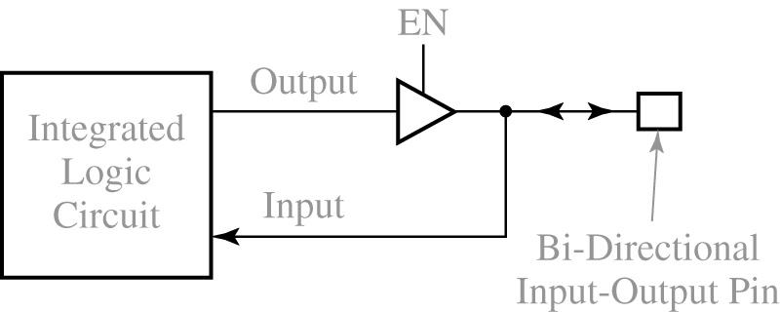
9.3 Three-State Buffers
Integrated Circuit with Bi-Directional Input/Output Pin

Slide 18
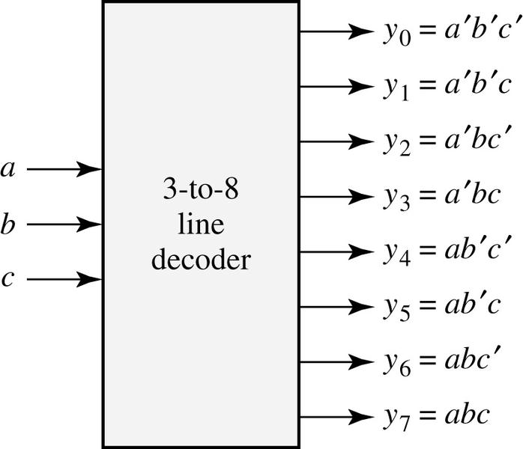
9.4 Decoders and Encoders
3-to-8 Line Decoder
a b c | y₀ | y₁ | y₂ | y₃ | y₄ | y₅ | y₆ | y₇
0 0 0 0 0 1 0 1 0 0 1 1 1 0 0 1 0 1 1 1 0 1 1 1 | 1 0 0 0 0 0 0 0 | 0 1 0 0 0 0 0 0 | 0 0 1 0 0 0 0 0 | 0 0 0 1 0 0 0 0 | 0 0 0 0 10 0 0 | 0 0 0 0 0 10 0 | 0 0 0 0 0 0 10 | 0 0 0 0 0 0 0 1

Slide 19
9.4 Decoders and Encoders
A 4-to-10 Line Decoder

Slide 20
9.4 Decoders and Encoders
A 4-to-10 Line Decoder
BCD Input | Decimal Output
A B C D | 0 | 1 | 2 | 3 | 4 | 5 | 6 | 7 | 8 | 9
0 0 0 0 0 0 0 1 0 0 1 0 0 0 1 1 0 1 0 0 0 1 0 1 0 1 1 0 0 1 1 1 1 0 0 0 1 0 0 1 1 0 1 0 1 0 1 1 1 1 0 0 1 1 0 1 1 1 1 0 1 1 1 1 | 0 1 1 1 1 1 1 1 1 1 1 1 1 1 1 1 | 1 0 1 1 1 1 1 1 1 1 1 1 1 1 1 1 | 1 1 0 1 1 1 1 1 1 1 1 1 1 1 1 1 | 1 1 1 0 1 1 1 1 1 1 1 1 1 1 1 1 | 1 1 1 1 0 1 1 1 1 1 1 1 1 1 1 1 | 1 1 1 1 1 0 1 1 1 1 1 1 1 1 1 1 | 1 1 1 1 1 1 0 1 1 1 1 1 1 1 1 1 | 1 1 1 1 1 1 1 0 1 1 1 1 1 1 1 1 | 1 1 1 1 1 1 1 1 0 1 1 1 1 1 1 1 | 1 1 1 1 1 1 1 1 1 0 1 1 1 1 11
(c) Truth Table

Slide 21
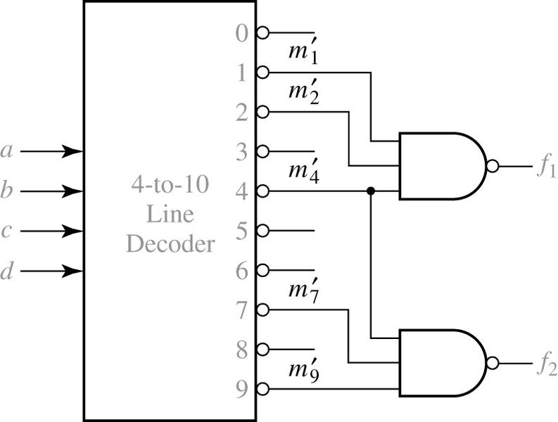
9.4 Decoders and Encoders
Realization of a Multiple-Output Circuit Using a Decoder

Slide 22
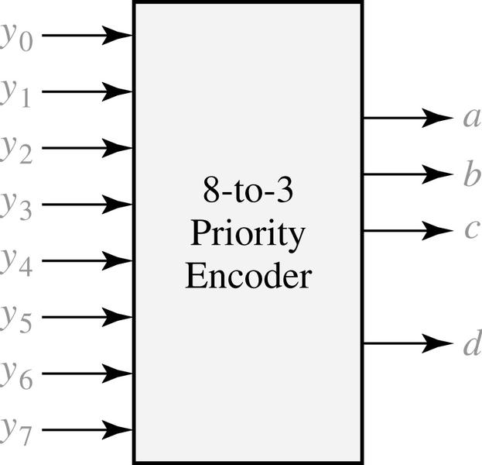
9.4 Decoders and Encoders
8-to-3 Priority Encoder
y₀ | y₁ | y₂ | y₃ | y₄ | y₅ | y₆ | y₇ | a | b | c | d
0 1 X X X X X X X | 0 0 1 X X X X X X | 0 0 0 1 X X X X X | 0 0 0 0 1 X X X X | 0 0 0 0 01 X X X | 0 0 0 0 0 0 1 X X | 0 0 0 0 0 0 0 1 X | 0 0 0 0 0 0 0 0 1 | 0 0 0 0 0 1 1 1 1 | 0 0 0 1 1 0 0 1 1 | 0 0 1 0 1 0 1 0 1 | 0 1 1 1 1 1 1 1 1

Slide 23
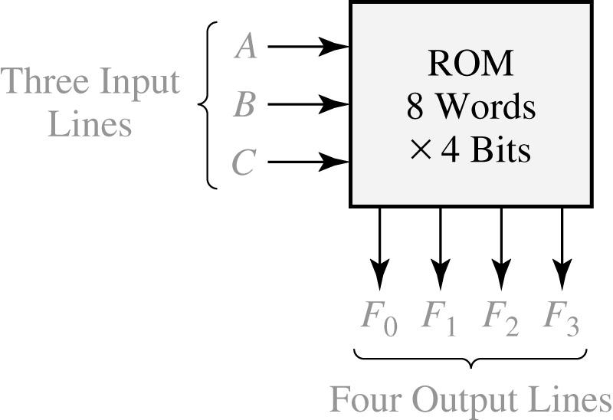
9.5 Read-Only Memories
An 8-Word x 4-Bit ROM
A | B | C |  |  | F₀ | F₁ | F₂ | F₃
0 0 0 0 1 1 1 1 | 0 0 1 1 0 0 1 1 | 0 1 0 1 0 1 0 1 |  |  | 1 1 0 0 1 0 1 0 | 0 0 1 1 1 0 1 1 | 1 1 1 0 0 0 1 0 | 0 0 1 1 0 1 1 1
typical data stored in ROM
(2³ words of
4bits each)
(a) Block diagram
(b) Truth table for ROM

Slide 24
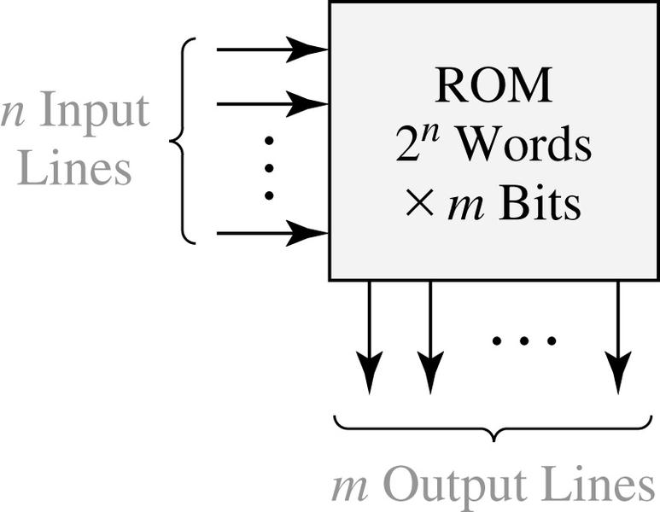
9.5 Read-Only Memories
Read-Only Memory with n Inputs and m Outputs
n input Variables |  |  |  | m output Variables
00 00 00 00 11 11 11 11 | · · · · · · · · · · · · · · · · · · · · · · · · · · · · · · · · · · | 00 01 10 11 00 01 10 11 |  |  | 100 010 101 110 001 110 011 111 | · · · · · · · · · · · · · · · · · · · · · · · · · · · · · · · · · · | 110 111 101 010 · · 011 110 000 101
typical data array stored
in ROM
(2^{n} words of
m bits each)

Slide 25
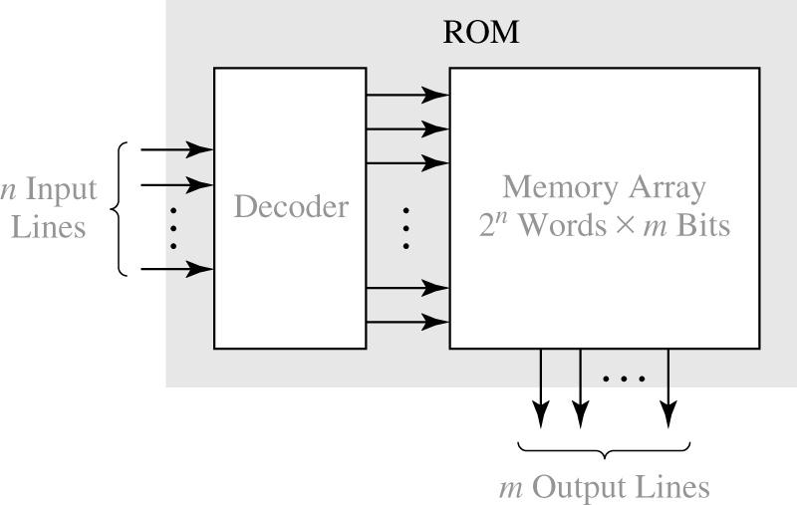
9.5 Read-Only Memories
Basic ROM Structure

Slide 26
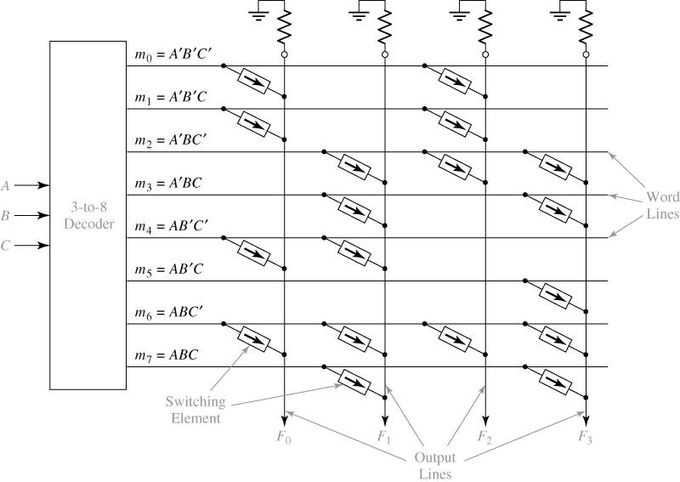
9.5 Read-Only Memories
An 8-Word x 4-Bit ROM

Slide 27
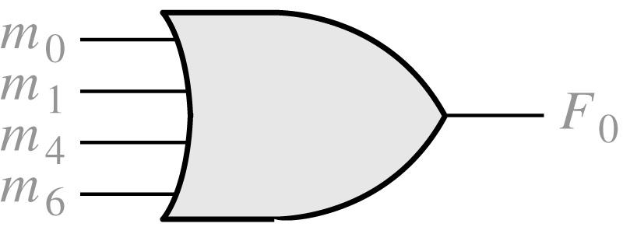
9.5 Read-Only Memories
Equivalent OR Gate for F₀

Slide 28
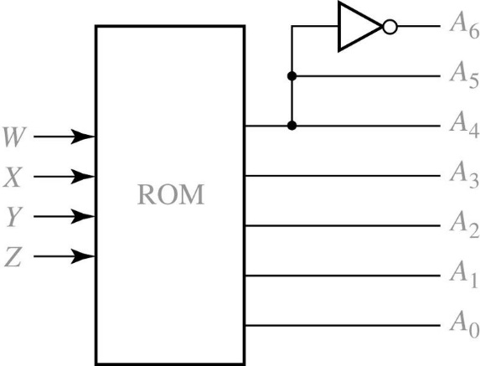
9.5 Read-Only Memories
Hexadecimal to ASCII Code Converter
Input |  |  |  | Hex Digit |  |  | ASCII Code for Hex Digit
W | X | Y | Z |  |  |  | A₆ | A₅ | A₄ | A₃ | A₂ | A₁ | A₀
0 0 0 0 0 0 0 0 1 1 1 1 1 1 1 1 | 0 0 0 0 1 1 1 1 0 0 0 0 1 1 1 1 | 0 0 1 1 0 0 1 1 0 0 1 1 0 0 1 1 | 0 1 0 1 0 1 0 1 0 1 0 1 0 1 0 1 |  | 0 1 2 3 4 5 6 7 8 9 A B C D E F |  | 0 0 0 0 0 0 0 0 0 0 1 1 1 1 1 1 | 1 1 1 1 1 1 1 1 1 1 0 0 0 0 0 0 | 1 1 1 1 1 1 1 1 1 1 0 0 0 0 0 0 | 0 0 0 0 0 0 0 0 1 1 0 0 0 0 0 0 | 0 0 0 0 1 1 1 1 0 0 0 0 0 1 1 1 | 0 0 1 1 0 0 1 1 0 0 0 1 1 0 0 1 | 0 1 0 1 0 1 0 1 0 1 1 0 1 0 1 0

Slide 29
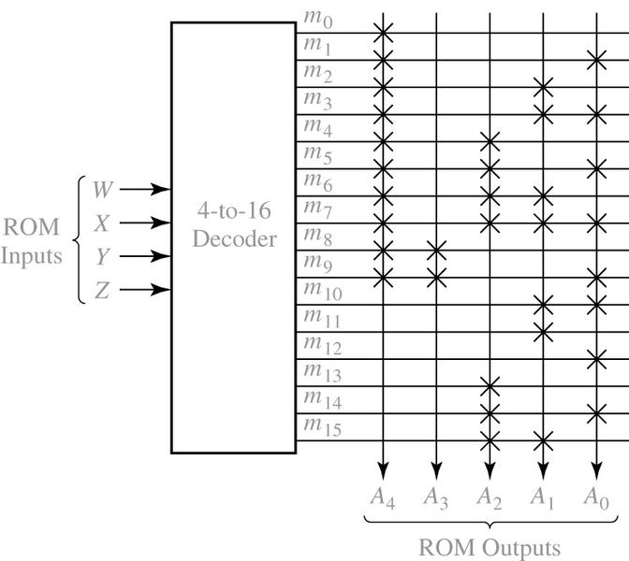
9.5 Read-Only Memories
ROM Realization of Code Converter

Slide 30
9.5 Read-Only Memories
Types of ROMs
Mask-programmable ROM
Programmable ROM
Electrically Erasable Programmable ROM

Slide 31
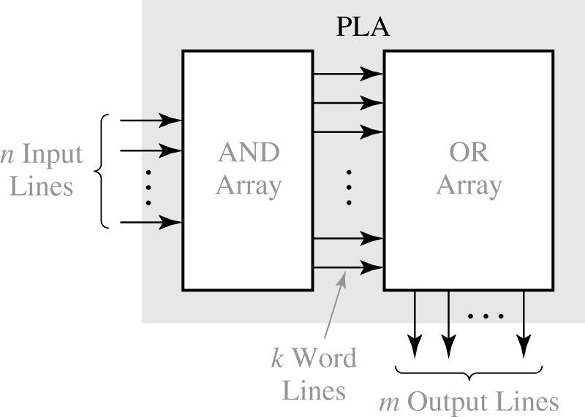
9.6 Programmable Logic Devices
Programmable Logic Array (PLA) Structure
Both AND array and OR array are programmable.

Slide 32
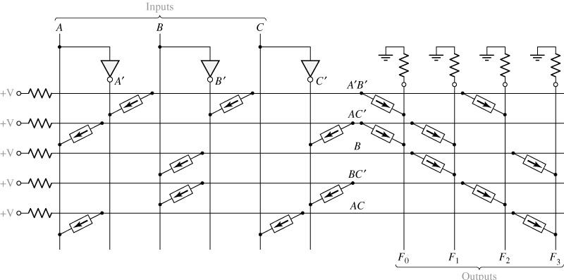
9.6 Programmable Logic Devices
PLA with Three Inputs, Five Product Terms, and Four Outputs

Slide 33
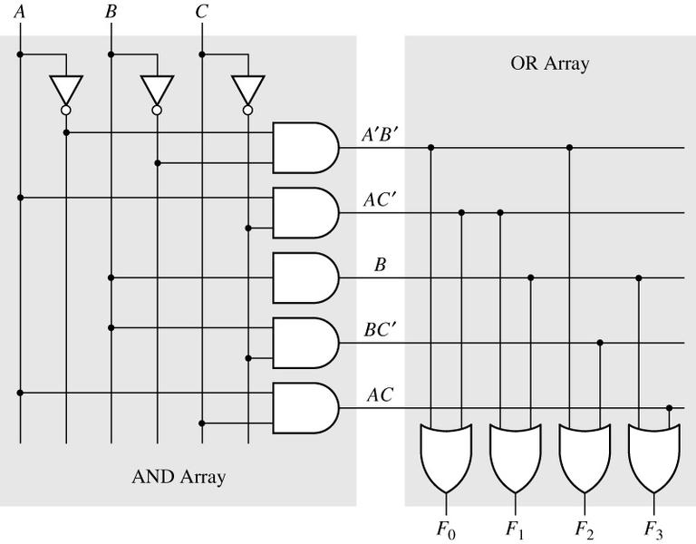
9.6 Programmable Logic Devices
AND-OR Array Equivalent to Figure 9-25

Slide 34
9.6 Programmable Logic Devices
PLA Table for Figure 9-25
Product Term |  | Inputs |  |  |  | Outputs
 |  | A | B | C |  | F₀ | F₁ | F₂ | F₃
A’B’ AC’ B BC’ AC |  | 0 1 - - 1 | 0 - 1 1 - | - 0 - 0 1 |  | 1 1 0 0 0 | 0 1 1 0 0 | 1 0 0 1 0 | 0 0 1 0 1

Slide 35
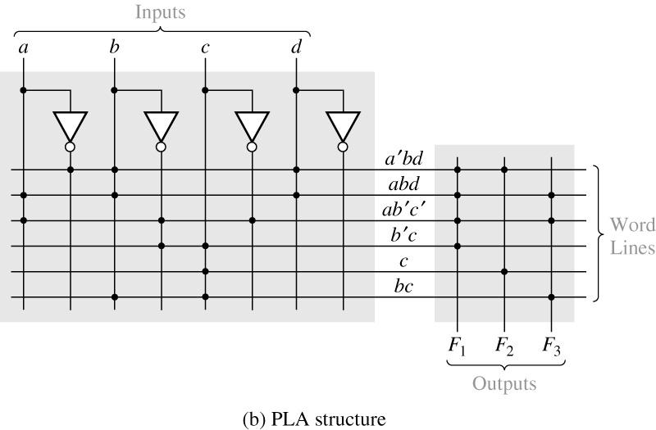
9.6 Programmable Logic Devices
PLA Realization of Equations (7-23b) (p194)
a | b | c | d |  | f₁ | f₂ | f₃
0 1 1 - - - | 1 1 0 0 - 1 | - - 0 1 1 1 | 1 1 - - - - |  | 1 1 1 1 0 0 | 1 0 0 0 1 0 | 0 1 1 0 0 1
(a) PLA table

Slide 36
9.6 Programmable Logic Devices
Programmable Array Logic (PAL)
AND array is programmable and OR array is fixed.
PAL

Slide 37
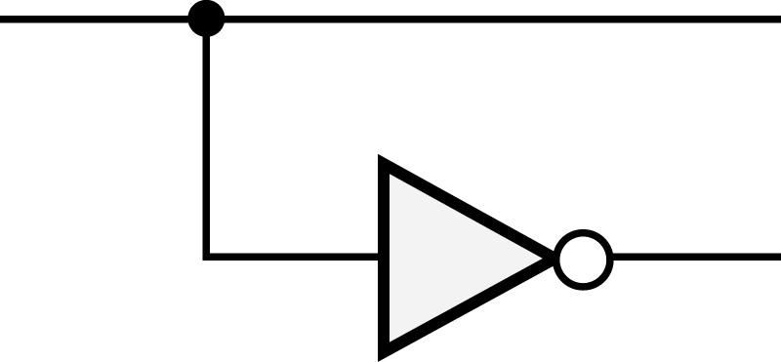
9.6 Programmable Logic Devices
Programmable Array Logic (PAL)
AND array is programmable and OR array is fixed.
logically equal

Slide 38
9.6 Programmable Logic Devices
Programmable Array Logic
Connections to the AND gate inputs in a PAL is represented by X

Slide 39
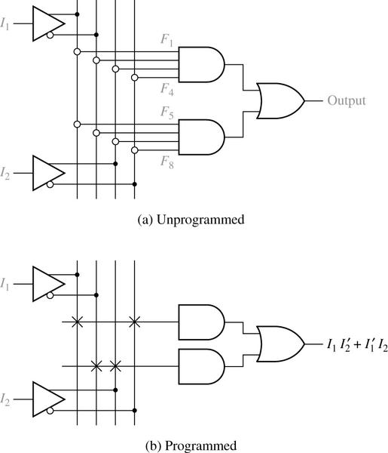
9.6 Programmable Logic Devices
PAL Segment

Slide 40
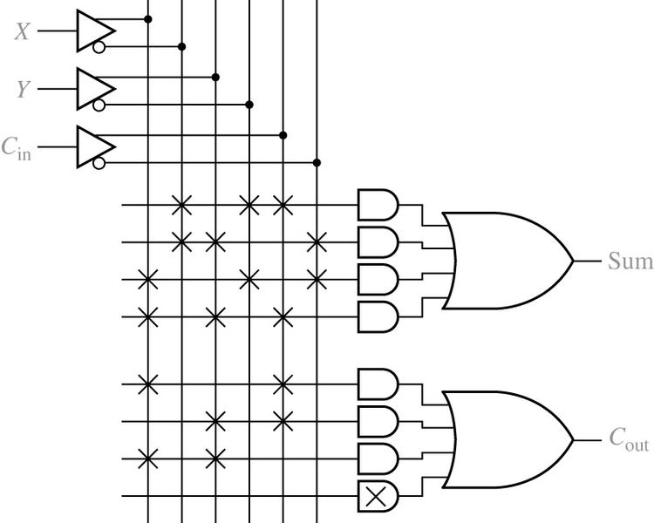
9.6 Programmable Logic Devices
Implementation of a Full Adder Using a PAL

Slide 41
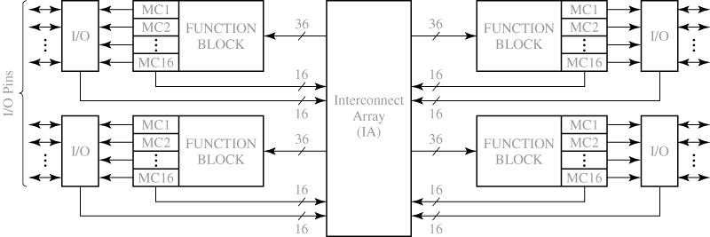
9.7 Complex Programmable Logic Devices
Basic Architecture of Xilinx XCR3064XL CPLD
4 Function Blocks: programmable AND-OR array
16 Macrocells per Block: flip-flop and MUXs

Slide 42
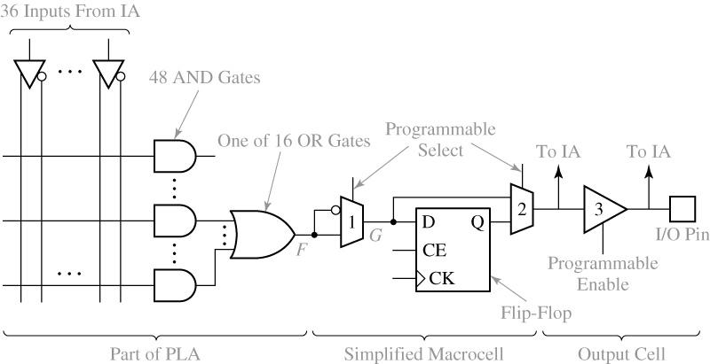
9.7 Complex Programmable Logic Devices
CPLD Function Block and Macrocell
(A Simplified Version of XCR3064XL)

Slide 43
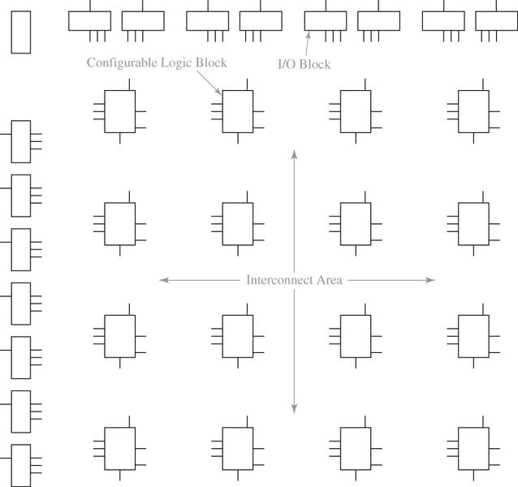
9.8 Field Programmable Gate Arrays
Layout of a Typical FPGA

Slide 44
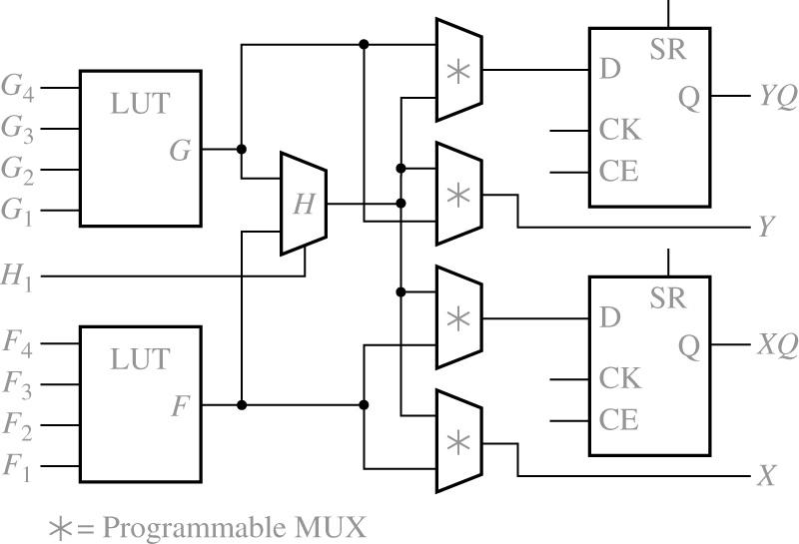
9.8 Field Programmable Gate Arrays
Simplified Configurable Logic Block (CLB)
Function Generator
Function Generator

Slide 45
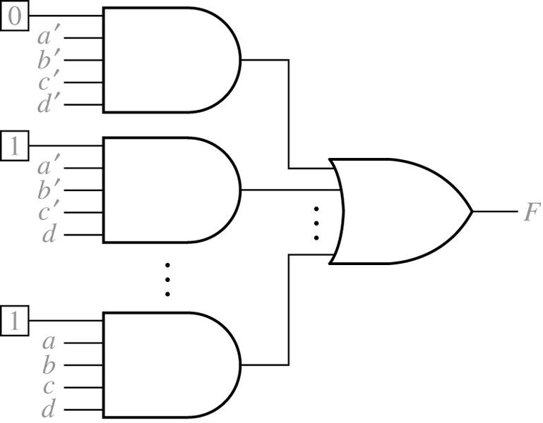
9.8 Field Programmable Gate Arrays
Implementation of a Function Generator (Lookup Table, LUT)
a | b | c | d | f
0 0 · · 1 | 0 0 · · 1 | 0 0 · · 1 | 0 1 · · 1 | 0 1 · · 1

Slide 46
9.8 Field Programmable Gate Arrays
Decomposition if switching Functions

Slide 47
9.8 Field Programmable Gate Arrays
Decomposition if switching Functions

Slide 48
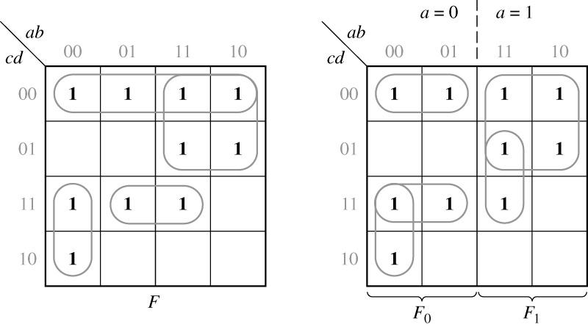
9.8 Field Programmable Gate Arrays
Function Expansion Using a Karnaugh Map

Slide 49
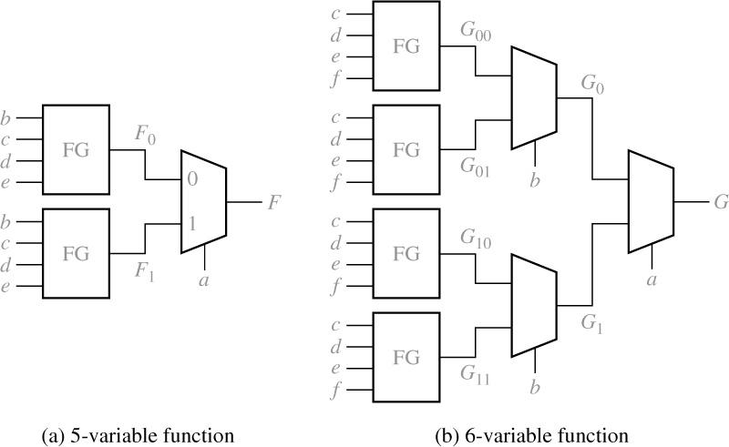
9.8 Field Programmable Gate Arrays
Realization of Five- and Six-Variable Functions
with Function Generators

Slide 50
