Slide 1
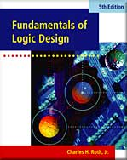
UNIT 5 KARNAUGH MAPS
Objectives
Study Guide
5.1 Minimum Forms of Switching Functions
5.2 Two- and Three-Variable Karnaugh Maps
5.3 Four-Variable Karnaugh Maps
5.4 Determination of Minimum Expressions
5.5 Five-Variable Karnaugh Maps
5.6 Other Uses of Karnaugh Maps
5.7 Other Forms of Karnaugh Maps
Programmed Exercises
Problems

Slide 2
Objectives
Given a function (completely or in completely specified) of three to five variable, plot it on a Karnaugh map. The function may be given in minterm, maxterm, or algebraic form.
Determine the essential prime implicants of a function from a map.
Obtain the minimum sum-of-products or minimum product-of-sums form of a function from the map.
Determine all of the prime implicants of a function from a map.
Understand the relation between operations performed using the map and the corresponding algebraic operation.

Slide 3
Karnaugh Maps
Two Problems of Simplifying a Switching Function Using Algebraic Techniques
Difficult to apply in a systematic way.
Difficult to tell when you have arrived at a minimum solution.
Karnaugh Map method and Quine-McCluskey Procdure
Easy and systematic to get a a minimum solution.

Slide 4
5.1 Minimum Forms of Switching Functions
Realizing a switching function using AND and OR gates
Sum-of-Products form

Slide 5
5.1 Minimum Forms of Switching Functions
Sum-of-Products form
What we want is a circuit with
Minimum number of gates
Minimum number of gate inputs
Minimum number of terms
Minimum number of literals
Minimum Sum-of-Products form

Slide 6
5.1 Minimum Forms of Switching Functions
Procedure for obtaining a minimum sum-of-products
Combine terms by using . Do this repeatedly to eliminates as many literals as possible.
A given term may be used more than once because
Eliminate redundant terms by using the consensus theorem or other theorems.

Slide 7
5.1 Minimum Forms of Switching Functions
Example: Find a minimum sum-of-products
The result may depend on the order in which terms are combined or eliminated

Slide 8
5.1 Minimum Forms of Switching Functions
Example: Find a minimum product-of-sums
dual
Eliminated by consensus

Slide 9
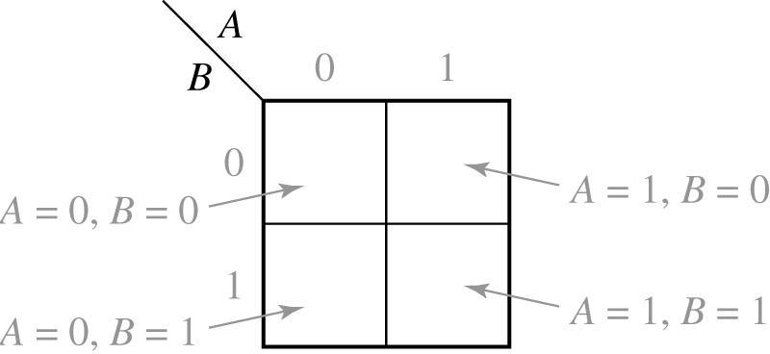
5.2 Two- and Three-Variable Karnaugh Maps
A 2-variable Karnaugh Map

Slide 10
5.2 Two- and Three-Variable Karnaugh Maps
Example: Truth table and Karnaugh map for a two-variable function
A B | F
0 0 0 1 1 0 1 1 | 1 1 0 0
(a)

Slide 11
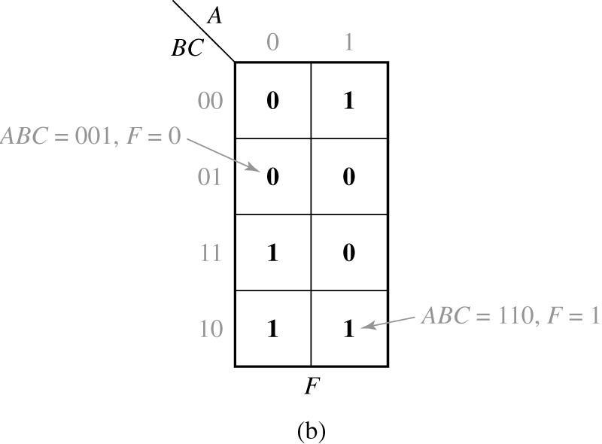
5.2 Two- and Three-Variable Karnaugh Maps
Example: Truth table and Karnaugh map for a three-variable function
A B C | F
0 0 0 0 0 1 0 1 0 0 1 1 1 0 0 1 0 1 1 1 0 1 1 1 | 0 0 1 1 1 0 1 0
(a)

Slide 12
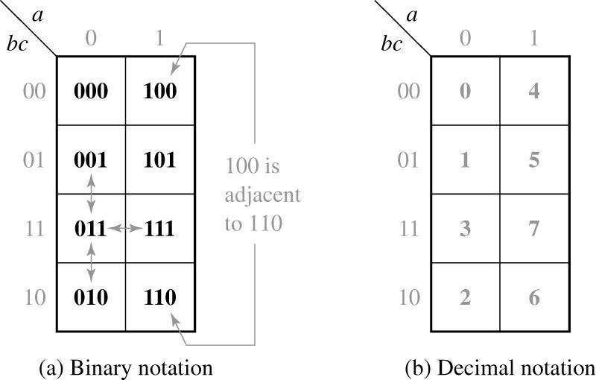
5.2 Two- and Three-Variable Karnaugh Maps
Location of minterms on a three-variable Karnaugh map
Minterms in adjacent squares differ in only one variable
Can be combined using the theorem

Slide 13
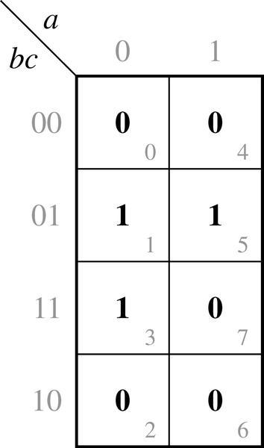
5.2 Two- and Three-Variable Karnaugh Maps
Plot of minterms and maxterms
Karnaugh Map of
Plot of minterm: mark 1
Plot of maxterm: mark 0

Slide 14
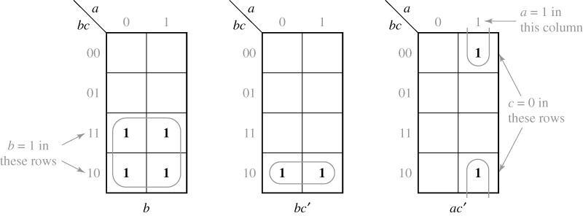
5.2 Two- and Three-Variable Karnaugh Maps
Karnaugh maps for non-minterm product terms
term b
term bc’
term ac’

Slide 15
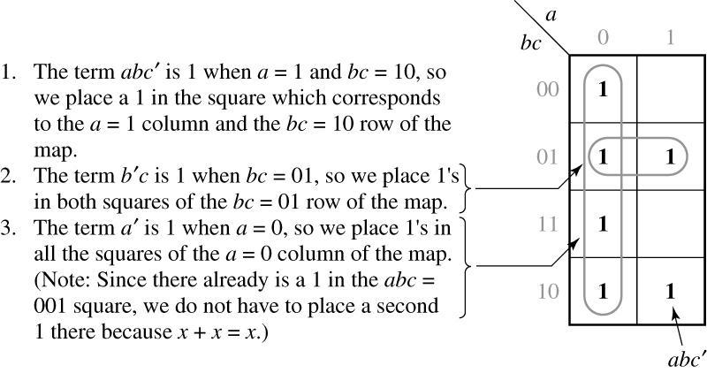
5.2 Two- and Three-Variable Karnaugh Maps
Karnaugh maps for non-minterm product terms

Slide 16
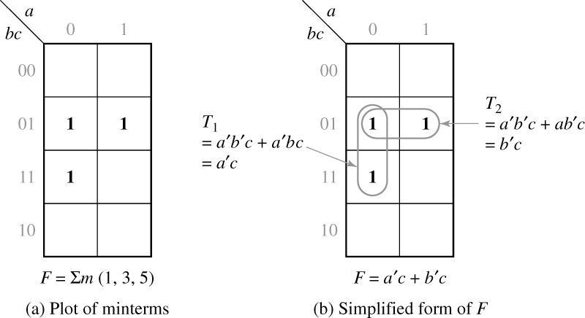
5.2 Two- and Three-Variable Karnaugh Maps
$$F\left(a,b,c\right)=\sum{m(1,3,5)}$$
Simplification of a Three-Variable Function
$$F=T_{1}+T_{2}=a^{′}c+b^{′}c$$

Slide 17
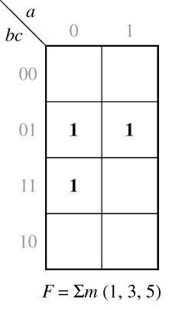
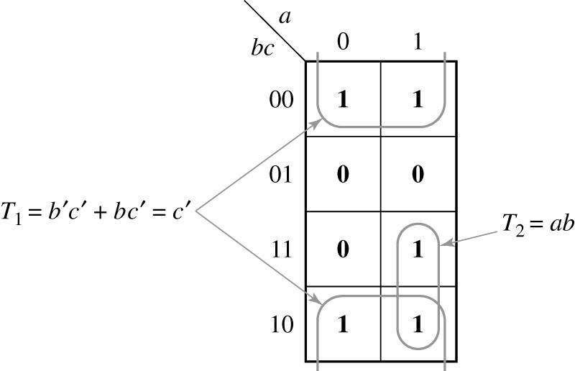
5.2 Two- and Three-Variable Karnaugh Maps
Complement of a function
F’:
Replace 0 → 1
and 1 → 0
$$F^{′}=T_{1}+T_{2}=c^{′}+ab$$

Slide 18
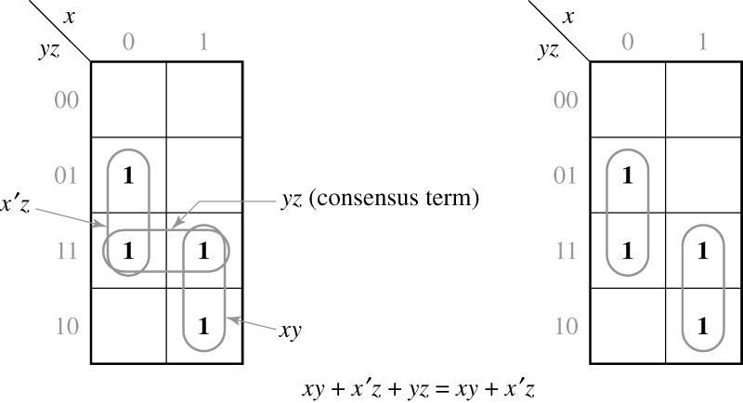
5.2 Two- and Three-Variable Karnaugh Maps
Karnaugh map for consensus theorem
Consensus term is redundant

Slide 19
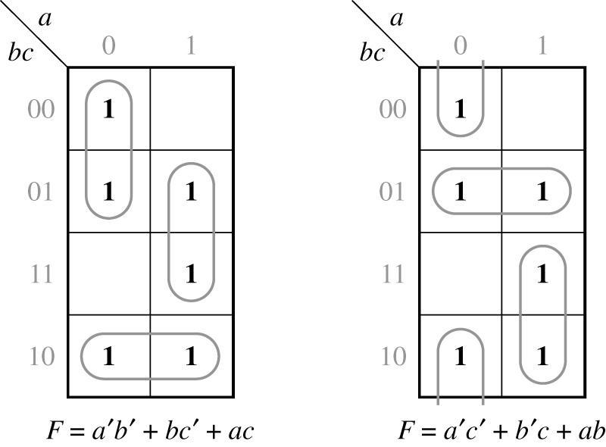
5.2 Two- and Three-Variable Karnaugh Maps
Function with two minimum forms
$$F(a,b,c)=\sum{m(}0,1,2,5,6,7)$$

Slide 20
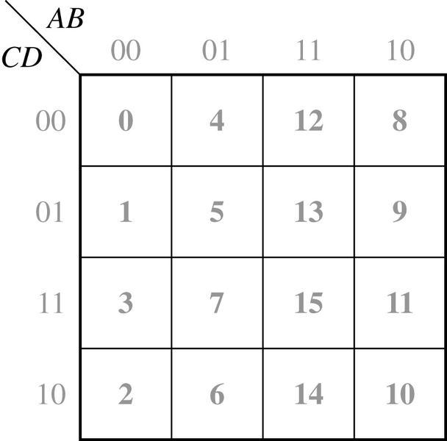
5.3 Four-Variable Karnaugh Maps
Location of minterms on four-variable Karnaugh map

Slide 21
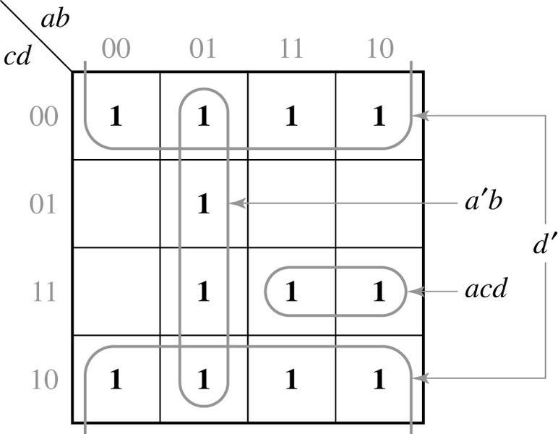
5.3 Four-Variable Karnaugh Maps
Plot of a function
$$f\left(a,b,c,d\right)=acd+a^{′}b+d′$$

Slide 22
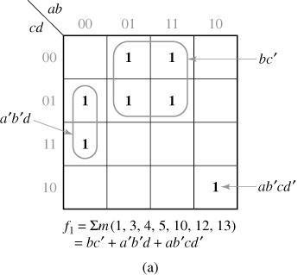
5.3 Four-Variable Karnaugh Maps
Simplification of four-variable function

Slide 23
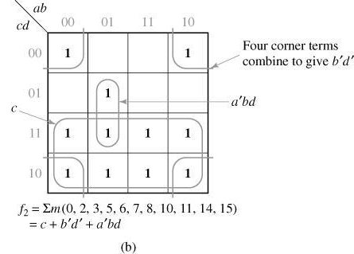
5.3 Four-Variable Karnaugh Maps
Simplification of four-variable function

Slide 24
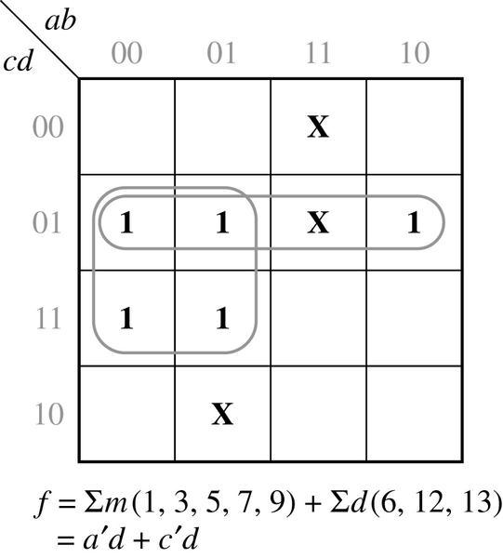
5.3 Four-Variable Karnaugh Maps
Simplification of an function with don’t care conditions
don’t care term

Slide 25
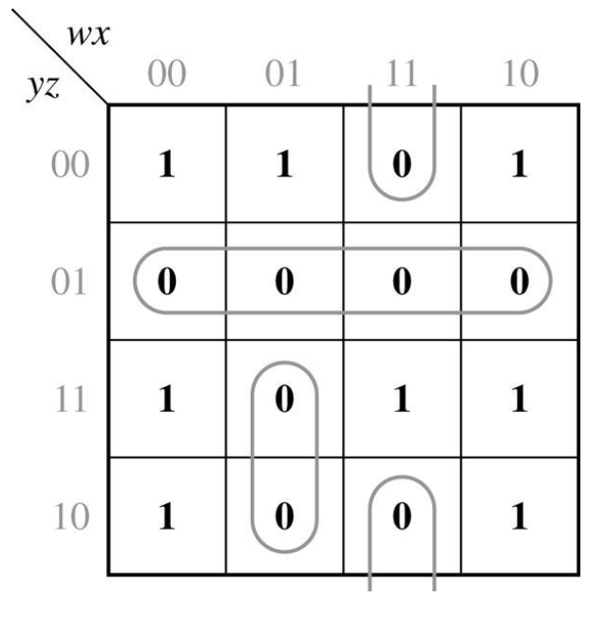
5.3 Four-Variable Karnaugh Maps
Find minimum product-of-sums by using Karnaugh map
Given
Plot 1’s of f
Group 0’s in the map → f’
Apply DeMorgan’s law

Slide 26
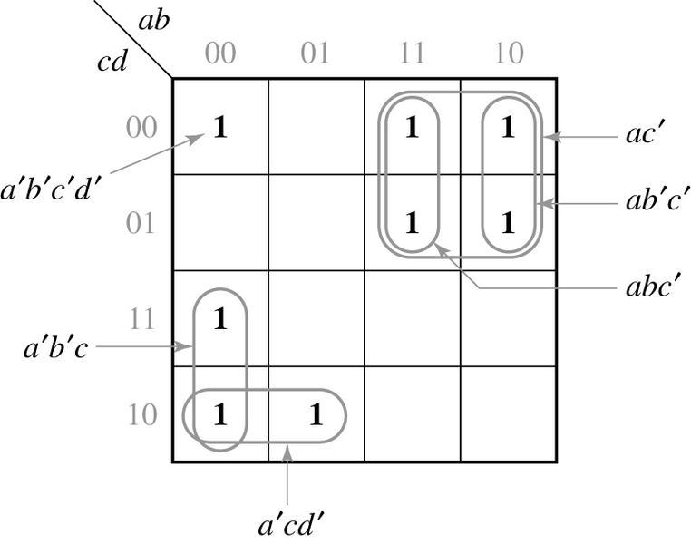
5.4 Determination of Minimum Expressions Using Essential Prime Implicants
Implicants of F
Any product term in sum-of products form
Prime Implicants of F
A product term which can not be combined with other terms to eliminate variable
Prime Implicants
Non-Prime Implicants

Slide 27
5.4 Determination of Minimum Expressions Using Essential Prime Implicants
Determination of Prime Implicants (PI)
A single 1 on a map can be a PI if it is not adjacent to any other 1’s.
Two adjacent 1’s if they are not contained in a group of four 1’s.
Four adjacent 1’s if they are not contained in a group of eight 1’s.
And so on…
Prime Implicants
Non-Prime Implicants

Slide 28
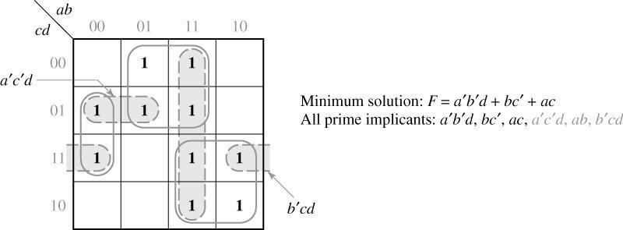
5.4 Determination of Minimum Expressions Using Essential Prime Implicants
Prime Implicants and Minimum Solution
ab

Slide 29
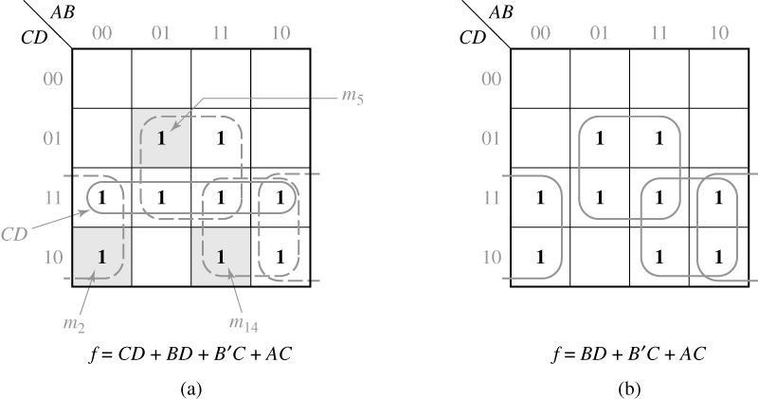
5.4 Determination of Minimum Expressions Using Essential Prime Implicants
Systematic Procedure for Selecting Prime Implicants
CD is chosen first
Other PI’s are chosen first

Slide 30
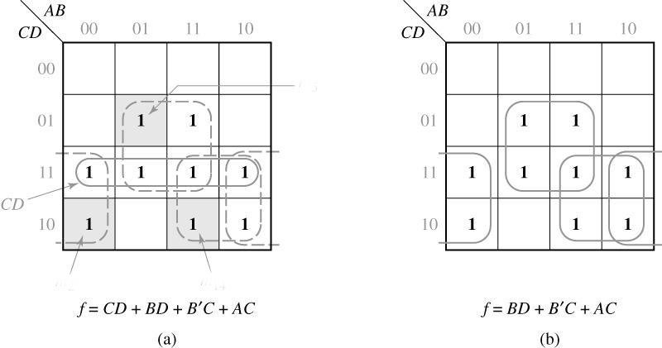
5.4 Determination of Minimum Expressions Using Essential Prime Implicants
Essential Prime Implicants (EPI)
If a minterm is covered by only one PI, the PI is said to be an EPI
m₅
m₂
m₁₄
BD, B’C, AC: EPI

Slide 31
5.4 Determination of Minimum Expressions Using Essential Prime Implicants
Procedure for Selecting EPI
AB
BC’
Loop all PI
Find minterm covered by only one PI
Select that PI as an EPI
Repeat step 2 and 3
CD
00
01
11
10
00
1
1
0
4
12
8
01
1
1
1
1
5
13
9
11
1
1
1
3
7
15
11
10
1
1
1. m₄ is covered by only BC’
2. m₁₀ is covered by only AC
3. BC’ and AC are EPI
2
6
14
10
AC

Slide 32
5.4 Determination of Minimum Expressions Using Essential Prime Implicants
Systematic Approach for Finding EPIs
If a given minterm and all of the 1’s adjacent to it are covered by a single term, then that term is an EPI.
If all of the 1’s adjacent to a given minterm are not covered by a single term, then there are two or more PIs which cover that minterm, and we cannot say whether these PIs are essential or not without checking other minterms.

Slide 33
5.4 Determination of Minimum Expressions Using Essential Prime Implicants
Systematic Approach for Finding EPIs
Check adjacent 1’s for m₀(1₀)
No single term covers 1₀, 1₁, 1₂, 1₄.
No EPIs
AB
CD
00
01
11
10
00
1
1
Check adjacent 1’s for 1₁
A’C’ covers 1₁, 1₀, 1₅.
A’C’ is an EPI.
A’C’
0
4
12
8
01
1
1
1
5
13
9
11
1
1
1
Check adjacent 1’s for 1₂
A’B’D’ covers 1₂, 1₀.
A’B’D’ is an EPI.
3
7
15
11
10
1
2
6
14
10
A’B’D’

Slide 34
5.4 Determination of Minimum Expressions Using Essential Prime Implicants
Systematic Approach for Finding EPIs
Check adjacent 1’s for 1₇
No single term covers 1₇, 1₅, 1₁₅.
No EPIs
AB
CD
00
01
11
10
00
1
1
Check adjacent 1’s for 1₁₁
ACD covers 1₁, 1₀, 1₅.
ACD is an EPI.
A’C’
0
4
12
8
01
1
1
1
5
13
9
11
1
1
1
A’BD or BCD is selected to include 1₇.
A’BD
3
7
15
11
10
1
2
6
14
10
A’B’D’
BCD
ACD

Slide 35
5.4 Determination of Minimum Expressions Using Essential Prime Implicants
Flowchart for Determining a Minimum SOP Using a Karnaugh Map
Choose a 1 which has not been covered.
NO
All uncovered 1’s checked?
Find all adjacent 1’s and X’s.
YES
Are the chosen 1 and its adjacent 1’s and X’s covered by a single term?
NO
Find a minimum set of prime implicants which cover the remaining 1’s on the map.
YES
That term is an EPI. Loop it.
Stop.

Slide 36
5.4 Determination of Minimum Expressions Using Essential Prime Implicants
A’B covers 1₆ and its adjacent → EPI
AB’D’ covers 1₁₀ and its adjacent → EPI
AC’D is chosen for minimal cover → AC’D is not an EPI
AB
CD
00
01
11
10
00
X₀
1₄
1₈
01
1₅
1₁₃
1₉
AC’D
11
X₇
X₁₅
A’B
10
1₆
1₁₀
AB’D’

Slide 37
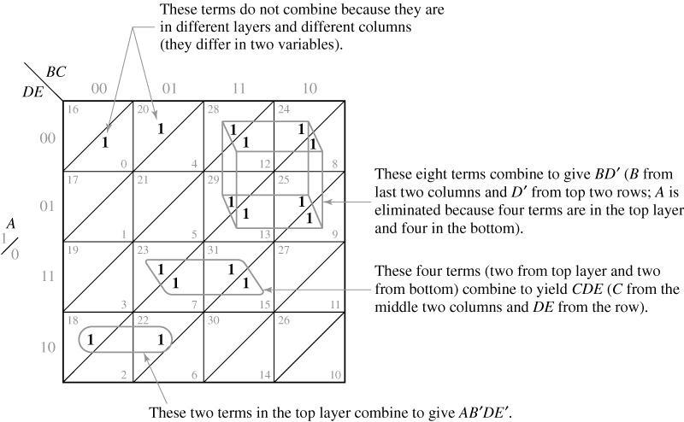
5.5 Five-Variable Karnaugh Maps
Two Layers of Four-Variable Karnaugh Map

Slide 38
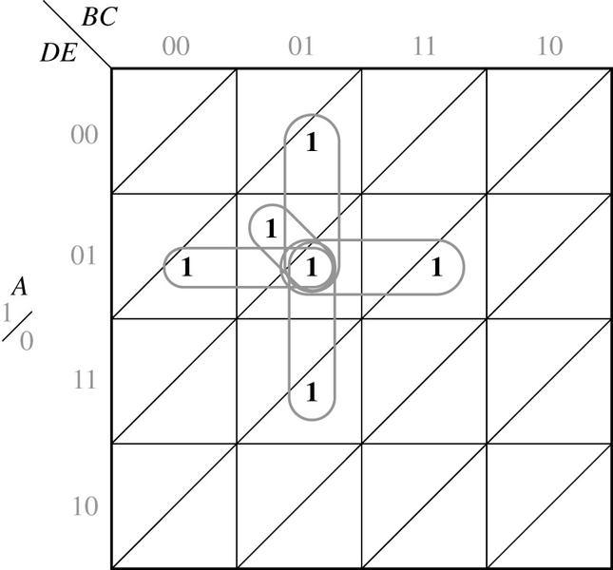
5.5 Five-Variable Karnaugh Maps
Five Adjacent Terms
Four adjacent terms in the same layer
One adjacent term in the other layer

Slide 39
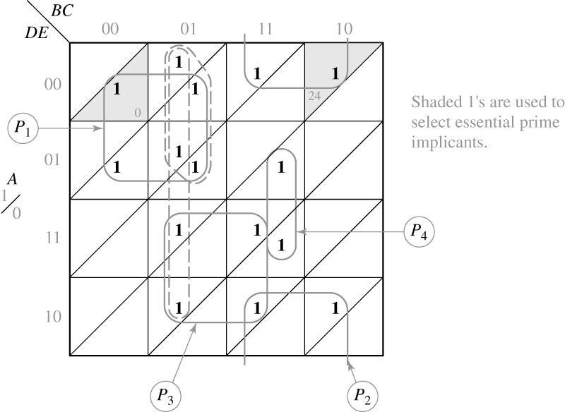
5.5 Five-Variable Karnaugh Maps
Resulting minimum solution

Slide 40
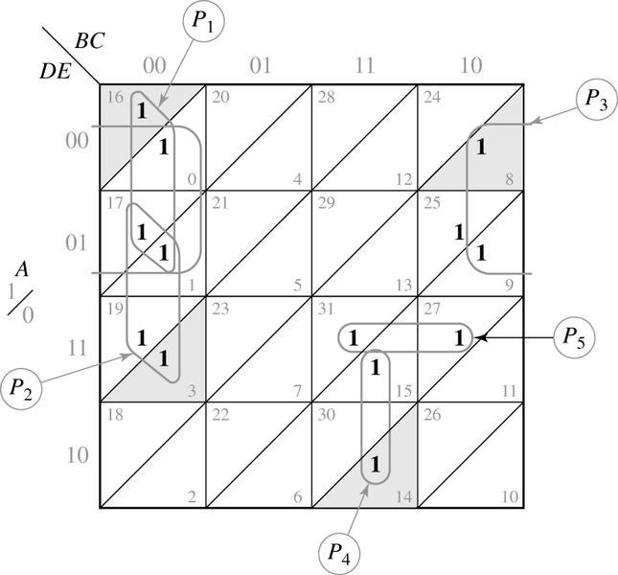
5.5 Five-Variable Karnaugh Maps
Final solution

Slide 41
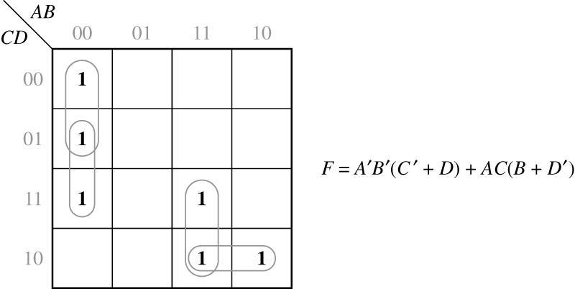
5.6 Other Uses of Karnaugh Maps
Finding Common Terms

Slide 42
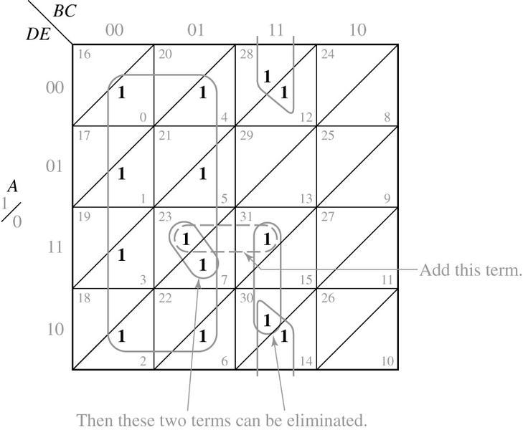
5.6 Other Uses of Karnaugh Maps
A Guide for Simplifying a Function Algebraically
ACDE

Slide 43
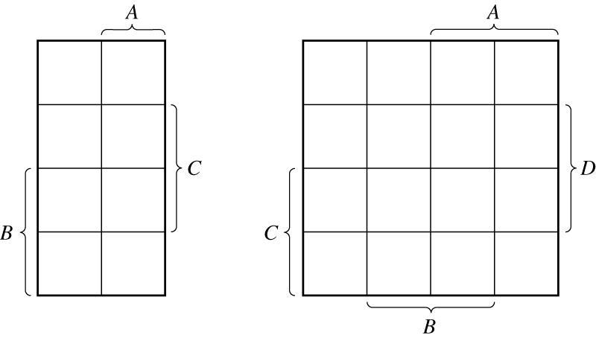
5.7 Other Forms of Karnaugh Maps
Veitch Diagrams

Slide 44
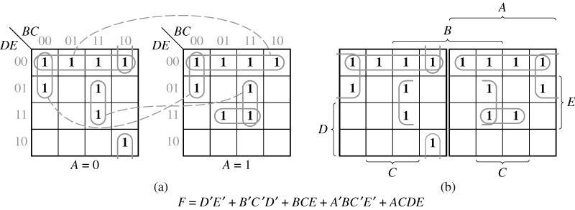
5.7 Other Forms of Karnaugh Maps
Other Forms of Five-Variable Karnaugh Maps

