Slide 1
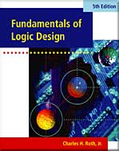
UNIT 4
Applications of Boolean Algebra/
Minterm and Maxterm Expansions
Objectives
Study Guide
4.1 Conversion of English Sentences to Boolean
Equations
4.2 Combinational Logic Design Using a Truth Table
4.3 Minterm and Maxterm Expansions
4.4 General Minterm and Maxterm Expansions
4.5 Incompletely Specified Functions
4.6 Examples of Truth Table Construction
4.7 Design of Binary Adders and Subtracters

Slide 2
Objective
Conversion of Verbal Description to Boolean Equations
Combinational Logic Design Using a Truth Table
Minterm and Maxterm Expansions
General Minterm and Maxterm Expansions
Incompletely Specified Functions (Don’t care term)
Examples of Truth Table Construction
Design of Binary Adders(Full adder) and Subtracters

Slide 3
4.1 Conversion of Verbal Description to Boolean Equations
Steps in designing a single-output combinational switching circuit
Find a switching function which specifies the desired behavior of the circuit
Find a simplified algebraic expression for the function
Realize the simplified function using available logic elements

Slide 4
4.1 Conversion of Verbal Description to Boolean Equations
Example
Mary watches TV if it is Monday night and she has finished her homework.
F = 1 if “Mary watches TV ” is true; otherwise, F = 0;
A = 1 if “it is Monday night ” is true; otherwise, A = 0;
B = 1 if “she has finished her homework” is true; otherwise, B = 0;
F is ‘true’ if A and B are both ‘true’ → F = A·B

Slide 5
4.1 Conversion of Verbal Description
to Boolean Equations
1. Verbal Description
The alarm will ring iff the alarm switch is turned on and the door is not closed, or it is after 6PM and window is not closed.
Breaking Down
The alarm will ring iff
the alarm switch is turned on and the door is not closed,
or it is after 6PM and window is not closed.
Z
A
B’
C
D’

Slide 6
4.1 Conversion of Verbal Description
to Boolean Equations
2. Boolean Equation
The alarm will ring iff
the alarm switch is turned on and the door is not closed,
or it is after 6PM and window is not closed.
Z
A
B’
C
D’

Slide 7
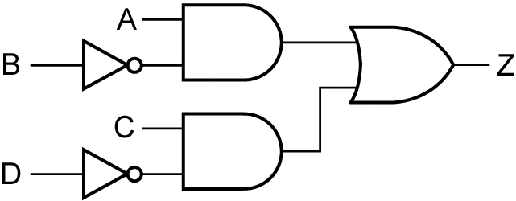
4.1 Conversion of Verbal Description
to Boolean Equations
2. Boolean Equation
3. Circuit Realization

Slide 8
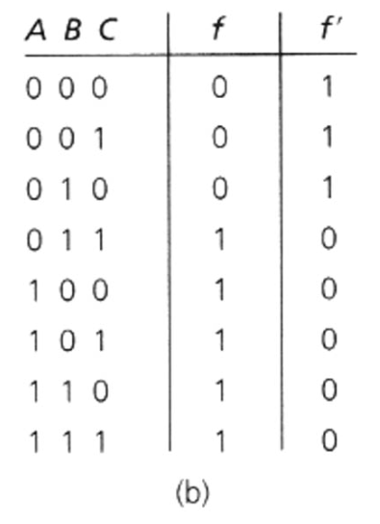
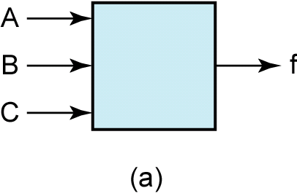
4.2 Combinational Logic Design
Using a Truth Table
Verbal Description
A switching circuit with three inputs and one output
The inputs are A, B, and C and represent a binary number N
f = 1 if N ≥ 011₂ and f = 0 if N < 011₂

Slide 9
4.2 Combinational Logic Design
Using a Truth Table
Deriving an algebraic expression for f = 1
Simplifying the algebraic expression

Slide 10
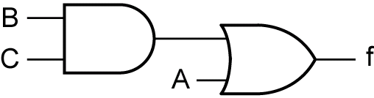
4.2 Combinational Logic Design Using a Truth Table
Original Equation
Simplified Equation
Circuit Realization

Slide 11
4.2 Combinational Logic Design Using a Truth Table
Expression for f = 0 i.e. f’ = 1
Taking the complement of f ’

Slide 12
4.2 Combinational Logic Design Using a Truth Table
Expression for f = 0

Slide 13
4.2 Combinational Logic Design Using a Truth Table
Simplifying

Slide 14
4.3 Minterm and Maxterm Expansions
Literal
A variable or its complement (e.g. A, A’)
Minterm of n variables
A product of n literals in which each variable appears exactly once in either true or complemented form, but not both
Notation
m_{i}

Slide 15
4.3 Minterm and Maxterm Expansions
Minterm of 3 variables
Row No. | A B C | Minterms | Maxterms
0 1 2 3 4 5 6 7 | 0 0 0 0 0 1 0 1 0 0 1 1 1 0 0 1 0 1 1 1 0 1 1 1 | A’B’C’ = m₀ A’B’C = m₁ A’BC’ = m₂ A’BC = m₃ AB’C’ = m₄ AB’C = m₅ ABC’ = m₆ ABC = m₇ | A+B+C = M₀ A+B+C’ = M₁ A+B’+C = M₂ A+B’+C’ = M₃ A’+B+C = M₄ A’+B+C’ = M₅ A’+B’+C = M₆ A’+B’+C’ = M₇

Slide 16
4.3 Minterm and Maxterm Expansions
Sum of minterms
Minterm expansion
Standard sum of products
Canonical sum of products

Slide 17
4.3 Minterm and Maxterm Expansions
Maxterm of n variables
A sum of n literals in which each variable appears exactly once in either true or complemented form, but not both
Notation
M_{i}

Slide 18
4.3 Minterm and Maxterm Expansions
Maxterm of 3 variables
Row No. | A B C | Minterms | Maxterms
0 1 2 3 4 5 6 7 | 0 0 0 0 0 1 0 1 0 0 1 1 1 0 0 1 0 1 1 1 0 1 1 1 | A’B’C’ = m₀ A’B’C = m₁ A’BC’ = m₂ A’BC = m₃ AB’C’ = m₄ AB’C = m₅ ABC’ = m₆ ABC = m₇ | A+B+C = M₀ A+B+C’ = M₁ A+B’+C = M₂ A+B’+C’ = M₃ A’+B+C = M₄ A’+B+C’ = M₅ A’+B’+C = M₆ A’+B’+C’ = M₇

Slide 19
4.3 Minterm and Maxterm Expansions
Product of maxterms
Maxterm expansion
Standard product of sums
Canonical product of sums

Slide 20
4.3 Minterm and Maxterm Expansions
Finding Complement

Slide 21
4.3 Minterm and Maxterm Expansions
Minterm and Maxterm expansions are complement each other

Slide 22
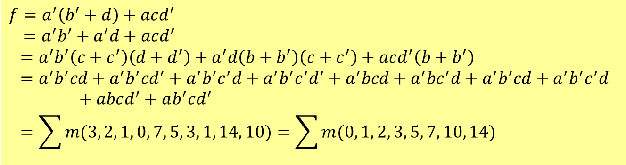

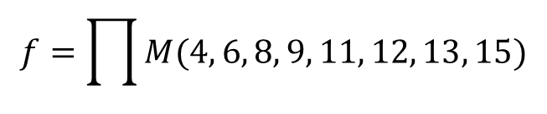
4.3 Minterm and Maxterm Expansions
Introducing Missing Variables
Find the minterm expansion of
$$f\left(a,b,c,d\right)=a^{′}\left(b^{′}+d\right)+acd′$$
$$f=a^{′}\left(b^{′}+d\right)+acd^{′}$$
$=a^{′}b^{′}+a^{′}d+acd^{′}$
$$=a^{′}b^{′}\left(c+c^{′}\right)\left(d+d^{′}\right)+a^{′}d\left(b+b^{′}\right)\left(c+c^{′}\right)+acd^{′}\left(b+b^{′}\right)$$
$$=a^{′}b^{′}cd+a^{′}b^{′}cd^{′}+a^{′}b^{′}c^{′}d+a^{′}b^{′}c^{′}d^{′}+a^{′}bcd+a^{′}bc^{′}d+a^{′}b^{′}cd+a^{′}b^{′}c^{′}d+abcd^{′}+ab^{′}cd^{′}$$
$$=\sum{m(3, 2, 1, 0, 7, 5, 3, 1, 14, 10)}=\sum{m(0, 1, 2, 3, 5, 7, 10, 14)}$$
$$f=\prod{M(4, 6, 8, 9, 11, 12, 13, 15)}$$
Maxterm expansion

Slide 23
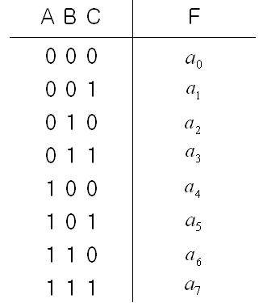
4.4 General Minterm and Maxterm Expansions
Minterm expansion for general function
a_{i} =1, minterm m_{i} is present
a_{i} =0, minterm m_{i} is not present
General truth table for 3 variables
a_{i} is either ‘0’ or ‘1’

Slide 24
4.4 General Minterm and Maxterm Expansions
Maxterm expansion for general function
a_{i} =1, a_{i} + M_{i} =1 , Maxterm M_{i} is not present
a_{i} =0, Maxterm is present
General truth table for 3 variables
a_{i} is either ‘0’ or ‘1’

Slide 25
4.4 General Minterm and Maxterm Expansions
Finding Complement
All minterms which are not present in F are present in F’

Slide 26
4.4 General Minterm and Maxterm Expansions
Finding Complement
All maxterms which are not present in F are present in F’

Slide 27
4.4 General Minterm and Maxterm Expansions
Generalizing Equations for n Variables

Slide 28
4.4 General Minterm and Maxterm Expansions
Product of Boolean functions
If i and j are different, m_{i} m_{j} = 0
f₁ f₂ contains only those minterms which are present in both f₁ and f₂.

Slide 29
4.4 General Minterm and Maxterm Expansions
Product of Boolean functions
Example

Slide 30
Conversion between minterm and maxterm expansions of F and F’
DESIRED FORM
 | Minterm Expansion of F | Maxterm Expansion of F | Minterm Expansion of F’ | Maxterm Expansion of F’
Minterm Expansion of F |  | Maxterm nos. are those nos. not on the minterm list for F | List minterms not present in F | Maxterm nos. are the same as minterm nos. of F
Maxterm Expansion of F | Minterm nos. are those nos. not on the maxterm list for F |  | Minterm nos. are the same as maxterm nos. of F | List maxterms not present in F
GIVEN FORM

Slide 31
Conversion between minterm and maxterm expansions of F and F’
For Three Variables
DESIRED FORM
 | Minterm Expansion of F | Maxterm Expansion of F | Minterm Expansion of F’ | Maxterm Expansion of F’
F= ∑m(3,4,5,6,7) |  | ∏M(0,1,2) | ∑m(0,1,2) | ∏M(3,4,5,6,7)
F=∏M(0,1,2) | ∑m(3,4,5,6,7) |  | ∑m(0,1,2) | ∏M(3,4,5,6,7)
GIVEN FORM

Slide 32
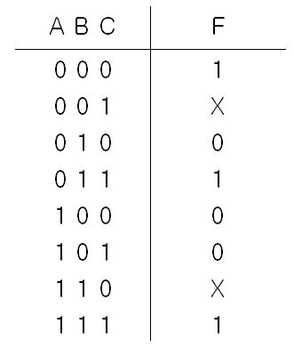
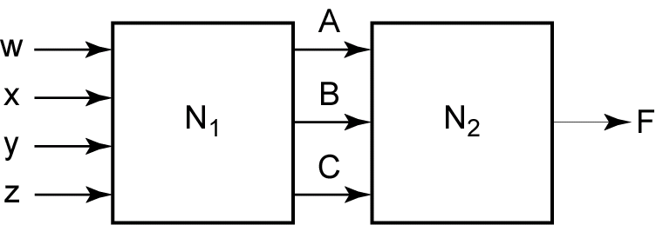
4.5 Incompletely Specified Functions
Don’t Care
Truth Table with Don’t Cares
If N₁ output does not generate all possible combination of A, B, C, the output of N₂(F) has don’t care values.

Slide 33
4.5 Incompletely Specified Functions
Don’t Care
When realize, assign values which will help simplify the function
Case 1: assign ‘0’ on X’s
Case 2: assign ‘1’ to the first X and ‘0’ to the second ‘X’
Case 3: assign ‘1’ on X’s
The case 2 leads to the simplest function

Slide 34
4.5 Incompletely Specified Functions
Notation for Don’t Care Terms
Minterm expansion for incompletely specified function
Don’t Cares
Maxterm expansion for incompletely specified function
Don’t Cares

Slide 35




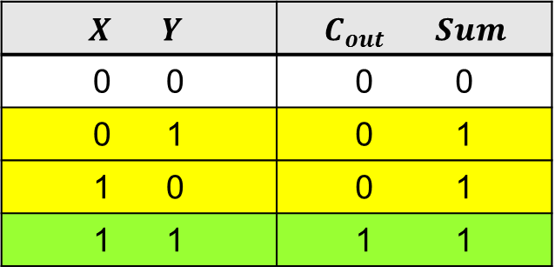


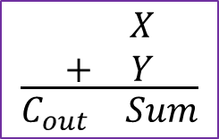
4.7 Design of Binary Adders and Subtracters
Half Adder
Truth Table for a Half Adder
$$X Y$$ | $$C_{out} Sum$$
0 0 | 0 0
0 1 | 0 1
1 0 | 0 1
1 1 | 1 1
$$X$$
Half
Adder
$$C_{out}$$
$$Y$$
$$Sum$$
$$\frac{\begin{matrix} & X \\ + & Y\end{matrix}}{\begin{matrix}C_{out} & Sum\end{matrix}}$$
$$Sum=X^{′}Y+XY^{′}=X⊕Y$$
$$C_{out}=XY$$

Slide 36
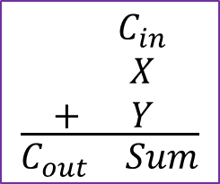

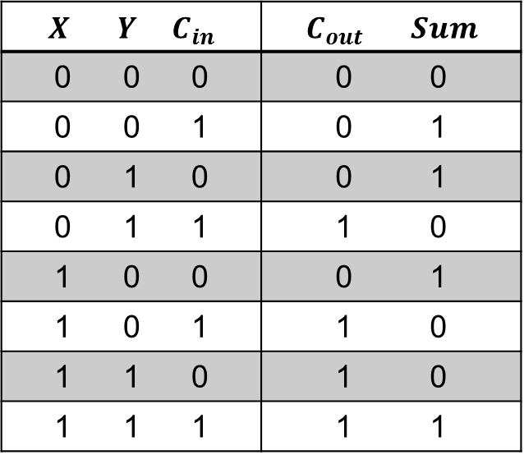



4.7 Design of Binary Adders and Subtracters
Full Adder
Truth Table for a Full Adder
$$X Y C_{in}$$ | $$C_{out} Sum$$
0 0 0 | 0 0
0 0 1 | 0 1
0 1 0 | 0 1
0 1 1 | 1 0
1 0 0 | 0 1
1 0 1 | 1 0
1 1 0 | 1 0
1 1 1 | 1 1
$$X$$
Full
Adder
$$C_{out}$$
$$Y$$
$$Sum$$
$$C_{in}$$
$$\frac{\begin{matrix} & C_{in} \\ & X \\ + & Y\end{matrix}}{\begin{matrix}C_{out} & Sum\end{matrix}}$$

Slide 37
4.7 Design of Binary Adders and Subtracters
Implementation of Full Adder

Slide 38
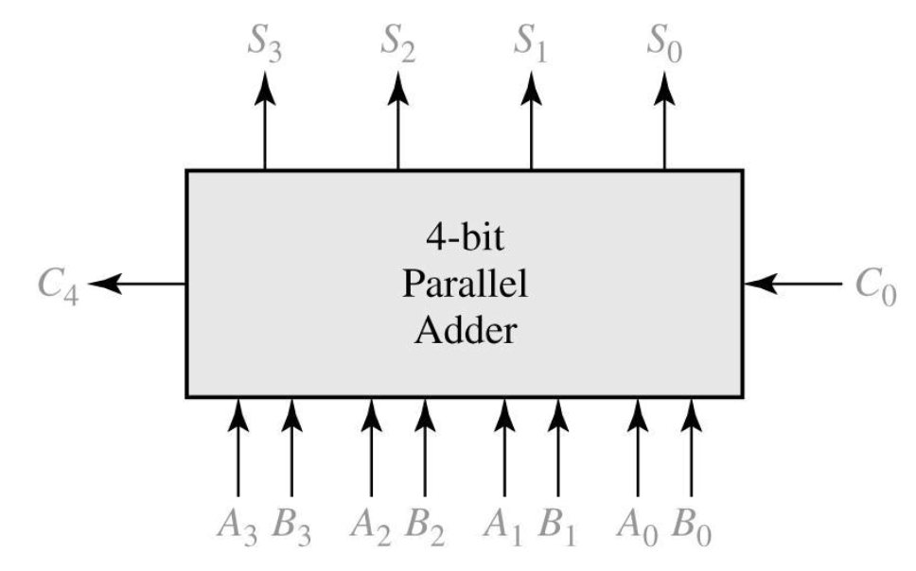
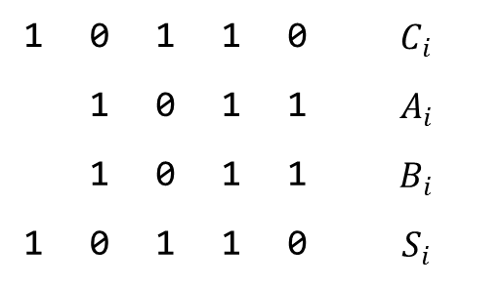

4.7 Design of Binary Adders and Subtracters
Parallel Adder for 4 bit Binary Numbers
1 | 0 | 1 | 1 | 0 | $$C_{i}$$
 | 1 | 0 | 1 | 1 | $$A_{i}$$
 | 1 | 0 | 1 | 1 | $$B_{i}$$
1 | 0 | 1 | 1 | 0 | $$S_{i}$$
$$+$$

Slide 39
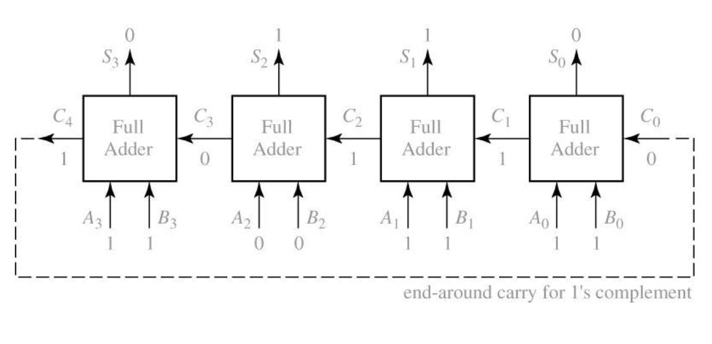
4.7 Design of Binary Adders and Subtracters
Parallel Adder Composed of Four Full Adders
Carry Ripple Adder (slow!)

Slide 40
4.7 Design of Binary Adders and Subtracters
Signed numbers in 1’s complement
The end-around carry is accomplished by connecting C₄ to C₀ input
Signed numbers in 2’s complement
The last carry (C₄) is discarded, and no carry into the first cell

Slide 41
4.7 Design of Binary Adders and Subtracters
Overflow(V) when adding two signed binary number

Slide 42
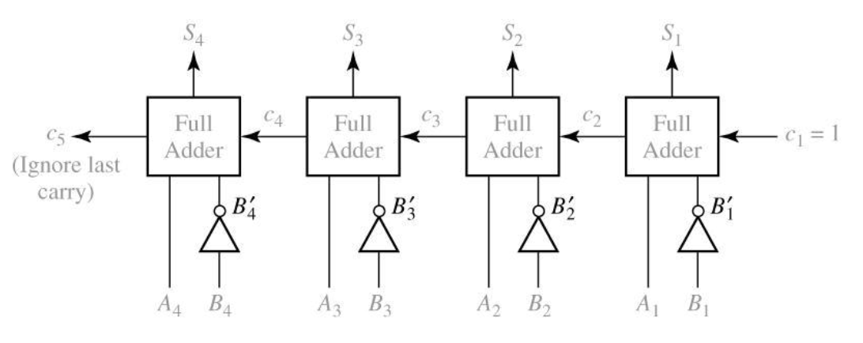
4.7 Design of Binary Adders and Subtracters
Binary Subtracter Using Full Adder
Subtraction is done by adding the 2’s complemented number to be subtracted
2’s complemented number

Slide 43
4.7 Design of Binary Adders and Subtracters
Parallel Subtracter Using Full Subtracters
d_{n}
d_{i}
d₂
d₁
b_{n+1}
Full Subtracter
b_{n}
b_{i+1}
Full Subtracter
b_{i}
b₃
Full Subtracter
b₂
Full Subtracter
b₁=0
x_{n}
y_{n}
x_{i}
y_{i}
x₂
y₂
x₁
y₁

Slide 44
4.7 Design of Binary Adders and Subtracters
Truth Table For Binary Full Subtracter
x_{i} y_{i} b_{i} | B_{i}+1 d_{i}
0 0 0 0 0 1 0 1 0 0 1 1 1 0 0 1 0 1 1 1 0 1 1 1 | 0 0 1 1 1 1 1 0 0 1 0 1 0 0 1 1

Slide 45
