Slide 1
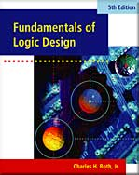
UNIT 2 Boolean Algebra
This chapter in the book includes:
Objectives
Study Guide
2.1 Introduction
2.2 Basic Operation
2.3 Boolean Expression and Truth Table
2.4 Basic Theorem
2.5 Commutative, Associative and Distributive Laws
2.6 Simplification Theorem
2.7 Multiplying Out and Factoring
2.8 DeMorgan’s Laws
Problems

Slide 2
Objectives
Topics introduced in this chapter:
Understand the basic operations and laws of Boolean algebra
Relate these operations and laws to AND, OR, NOT gates and switches
Prove these laws using a truth table
Manipulation of algebraic expression using
- Multiplying out
- Factoring
- Simplifying
- Finding the complement of an expression

Slide 3
2.1 Introduction
Boolean Algebra
Developed by George Boole
Basic mathematics for logic design
Restrict to switching circuits
Two state values: 0, 1
Switching algebra
Boolean Variable : X, Y, …
Can only have two state values: 0, 1
Representing True(1) or False (0)

Slide 4
2.2 Basic Operations
Basic Operations of Boolean Algebra
AND
OR
NOT
Complement
Inverse

Slide 5
2.2 Basic Operations (NOT)
NOT (Inverter)
$$0^{′}=1 \text{and} 1^{′}=0$$
$X^{′}=1 \text{if} X=0 \text{and} X^{′}=0 \text{if} X=$1
Gate Symbol

Slide 6
2.2 Basic Operations (AND)
AND
Truth Table
A B | C = A · B
0 0 0 1 1 0 1 1 | 0 0 0 1
Gate Symbol

Slide 7
2.2 Basic Operations (OR)
OR
Truth Table
A B | C = A + B
0 0 0 1 1 0 1 1 | 0 1 1 1
Gate Symbol

Slide 8
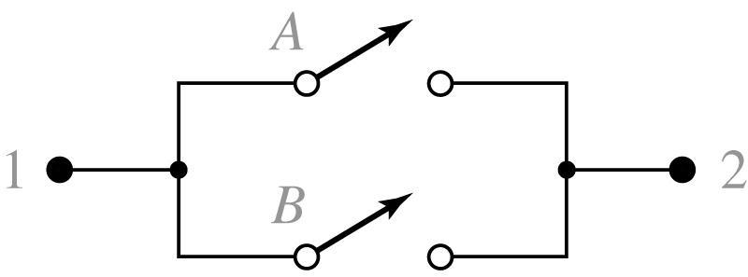
2.2 Basic Operations
Apply to Switch
$$X$$
AND
$$A$$
$$B$$
$$1$$
$$2$$
OR
$$A$$
$$1$$
$$B$$
$$2$$

Slide 9
2.3 Boolean Expressions and Truth Tables
Boolean Expression
Consists of the basic operations to one or more Boolean variables or constants
Precedence
Parentheses ()
NOT
AND
OR
Example
$$AB^{′}+C$$
$${\left[A\left(C+D\right)\right]}^{′}+BE$$

Slide 10
2.3 Boolean Expressions and Truth Tables
Boolean Expression
$$(AB^{′}+C)$$
Logic Circuit for Boolean Expression
$$A$$
$$AB′$$
$$B$$
$$(AB^{′}+C)$$
$$B′$$
$$C$$

Slide 11
2.3 Boolean Expressions and Truth Tables
Boolean Expression
$${\left[A\left(C+D\right)\right]}^{′}+BE$$
Logic Circuit for Boolean Expression
$$C$$
$$(C+D)$$
$$D$$
$$A(C+D)$$
$$[A\left(C+D\right)]′$$
$$A$$
$${\left[A\left(C+D\right)\right]}^{′}+BE$$
$$B$$
$$BE$$
$$E$$

Slide 12
2.3 Boolean Expressions and Truth Tables
Evaluation of Boolean Expression
By substituting a value 0 or 1 for each variable
Example
Evaluation of when A=B=C=1, D=E=0
Literal
Each appearance of a variable or its complement in a Boolean expression
Example
Corresponds to a gate input
ab
'
c
+
a
'
b
+
a
'
bc
'
+
b
'
c
'
10 literals

Slide 13
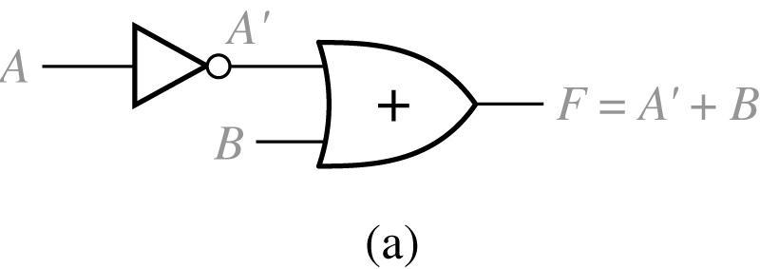
2.3 Boolean Expressions and Truth Tables
Truth Table
Specifies the value of a Boolean expression for every possible combination of value of the variables in the expression
Specifies the output values for a circuit logic gates in terms of the values of the input variables
Example: 2-input logic circuit
$$A′$$
A B | A’ | F = A’ + B
0 0 0 1 1 0 1 1 | 1 1 0 0 | 1 1 0 1
$$A$$
$$A$$
$$F=A^{′}+B$$
$$B$$

Slide 14
Proof an equation using truth table
2.3 Boolean Expressions and Truth Tables
$$AB^{′}+C=(A+C)(B^{′}+C)$$
n variable needs $2×2×2×⋯= 2^{n}$ rows.
n times
Truth table
A B C | B’ | AB’ | AB’ + C | A + C | B’ + C | (A + C) (B’ + C)
0 0 0 0 0 1 0 1 0 0 1 1 1 0 0 1 0 1 1 1 0 1 1 1 | 1 1 0 0 1 1 0 0 | 0 0 0 0 1 1 0 0 | 0 1 0 1 1 1 0 1 | 0 1 0 1 1 1 1 1 | 1 1 0 1 1 1 0 1 | 0 1 0 1 1 1 0 1

Slide 15
2.4 Basic Theorems
Operations with 0, 1
Idempotent Laws
Involution Laws
Complementary Laws
Example

Slide 16
2.4 Basic Theorems with Switch Circuits
Equivalent Switch Circuits

Slide 17
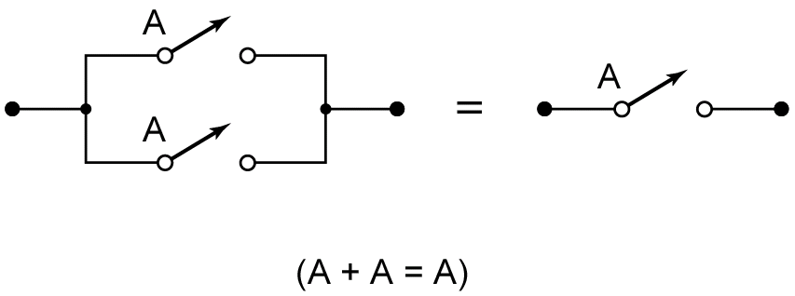
2.4 Basic Theorems with Switch Circuits
Equivalent Switch Circuits

Slide 18
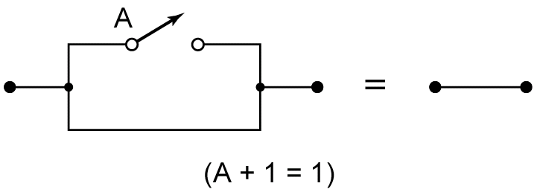
2.4 Basic Theorems with Switch Circuits
Equivalent Switch Circuits

Slide 19
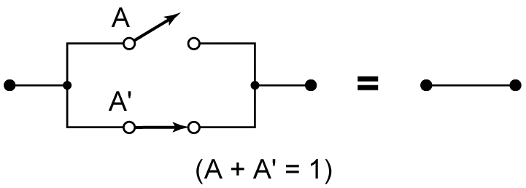
2.4 Basic Theorems with Switch Circuits
Equivalent Switch Circuits

Slide 20
2.5 Commutative, Associative, and Distributive Laws
Commutative Laws:
Associative Laws:
Proof of Associative Law for AND
X Y Z | XY YZ | (XY)Z X(YZ)
0 0 0 | 0 0 | 0 0
0 0 1 | 0 0 | 0 0
0 1 0 | 0 0 | 0 0
0 1 1 | 0 1 | 0 0
1 0 0 | 0 0 | 0 0
1 0 1 | 0 0 | 0 0
1 1 0 | 1 0 | 0 0
1 1 1 | 1 1 | 1 1

Slide 21
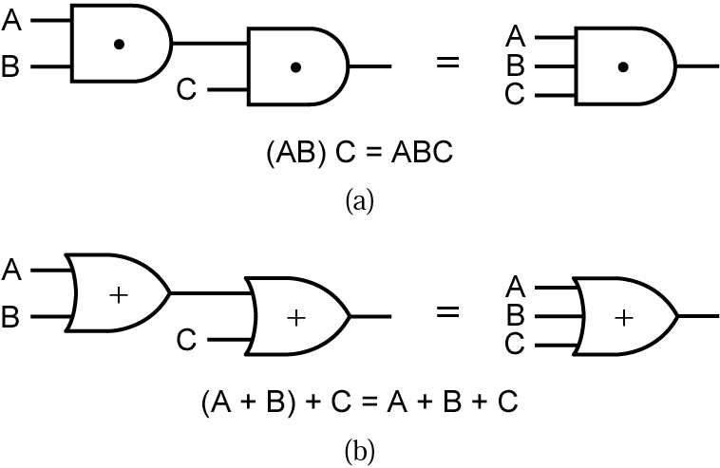
Associative Laws for AND and OR
Associative Law Using AND Gates
$$ABC=1 \text{iff} A=B=C=1$$
Associative Law Using OR Gates
$A+B+C=0 \text{iff} A=B=C=$0

Slide 22
Distributive Laws
Distributive Laws:
Valid only Boolean algebra not for ordinary algebra
Proof

Slide 23
2.6 Simplification Theorems
Why Simplify?
Simplifying the corresponding logic circuit
Useful Theorems for Simplification
Proof
Proof of XY’+Y=X+Y with Switches

Slide 24
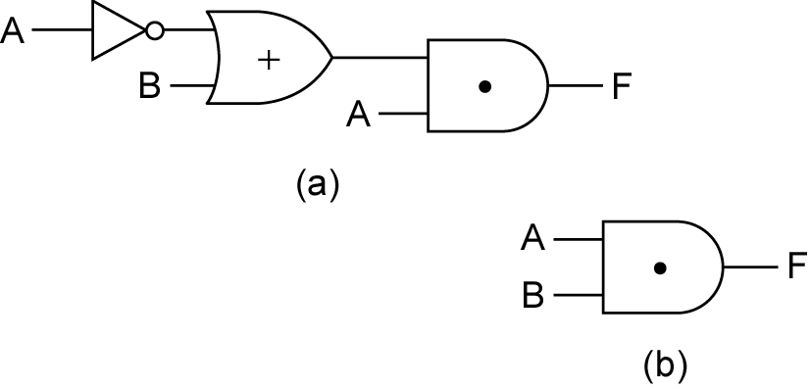
Application of Simplification Theorem to Equivalent Gate Circuits
2.6 Simplification Theorems

Slide 25
2.6 Simplification Theorems
Example 1:
Simplify
$$Z=A^{′}BC+A′$$
Solution:
$If we let X=A^{′}and Y=BC$
$then Z=X+XY=X$
$∴Z=A′$

Slide 26
2.6 Simplification Theorems

Slide 27
2.6 Simplification Theorems

Slide 28
2.7 Multiplying Out and Factoring
Multiplying out using distributive laws can obtain a
sum-of-products (SOP) form
Sum-of-product form:
Not in Sum-of-product form

Slide 29
2.7 Multiplying Out and Factoring
Example: Multiply out (A+BC)(A+D+E)

Slide 30
2.7 Multiplying Out and Factoring
Factoring using distributive laws can obtain a
product-of-sums (POS) form
Product-of-sum form

Slide 31
2.7 Multiplying Out and Factoring
Example1: Factor A+B’CD

Slide 32
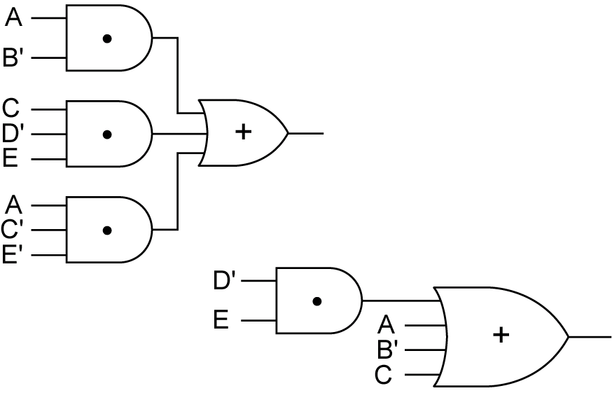
Circuits for Sum-of-Products Form
AB′ + CD′E + AC′E′
A + B′ + C + D′E

Slide 33
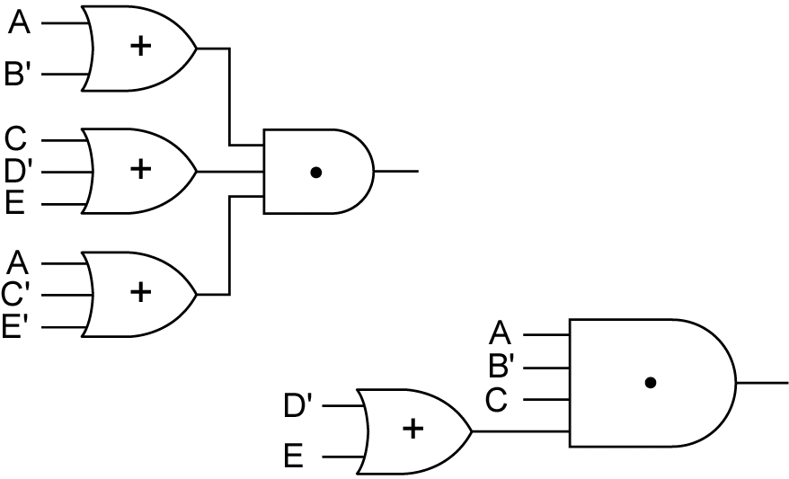
Circuits for Product-of-Sums Form
(A +B′)(C + D′ + E)(A + C′ + E′)
AB′C(D′ + E)

Slide 34
2.8 DeMorgan’s Laws
DeMorgan’s Laws
Proof
X Y | X’ Y’ | X + Y | ( X + Y )’ | X’ Y’ | XY | ( XY )’ | X’ + Y’
0 0 0 1 1 0 1 1 | 1 1 1 0 0 1 0 0 | 0 1 1 1 | 1 0 0 0 | 1 0 0 0 | 0 0 0 1 | 1 1 1 0 | 1 1 1 0
DeMorgan’s Laws for n variables
Example: Find the complement of (A’+B)C’.

Slide 35
2.8 DeMorgan’s Laws (Dual)
Complement of F=A’B+AB’
A B | A’ B | A B’ | F = A’B+AB’ | A’ B’ | A B | F’ = A’B’ + AB
0 0 0 1 1 0 1 1 | 0 1 0 0 | 0 0 1 0 | 0 1 1 0 | 1 0 0 0 | 0 0 0 1 | 1 0 0 1
Dual is formed by replacing AND with OR, OR with AND, 0 with 1, 1 with 0
Other method to obtain dual of an expression Complement the entire expression and complement each variable

