Slide 1
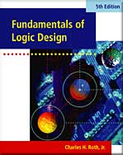
CHAPTER 17
VHDL FOR SEQUENTIAL LOGIC
This chapter in the book includes:
Objectives
Study Guide
17.1 Modeling Flip-Flops Using VHDL Processes
17.2 Modeling Registers and Counters Using VHDL Processes
17.3 Modeling Combinational Logic Using VHDL Processes
17.4 Modeling a Sequential Machine
17.5 Synthesis of VHDL Code
17.6 More About Processes and Sequential Statements
Problems
Simulation Problems

Slide 2
Objectives
VHDL expression for F/F,Shift register,counter
Sequential VHDL using process, if-else,case,wait..
3. Combination logic using process
4. VHDL : Two processes, update F/F, ROM and F/F’s
5. Given VHDL, draw the corresponding logic
6. Compile, simulate, synthesize a circuit

Slide 3
VHDL Process Statement
process statement structure
process(sensitivity-list)
begin
sequential-statements
end process;

Slide 4
Sequential Statements
if-then-else statement
if condition then
sequential-statements
end if;
if condition1 then
sequential-statements1
elsif condition2 then
sequential-statements2
elsif condition3 then
sequential-statements3
else
sequential-statements4
end if;
if condition then
sequential-statements1
else
sequential-statements2
end if;

Slide 5
Sequential Statements
case statement
case expression is
when choice1 => sequential statements1
when shoice2 => sequential statements2
…
[when others => sequential statements]
end case;
If no action is specified for the other choices, the clause should be
when other => null;

Slide 6
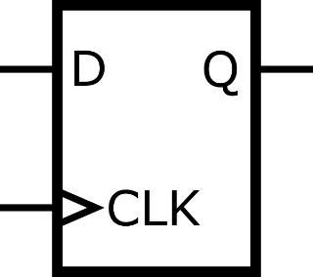
Modeling Flip-Flops Using VHDL Processes
VHDL Code for a Simple D Flip-Flop
library ieee;
use ieee.std_logic_1164.all;
entity d_ff is
port(D, CLK : in std_logic; -- data and clock inputs
Q : out std_logic); -- dff output
end d_ff ;
architecture prototype of d_ff is
begin
process (CLK)
begin
if (CLK’event and CLK=’1’) then
Q <= D;
end if; -- otherwise, does not change.
end process;
end prototype;

Slide 7
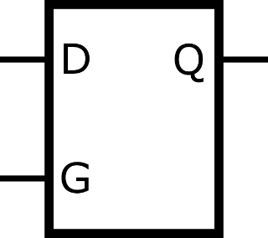
Modeling Flip-Flops Using VHDL Processes
VHDL Code for a Transparent Latch
library ieee;
use ieee.std_logic_1164.all;
entity t_latch is
port(D, G : in std_logic; -- data and clock inputs
Q : out std_logic); -- t_latch output
end t_latch ;
architecture prototype of t_latch is
begin
process(G, D)
begin
if G = ‘1’ then
Q <= D;
end if;
end process;
end prototype;

Slide 8
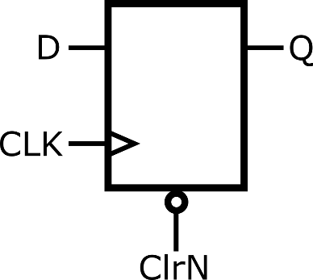
Modeling Flip-Flops Using VHDL Processes
VHDL Code For a D Flip-flop with Asynchronous Clear
library ieee;
use ieee.std_logic_1164.all;
entity d_ff is
port(D, CLK, ClrN : in std_logic;
Q : out std_logic);
end d_ff ;
architecture prototype of d_ff is
begin
process(CLK, ClrN)
begin
if ClrN = ‘0’ then
Q <= ‘0’;
elsif CLK’event and CLK=‘1’ then
Q <= D;
end if;
end process;
end prototype;

Slide 9
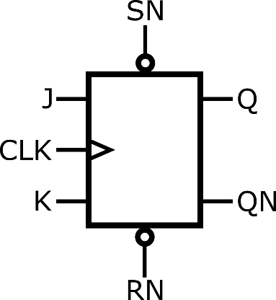
Modeling Flip-Flops Using VHDL Processes
J-K Flip-Flop Model
library ieee;
use ieee.std_logic_1164.all;
entity jk_ff is
port(SN, RN, J, K, CLK : in std_logic;
Q, QN : out std_logic);
end jk_ff ;
architecture prototype of jk_ff is
signal Qint: std_logic;
begin
Q <= Qint;
QN <= not Qint;
process(SN, RN, CLK)
begin
if RN = ‘0’ then Qint <= ‘0’;
elsif SN = ‘0’ then Qint <= ‘1’;
elsif CLK’event and CLK=‘1’ then
Qint <= (J and not Qint) or (not K and Qint);
end if;
end process;
end prototype;

Slide 10
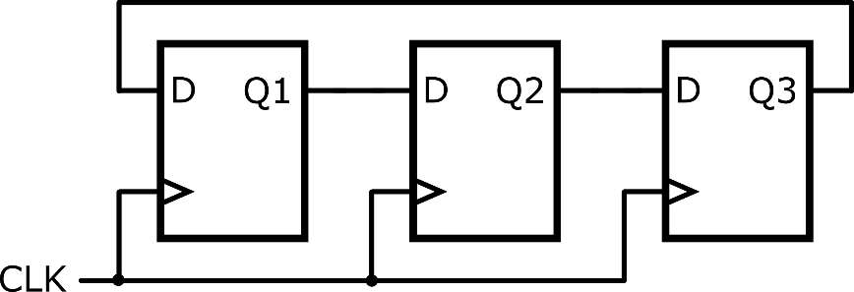
Modeling Registers and Counters Using VHDL Processes
Cyclic Shift Register
library ieee;
use ieee.std_logic_1164.all;
entity shift_register is
port(CLK: in std_logic);
end shift_register;
architecture prototype of shift_register is
signal Q1, Q2, Q3;
begin
process(CLK)
begin
if CLK’event and CLK=‘1’ then
Q1 <= Q3;
Q2 <= Q1;
Q3 <= Q2;
end if;
end process;
end prototype;

Slide 11
Modeling Registers and Counters Using VHDL Processes
Register with Synchronous Clear and Load
library ieee;
use ieee.std_logic_1164.all;
entity sync_reg is
port(CLR, Ld, CLK: in std_logic;
D: in std_logic_vector(3 downto 0);
Q: out std_logic_vector(3 downto 0));
end entity;
architecture prototype of sync_reg is
begin
process(CLK)
begin
if CLK'event and CLK = '1' then
if CLR = '1' then Q <= "0000";
elsif Ld = '1' then Q <= D;
end if;
end if;
end process;
end architecture;

Slide 12
Modeling Registers and Counters Using VHDL Processes
Left-Shift Register with Synchronous Clear and Load
library ieee;
use ieee.std_logic_1164.all;
entity shift_reg is
port(CLR, Ld, Ls, Rin, CLK: in std_logic;
D: in std_logic_vector(3 downto 0);
Q: buffer std_logic_vector(3 downto 0));
end entity;
architecture prototype of shift_reg is
begin
process(CLK)
begin
if CLK'event and CLK = '1' then
if CLR = '1' then Q <= "0000";
elsif Ld = '1' then Q <= D;
elsif LS = '1' then Q <= Q(2 downto 0) & Rin;
end if;
end if;
end process;
end architecture;

Slide 13
Modeling Registers and Counters Using VHDL Processes
VHDL Code for a Simple Synchronous Counter
library ieee;
use ieee.std_logic_1164.all;
use ieee.std_logic_unsigned.all; -- needed for Q <= Q+1
entity counter is
port(ClrN, En, CLK: in std_logic;
Q: buffer std_logic_vector(3 downto 0));
end entity;
architecture prototype of counter is
begin
process(CLK)
begin
if CLK'event and CLK = '1' then
if ClrN = ‘0' then Q <= "0000";
elsif En = '1' then Q <= Q + 1; -- Q: buffer
end if;
end if;
end process;
end architecture;

Slide 14
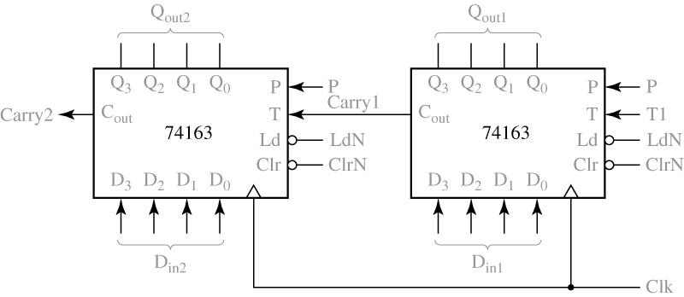
Modeling Registers and Counters Using VHDL Processes
Two 74163 Counter Cascaded to form an 8-Bit Counter

Slide 15
Modeling Registers and Counters Using VHDL Processes
Operation of the 74163 counter
If ClrN=0, all flip-flops are set to 0 following the rising clock edge.
If ClrN=1 and LdN=0, the D inputs are transferred in parallel to the flip-flops following the rising clock edge.
If ClrN=LdN=1 and P=T=1, the count is enabled and the counter state will be incremented by 1 following the rising clock edge.
If T=1, the counter generates a carry (C_{out}) in state 15, so

Slide 16
Modeling Registers and Counters Using VHDL Processes
74163 Counter Operation
Control Signals ClrN LdN P•T | Next State Q₃⁺ Q₂⁺ Q₁⁺ Q₀⁺
0 X X 1 0 X 1 1 0 1 1 1 | 0 0 0 0 D₃ D₂ D₁ D₀ Q₃ Q₂ Q₁ Q₀ present state + 1 | Clear Parallel load No change Count up

Slide 17
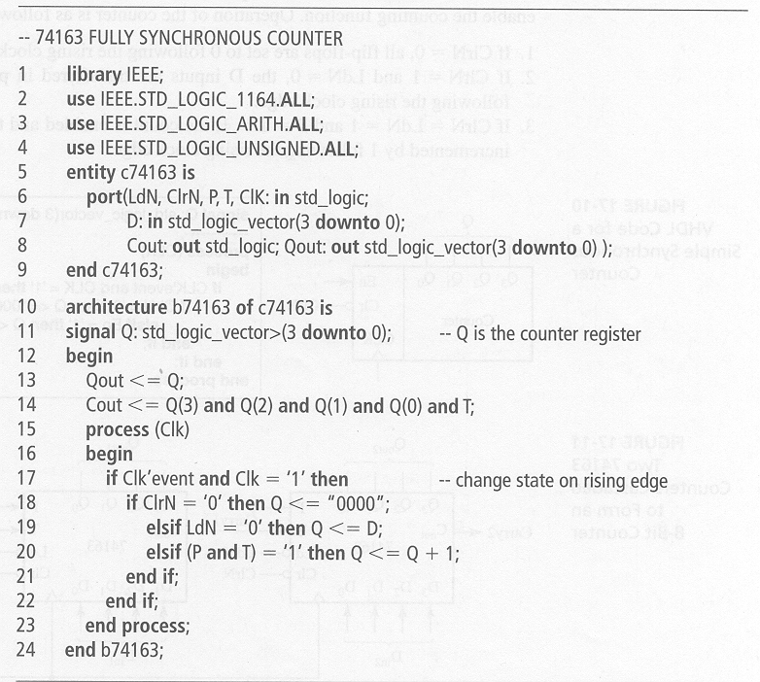
Modeling Registers and Counters Using VHDL Processes
VHDL Description for 74163
library IEEE;
use IEEE.STD_LOGIC_1164.ALL;
use IEEE.STD_LOGIC_ARITH.ALL;
use IEEE.STD_LOGIC_UNSIGNED.ALL;
entity c74163 is
port(LdN.ClrN,P,T,CLK: in std_logic;
D: in std_logic_vector(3 downto 0);
Cout: out std_logic; Qot: out std_logic_vector(3 downto 0));
end c74163;
architecture b74163 of c74163 is
signal Q:std_logic_vector>(3 downto 0); --- Q is the counter register
begin
Qout <=Q;
Cout <= Q(3) and Q(2) and Q(1) and Q(0) and T;
process (Clk)
begin
if Clk’ event and Clk=‘1’ then --- change state on rising edge
if ClrN=‘0’ then Q<=“000”;
elsif LdN=‘0’ then Q<=D;
elsif (P and T) = ‘1’ then Q<=Q+1;
end if;
end if;
end process;
end b74163

Slide 18
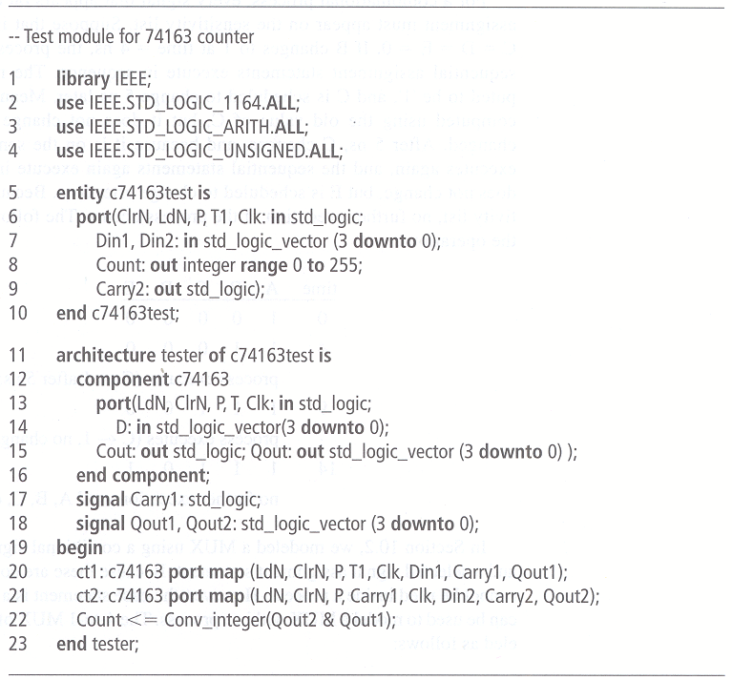
Modeling Registers and Counters Using VHDL Processes
VHDL for 8-Bit Counter
-- Test module for 74163 counter
library IEEE;
use IEEE.STD_LOGIC_1164.ALL;
use IEEE.STD_LOGIC_ARITH.ALL;
use IEEE.STD_LOGIC_UNSIGNED.ALL;
entity c74163test is
port(ClrN,LdN,P,T,CLK: in std_logic;
Din1,Din2: in std_logic_vector (3 downto 0);
Count: out integer range 0 to 255;
Carry2: out std_logic);
End c74163test;
Architecture tester of c74163test is
component c74163
port(LdN,ClrN,P,T,Clk:in std_logic;
D: in std_logic_vector(3 downto 0);
Cout: out std_logic; Qout: out std_logic_vector (3 downto 0));
end component;
signal Carry1:std_logic;
signal Qout1, Qout2:std_logic-vector (3 downto 0);
begin
ct1: c74163 port map (LdN,ClrN,P,T1,Clk,Din1, Carry1, Qout1);
ct2: c74163 port map (LdN, ClrN, P, Carry1, Clk, Din2, Carry2, Qout2);
Count<=Conv_integer(Qout2 & Qout1);
end tester;

Slide 19
Modeling Combination Logic Using VHDL Processes
VHDL Code for Gate Circuit
library ieee;
use ieee.std_logic_1164.all;
entity gate_ckt is
port(A, B, D: in std_logic;
E: out std_logic);
end entity;
architecture prototype of gate_ckt is
signal C: std_logic;
begin
process(A, B, C, D)
begin
C <= A and B;
E <= C or D;
end process;
end architecture;
Every signal that appears on the right side of a signal assignment must appear on the sensitivity list.

Slide 20
Modeling Combination Logic Using VHDL Processes
case statement
case expression is
when choice1 => sequential statements1
when shoice2 => sequential statements2
…
[when others => sequential statements]
end case;
If no action is specified for the other choices, the clause should be
when other => null;

Slide 21
Modeling Combination Logic Using VHDL Processes
Modeling of 4-to-1 MUX
library ieee;
use ieee.std_logic_1164.all;
entity mux_4_to_1 is
port(I0,I1,I2,I3,A,B: in std_logic;
F: out std_logic);
end entity;
architecture prototype of mux_4_to_1 is
signal sel: std_logic_vector(1 downto 0);
Begin
sel <= A & B;
process(sel, I0, I1, I2, I3)
begin
case sel is
when "00" => F <= I0;
when "01" => F <= I1;
when "10" => F <= I2;
when "11" => F <= I3;
when others => null;
end case;
end process;
end architecture;
when others => null;
This statement is required if sel is a std_logic_vector and omit if sel is a bit_vector
mux_4_to_1.vhd

Slide 22
Modeling a Sequential Machine
State Table for BCD-to-excess 3 Code Converter
General Model of Mealy Sequential Machine
PS | NS |  | Z
 | X=0 | X=1 | X=0 | X=1
S0 | S1 | S2 | 1 | 0
S1 | S3 | S4 | 1 | 0
S2 | S4 | S4 | 0 | 1
S3 | S5 | S5 | 0 | 1
S4 | S5 | S6 | 1 | 0
S5 | S0 | S0 | 0 | 1
S6 | S0 | - | 1 | -
Inputs (X)
Combinational
Circuit
Outputs (Z)
Nextstate
State
Register
State
Clock

Slide 23
Modeling a Sequential Machine
Behavioral model for Table 17-2 (based on the state table)
library ieee;
use ieee.std_logic_1164.all;
entity sm17_2 is
port(X, CLK: in std_logic;
Z: out std_logic);
end entity;
architecture prototype of sm17_2 is
signal State, Nextstate: integer range 0 to 6 := 0;
begin
process(State, X)
begin
case State is
when 0 =>
if X = '0' then Z <= '1'; Nextstate <= 1;
else Z <= '0'; Nextstate <= 2; end if;
when 1 =>
if X = '0' then Z <= '1'; Nextstate <= 3;
else Z <= '0'; Nextstate <= 4; end if;
when 2 =>
if X = '0' then Z <= '0'; Nextstate <= 4;
else Z <= '1'; Nextstate <= 4; end if;
PS | NS |  | Z
 | X=0 | X=1 | X=0 | X=1
S0 | S1 | S2 | 1 | 0
S1 | S3 | S4 | 1 | 0
S2 | S4 | S4 | 0 | 1
S3 | S5 | S5 | 0 | 1
S4 | S5 | S6 | 1 | 0
S5 | S0 | S0 | 0 | 1
S6 | S0 | - | 1 | -
Sm17_2.vhd

Slide 24
Modeling a Sequential Machine
Behavioral model for Table 17-2 (based on the state table) -- continued
when 3 =>
if X = '0' then Z <= '0'; Nextstate <= 5;
else Z <= '1'; Nextstate <= 5; end if;
when 4 =>
if X = '0' then Z <= '1'; Nextstate <= 5;
else Z <= '0'; Nextstate <= 6; end if;
when 5 =>
if X = '0' then Z <= '0'; Nextstate <= 0;
else Z <= '1'; Nextstate <= 0; end if;
when 6 =>
Z <= '1'; Nextstate <= 0;
when others => null;
end case;
end process;
process (CLK)
begin
if CLK'event and CLK = '1' then
State <= Nextstate;
end if;
end process;
end architecture;
PS | NS |  | Z
 | X=0 | X=1 | X=0 | X=1
S0 | S1 | S2 | 1 | 0
S1 | S3 | S4 | 1 | 0
S2 | S4 | S4 | 0 | 1
S3 | S5 | S5 | 0 | 1
S4 | S5 | S6 | 1 | 0
S5 | S0 | S0 | 0 | 1
S6 | S0 | - | 1 | -
Sm17_2.vhd

Slide 25
Modeling a Sequential Machine
A typical sequence of execution for the two processes
X changes and the first process executes. New values of Z and Nextstate are computed.
The clock falls, and the second process executes. Because CLK=‘0’, nothing happens.
The clock rises, and the second process executes again. Because CLK=‘1’,State is set equal to the Nextstate value.
If State changes, the first process executes again. New values of Z and Nextstate are computed.

Slide 26
Modeling a Sequential Machine
A simulator command file to test
add wave CLK X State Nextstate Z
signals to be included in the waveform output
force CLK 0 0, 1 100 –repeat 200
defines a clock with period 200 ns. CLK is ‘0’ at time 0 ns, ‘1’ at time 100 ns, and repeat every 200 ns
force X 0 0, 1 350, 0 550, 1 750, 0 950, 1 1350
signals to be included in the waveform output
run 1600
force signal_name v1 t1, v2 t2, …
signal_name is the value v1 at time t1, the value v2 at time t2, an so on.

Slide 27
Modeling a Sequential Machine
Simulation result waveforms for figure 17-16

Slide 28
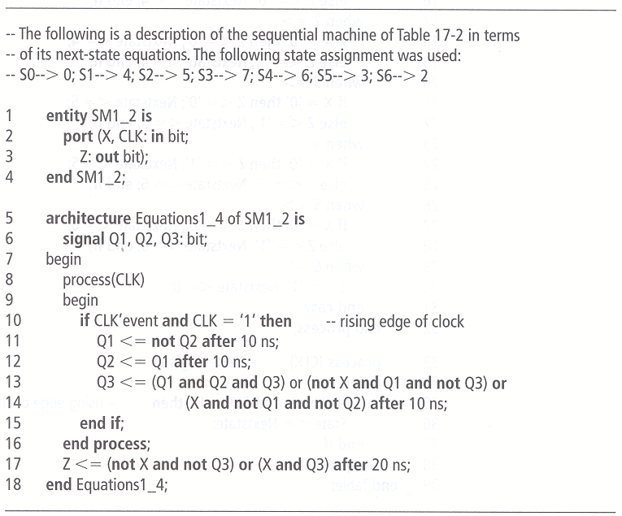
Modeling a Sequential Machine
Sequential machine model based on the next-state and output equations (Fig 16-3)

Slide 29
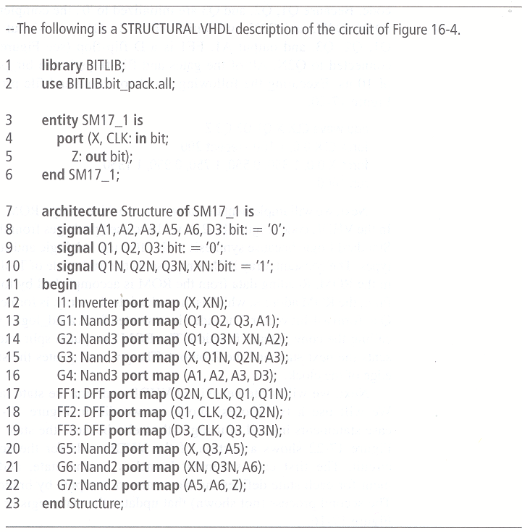
Modeling a Sequential Machine
Structural model of sequential machine based on actual interconnection of the components (actual circuit).

Slide 30
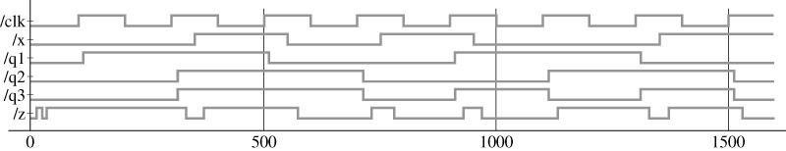
Modeling a Sequential Machine
A simulator command file to test
add wave CLK Q1 Q2 Q3 Z
force CLK 0 0, 1 100 –repeat 200
force X 0 0, 1 350, 0 550, 1 750, 0 950, 1 1350
run 1600
Output waveforms

Slide 31
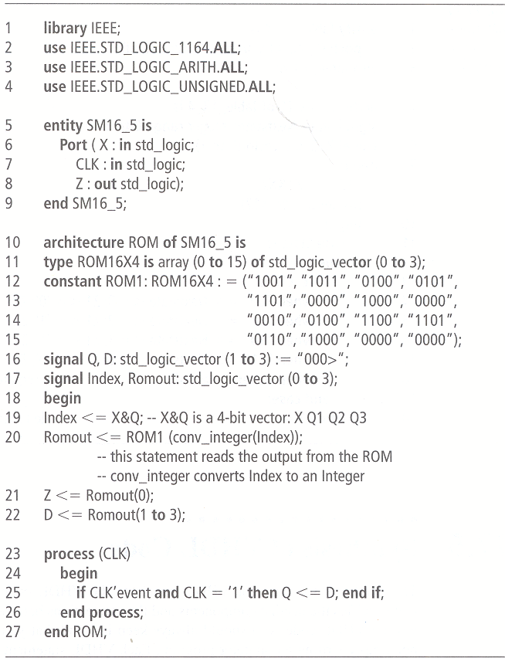
Modeling a Sequential Machine
Sequential Machine using a ROM

Slide 32
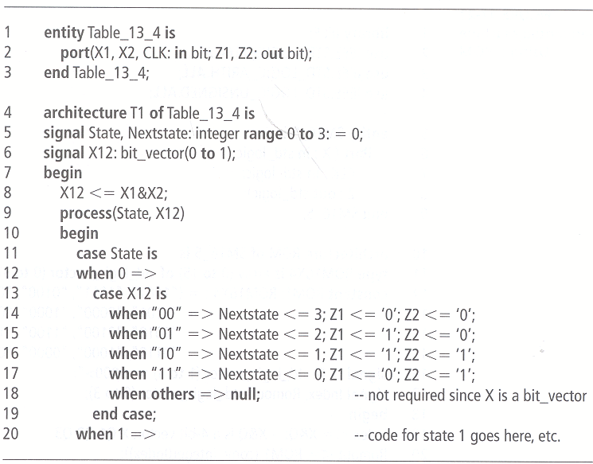
Modeling a Sequential Machine
Partial VHDL Code for the Table of Figure 13-4

Slide 33
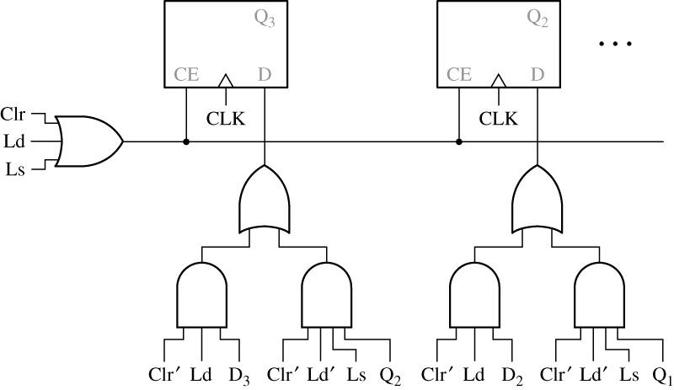
Synthesis of VHDL Code
Synthesis of VHDL Code From Figure 17-9

Slide 34
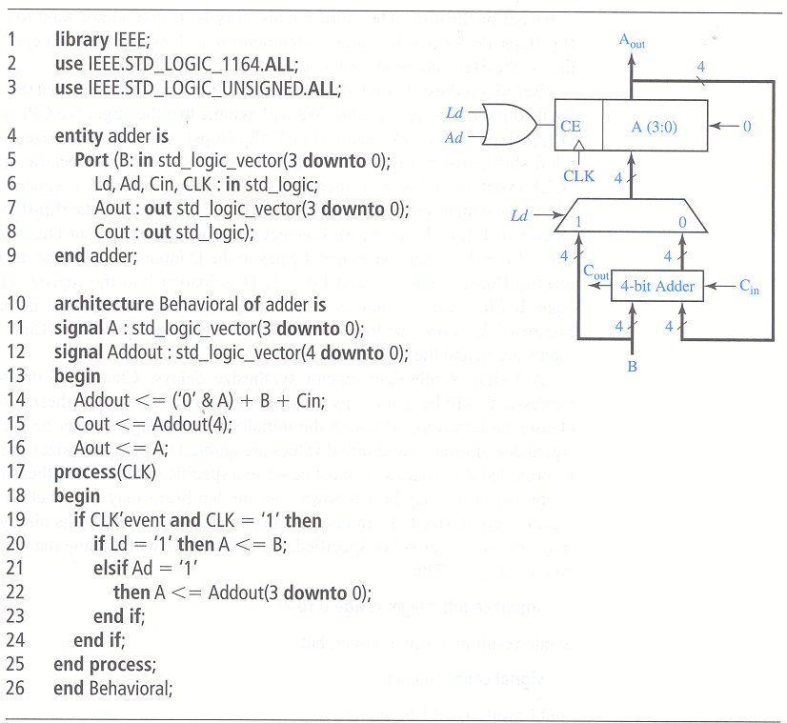
Synthesis of VHDL Code
VHDL Code and Synthesis Results for 4-Bit Adder with Accumulator

Slide 35
17.6 More About Processes And Sequential Statements
Process with wait statements may have the form
process
begin
sequential-statements
wait-statement
…
end process;
Wait statements can be of three different forms:
wait on sensitivity-list;
wait for time-expression;
wait until Boolean-expression;

Slide 36
17.6 More About Processes And Sequential Statements
process
begin
C<=A and B after 5ns;
E<=C or D after 5ns;
wait on A,B,C,D;
end process;
Therefore, the following process is equivalent to the one in Figure 17-14:
Consider the following example:
process
begin
wait until clk’event and clk=‘1’;
A<=E after 10ns; --(1)
B<=F after 5ns; --(2)
C<=G; --(3)
D<=H after 5ns; --(4)
end process;

Slide 37
17.6 More About Processes And Sequential Statements
If several VHDL statements in a process update the same signal at a given time, last value overrides. For example,
process(CLK)
begin
if CLK’event and CLK = ‘0’ then
Q<=A; Q<=B; Q<=C;
end if;
end process;

Slide 38


