Slide 1
UNIT 15 REDUCTION OF STATE TABLES STATE ASSIGNMENT
Objectives
Study Guide
15.1 Elimination of Redundant States
15.2 Equivalent States
15.3 Determination of State Equivalence Using an
Implication Table
15.4 Equivalent Sequential Circuits
15.5 Incompletely Specified State Tables
15.6 Derivation of Flip-Flop Input Equations
15.7 Equivalent State Assignments
15.8 Guidelines for State Assignment
15.9 Using a One-Hot State Assignment Problems

Slide 2
Objectives
Define equivalent states, state several ways of testing for state
equivalence, and determine if two states are equivalent.
2. Define equivalent sequential circuits and determine if two circuits
are equivalent.
3. Reduce a state table to a minimum number of rows.
4. Specify a suitable set of state assignments for a state table,
eliminating those assignments which are equivalent with respect to
the cost of realizing the circuit
5. State three guidelines which are useful in making state assignments,
and apply these to making a good state assignment for a given
state table
6. Given a state table and assignment, form the transition table and
derive flip-flop input equations
7. Make a one-hot state assignment for a state graph and write the
next state and output equations by inspection.

Slide 3
15.1 Elimination of Redundant States
Example 1: Z=1 when input sequence 0101 or 1001 occurs.
The circuit resets after every four inputs.
Mealy Circuit
A typical sequence of input and output
X = | 0101 | 0010 | 1001 | 0100
Z = | 0001 | 0000 | 0001 | 0000

Slide 4
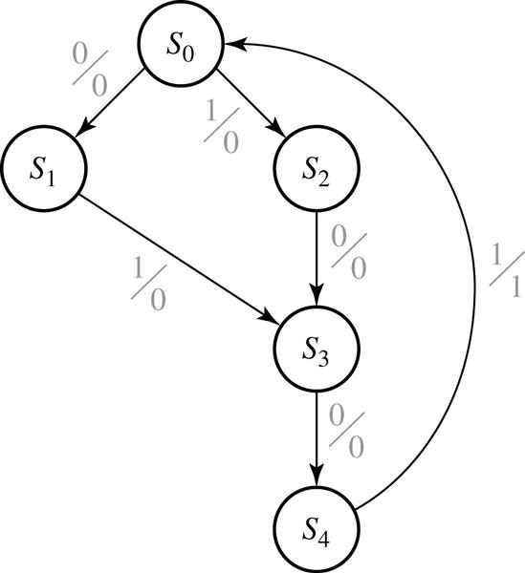
15.1 Elimination of Redundant States
Partial State Graph for Example 1
state | sequence received
S₀ S₁ S₂ S₃ S₄ | reset 0 1 01 or 10 010 or 100

Slide 5
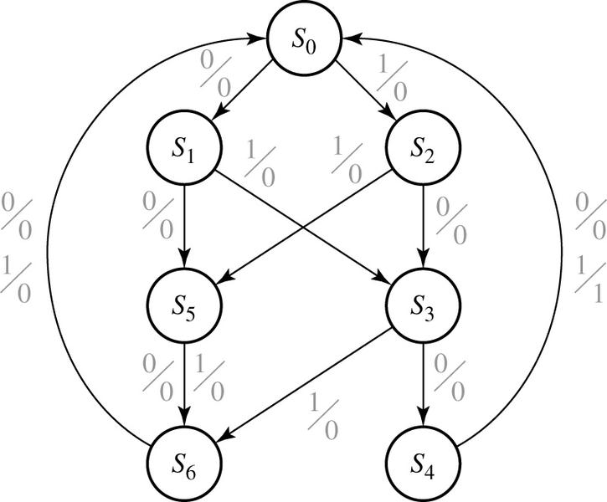
15.1 Elimination of Redundant States
Complete State Graph for Example 1
state | sequence received
S₀ S₁ S₂ S₃ S₄ S₅ S₆ | Reset 0 1 01 or 10 010 or 100 two inputs received, no 1 output is possible three inputs received, no 1 output is possible

Slide 6
15.1 Elimination of Redundant States
Table 15-1. State Table for Sequence Detector (0101, 1001)
Input Sequence | Present State | Next State |  | Present Output
 |  | X=0 | X=1 | X=0 | X=1
reset | A | B | C | 0 | 0
0 | B | D | E | 0 | 0
1 | C | F | G | 0 | 0
00 | D | H | I | 0 | 0
01 | E | J | K | 0 | 0
10 | F | L | M | 0 | 0
11 | G | N | P | 0 | 0
000 | H | A | A | 0 | 0
001 | I | A | A | 0 | 0
010 | J | A | A | 0 | 1
011 | K | A | A | 0 | 0
100 | L | A | A | 0 | 1
101 | M | A | A | 0 | 0
110 | N | A | A | 0 | 0
111 | P | A | A | 0 | 0

Slide 7
15.1 Elimination of Redundant States
Table 15-1. State Table for Sequence Detector (0101, 1001)
Input Sequence | Present State | Next State |  | Present Output
 |  | X=0 | X=1 | X=0 | X=1
reset | A | B | C | 0 | 0
0 | B | D | E | 0 | 0
1 | C | F | G | 0 | 0
00 | D | H | I | 0 | 0
01 | E | J | K | 0 | 0
10 | F | L | M | 0 | 0
11 | G | N | P | 0 | 0
000 | H | A | A | 0 | 0
001 | I | A | A | 0 | 0
010 | J | A | A | 0 | 1
011 | K | A | A | 0 | 0
100 | L | A | A | 0 | 1
101 | M | A | A | 0 | 0
110 | N | A | A | 0 | 0
111 | P | A | A | 0 | 0
Same N.S. & Outputs
for the same inputs
H ≡ I

Slide 8
15.1 Elimination of Redundant States
Table 15-1. State Table for Sequence Detector (0101, 1001)
Input Sequence | Present State | Next State |  | Present Output
 |  | X=0 | X=1 | X=0 | X=1
reset | A | B | C | 0 | 0
0 | B | D | E | 0 | 0
1 | C | F | G | 0 | 0
00 | D | H | I | 0 | 0
01 | E | J | K | 0 | 0
10 | F | L | M | 0 | 0
11 | G | N | P | 0 | 0
000 | H | A | A | 0 | 0
001 | I | A | A | 0 | 0
010 | J | A | A | 0 | 1
011 | K | A | A | 0 | 0
100 | L | A | A | 0 | 1
101 | M | A | A | 0 | 0
110 | N | A | A | 0 | 0
111 | P | A | A | 0 | 0
H
H ≡ I
Replace I with H

Slide 9
15.1 Elimination of Redundant States
Table 15-1. State Table for Sequence Detector (0101, 1001)
Input Sequence | Present State | Next State |  | Present Output
 |  | X=0 | X=1 | X=0 | X=1
reset | A | B | C | 0 | 0
0 | B | D | E | 0 | 0
1 | C | F | G | 0 | 0
00 | D | H | H | 0 | 0
01 | E | J | K | 0 | 0
10 | F | L | M | 0 | 0
11 | G | N | P | 0 | 0
000 | H | A | A | 0 | 0
010 | J | A | A | 0 | 1
011 | K | A | A | 0 | 0
100 | L | A | A | 0 | 1
101 | M | A | A | 0 | 0
110 | N | A | A | 0 | 0
111 | P | A | A | 0 | 0
Remove I

Slide 10
15.1 Elimination of Redundant States
Table 15-1. State Table for Sequence Detector (0101, 1001)
Present State | Next State |  | Present Output
 | X=0 | X=1 | X=0 | X=1
A | B | C | 0 | 0
B | D | E | 0 | 0
C | F | G | 0 | 0
D | H | H | 0 | 0
E | J | K | 0 | 0
F | L | M | 0 | 0
G | N | P | 0 | 0
H | A | A | 0 | 0
J | A | A | 0 | 1
K | A | A | 0 | 0
L | A | A | 0 | 1
M | A | A | 0 | 0
N | A | A | 0 | 0
P | A | A | 0 | 0
H ≡ K, M, N, P
Replace K, M, N, P with H

Slide 11
15.1 Elimination of Redundant States
Table 15-2. State Table for Sequence Detector
Present State | Next State |  | Present Output
 | X=0 | X=1 | X=0 | X=1
A | B | C | 0 | 0
B | D | E | 0 | 0
C | F | G | 0 | 0
D | H | H | 0 | 0
E | J | K H | 0 | 0
F | L | M H | 0 | 0
G | N H | P H | 0 | 0
H | A | A | 0 | 0
J | A | A | 0 | 1
K | A | A | 0 | 0
L | A | A | 0 | 1
M | A | A | 0 | 0
N | A | A | 0 | 0
P | A | A | 0 | 0
H ≡ K, M, N, P
Replace K, M, N, P with H

Slide 12
15.1 Elimination of Redundant States
Table 15-2. State Table for Sequence Detector
Present State | Next State |  | Present Output
 | X=0 | X=1 | X=0 | X=1
A | B | C | 0 | 0
B | D | E | 0 | 0
C | F | G | 0 | 0
D | H | H | 0 | 0
E | J | H | 0 | 0
F | L | H | 0 | 0
G | H | H | 0 | 0
H | A | A | 0 | 0
J | A | A | 0 | 1
L | A | A | 0 | 1
Remove K, M, N, P

Slide 13
15.1 Elimination of Redundant States
Table 15-2. State Table for Sequence Detector
Present State | Next State |  | Present Output
 | X=0 | X=1 | X=0 | X=1
A | B | C | 0 | 0
B | D | E | 0 | 0
C | F | G | 0 | 0
D | H | H | 0 | 0
E | J | H | 0 | 0
F | L | H | 0 | 0
G | H | H | 0 | 0
H | A | A | 0 | 0
J | A | A | 0 | 1
L | A | A | 0 | 1
J ≡ L
Replace L with J

Slide 14
15.1 Elimination of Redundant States
Table 15-2. State Table for Sequence Detector
Present State | Next State |  | Present Output
 | X=0 | X=1 | X=0 | X=1
A | B | C | 0 | 0
B | D | E | 0 | 0
C | F | G | 0 | 0
D | H | H | 0 | 0
E | J | H | 0 | 0
F | L J | H | 0 | 0
G | H | H | 0 | 0
H | A | A | 0 | 0
J | A | A | 0 | 1
L | A | A | 0 | 1
J ≡ L
Replace L with J

Slide 15
15.1 Elimination of Redundant States
Table 15-2. State Table for Sequence Detector
Present State | Next State |  | Present Output
 | X=0 | X=1 | X=0 | X=1
A | B | C | 0 | 0
B | D | E | 0 | 0
C | F | G | 0 | 0
D | H | H | 0 | 0
E | J | H | 0 | 0
F | J | H | 0 | 0
G | H | H | 0 | 0
H | A | A | 0 | 0
J | A | A | 0 | 1
Remove L

Slide 16
15.1 Elimination of Redundant States
Table 15-2. State Table for Sequence Detector
Present State | Next State |  | Present Output
 | X=0 | X=1 | X=0 | X=1
A | B | C | 0 | 0
B | D | E | 0 | 0
C | F | G | 0 | 0
D | H | H | 0 | 0
E | J | H | 0 | 0
F | J | H | 0 | 0
G | H | H | 0 | 0
H | A | A | 0 | 0
J | A | A | 0 | 1
D ≡ G
Replace G with D

Slide 17
15.1 Elimination of Redundant States
Table 15-2. State Table for Sequence Detector
Present State | Next State |  | Present Output
 | X=0 | X=1 | X=0 | X=1
A | B | C | 0 | 0
B | D | E | 0 | 0
C | F | G D | 0 | 0
D | H | H | 0 | 0
E | J | H | 0 | 0
F | J | H | 0 | 0
G | H | H | 0 | 0
H | A | A | 0 | 0
J | A | A | 0 | 1
D ≡ G
Replace G with D

Slide 18
15.1 Elimination of Redundant States
Table 15-2. State Table for Sequence Detector
Present State | Next State |  | Present Output
 | X=0 | X=1 | X=0 | X=1
A | B | C | 0 | 0
B | D | E | 0 | 0
C | F | D | 0 | 0
D | H | H | 0 | 0
E | J | H | 0 | 0
F | J | H | 0 | 0
H | A | A | 0 | 0
J | A | A | 0 | 1
E ≡ F
Replace F with E

Slide 19
15.1 Elimination of Redundant States
Table 15-2. State Table for Sequence Detector
Present State | Next State |  | Present Output
 | X=0 | X=1 | X=0 | X=1
A | B | C | 0 | 0
B | D | E | 0 | 0
C | F E | D | 0 | 0
D | H | H | 0 | 0
E | J | H | 0 | 0
F | J | H | 0 | 0
H | A | A | 0 | 0
J | A | A | 0 | 1
E ≡ F
Replace F with E

Slide 20
15.1 Elimination of Redundant States
Table 15-2. State Table for Sequence Detector (Reduced)
Present State | Next State |  | Present Output
 | X=0 | X=1 | X=0 | X=1
A | B | C | 0 | 0
B | D | E | 0 | 0
C | E | D | 0 | 0
D | H | H | 0 | 0
E | J | H | 0 | 0
H | A | A | 0 | 0
J | A | A | 0 | 1

Slide 21
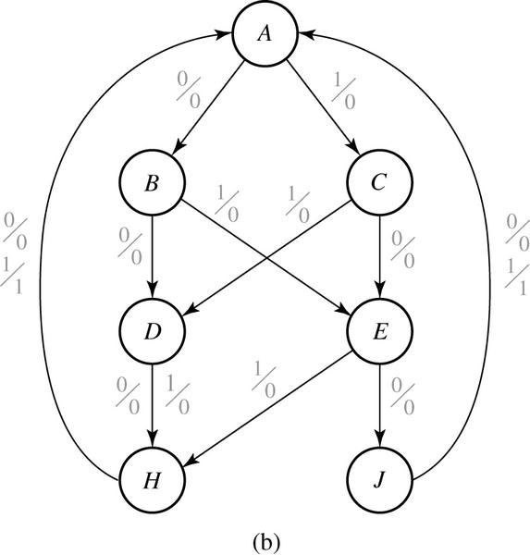
15.1 Elimination of Redundant States
Fig 15-1. Reduced State Table and Graph for Sequence Detector
P.S. | N.S. |  | Output
 | X=0 | X=1 | X=0 | X=1
A | B | C | 0 | 0
B | D | E | 0 | 0
C | E | D | 0 | 0
D | H | H | 0 | 0
E | J | H | 0 | 0
H | A | A | 0 | 0
J | A | A | 0 | 1
0
Row Matching
- Finding equivalent states

Slide 22
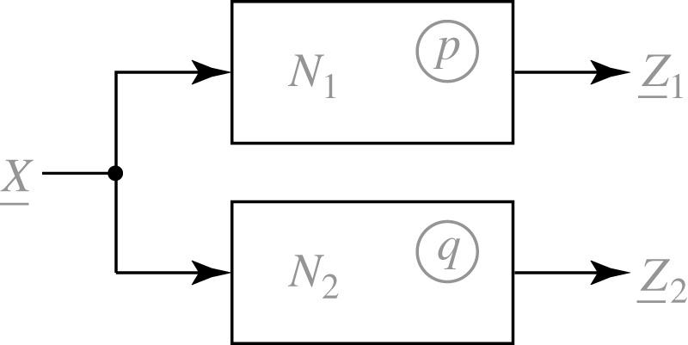
15.2 Equivalent States
Definition 15.1
Let N₁ and N₂ be sequential circuits (not necessarily different). Let X represent a sequence of inputs of arbitrary length. Then state p in N₁ is equivalent to state q in N₂ iff for every possible input sequence X.
$λ_{1}\left(p,\underline{X}\right) and λ_{2}\left(q,\underline{X}\right)$ are output sequences.

Slide 23
15.2 Equivalent States
$λ\left(p,\underline{X}\right) and λ\left(p,\underline{X}\right)$ are output sequences.
$δ\left(p,\underline{X}\right) and δ\left(p,\underline{X}\right)$ are next state sequences.
Theorem 15.1
Two states p and q of a sequential circuit are equivalent iff for every single input X, the outputs are the same and the next states are equivalent, that is,
Equivalent

Slide 24
15.3 Determination of State Equivalence Using an Implication Table
Table 15-3.
Fig 15-3. Implication Chart for Table 15-3
$$a≡b \text{iff} d≡f \text{and} c≡h$$
Present State | Next State |  | Present Output
 | X=0 | X=1
a | d | c | 0
b | f | h | 0
c | e | d | 1
d | a | e | 0
e | c | a | 1
f | f | b | 1
g | b | h | 0
h | c | g | 1
b | d-f c-h
c
d | a-d c-e | a-f e-h
e |  |  | c-e a-d
f |  |  | e-f b-d |  | c-f a-b
g | b-d c-h | b-f |  | a-b e-h
h |  |  | c-e d-g |  | a-g | c-f b-g
 | a | b | c | d | e | f | g
$$a≠b \text{because} \text{the} \text{outputs} \text{differ}$$

Slide 25
15.3 Determination of State Equivalence Using an Implication Table
Table 15-3.
Fig 15-3. Implication Chart for Table 15-3
Present State | Next State |  | Present Output
 | X=0 | X=1
a | d | c | 0
b | f | h | 0
c | e | d | 1
d | a | e | 0
e | c | a | 1
f | f | b | 1
g | b | h | 0
h | c | g | 1
b | d-f c-h
c
d | a-d c-e | a-f e-h
e |  |  | c-e a-d
f |  |  | e-f b-d |  | c-f a-b
g | b-d c-h | b-f |  | a-b e-h
h |  |  | c-e d-g |  | a-g | c-f b-g
 | a | b | c | d | e | f | g
Remove Self-implied

Slide 26
15.3 Determination of State Equivalence Using an Implication Table
Table 15-3.
Fig 15-3. Implication Chart for Table 15-3
Present State | Next State |  | Present Output
 | X=0 | X=1
a | d | c | 0
b | f | h | 0
c | e | d | 1
d | a | e | 0
e | c | a | 1
f | f | b | 1
g | b | h | 0
h | c | g | 1
b | d-f c-h
c
d | c-e | a-f e-h
e |  |  | a-d
f |  |  | e-f b-d |  | c-f a-b
g | b-d c-h | b-f |  | a-b e-h
h |  |  | c-e d-g |  | a-g | c-f b-g
 | a | b | c | d | e | f | g
After removing Self-implied

Slide 27
15.3 Determination of State Equivalence Using an Implication Table
Table 15-3.
Fig 15-3. Implication Chart for Table 15-3
Present State | Next State |  | Present Output
 | X=0 | X=1
a | d | c | 0
b | f | h | 0
c | e | d | 1
d | a | e | 0
e | c | a | 1
f | f | b | 1
g | b | h | 0
h | c | g | 1
b | d-f c-h
c
d | c-e | a-f e-h
e |  |  | a-d
f |  |  | e-f b-d |  | c-f a-b
g | b-d c-h | b-f |  | a-b e-h
h |  |  | c-e d-g |  | a-g | c-f b-g
 | a | b | c | d | e | f | g
Remove non-equivalent pairs

Slide 28
15.3 Determination of State Equivalence Using an Implication Table
Table 15-3.
Fig 15-3. Implication Chart for Table 15-3
Present State | Next State |  | Present Output
 | X=0 | X=1
a | d | c | 0
b | f | h | 0
c | e | d | 1
d | a | e | 0
e | c | a | 1
f | f | b | 1
g | b | h | 0
h | c | g | 1
b | d-f c-h
c
d | c-e | a-f e-h
e |  |  | a-d
f |  |  | e-f b-d |  | c-f a-b
g | b-d c-h | b-f |  | a-b e-h
h |  |  | c-e d-g |  | a-g | c-f b-g
 | a | b | c | d | e | f | g
Remove non-equivalent pairs

Slide 29
15.3 Determination of State Equivalence Using an Implication Table
Table 15-3.
Fig 15-3. Implication Chart for Table 15-3
Present State | Next State |  | Present Output
 | X=0 | X=1
a | d | c | 0
b | f | h | 0
c | e | d | 1
d | a | e | 0
e | c | a | 1
f | f | b | 1
g | b | h | 0
h | c | g | 1
b | d-f c-h
c
d | c-e | a-f e-h
e |  |  | a-d
f |  |  | e-f b-d |  | c-f a-b
g | b-d c-h | b-f |  | a-b e-h
h |  |  | c-e d-g |  | a-g | c-f b-g
 | a | b | c | d | e | f | g
Remove non-equivalent pairs

Slide 30
15.3 Determination of State Equivalence Using an Implication Table
Table 15-3.
Fig 15-3. Implication Chart for Table 15-3
Present State | Next State |  | Present Output
 | X=0 | X=1
a | d | c | 0
b | f | h | 0
c | e | d | 1
d | a | e | 0
e | c | a | 1
f | f | b | 1
g | b | h | 0
h | c | g | 1
b | d-f c-h
c
d | c-e | a-f e-h
e |  |  | a-d
f |  |  | e-f b-d |  | c-f a-b
g | b-d c-h | b-f |  | a-b e-h
h |  |  | c-e d-g |  | a-g | c-f b-g
 | a | b | c | d | e | f | g
Remove non-equivalent pairs

Slide 31
15.3 Determination of State Equivalence Using an Implication Table
Table 15-3.
Fig 15-3. Implication Chart for Table 15-3
Present State | Next State |  | Present Output
 | X=0 | X=1
a | d | c | 0
b | f | h | 0
c | e | d | 1
d | a | e | 0
e | c | a | 1
f | f | b | 1
g | b | h | 0
h | c | g | 1
b | d-f c-h
c
d | c-e | a-f e-h
e |  |  | a-d
f |  |  | e-f b-d |  | c-f a-b
g | b-d c-h | b-f |  | a-b e-h
h |  |  | c-e d-g |  | a-g | c-f b-g
 | a | b | c | d | e | f | g
Remove non-equivalent pairs

Slide 32
15.3 Determination of State Equivalence Using an Implication Table
Table 15-3.
Fig 15-3. Implication Chart for Table 15-3
Present State | Next State |  | Present Output
 | X=0 | X=1
a | d | c | 0
b | f | h | 0
c | e | d | 1
d | a | e | 0
e | c | a | 1
f | f | b | 1
g | b | h | 0
h | c | g | 1
b | d-f c-h
c
d | c-e | a-f e-h
e |  |  | a-d
f |  |  | e-f b-d |  | c-f a-b
g | b-d c-h | b-f |  | a-b e-h
h |  |  | c-e d-g |  | a-g | c-f b-g
 | a | b | c | d | e | f | g
Remove non-equivalent pairs

Slide 33
15.3 Determination of State Equivalence Using an Implication Table
Table 15-3.
Fig 15-3. Implication Chart for Table 15-3
Present State | Next State |  | Present Output
 | X=0 | X=1
a | d | c | 0
b | f | h | 0
c | e | d | 1
d | a | e | 0
e | c | a | 1
f | f | b | 1
g | b | h | 0
h | c | g | 1
b | d-f c-h
c
d | c-e | a-f e-h
e |  |  | a-d
f |  |  | e-f b-d |  | c-f a-b
g | b-d c-h | b-f |  | a-b e-h
h |  |  | c-e d-g |  | a-g | c-f b-g
 | a | b | c | d | e | f | g
Remove non-equivalent pairs

Slide 34
15.3 Determination of State Equivalence Using an Implication Table
Table 15-3.
Fig 15-3. Implication Chart for Table 15-3
Present State | Next State |  | Present Output
 | X=0 | X=1
a | d | c | 0
b | f | h | 0
c | e | d | 1
d | a | e | 0
e | c | a | 1
f | f | b | 1
g | b | h | 0
h | c | g | 1
b | d-f c-h
c
d | c-e | a-f e-h
e |  |  | a-d
f |  |  | e-f b-d |  | c-f a-b
g | b-d c-h | b-f |  | a-b e-h
h |  |  | c-e d-g |  | a-g | c-f b-g
 | a | b | c | d | e | f | g
After first pass

Slide 35
15.3 Determination of State Equivalence Using an Implication Table
Table 15-3.
Fig 15-3. Implication Chart for Table 15-3
Present State | Next State |  | Present Output
 | X=0 | X=1
a | d | c | 0
b | f | h | 0
c | e | d | 1
d | a | e | 0
e | c | a | 1
f | f | b | 1
g | b | h | 0
h | c | g | 1
b | d-f c-h
c
d | c-e | a-f e-h
e |  |  | a-d
f |  |  | e-f b-d |  | c-f a-b
g | b-d c-h | b-f |  | a-b e-h
h |  |  | c-e d-g |  | a-g | c-f b-g
 | a | b | c | d | e | f | g
Remove non-equivalent pairs

Slide 36
15.3 Determination of State Equivalence Using an Implication Table
Table 15-3.
Fig 15-3. Implication Chart for Table 15-3
Present State | Next State |  | Present Output
 | X=0 | X=1
a | d | c | 0
b | f | h | 0
c | e | d | 1
d | a | e | 0
e | c | a | 1
f | f | b | 1
g | b | h | 0
h | c | g | 1
b | d-f c-h
c
d | c-e | a-f e-h
e |  |  | a-d
f |  |  | e-f b-d |  | c-f a-b
g | b-d c-h | b-f |  | a-b e-h
h |  |  | c-e d-g |  | a-g | c-f b-g
 | a | b | c | d | e | f | g
Remove non-equivalent pairs

Slide 37
15.3 Determination of State Equivalence Using an Implication Table
Table 15-3.
Fig 15-3. Implication Chart for Table 15-3
Present State | Next State |  | Present Output
 | X=0 | X=1
a | d | c | 0
b | f | h | 0
c | e | d | 1
d | a | e | 0
e | c | a | 1
f | f | b | 1
g | b | h | 0
h | c | g | 1
b | d-f c-h
c
d | c-e | a-f e-h
e |  |  | a-d
f |  |  | e-f b-d |  | c-f a-b
g | b-d c-h | b-f |  | a-b e-h
h |  |  | c-e d-g |  | a-g | c-f b-g
 | a | b | c | d | e | f | g
Remove non-equivalent pairs

Slide 38
15.3 Determination of State Equivalence Using an Implication Table
Table 15-3.
Fig 15-3. Implication Chart for Table 15-3
Present State | Next State |  | Present Output
 | X=0 | X=1
a | d | c | 0
b | f | h | 0
c | e | d | 1
d | a | e | 0
e | c | a | 1
f | f | b | 1
g | b | h | 0
h | c | g | 1
b | d-f c-h
c
d | c-e | a-f e-h
e |  |  | a-d
f |  |  | e-f b-d |  | c-f a-b
g | b-d c-h | b-f |  | a-b e-h
h |  |  | c-e d-g |  | a-g | c-f b-g
 | a | b | c | d | e | f | g
After second pass

Slide 39
15.3 Implication Chart After First Pass
Fig 15-5. Implication Chart After Second Pass
b | d-f c-h
c
d | c-e | a-f e-h
e |  |  | a-d
f |  |  | e-f b-d |  | c-f a-b
g | b-d c-h | b-f |  | a-b e-h
h |  |  | c-e d-g |  | a-g | c-f b-g
 | a | b | c | d | e | f | g
Present State | Next State |  | Present Output
 | X=0 | X=1
a | d | c | 0
b | f | h | 0
c | e c | d | 1
d | a | e c | 0
e | c | a | 1
f | f | b | 1
g | b | h | 0
h | c | g | 1
Replace e with c

Slide 40
15.3 Implication Chart After First Pass
Fig 15-5. Implication Chart After Second Pass
b | d-f c-h
c
d | c-e | a-f e-h
e |  |  | a-d
f |  |  | e-f b-d |  | c-f a-b
g | b-d c-h | b-f |  | a-b e-h
h |  |  | c-e d-g |  | a-g | c-f b-g
 | a | b | c | d | e | f | g
Present State | Next State |  | Present Output
 | X=0 | X=1
a | d a | c | 0
b | f | h | 0
c | c | d a | 1
d | a | c | 0
f | f | b | 1
g | b | h | 0
h | c | g | 1
Replace d with a

Slide 41
15.3 Implication Chart After First Pass
State table before reduction
State table after reduction
Present State | Next State |  | Present Output
 | X=0 | X=1
a | d | c | 0
b | f | h | 0
c | e | d | 1
d | a | e | 0
e | c | a | 1
f | f | b | 1
g | b | h | 0
h | c | g | 1
Present State | Next State |  | Present Output
 | X=0 | X=1
a | a | c | 0
b | f | h | 0
c | c | a | 1
f | f | b | 1
g | b | h | 0
h | c | g | 1

Slide 42
15.4 Equivalent Sequential Circuits
Definition 15.2
Sequential circuit N₁ is equivalent to sequential circuit N₂ if for each state p in N₁ , there is a state q in N₂ such that , and conversely, for each state s in N₂ , there is a state t in N₁ such that

Slide 43
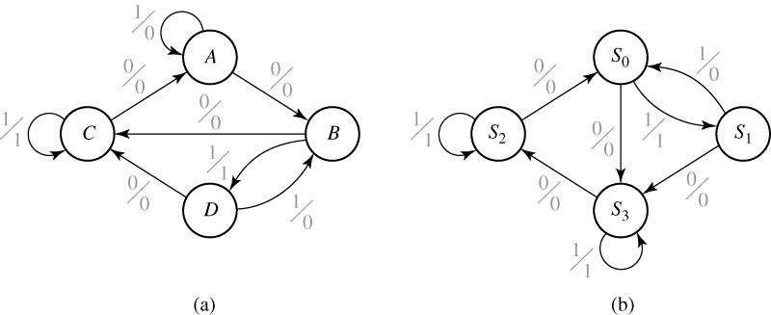
15.4 Equivalent Sequential Circuits
Fig 15-6. Tables and Graphs for Equivalent Circuits
 | X=0 | X=1 | X=0 | X=1
A | B | A | 0 | 0
B | C | D | 0 | 1
C | A | C | 0 | 1
D | C | B | 0 | 0
 | X=0 | X=1 | X=0 | X=1
S₀ | S₃ | S₁ | 0 | 1
S₁ | S₃ | S₀ | 0 | 0
S₂ | S₀ | S₂ | 0 | 0
S₃ | S₂ | S₃ | 0 | 1

Slide 44
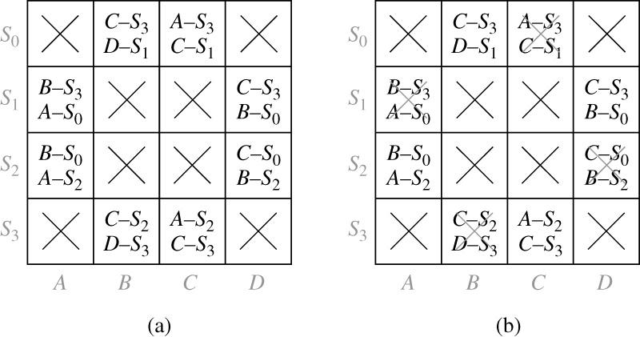
15.4 Equivalent Sequential Circuits
Fig 15-7. Implication Tables for Determining Circuit Equivalence

Slide 45
15.5 Incompletely Specified State Tables
Fig 15-8.
The possible input-output sequence for circuit B
 | t₀ | t₁ | t₂ |  | t₀ | t₁ | t₂
X= | 1 | 0 | 0 | Z= | - | - | 0
 | 1 | 1 | 0 |  | - | - | 1
(- is a don’t care output)
Table 15-5. Incompletely Specified State Table
 | X=0 X=1 |  | 0 1
S₀ | ₋ | S₁ | - | -
S₁ | S₂ | S₃ | - | -
S₂ | S₀ | - | 0 | -
S₃ | S₀ | - | 1 | -
 | X=0 X=1 |  | 0 1
S₀ | (S₀) | S₁ | (0) | -
S₁ | S₂ S₀ | S₃ | (1) | -
S₂ | S₀ | (S₁) | 0 | -
S₃ | S₀ | (S₃) | 1 | -
 | X=0 X=1 |  | 0 1
S₀ | S₀ | S₁ | 0 | -
S₁ | S₀ | S₁ | 1 | -

Slide 46
15.6 Derivation of Flip-Flop Input Equations
The procedure to drive the flip-flop input equations:
Assign flip-flop state values to correspond to the states in the reduced table
Construct a transition table which gives the next states of the flip-flops as a function of the present states and inputs
Derive the next-state maps from the transition table
Find flip-flop input maps from the next-state maps using the techniques developed in Unit 12 and find the flip-flop input equations from maps

Slide 47
15.6 Derivation of Flip-Flop Input Equations
Table 15-6
ABC | A⁺B⁺C⁺ |  | Z
 | X=0 | X=1 | 0 | 1
000 | 110 | 001 | 0 | 0
110 | 111 | 001 | 0 | 0
001 | 110 | 011 | 0 | 0
111 | 101 | 001 | 0 | 0
011 | 110 | 010 | 0 | 0
101 | 101 | 001 | 1 | 0
010 | 110 | 010 | 0 | 1
 | X=0 X=1 |  | 0 1
S₀ | S₁ | S₂ | 0 | 0
S₁ | S₃ | S₂ | 0 | 0
S₂ | S₁ | S₄ | 0 | 0
S₃ | S₅ | S₂ | 0 | 0
S₄ | S₁ | S₆ | 0 | 0
S₅ | S₅ | S₂ | 1 | 0
S₆ | S₁ | S₆ | 0 | 1

Slide 48
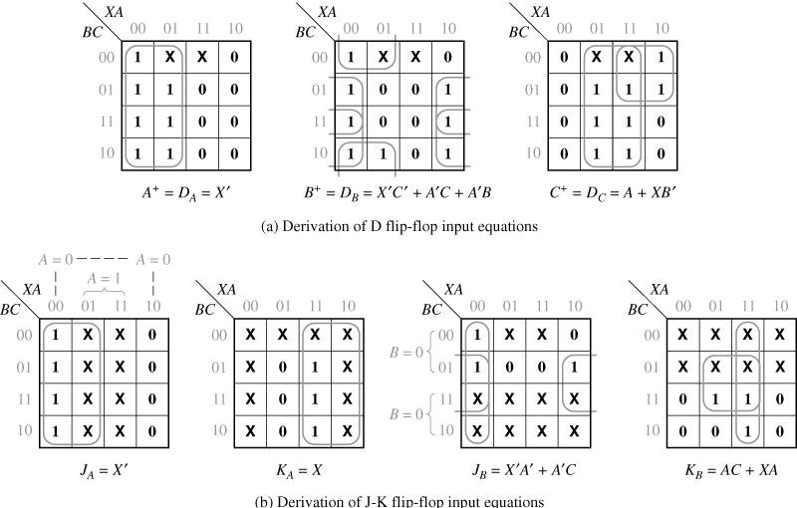
15.6 Derivation of Flip-Flop Input Equations
Fig. 15-9 Next-State Maps for Table 15-6

Slide 49
15.6 Derivation of Flip-Flop Input Equations
Table 15-7
PS | Next State |  |  |  | Output(Z₁Z₂)
 | X₁X₂= |  |  |  | X₁X₂=
 | 00 | 01 | 11 | 10 | 00 | 01 | 11 | 10
S₀ | S₀ | S₀ | S₁ | S₁ | 00 | 00 | 01 | 01
S₁ | S₁ | S₃ | S₂ | S₁ | 00 | 10 | 10 | 00
S₂ | S₃ | S₃ | S₂ | S₂ | 11 | 11 | 00 | 00
S₃ | S₀ | S₃ | S₂ | S₀ | 00 | 00 | 00 | 00
AB | A⁺B⁺ |  |  |  | Output(Z₁Z₂)
 | X₁X₂= |  |  |  | X₁X₂=
 | 00 | 01 | 11 | 10 | 00 | 01 | 11 | 10
00 | 00 | 00 | 01 | 01 | 00 | 00 | 01 | 01
01 | 01 | 10 | 11 | 01 | 00 | 10 | 10 | 00
11 | 10 | 10 | 11 | 11 | 11 | 11 | 00 | 00
10 | 00 | 10 | 11 | 00 | 00 | 00 | 00 | 00
(a) State table
(b) Transition table

Slide 50
15.6 Derivation of Flip-Flop Input Equations
Fig.15-10 Next-State Maps for Table 15-7
Fig.15-11 Derivation of S-R Equations for Table 15-7

Slide 51
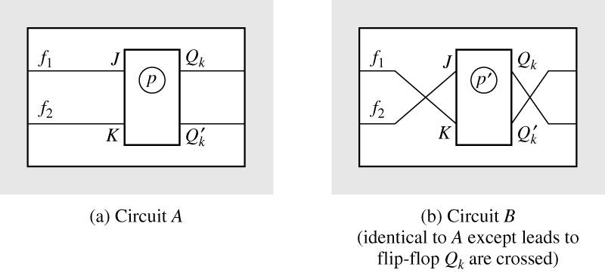
15.7 Equivalent State Assignments
Table 15-8. State Assignments for 3-Row Tables
 | 1 | 2 | 3 | 4 | 5 | 6 | 7 |  | 19 | 20 | 21 | 22 | 23 | 24
S₀ | 00 | 00 | 00 | 00 | 00 | 00 | 01 | … | 11 | 11 | 11 | 11 | 11 | 11
S₁ | 01 | 01 | 10 | 10 | 11 | 11 | 00 |  | 00 | 00 | 01 | 01 | 10 | 10
S₂ | 10 | 11 | 01 | 11 | 01 | 10 | 10 |  | 01 | 10 | 00 | 10 | 00 | 01
Fig. 15-12 Equivalent Circuits Obtained by Complementing Q_{k}

Slide 52
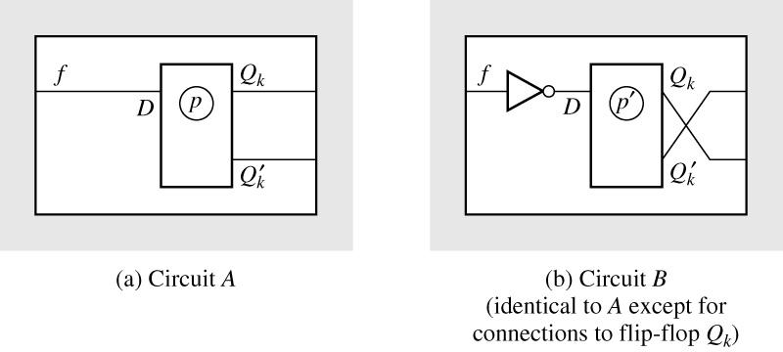
15.7 Equivalent State Assignments
Fig. 15-13 Equivalent Circuits Obtained by Complementing Q_{k}
Table 15-9
Assignments |  |  | Present State | Next State |  | Output
A₃ | B₃ | C₃ |  | X=0 | 1 | 0 | 1
00 | 00 | 11 | S₁ | S₁ | S₃ | 0 | 0
01 | 10 | 10 | S₂ | S₂ | S₁ | 0 | 1
10 | 01 | 01 | S₃ | S₂ | S₃ | 1 | 0

Slide 53
15.7 Equivalent State Assignments
The resulting J and K input equations
Table 15-10 Nonequivalent Assignments for Three and Four States
 | 3-State Assignments |  |  | 4-State Assignments
States | 1 | 2 | 3 | 1 | 2 | 3
a | 00 | 00 | 00 | 00 | 00 | 00
b | 01 | 01 | 11 | 01 | 01 | 11
c | 10 | 11 | 01 | 10 | 11 | 01
d | - | - | - | 11 | 10 | 10

Slide 54
15.7 Equivalent State Assignments
Table 15-11 Number of Distinct(Nonequivalent)State Assignments
Number of States | Minimum Number of State Variables | Number of Distinct Assignments
2 | 1 | 1
3 | 2 | 3
4 | 2 | 3
5 | 3 | 140
6 | 3 | 420
7 | 3 | 840
8 | 3 | 840
9 | 4 | 10,810,800
… | … | …
16 | 4

Slide 55
15.8 Guidelines for State Assignment
Guidelines for state assignment
States which have the same next state for a given input should be given adjacent assignments
States which are the next states of the same state should be given adjacent assignments
States which have the same output for a given input should be given adjacent assignments

Slide 56
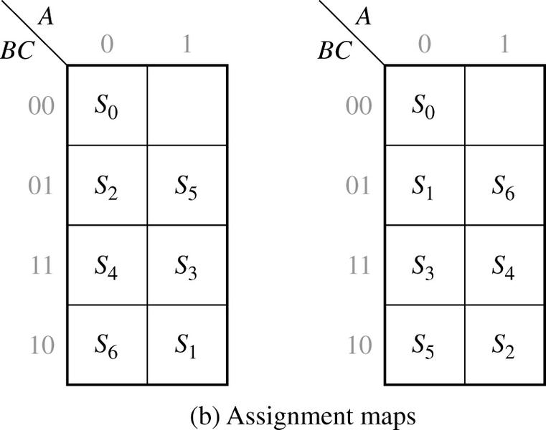
15.8 Guidelines for State Assignment
Fig. 15-14
ABC |  | X=0 | 1 | 0 | 1
000 | S₀ | S₁ | S₂ | 0 | 0
110 | S₁ | S₃ | S₂ | 0 | 0
001 | S₂ | S₁ | S₄ | 0 | 0
111 | S₃ | S₅ | S₂ | 0 | 0
011 | S₄ | S₁ | S₆ | 0 | 0
101 | S₅ | S₅ | S₂ | 1 | 0
010 | S₆ | S₁ | S₆ | 0 | 1
(a) State table
The sets of adjacent states specified by Guidelines 1 and 2

Slide 57
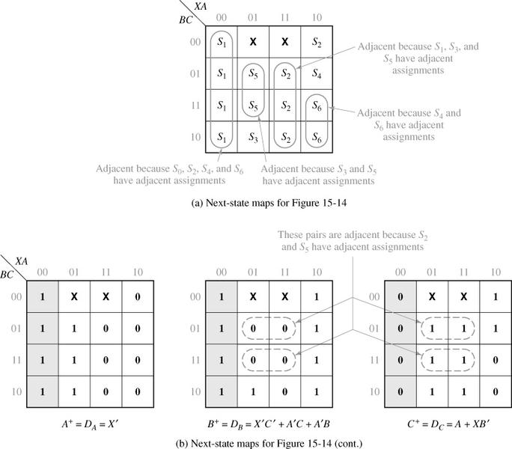
15.8 Guidelines for State Assignment
Fig. 15-15 Next-State Maps for Figure 15-14

Slide 58
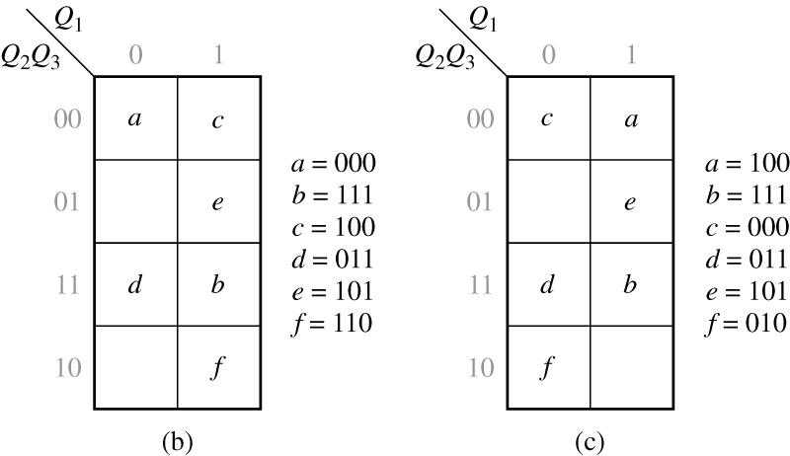
15.8 Guidelines for State Assignment
Fig. 15-16 State Table and Assignments
 | X=0 | 1 | X=0 | 1
a | a | c | 0 | 0
b | d | f | 0 | 1
c | c | a | 0 | 0
d | d | b | 0 | 1
e | b | f | 1 | 0
f | c | e | 1 | 0
(a)
The sets of adjacent states specified by each Guidelines

Slide 59
15.8 Guidelines for State Assignment
Table 15-12 Transition Table for Figure 15-16(a)
Q₁Q₂Q₃ | Q₁⁺ Q₂⁺ Q₃⁺
 | X=0 | 1 | X=0 | 1
1 0 0 | 100 | 000 | 0 | 0
1 1 1 | 011 | 010 | 0 | 1
0 0 0 | 000 | 100 | 0 | 0
0 1 1 | 011 | 111 | 0 | 1
1 0 1 | 111 | 010 | 1 | 0
0 1 0 | 000 | 101 | 1 | 0

Slide 60
15.8 Guidelines for State Assignment
Fig. 15-17 Next-State and Output Maps for Table15-12
The D flip-flop input equations
The output equations

Slide 61
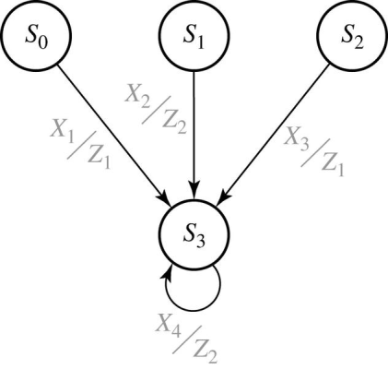
15.9 Using a One-Hot State Assignment
Fig. 15-18 Partial State Graph
The One-hot assignment example
The next-state equation for Q₃
Because Q₀=1 implies Q₁= Q₂= Q₃=0,

Slide 62
15.9 Using a One-Hot State Assignment
The One-hot assignment example by replacing Q₀ with Q’₀
The modified equations
The next-state equations
The output equations

