Slide 1

CHAPTER 14
Derivation of State Graphs and Tables
This chapter in the book includes:
Objectives
Study Guide
14.1 Design of a Sequence Detector
14.2 More Complex Design Problems
14.3 Guidelines for Construction of State Graphs
14.4 Serial Data Code Conversion
14.5 Alphanumeric State Graph Notation
Programmed Exercises
Problems

Slide 2
Objectives
Given a problem statement for the design of a Mealy or Moore
sequential circuit, find the corresponding state graph and table.
2. Explain the significance of each state in your graph or table
in terms of the input sequences required to reach that state.
3. Check your state graph using appropriate input sequences.

Slide 3
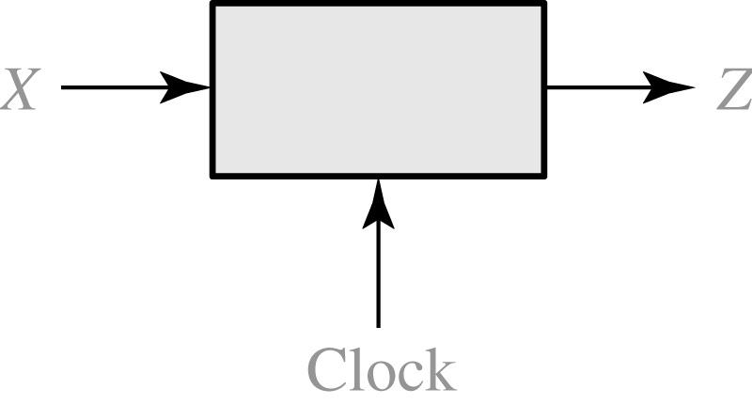
14.1 Design of a Sequence Detector
Sequence Detector to be Designed
Z=1 for input sequence of ‘101’
X = | 0 | 0 | 1 | 1 | 0 | 1 | 1 | 0 | 0 | 1 | 0 | 1 | 0 | 1 | 0 | 0
Z = | 0 | 0 | 0 | 0 | 0 | 1 | 0 | 0 | 0 | 0 | 0 | 1 | 0 | 1 | 0 | 0
(time: | 0 | 1 | 2 | 3 | 4 | 5 | 6 | 7 | 8 | 9 | 10 | 11 | 12 | 13 | 14 | 15)

Slide 4
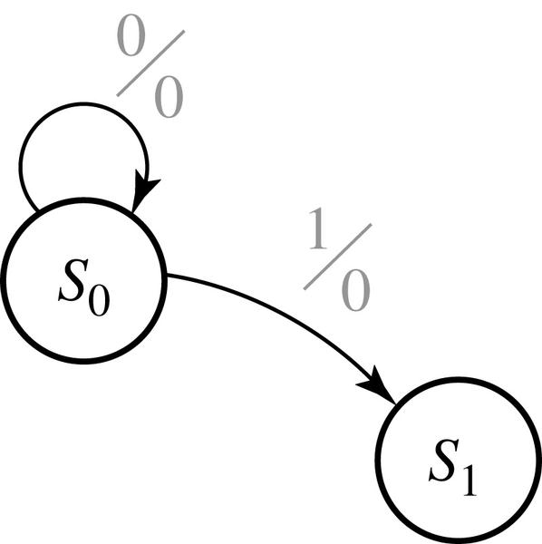
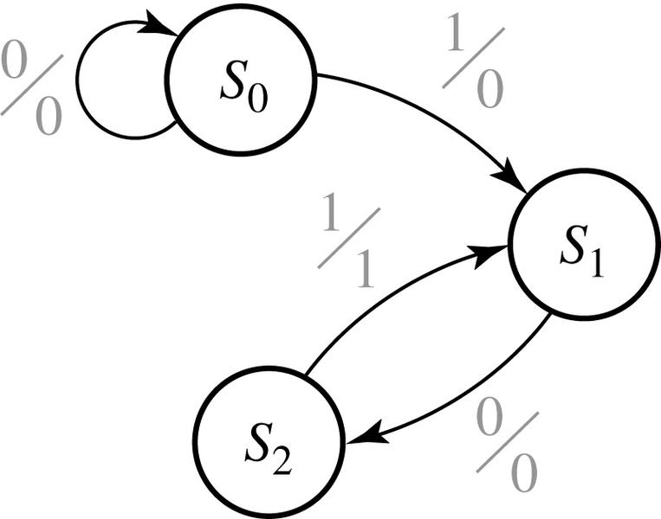
14.1 Design of a Sequence Detector
Mealy Formation of State Graph

Slide 5
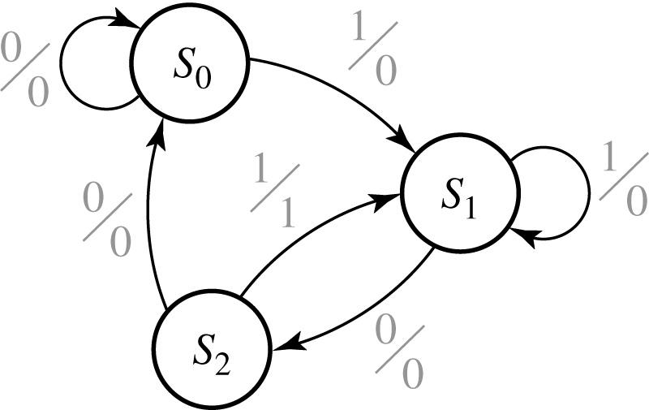
14.1 Design of a Sequence Detector
Mealy State Graph for Sequence Detector

Slide 6
14.1 Design of a Sequence Detector
State Table
Present state
Next State
Present
Output
X = 0
X = 1
X = 0
X =1
S₀
S₁
S₂
S₀
S₂
S₀
S₁
S₁
S₁
0
0
0
0
0
1
Transition Table with State Assignment
AB
A⁺ B⁺
Z
X = 0
X = 1
X = 0
X =1
00
01
10
00
10
00
01
01
01
0
0
0
0
0
1

Slide 7
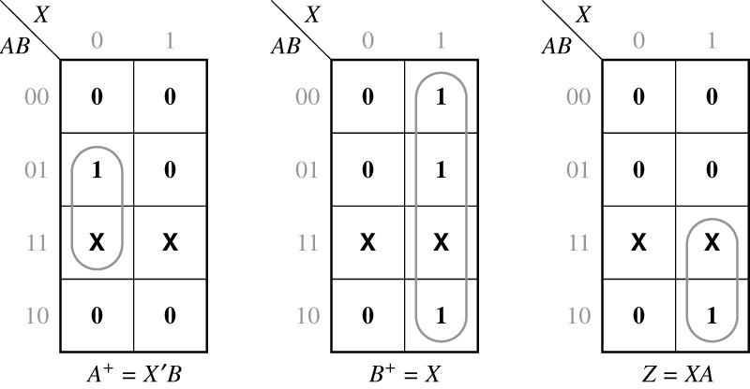
14.1 Design of a Sequence Detector
Map for the Output Function Z (from Table 1,2)

Slide 8
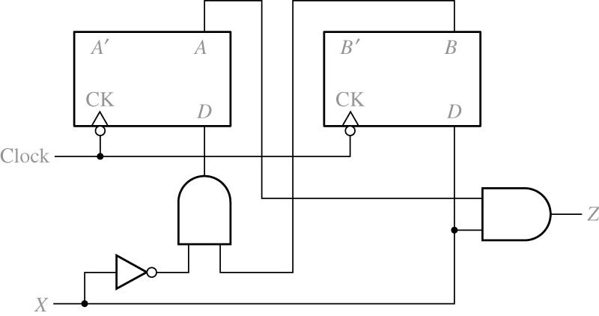
14.1 Design of a Sequence Detector
Final Circuit

Slide 9
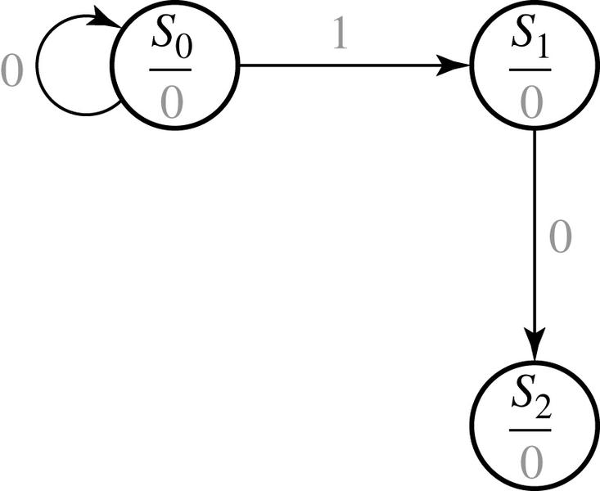
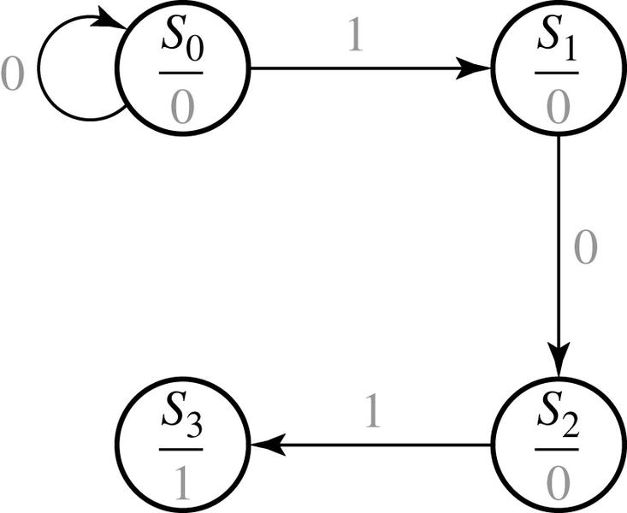
14.1 Design of a Sequence Detector
Moore Machine Design Process

Slide 10
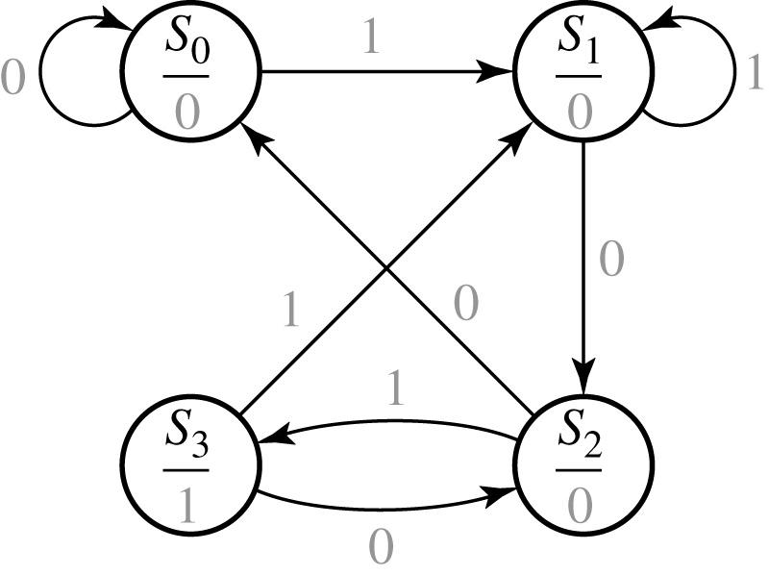
14.1 Design of a Sequence Detector
Moore State Graph for Sequence Detector

Slide 11
14.1 Design of a Sequence Detector
State Table
Transition Table with State Assignment
Present State |  | Next State |  | Present Output (Z)
 |  | X = 0 | X = 1
S₀ S₁ S₂ S₃ |  | S₀ S₂ S₀ S₂ | S₁ S₁ S₃ S₁ | 0 0 0 1
AB |  | A⁺ B⁺ |  | Z
 |  | X = 0 | X = 1
00 01 11 10 |  | 00 11 00 11 | 01 01 10 01 | 0 0 0 1

Slide 12
14.2 More Complex Design Problems
The circuit to be designed (Mealy)
Output Z=1 if input sequence ends in either 010 or 1001
X= | 0 | 0 | 1 | 0 | 1 | 0 | 0 | 1 | 0 | 0 | 0 | 1 | 0 | 0 | 1 | 1 | 0
 |  |  |  | ↑ |  | ↑ |  | ↑ | ↑ |  |  |  | ↑ |  | ↑
 |  |  |  | a |  | b |  | c | d |  |  |  | e |  | f
Z= | 0 | 0 | 0 | 1 | 0 | 1 | 0 | 1 | 1 | 0 | 0 | 0 | 1 | 0 | 1 | 0 | 0

Slide 13
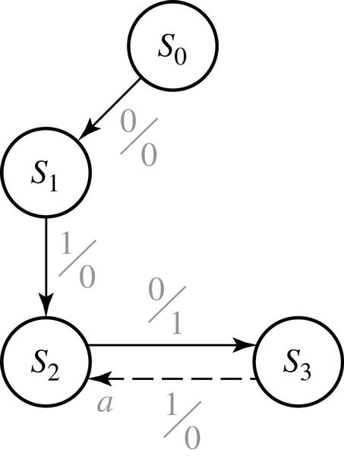
14.2 More Complex Design Problems
Formation of State Graph (010 sequence)
state | sequence received
S₀ S₁ S₂ S₃ | reset 0 01 010

Slide 14
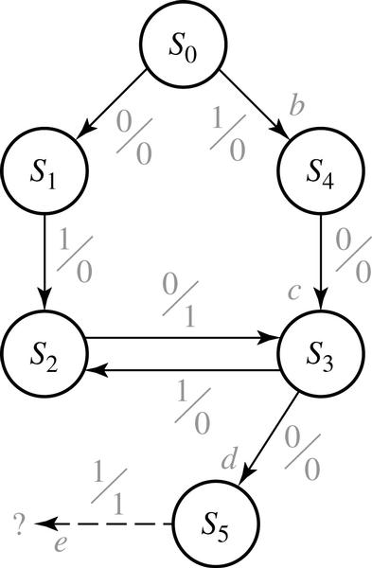
14.2 More Complex Design Problems
Formation of State Graph (1001 sequence)
state | sequence ends in
S₀ S₁ S₂ S₃ S₄ S₅ | reset 0 (but not 10) 01 10 1 (but not 01) 100

Slide 15
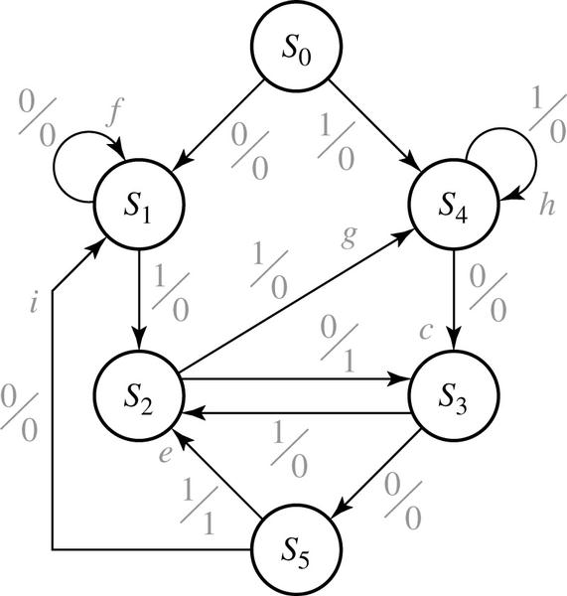
14.2 More Complex Design Problems
Completed State Graph for a Sequence Detector to be Designed
state | sequence ends in
S₀ S₁ S₂ S₃ S₄ S₅ | reset 0 (but not 10) 01 10 1 (but not 01) 100

Slide 16
14.2 More Complex Design Problems
The circuit to be designed (Moore)
Output Z=1 if the total number of 1’s received is odd and at least two consecutive 0’s have been received
X= | 1 | 0 | 1 | 1 | 0 | 0 | 1 | 1
 | ↑ |  |  | ↑ |  | ↑ | ↑ | ↑
 | a |  |  | b |  | c | d | e
Z= | (0) | 0 | 0 | 0 | 0 | 1 | 0 | 1

Slide 17

14.2 More Complex Design Problems
Formation of State Graph (Step 1)

Slide 18
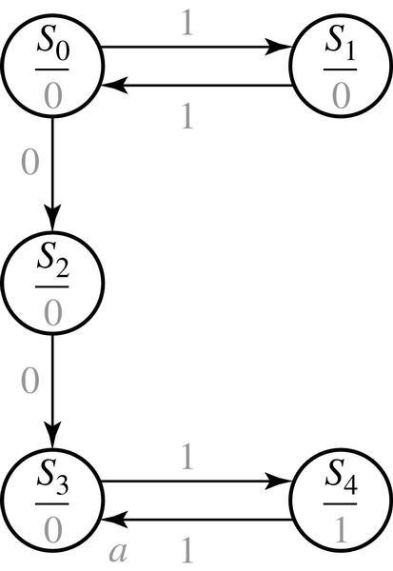
14.2 More Complex Design Problems
Formation of State Graph (Step 2)
state | sequence ends in
S₀ S₁ S₂ S₃ S₄ | reset or even 1’s odd 1’s even 1’s and ends in 0 even 1’s and 00 has occurred 00 has occurred and odd 1’s

Slide 19
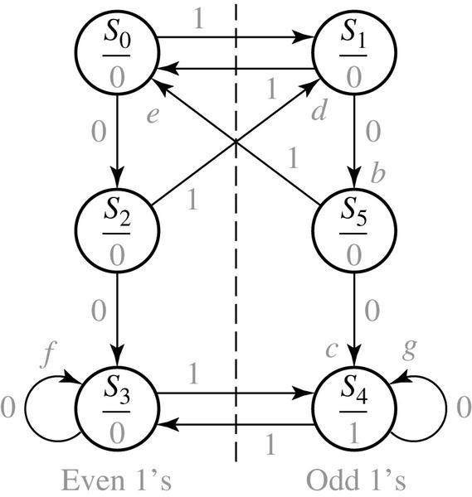
14.2 More Complex Design Problems
Completed State Graph for a Sequence Detector to be Designed
state | sequence ends in
S₀ S₁ S₂ S₃ S₄ S₅ | reset or even 1’s odd 1’s even 1’s and ends in 0 even 1’s and 00 has occurred odd 1’s and 00 has occurred odd 1’s and ends in 0

Slide 20
14.3 Guidelines for Construction of State Graphs
Construct some sample input and output sequences to make sure that you
understand the problem statement.
2. Determine under what conditions the circuit should reset to its initial state.
3. If only one or two sequences lead to a non-zero output, a good way to start is to
Construct a partial state graph for those sequences.
4. Determine what sequences or groups of sequences must be remembered
by the circuit and set up states accordingly.
5. Each time you add an arrow to the state graph, determine it can go to one of
the previously defined states or whether a new state must be added
6. Check your state graph to make sure there is one and only one path leaving
each state for each combination of values of the input variables
7. When your state graph is complete, test it by applying the input sequences
formulated in part1 and making sure the output sequences are correct

Slide 21
14.3 Guidelines for Construction of State Graphs
Example 1: Z=1 when input sequence 0101 or 1001 occurs.
The circuit resets after every four inputs.
Mealy Circuit
A typical sequence of input and output
X = | 0101 | 0010 | 1001 | 0100
Z = | 0001 | 0000 | 0001 | 0000

Slide 22
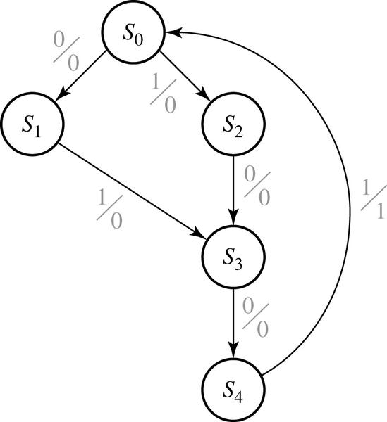
14.3 Guidelines for Construction of State Graphs
Partial State Graph for Example 1
State | Sequence Received
S₀ | reset
S₁ | 0
S₂ | 1
S₃ | 01 or 10
S₄ | 010 or 100
The circuit goes to the same state if either 01 or 10 received.

Slide 23
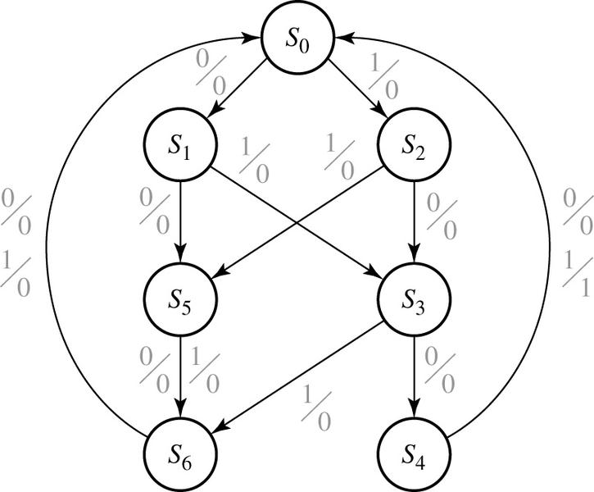
14.3 Guidelines for Construction of State Graphs
Complete State Graph for Example 1
state | sequence received
S₀ S₁ S₂ S₃ S₄ S₅ S₆ | Reset 0 1 01 or 10 010 or 100 two inputs received, no 1 output is possible three inputs received, no 1 output is possible

Slide 24
14.3 Guidelines for Construction of State Graphs
Example 2: Z₁=1 every time the input sequence 100 is completed, provided that the sequence 010 has never occurred.
Z₂=1 every time the input sequence 010 is completed
Once Z₂=1 occurred, Z₁=1 can never occur but not vice versa
Find Mealy circuit.
A typical sequence of input and output
X | = | 1 | 0 | 0 | 1 | 1 | 0 | 0 | 1 | 0 | 1 | 0 | 1 | 0 | 0 | 1 | 0 | 1 | 1 | 0 | 1 | 0 | 0
Z₁ | = | 0 | 0 | 1 | 0 | 0 | 0 | 1 | 0 | 0 | 0 | 0 | 0 | 0 | 0 | 0 | 0 | 0 | 0 | 0 | 0 | 0 | 0
Z₂ | = | 0 | 0 | 0 | 0 | 0 | 0 | 0 | 0 | 1 | 0 | 1 | 0 | 1 | 0 | 0 | 1 | 0 | 0 | 0 | 0 | 1 | 0

Slide 25
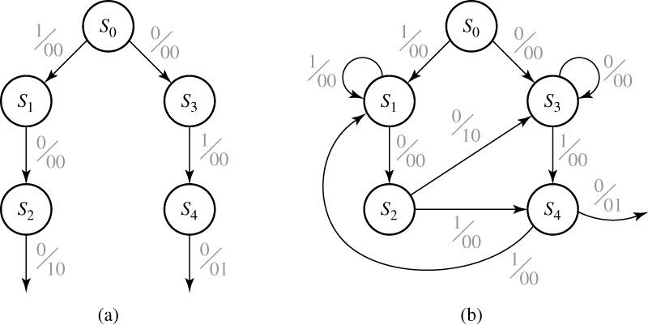
14.3 Guidelines for Construction of State Graphs
Partial Graphs for Example 2

Slide 26
14.3 Guidelines for Construction of State Graphs
State Descriptions for Example 2
stats | Description
S₀ S₁ S₂ S₃ S₄ | No progress on 100 Progress of 1 on 100 Progress of 10 on 100 No progress on 100 Progress of 10 on 100 | No progress on 010 No progress on 010 Progress of 0 on 010 Progress of 0 on 010 Progress of 01 on 010 | 010 has never occurred
S₅ S₆ S₇ |  | Progress of 0 on 010 Progress of 01 on 010 No progress on 010 | 010 has occurred

Slide 27
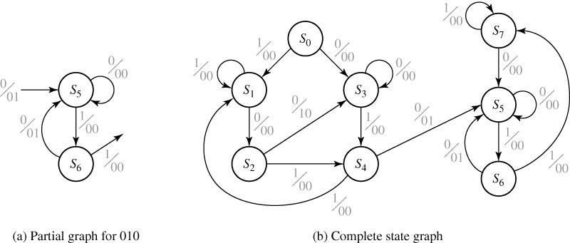
14.3 Guidelines for Construction of State Graphs
State Graphs for Example 2

Slide 28
14.3 Guidelines for Construction of State Graphs
State Table for Example 2
Present state |  | Next X = 0 | State X = 1 |  | Output X = 0 | (Z₁ Z₂) X = 1
S₀ S₁ S₂ S₃ S₄ S₅ S₆ S₇ |  | S₃ S₂ S₃ S₃ S₅ S₅ S₅ S₅ | S₁ S₁ S₄ S₄ S₁ S₆ S₇ S₇ |  | 00 00 10 00 01 00 01 00 | 00 00 00 00 00 00 00 00

Slide 29
14.3 Guidelines for Construction of State Graphs
Example 3: Two inputs – X₁, X₂, One output – Z
(a) The input sequence X₁X₂=01, 11 causes the output 0
(b) The input sequence X₁X₂=10, 11 causes the output 1
(c) The input sequence X₁X₂=10, 01 causes the output to change
Derive a Moore state graph.
Previous Input (X₁X₂) | Output (Z) | State Designation
00 or 11 00 or 11 01 01 10 10 | 0 1 0 1 0 1 | S₀ S₁ S₂ S₃ S₄ S₅

Slide 30
14.3 Guidelines for Construction of State Graphs
State Table for Example 3
Present |  | Z |  |  | Next state
State |  |  | X₁X₂ | = | 00 | 01 | 11 | 10
S₀ S₁ S₂ S₃ S₄ S₅ |  | 0 1 0 1 0 1 |  |  | S₀ S₁ S₀ S₁ S₀ S₁ | S₂ S₃ S₂ S₃ S₃ S₂ | S₀ S₁ S₀ S₀ S₁ S₁ | S₄ S₅ S₄ S₅ S₄ S₅

Slide 31
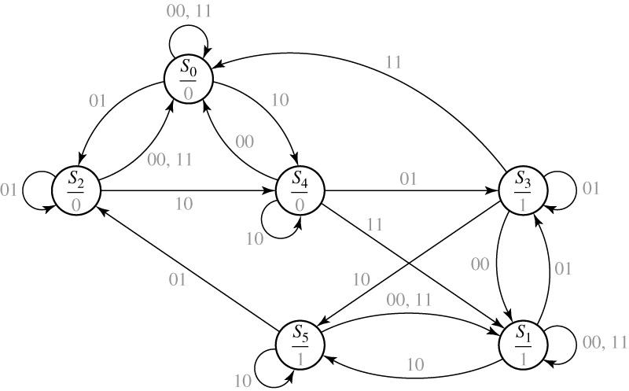
14.3 Guidelines for Construction of State Graphs
State Graph for Example 3

Slide 32
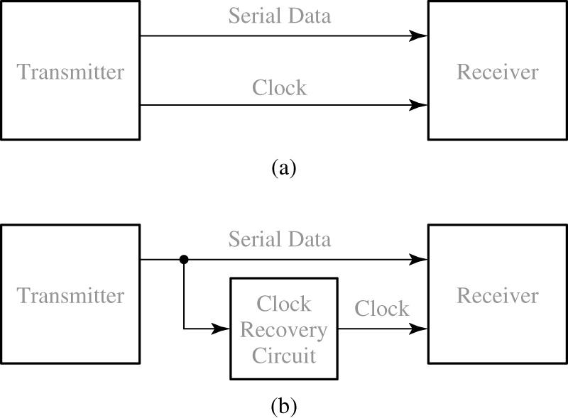
14.4 Serial Data Code Conversion
Serial Data Transmission

Slide 33
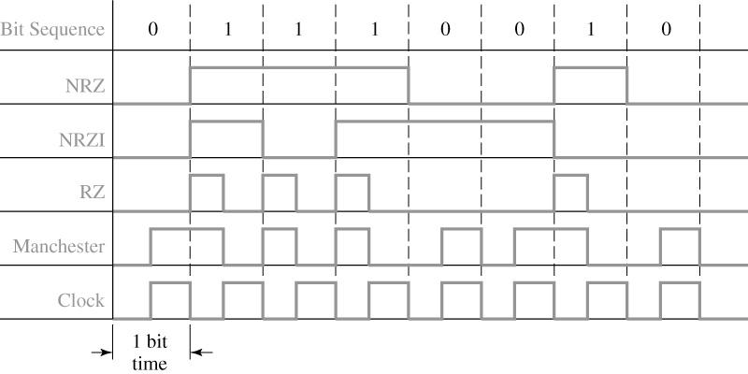
14.4 Serial Data Code Conversion
Coding Schemes for Serial Data Transmission

Slide 34
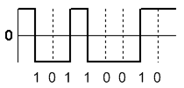
14.4 Serial Data Code Conversion
Non-Return-to-Zero Inverted (NRZI)
The two level NRZI signal has
a transition at a clock boundary if the bit being transmitted is a logical 1, and
does not have a transition if the bit being transmitted is a logical 0.

Slide 35
14.4 Serial Data Code Conversion
Manchester code
Each bit is transmitted in a fixed time (the "period").
A 0 is expressed by a low-to-high transition, a 1 by high-to-low transition.
The transitions which signify 0 or 1 occur at the midpoint of a period.
Transitions at the start of a period are overhead and don't signify data.

Slide 36
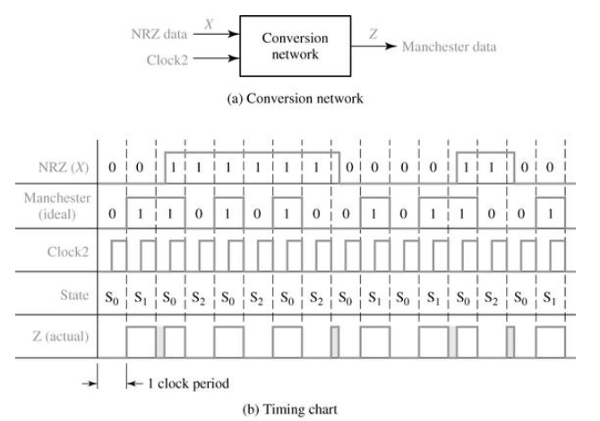
14.4 Serial Data Code Conversion
Mealy circuit for NRZ to Manchester Conversion

Slide 37
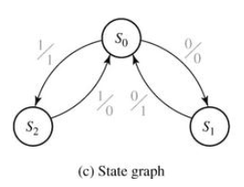
14.4 Serial Data Code Conversion
Sequence Detector to be Designed (Mealy)
Present |  | Next State |  |  | Output (Z)
State |  | X = 0 |  | X = 1 | X = 0 |  | X = 1
S₀ S₁ S₂ |  | S₁ S₀ - |  | S₂ - S₀ | 0 1 - |  | 1 - 0
(d) State table

Slide 38
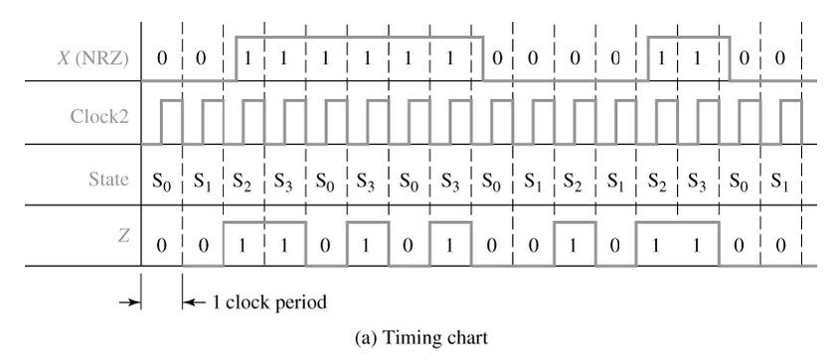
14.4 Serial Data Code Conversion
Moore Circuit for NRZ-to-Manchester Conversion

Slide 39
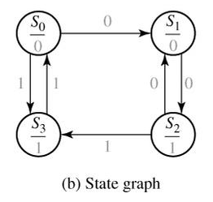
14.4 Serial Data Code Conversion
Moore Circuit for NRZ-to-Manchester Conversion
Present |  | Next State |  |  | Present
State |  | X = 0 |  | X = 1 | Output (Z)
S₀ S₁ S₂ S₃ |  | S₁ S₂ S₁ - |  | S₃ - S₃ S₀ | 0 0 1 1
(c) State table

Slide 40
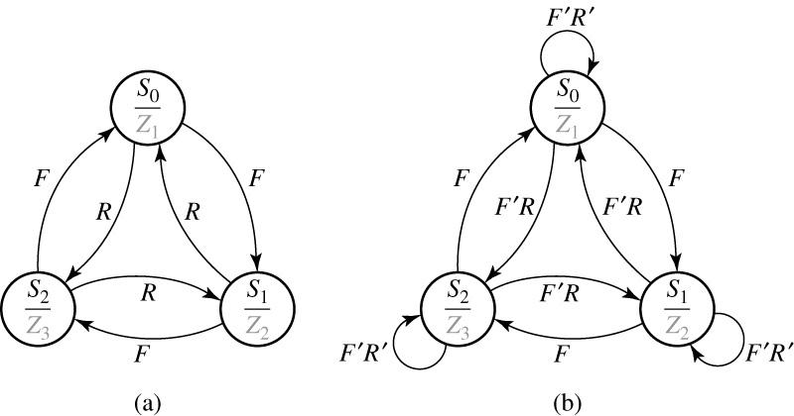
14.5 Alphanumeric State Graph Notation
State Graphs with Variable Names on Arc Labels

Slide 41
14.5 Alphanumeric State Graph Notation
State Table for Fig 14-22
PS | NS |  |  |  |  | Output
 | FR = | 00 | 01 | 10 | 11 | Z₁ | Z₂ | Z₃
S₀ S₀ S₀ |  | S₀ S₀ S₀ | S₀ S₀ S₀ | S₀ S₀ S₀ | S₀ S₀ S₀ | 1 0 0 | 0 1 0 | 0 0 1
The result :
If we AND together every possible pair of arc labels emanating from S₀, we get

Slide 42


