Slide 1
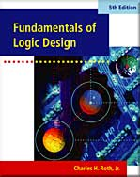
UNIT 12 REGISTERS AND COUNTERS
This chapter in the book includes:
Objectives
Study Guide
12.1 Registers and Register Transfers
12.2 Shift Registers
12.3 Design of Binary Counters
12.4 Counters for Other Sequences
12.5 Counter Design Using S-R and J-K Flip-Flops
12.6 Derivation of Flip-Flop Input Equations--Summary
Problems

Slide 2
Objectives
Explain the operation of registers. Understand how to transfer data
between registers using tri-state bus
2. Explain the shift register operation, how to build them and
analyze operation. Construct a timing diagram for a shift register
3. Explain the operation of binary counters, how to build them using F/F
and gates and analyze operation.
4. Given the present state and desired next state of F/F, determine
the required F/F/ inputs
5. Given the desired counting sequence for a counter, derive F/F input equations.
6. Explain the procedures used for deriving F/F input equation.
7.Construct a timing diagram for a counter by tracing signals through the circuit.

Slide 3
Registers and Counters
Register
A group of flip-flops
Use a common clock input
Used to store and shift binary data
Counter
A group of flip-flops
Change states in a prescribed sequence

Slide 4
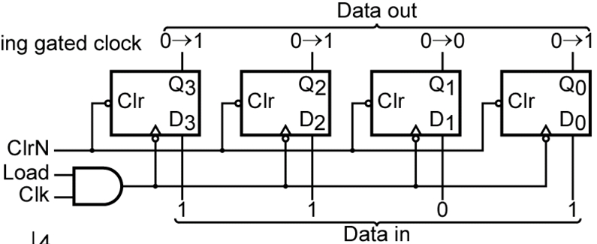
12.1 Registers and Register Transfers
4-Bit D Flip-Flop Registers with Data, Load, Clear, and Clock inputs
ClrN signal for asynchronous clear
Load signal ANDed with Clk signal → may cause timing problems

Slide 5
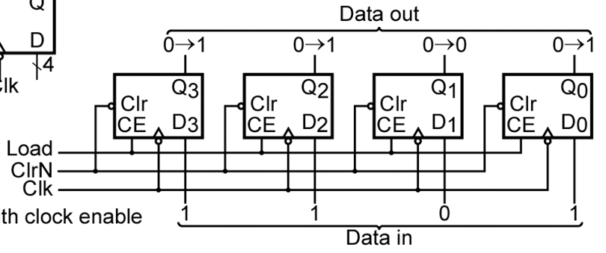
12.1 Registers and Register Transfers
4-Bit D Flip-Flop Registers with Data, Load, Clear, and Clock inputs
Load signal is applied to CE (Clock Enable) pin

Slide 6
12.1 Registers and Register Transfers
4-Bit D Flip-Flop Registers with Data, Load, Clear, and Clock inputs
Symbol
4
Bus
Q
ClrN
Clr
CE
D
4
Bus
Load
Clk

Slide 7
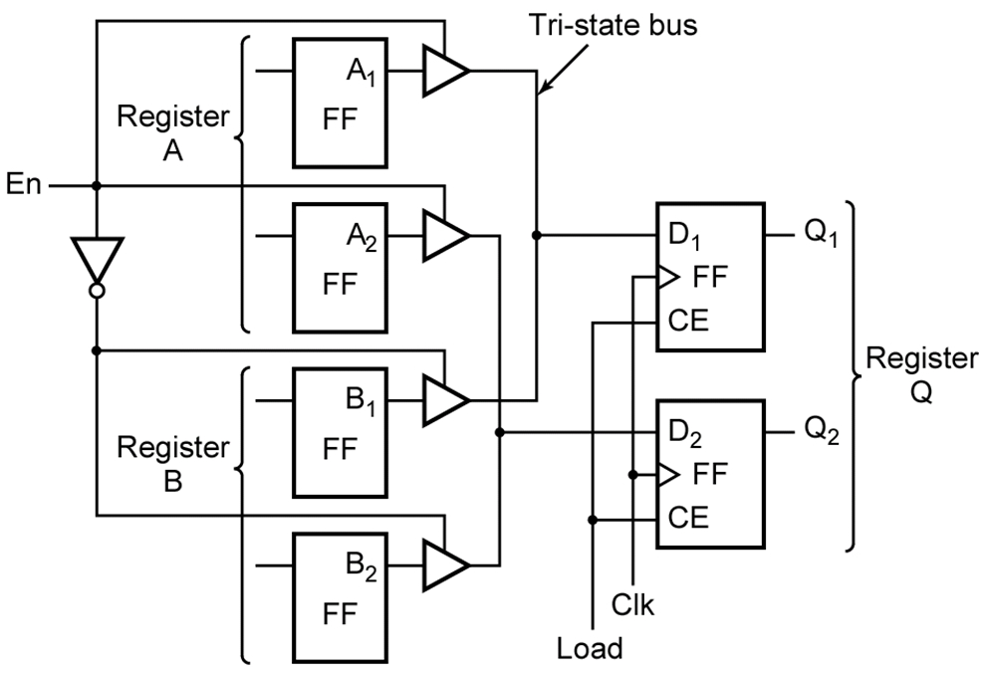
12.1 Registers and Register Transfers
Data Transfer Between Registers

Slide 8
12.1 Registers and Register Transfers
Data Transfer Between Registers (A → Q)
EN = 1
Load = 1

Slide 9
12.1 Registers and Register Transfers
Data Transfer Between Registers (B → Q)
EN = 0
Load = 1

Slide 10
12.1 Registers and Register Transfers
8-Bit Register with Tri-State Output

Slide 11
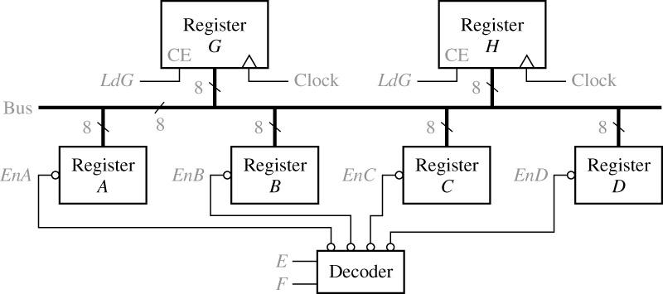
12.1 Registers and Register Transfers
Data Transfer Using a Tri-State Bus
LdH

Slide 12
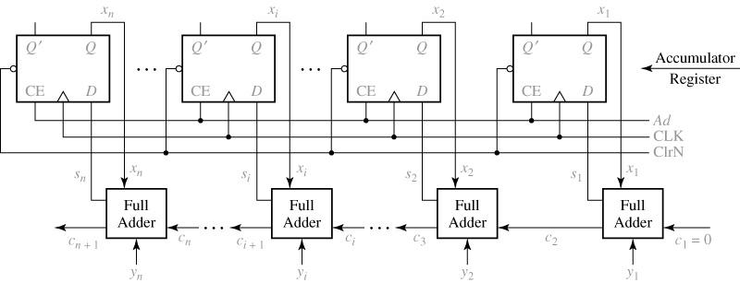
12.1 Registers and Register Transfers
Parallel Adder with Accumulator

Slide 13
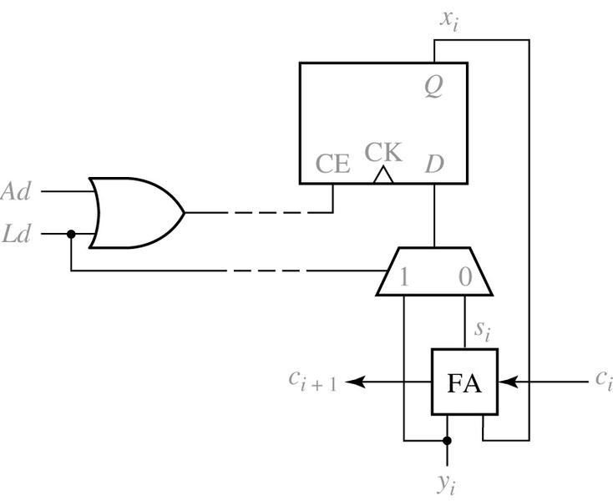
12.1 Registers and Register Transfers
Typical Adder Cell with Multiplexer

Slide 14
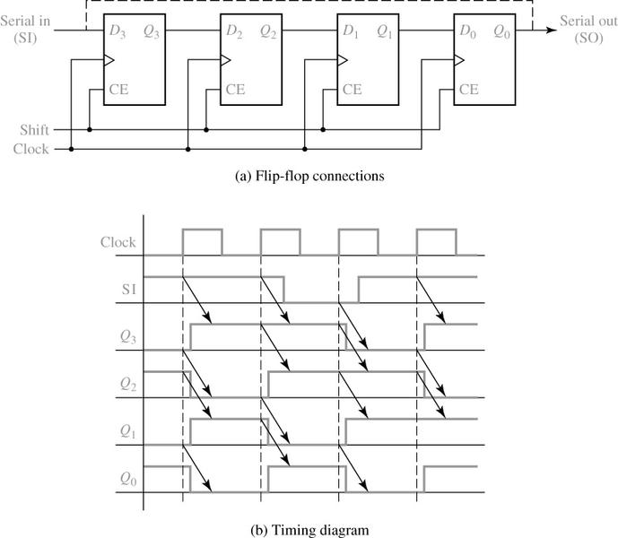
12-2 Shift Registers
4-bit Right-Shift Register
Shifting occurs when Shift = 1
0101→1010→1101→0110→1011

Slide 15
12-2 Shift Registers
4-bit End-Around Right-Shift Register

Slide 16
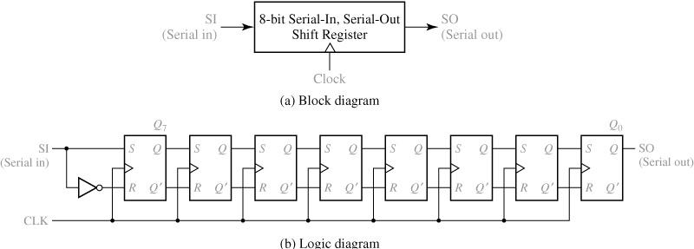
12-2 Shift Registers
8-Bit Serial-in, Serial-out Shift Register ( Commercialized in IC )

Slide 17
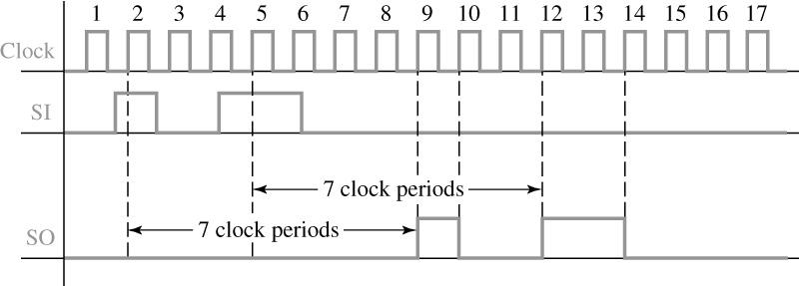
12-2 Shift Registers
Typical Timing Diagram for Shift Register

Slide 18
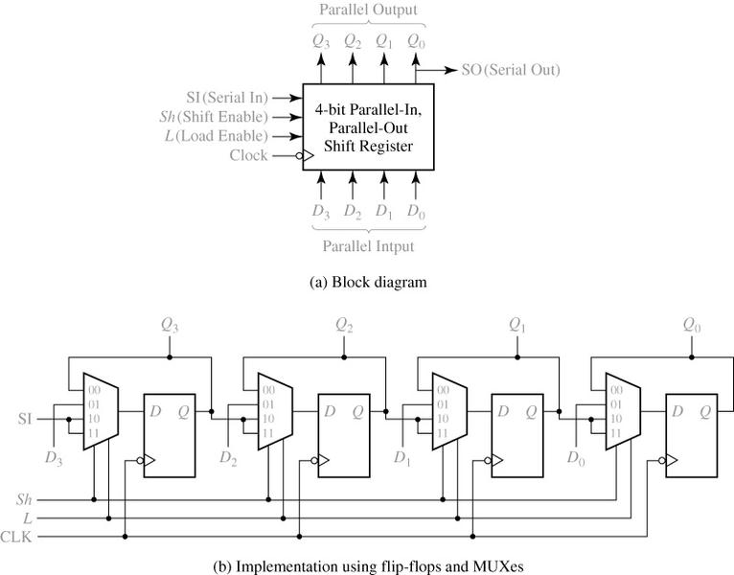
12-2 Shift Registers
Parallel-in, Parallel-Out Right Shift Register

Slide 19
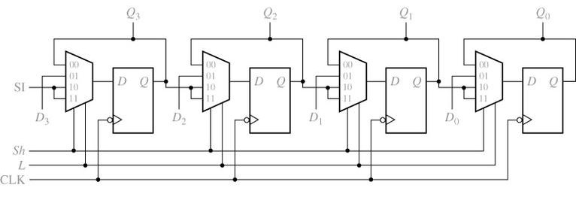
12-2 Shift Registers
Parallel-in, Parallel-Out Right Shift Register
Inputs Sh (Shift) L(Load) | Next State Q₃⁺ Q₂⁺ Q₁⁺ Q₀⁺ | Action
0 0 0 1 1 X | Q₃ Q₂ Q₁ Q₀ D₃ D₂ D₁ D₀ SI Q₃ Q₂ Q₁ | No change Load Right shift

Slide 20
12-2 Shift Registers
The Next-state Equations for the Shifter Register
Typical Application of the Shifter Register
Conversion of parallel data to serial data

Slide 21
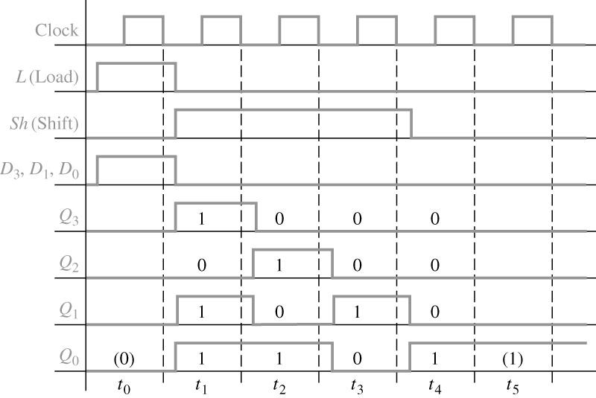
12-2 Shift Registers
Timing Diagram for Shift Register

Slide 22
12-2 Shift Registers
Shift Register with Inverted Feedback → Johnson Counter
Initial states = 000
Initial states = 010
A 3-bit shift register
Successive states

Slide 23
12.3 Design of Binary Counters
Counter
Synchronous counter
State changes occur simultaneously
Asynchronous counter (Ripple counter)
One flip-flop triggers the next flip-flop in line

Slide 24
12.3 Design of Binary Counters
A binary counter using three T F/F to count clock pulses
Design of a 3-bit Synchronous Binary Counter by Inspection of Counting Sequence
Counting
Sequence
To determine the flip-flop inputs – T_{A}, T_{B}, T_{C}
C B A
0 0 0
0 0 1
0 1 0
0 1 1
1 0 0
1 0 1
1 1 0
1 1 1
0 0 0
…
A changes state for every clock input
→ T_{A} = 1
B changes state if A = 1
→ T_{B} = A
C changes state if A = 1 and B = 1
→ T_{C} = A AND B

Slide 25
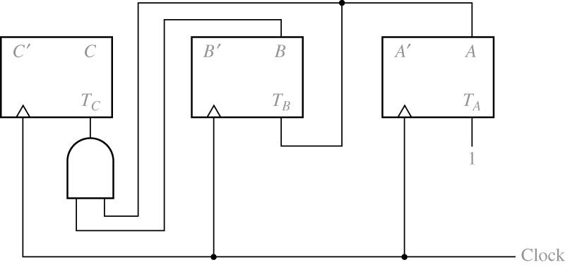
12.3 Design of Binary Counters
A binary counter using three T F/F to count clock pulses
Design of a 3-bit Synchronous Binary Counter by Inspection of Counting Sequence
T_{A} = 1
T_{B} = A
T_{C} = A AND B

Slide 26
12.3 Design of Binary Counters
Design of a 3-bit Synchronous Binary Counter by Using a State Table
State Table for 3-bit Binary Counter
Present State C B A | Next State Flip-Flop Inputs C⁺ B⁺ A⁺ T_{C} T_{B} T_{A}
0 0 0 0 0 1 0 1 0 0 1 1 1 0 0 1 0 1 1 1 0 1 1 1 | 0 0 1 0 0 1 0 1 0 0 1 1 0 1 1 0 0 1 1 0 0 1 1 1 1 0 1 0 0 1 1 1 0 0 1 1 1 1 1 0 0 1 0 0 0 1 1 1

Slide 27
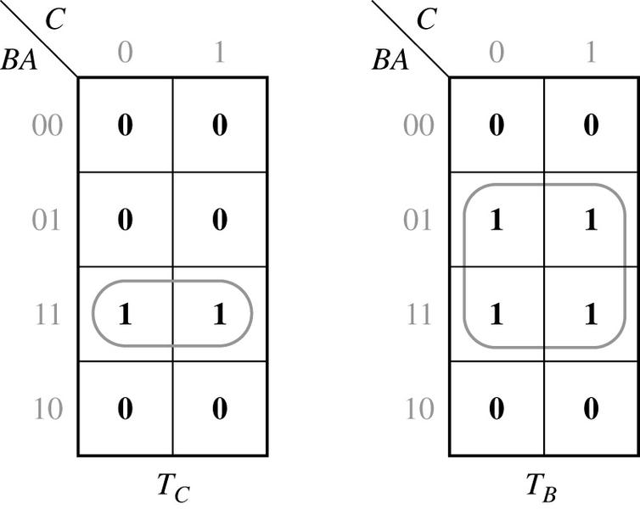
12.3 Design of Binary Counters
Karnaugh Map for 3-bit Synchronous Binary Counter
T_{A} = 1, T_{B} = A, T_{C} = AB

Slide 28
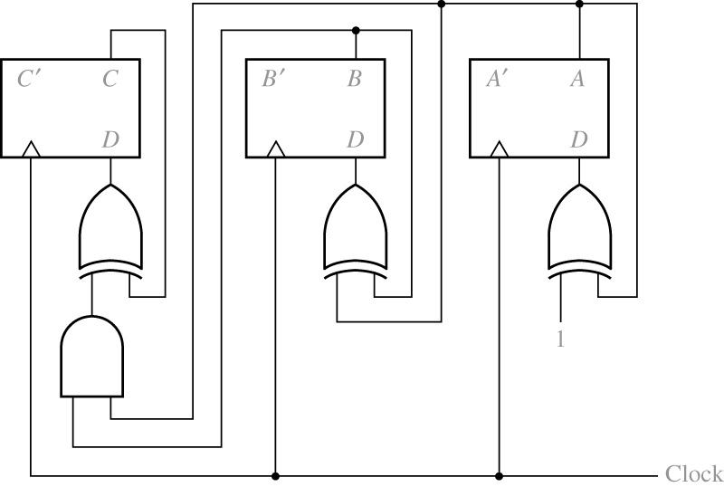
12.3 Design of Binary Counters
3-bit Synchronous Binary Counter with D Flip-Flops
To convert each D flip-flop to a T flip-flop by adding XOR gates

Slide 29
12.3 Design of Binary Counters
3-bit Synchronous Binary Counter with D Flip-Flops
3-bit Synchronous Binary Counter with D Flip-Flops
To derive the D flip-flop input from the state table
Q⁺ = D
Present State C B A | Next State Flip-Flop Inputs C⁺ B⁺ A⁺ D_{C} D_{B} D_{A}
0 0 0 0 0 1 0 1 0 0 1 1 1 0 0 1 0 1 1 1 0 1 1 1 | 0 0 1 0 0 1 0 1 0 0 1 0 0 1 1 0 1 1 1 0 0 1 0 0 1 0 1 1 0 1 1 1 0 1 1 0 1 1 1 1 1 1 0 0 0 0 0 0

Slide 30
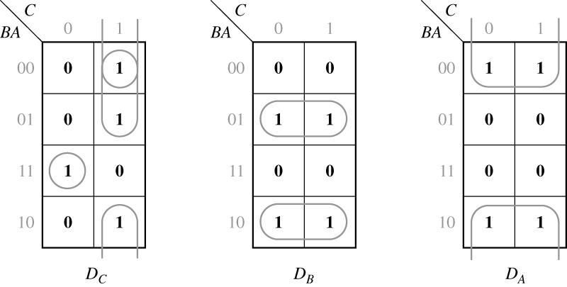
12.3 Design of Binary Counters
The D input equations derived from the maps are
Karnaugh Maps for D Flip-Flops

Slide 31
12.3 Design of Binary Counters
3-bit Synchronous Binary Counter with D Flip-Flops

Slide 32
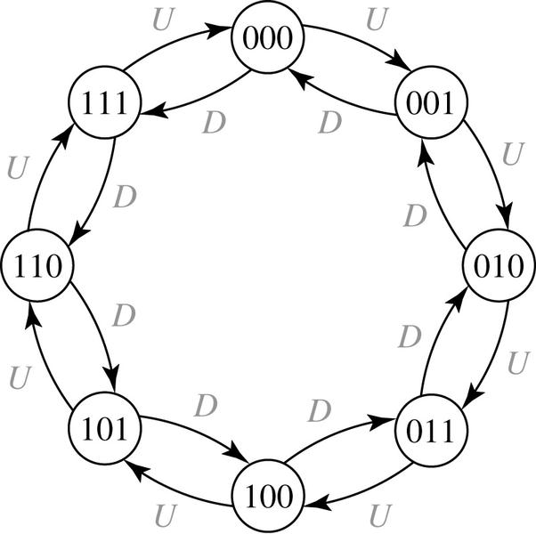
12.3 Design of Binary Counters
3-bit Synchronous Binary Up-Down Counter
State Graph
State Table
CBA | C⁺B⁺A⁺
 | U | D
000 | 001 | 111
001 | 010 | 000
010 | 011 | 001
011 | 100 | 010
100 | 101 | 011
101 | 110 | 100
110 | 111 | 101
111 | 000 | 110
When U = 1, Up counting
When D = 1, Down counting

Slide 33
12.3 Design of Binary Counters
3-bit Synchronous Binary Up-Down Counter Using D flip-flops
State Table
Logic Equations
CBA | C⁺B⁺A⁺
 | U | D
000 | 001 | 111
001 | 010 | 000
010 | 011 | 001
011 | 100 | 010
100 | 101 | 011
101 | 110 | 100
110 | 111 | 101
111 | 000 | 110

Slide 34
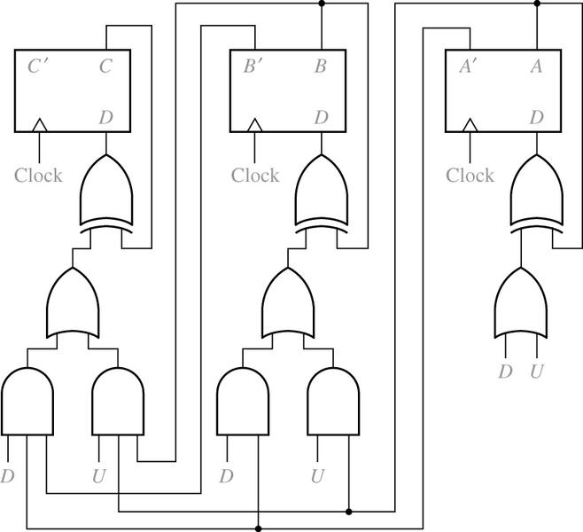
12.3 Design of Binary Counters
3-bit Synchronous Binary Up-Down Counter Using D flip-flops
Logic Equations

Slide 35
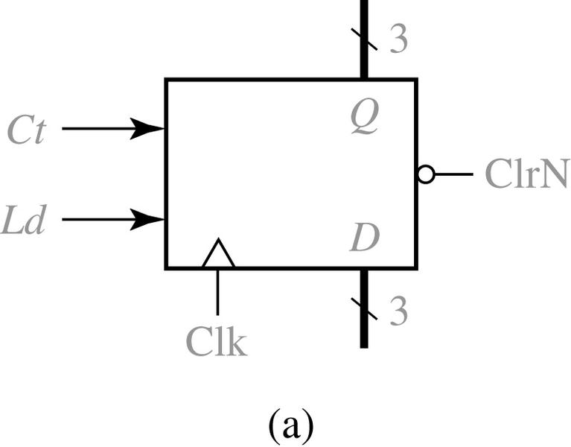
12.3 Design of Binary Counters
Loadable Counter with Count Enable
Block Diagram
Function Table
(b)

Slide 36
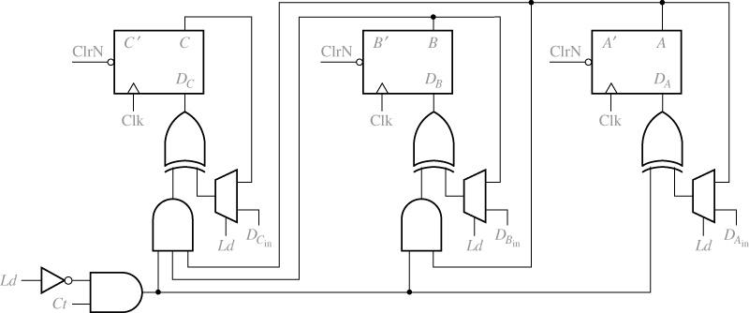
12.3 Design of Binary Counters
Loadable Counter Using F/F, MUX, and gates
0
0
0
1
1
1

Slide 37
12.3 Design of Binary Counters
Next-state Equations for the Loadable Counter

Slide 38
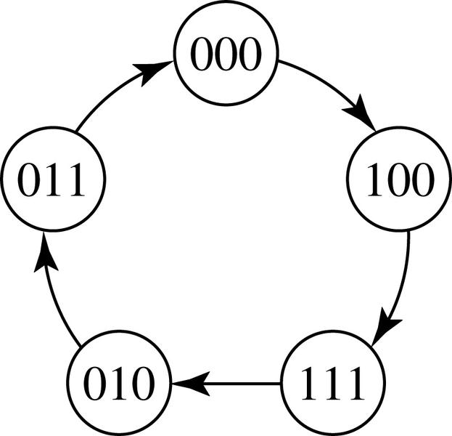
12.4 Counters for Other Sequences
Design of Non-Straight Binary Counter Using T Flip-Flops
State Graph for Counter
State Table
Present State C B A | Next State C⁺ B⁺ A⁺
0 0 0 0 0 1 0 1 0 0 1 1 1 0 0 1 0 1 1 1 0 1 1 1 | 1 0 0 - - - 0 1 1 0 0 0 1 1 1 - - - - - - 0 1 0

Slide 39
12.4 Counters for Other Sequences
Design of Non-Straight Binary Counter Using T Flip-Flops
Flip-Flop Inputs
Present State C B A | Next State Flip-Flop Inputs C⁺ B⁺ A⁺ T_{C} T_{B} T_{A}
0 0 0 0 0 1 0 1 0 0 1 1 1 0 0 1 0 1 1 1 0 1 1 1 | 1 0 0 1 0 0 - - - - - - 0 1 1 0 0 1 0 0 0 0 1 1 1 1 1 0 1 1 - - - - - - - - - - - - 0 1 0 1 0 1

Slide 40
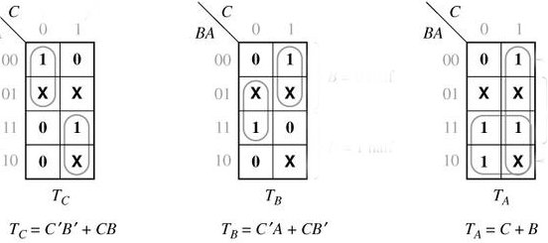
12.4 Counters for Other Sequences
Design of Non-Straight Binary Counter Using T Flip-Flops
Present State C B A | Next State F/F Inputs C⁺ B⁺ A⁺ T_{C} T_{B} T_{A}
0 0 0 0 0 1 0 1 0 0 1 1 1 0 0 1 0 1 1 1 0 1 1 1 | 1 0 0 1 0 0 - - - - - - 0 1 1 0 0 1 0 0 0 0 1 1 1 1 1 0 1 1 - - - - - - - - - - - - 0 1 0 1 0 1
Flip-Flop Input Functions

Slide 41
12.4 Counters for Other Sequences
The Other Method to Derive Input Functions from the Next-State Maps
Input Function of T Flip-Flop
Q Q⁺ | T
0 0 0 1 1 0 1 1 | 0 1 1 0
If Q = 0, then T = Q⁺
If Q = 1, then T = (Q⁺ )’

Slide 42
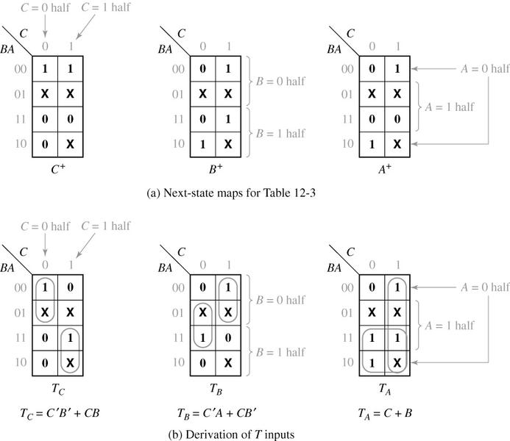
12.4 Counters for Other Sequences
The Other Method to Derive Input Functions from the Next-State Maps
Present State C B A | Next State C⁺ B⁺ A⁺
0 0 0 0 0 1 0 1 0 0 1 1 1 0 0 1 0 1 1 1 0 1 1 1 | 1 0 0 - - - 0 1 1 0 0 0 1 1 1 - - - - - - 0 1 0
Q Q⁺ | T
0 0 0 1 1 0 1 1 | 0 1 1 0

Slide 43
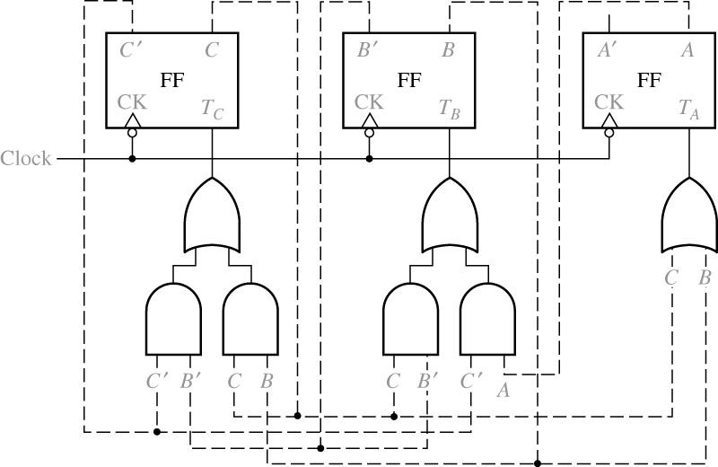
12.4 Counters for Other Sequences
Design of Non-Straight Binary Counter Using T Flip-Flops

Slide 44
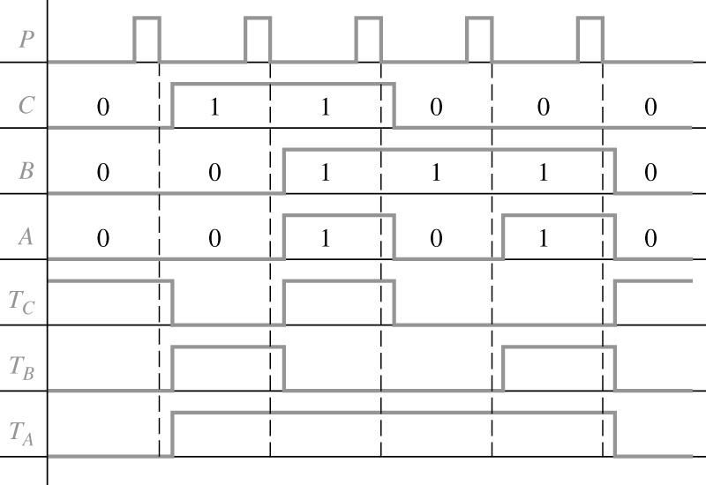
12.4 Counters for Other Sequences
Timing Diagram for Non-Straight Binary Counter Using T Flip-Flops

Slide 45
12.4 Counters for Other Sequences
Analysis for Unused States
CBA = 001, 101, 110

Slide 46
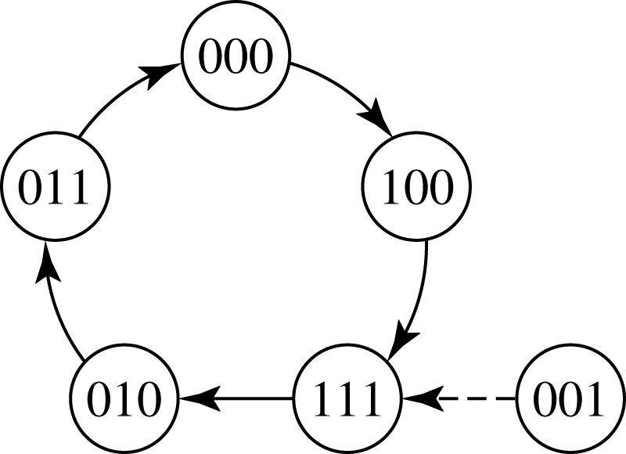
12.4 Counters for Other Sequences
Analysis for Unused States
CBA = 001, 101, 110
110
101

Slide 47
12.4 Counters for Other Sequences
Design Procedure for a Counter Using T Flip-Flop
Form a state table.
Next states for each present states
2. Plot the next-state maps from the table.
3. Plot a T input map for each F/F .
4. Find the T input equations from the maps
5. Realize the circuit.

Slide 48
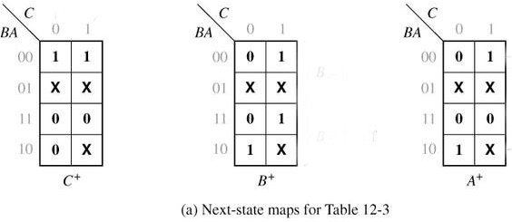
12.4 Counters for Other Sequences
Design of Non-Straight Binary Counter Using D Flip-Flop
Flip-Flop Input Function for D Flip-Flop: Q⁺ = D

Slide 49
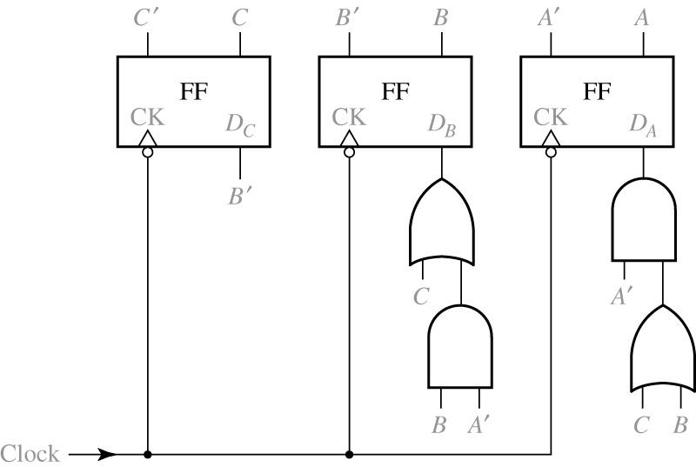
12.4 Counters for Other Sequences
Design of Non-Straight Binary Counter Using D Flip-Flop

Slide 50
12.5 Counter Design Using S-R and J-K Flip-Flops
S-R Flip-Flop Inputs
Inputs not allowed
(a)
(b)
(c)

Slide 51
12.5 Counter Design Using S-R and J-K Flip-Flops
Design of Non-Straight Binary Counter Using S-R Flip-Flop

Slide 52
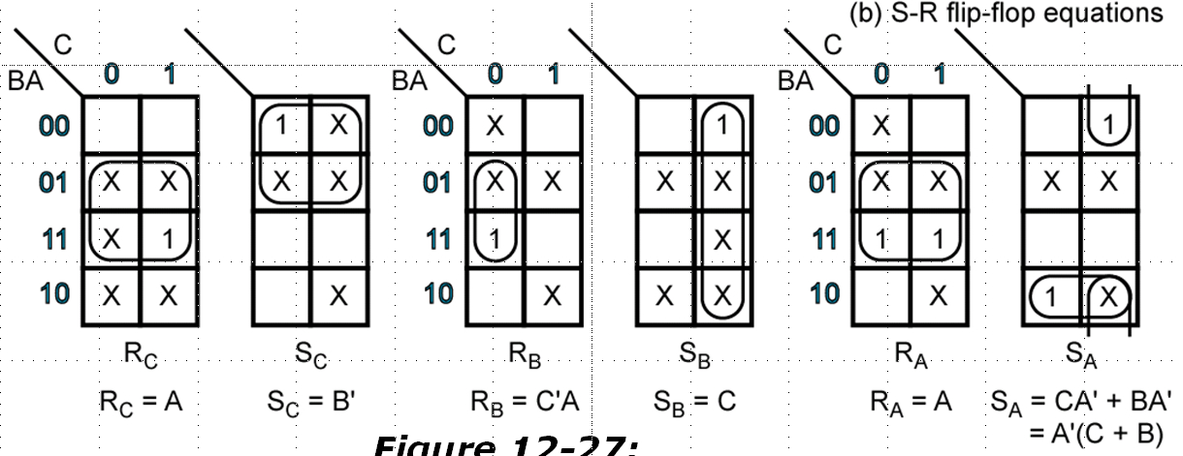
12.5 Counter Design Using S-R and J-K Flip-Flops
Design of Non-Straight Binary Counter Using S-R Flip-Flop

Slide 53
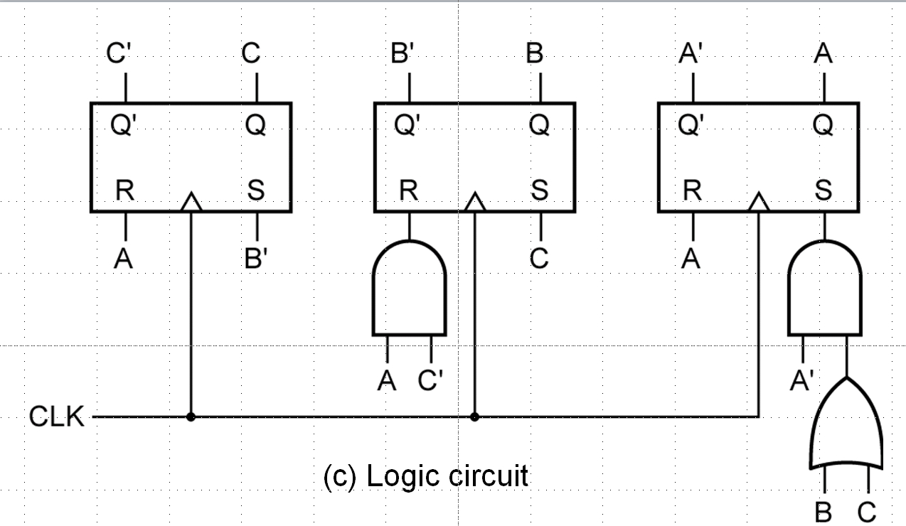
12.5 Counter Design Using S-R and J-K Flip-Flops
Design of Non-Straight Binary Counter Using S-R Flip-Flop

Slide 54
12.5 Counter Design Using S-R and J-K Flip-Flops
J-K Flip-Flop Inputs
(a)
(b)
(c)

Slide 55
12.5 Counter Design Using S-R and J-K Flip-Flops
Design of Non-Straight Binary Counter Using J-K Flip-Flop

Slide 56
12.6 Derivation of Flip-Flop Input Equations-Summary
Design of Non-Straight Binary Counter Using J-K Flip-Flop

Slide 57
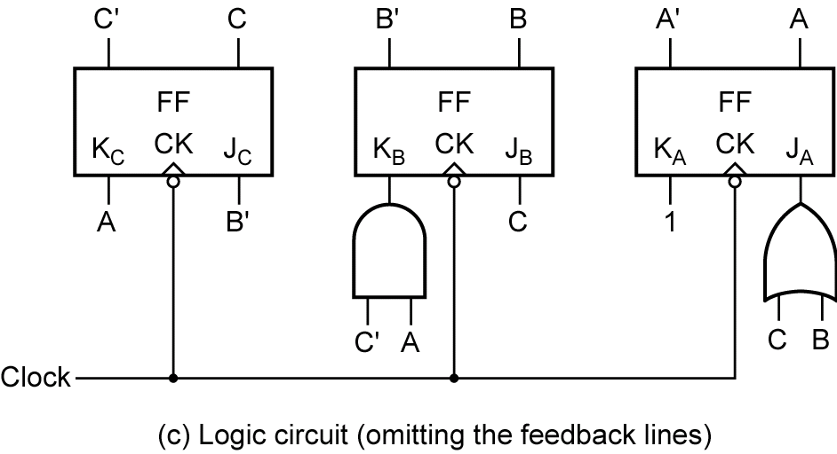
12.6 Derivation of Flip-Flop Input Equations-Summary
Design of Non-Straight Binary Counter Using J-K Flip-Flop

Slide 58
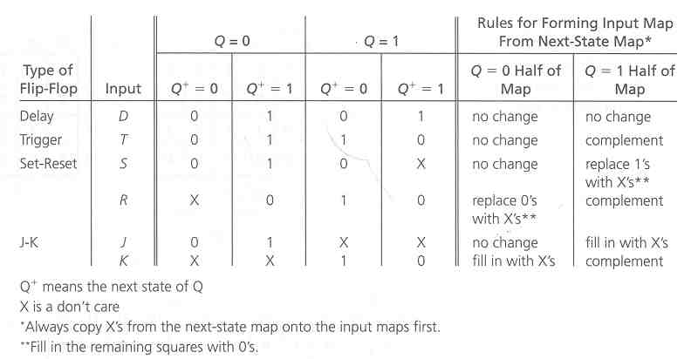
12.6 Derivation of Flip-Flop Input Equations-Summary
Determination of Flip-Flop Input Equations from Next-State Equations Using Karnaugh Maps

Slide 59
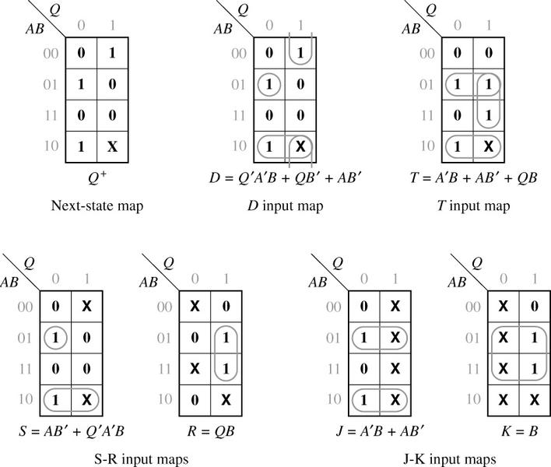
12.6 Derivation of Flip-Flop Input Equations-Summary
Example (illustrating the use of Table 12-9)

Slide 60
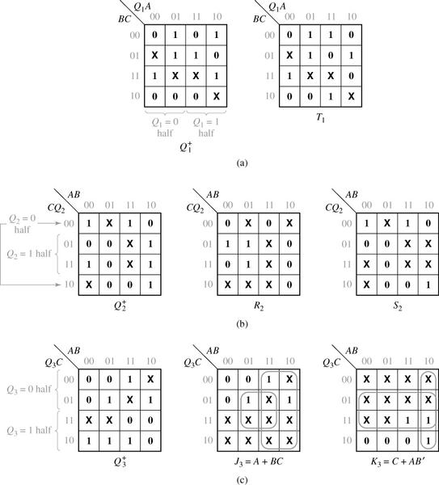
12.6 Derivation of Flip-Flop Input Equations-Summary
Derivation of Flip-Flop Input Equations Using 4-Variable Maps

