Slide 1
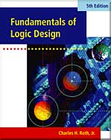
UNIT 10
Introduction to VHDL
This chapter in the book includes:
Objectives
Study Guide
10.1 VHDL Description of Combinational Circuits
10.2 VHDL Models for Multiplexers
10.3 VHDL Modules
10.4 Signals and Constants
10.5 Arrays
10.6 VHDL Operators
10.7 Packages and Libraries
10.8 IEEE Standard Logic
10.9 Compilation and Simulation of VHDL Code
Problems
Design Problems

Slide 2
Objectives
Represent gates and combinational logic by concurrent VHDL statements.
2. Given a set of concurrent VHDL statements, draw the corresponding
combinational logic circuit,
3. Write a VHDL module for a combinational circuit.
4. Compile and simulate a VHDL module.
5. Use the basic VHDL operators and understand their order of precedence.
6. Use the VHDL types : bit, bit_vector, Boolean, and integer.
Define and use an array-type.
7. Use IEEE Standard Logic. Use std_logic_vectors, together with overloaded
operators, to perform arithmetic operations.

Slide 3
Introduction to VHDL
HDL
Hardware Description Language
Allows a digital system to be designed and debugged at a higher level
before implementation
VHDL and Verilog
VHDL
VHSIC(Very High Speed IC) Hardware Description Language
Can describe the Behavior Level, Data Flow Level, Structural Level
Became an IEEE standard in 1987, revised in 1993

Slide 4
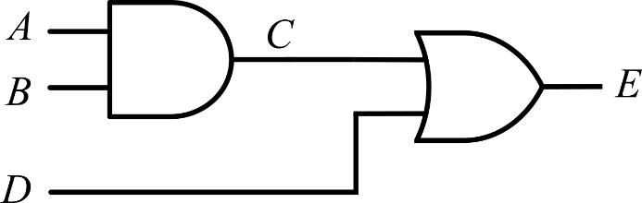
VHDL Modules
Complete VHDL Module
entity
  Declare all of the inputs and outputs
architecture
  Specify the internal operation of the module
Example:
VHDL Module with Two Gates
entity two_gates is
port (A, B, D: in bit;
E: out bit);
end two_gates;
architecture gates of two_gates is
signal C: bit;
begin
C <= A and B; -- concurrent statement
E <= C; -- concurrent statement
end gates;

Slide 5

VHDL Modules
entity declaration form: includes a list of interface signals
entity entity-name is
[port (interface-signal-declaration);]
end [entity][entity-name];
entity two_gates is
port (A, B, D: in bit;
E: out bit);
end two_gates;
architecture gates of two_gates is
signal C: bit;
begin
C <= A and B; -- concurrent statement
E <= C; -- concurrent statement
end gates;
Interface Signal Declaration
list-of-interface-signals: mode type [:=initial-value]
{; list-of-interface-signals: mode type [: =initial-value]};
mode
in: input signal
out: output signal
inout: bi-directional signal
type
bit
bit_vector
other types

Slide 6
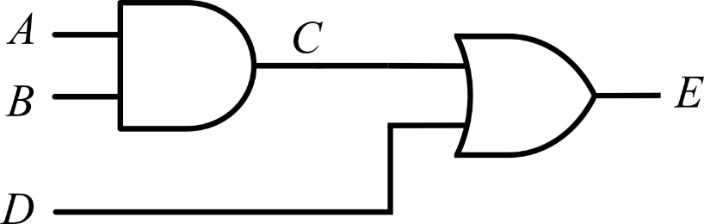
VHDL Modules
architecture declaration dorm
architecture architecture-name of entity-name is
[declarations]
begin
architecture body
end [architecture] [architecture-name];
Example: Architecture Declaration
entity two_gates is
port (A, B, D: in bit;
E: out bit);
end two_gates;
architecture gates of two_gates is
signal C: bit;
begin
C <= A and B; -- concurrent statement
E <= C; -- concurrent statement
end gates;

Slide 7
Standard Models in VHDL Architectures
The architecture body can contain any or all of the following VHDL models.
Each model can contain concurrent statements and / or sequential statements.
  Data-flow model
    concurrent signal assignment
    conditional signal assignment
    selected signal assignment
  Behavioral model
    process statement
  Structural model

Slide 8
Concurrent Statements
Each concurrent statement is interpreted as acting in parallel (concurrently) to other concurrent statements.
Four types of concurrent statements
  Concurrent signal assignment statement
  Conditional signal assignment statement
  Selected signal assignment statement
  Process statement
The process statement is a concurrent statement that contains a series of sequential statements which will be executed in a sequential manner, one after the other.

Slide 9
Sequential Statements
Statements appearing within the process statement are sequential statements.
Three types of sequential statements
  signal assignment statement
  if statement
  case statement

Slide 10
Concurrent Signal Assignment Statement
(Concurrent Statements)
The order of the following concurrent statement is unimportant.
entity two_gates is
port (A,B,D: in bit; E: out bit);
end two_gates;
architecture gates of two_gates is
signal C: bit;
begin
C <= A and B; -- concurrent
E <= C or D; -- statements
end gates;
entity two_gates is
port (A,B,D: in bit; E: out bit);
end two_gates;
architecture gates of two_gates is
signal C: bit;
begin
E <= C or D; -- concurrent
C <= A and B; -- statements
end gates;
≡

Slide 11
Concurrent Signal Assignment Statements
(Concurrent Statements)
Example: Write the VHDL code that implements a three-input NAND gate. The three input signals are named A, B and C and the output signal name is F.
-- library declaration
library IEEE;
use IEEE.std_logic_1164.all;
--entity
entity my_nand3 is
port(A, B, C : in std_logic;
F : out std_logic);
end my_nand3;
--architecture
architecture ex1_nand3 of my_nand3 is
begin
F <= not (A and B and C);
end ex1_nand3;

Slide 12
Concurrent Signal Assignment Statements
(Concurrent Statements)
Example: Write the VHDL code to implement the function expressed by the following logic equation: $F3=L^{′}∙M′∙N+L∙M$
-- library declaration
library IEEE;
use IEEE.std_logic_1164.all;
--entity
entity my_ckt_f3 is
port(L, M, N : in std_logic;
F3 : out std_logic);
end my_ckt_f3;
--architecture
architecture f3_2 of my_ckt_f3 is
begin
F3 <= ((not L) and (not M) and N) or (L and M);
end f3_2;

Slide 13
Concurrent Signal Assignment Statements
(Concurrent Statements)
Example: Write the VHDL code to implement the function expressed by the following logic equation: $F3=L^{′}∙M′∙N+L∙M$
-- Alternative solution
-- library declaration
library IEEE;
use IEEE.std_logic_1164.all;
--entity
entity my_ckt_f3 is
port(L, M, N : in std_logic;
F3 : out std_logic);
end my_ckt_f3;
--architecture
architecture f3_2 of my_ckt_f3 is
signal A1, A2: std_logic; -- intermediate signals
begin
A1 <= ((not L) and (not M) and N);
A2 <= L and M;
F3 <= A1 or A2;
end f3_2;

Slide 14
Conditional Signal Assignment Statements - when
(Concurrent Statements)
General form of a Conditional Signal Assignment statement
signal_name <= expression1 when condition1 else
expression2 when condition2 else
expressionN;

Slide 15
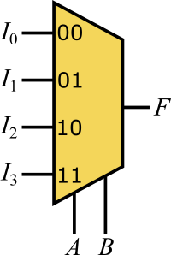
Conditional Signal Assignment Statements - when
(Concurrent Statements)
Example: 4-to-1 MUX
-- library declaration
library IEEE;
use IEEE.std_logic_1164.all;
--entity
entity my_4to1_mux is
port(I3, I2, I1, I0: in std_logic;
A,B: in std_logic;
F: out std_logic);
end my_4to1_mux;
--architecture
architecture mux4to1 of my_4to1_mux is
begin
F <= I0 when A='0' and B='0' else
I1 when A='0' and B='1' else
I2 when A='1' and B='0' else
I3 when A='1' and B='1' else
'0';
end mux4to1;

Slide 16
Conditional Signal Assignment Statements - when
(Concurrent Statements)
Example: 4-to-1 MUX (Alternative solution)
-- library declaration
library IEEE;
use IEEE.std_logic_1164.all;
--entity
entity my_4to1_mux is
port(I3, I2, I1, I0: in std_logic;
A,B: in std_logic;
F: out std_logic);
end my_4to1_mux;
--architecture
architecture mux4to1 of my_4to1_mux is
signal sel: std_logic_vector(1 downto 0);
begin
sel <= A&B;
F <= I0 when sel=“00” else
I1 when sel=“01” else
I2 when sel=“10” else
I3 when sel=“11” else
'0';
end mux4to1;

Slide 17
Conditional Signal Assignment Statements - when
(Concurrent Statements)
Example: Conditional signal assignment statement for the function: $F3=L^{′}∙M′∙N+L∙M$
-- library declaration
library IEEE;
use IEEE.std_logic_1164.all;
--entity
entity my_ckt_f3 is
port(L, M, N : in std_logic;
F3 : out std_logic);
end my_ckt_f3;
--architecture
architecture f3_2 of my_ckt_f3 is
begin
F3 <= '1' when (L= '0' AND M = '0' AND N = '1') else
'1' when (L= '1' AND M = '1') else
'0';
end f3_2;

Slide 18
Selected Signal Assignment Statements - with select
(Concurrent Statements)
General form of a Selected Signal Assignment statement
with choose_expression select
signal_name <= expression1 when choice1,
expression2 when choice2,
expressionN when choiceN;

Slide 19
Selected Signal Assignment Statements - with select
(Concurrent Statements)
Example: 4-to-1 MUX
-- library declaration
library IEEE;
use IEEE.std_logic_1164.all;
--entity
entity my_4to1_mux is
port(I3, I2, I1, I0: in std_logic;
A,B: in std_logic;
F: out std_logic);
end my_4to1_mux;
--architecture
architecture mux4to1 of my_4to1_mux is
signal sel: std_logic_vector(1 downto 0);
begin
sel <= A&B;
with sel select
F <= I0 when "00",
I1 when "01",
I2 when "10",
I3 when "11",
'0' when others;
end mux4to1;

Slide 20

Selected Signal Assignment Statements - with select
(Concurrent Statements)
Example: Selected signal assignment statement: $F3=L^{′}∙M′∙N+L∙M$
-- library declaration
library IEEE;
use IEEE.std_logic_1164.all;
--entity
entity my_ckt_f3 is
port(L, M, N: in std_logic;
F3: out std_logic);
end my_ckt_f3;
--architecture
architecture f3_2 of my_ckt_f3 is
signal sig: std_logic_vector(2 downto 0); -- local
begin
sig <= L & M & N; -- concatenation operator
with sig select
F3 <= '1' when "001" | "110" | "111",
'0' when others;
end f3_2;
$$\begin{aligned}F3&=L^{′}∙M^{′}∙N+L∙M \\ &=L^{′}∙M^{′}∙N+L∙M\left(N^{′}+N\right) \\ &=L^{′}∙M^{′}∙N+L∙M∙N^{′}+L∙M∙N \\ &=\sum{\left(1, 6, 7\right)}\end{aligned}$$

Slide 21
Structural Model
Example: Entity and Architecture Declaration for A Full Adder Module
X
FullAdder
Cout
entity FullAdder is
port (X, Y, Cin: in bit;
Cout, Sum: out bit);
end two_gates;
Y
Cin
Sum
architecture Equations of FullAdder is
begin --concurrent assignment statements
Sum <= X xor Y xor Cin after 10 ns;
Cout <=(X and Y) or (X and Cin) or (Y and Cin) after 10 ns;
end Equations;

Slide 22
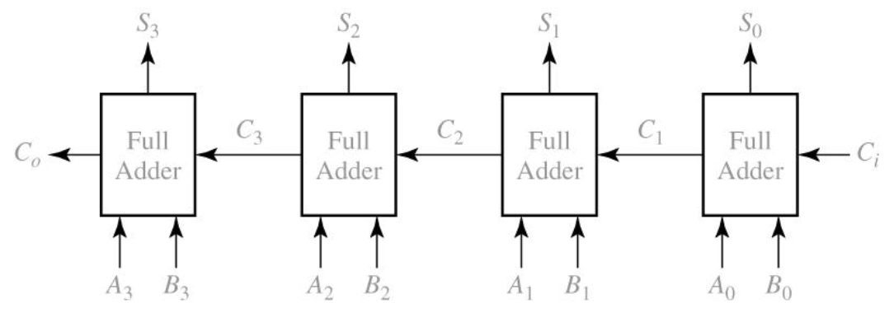
Structural Model
Application of the FullAdder: 4-Bit Full Adder

Slide 23
Structural Model
Structural Description of the 4-Bit Full Adder (1 / 2)
-- library declaration
library IEEE;
use IEEE.std_logic_1164.all;
--entity
entity full_adder is
port (X, Y, Cin: in std_logic;
Cout, Sum: out std_logic);
end full_adder;
--architecture
architecture my_fa of full_adder is
begin
Sum <= X xor Y xor Cin;
Cout <= (X and Y) or (X and Cin) or (Y and Cin);
end my_fa;

Slide 24
Structural Model
Structural Description of the 4-Bit Full Adder (2 / 2)
-- library declaration
library IEEE;
use IEEE.std_logic_1164.all;
--entity for 4-bit FA
entity Adder4 is
port (A, B: in std_logic_vector(3 downto 0); Ci: in std_logic;
S: out std_logic_vector(3 downto 0); Co: out std_logic);
end Adder4;
--architecture for 4-bit FA
architecture Structure of Adder4 is
component FullAdder
port (X, Y, Cin: in std_logic; -- Inputs
Cout, Sum: out std_logic); -- Outputs
end component;
signal C: std_logic_vector(3 downto 1);
begin -- instantiate four copies of the FullAdder
FA0: FullAdder port map (A(0), B(0), Ci, C(1), S(0));
FA1: FullAdder port map (A(1), B(1), C(1), C(2), S(1));
FA2: FullAdder port map (A(2), B(2), C(2), C(3), S(2));
FA3: FullAdder port map (A(3), B(3), C(3), Co, S(3));
end Structure;

Slide 25
VHDL Modules - Component
Components used within the architecture are declared at the beginning of the architecture
Components Declaration Form
component component-name
port (list-of-interface-signals-and-their-types);
end component;
label: component-name port map (list-of-actual-signals);

Slide 26
Signals and Constants
Internal Signal Declaration Form
signal list_of_signal_names: type_name [constraint] [:= initial_value];
Example
signal A,B,C: bit_vector(3 downto 0):= “1111”;
-- A, B, and C are 4-bit vectors dimensioned 3 downto 0 and initialized to 1111.
signal E,F: integer range 0 to 15;
-- E and F are integers range from 0 to 15, initialized by default to 0.

Slide 27
Signals and Constants
Constant Declaration Form
constant constant_name: type_name [constraint] [:=constant_value];
Example
constant limit : integer := 17;
-- A constant named limit of type integer with a value of 17
constant delay1 : time := 5 ns;
-- A constant named delay1 of type time with the value of 5 ns
Example: Use of Constant
A<=B after delay1;

Slide 28
Signals and Constants
Predefined types that can be used as signals or constants
bit ‘0’ or ‘1’
boolean FALSE or TRUE
integer An integer in the range -(2³¹ -1) to +(2³¹ -1)
(some implementations support a wider range)
positive An integer in the range 1 to 2³¹-1 (positive integers)
natural An integer in the range 0 to 2³¹-1 (positive integers and zero)
real Floating-point number in the range -1.0E38 to +1.0E38
character Any legal VHDL character including upper- and lower case letters,
digits, and special characters; each printable character must be
enclosed in single quotes, e.g.,’d’,’7’,’+’
time An integer with units fs, ps, ns, us, ms, sec, min, or hr

Slide 29
Signals and Constants
Example of User-defined Types – enumeration type
type state_type is (S0,S1,S2,S3,S4,S5);
signal state : state_type := S1;
state <= S3;

Slide 30
Arrays
In order to use an array in VHDL
  Declare an array type
  Declare an array object
Declaration of a one-dimensional array type named SHORT_WORD
type SHORT_WORD is array (15 downto 0) of bit;
Declaration of array objects of type SHORT_WORD
signal DATA_WORD: SHORT_WORD;
-- DATA_WORD is a signal array of 16 bits, indexed 15 down to 0, initialized by default to all ‘0’ bits
signal ALT_WORD: SHORT_WORD := “0101010101010101”;
-- ALT_WORD is a signal array of 16 bits which is initialized as above
constant ONE_WORD: SHORT_WORD := (others =>’1’);
--ONE_WORD is a constant array of 16 bits; all bits are set to ‘1’ by (others =>’1’)

Slide 31
Arrays
General Form of Array Type and Array Object Declaration
type array_type_name is array index_range of element_type;
signal array_name: array_type_name[:= initial_values];
signal may be replaced with constant

Slide 32
Arrays
Definition of Two Dimensional Array Signal
type matrix4x3 is array (1 to 4, 1 to 3) of integer;
signal matrixA: matrix4x3 := ((1,2,3), (4,5,6,), (7,8,9), (10,11,12));
Example
matrixA(3,2) refers to element 8.
B <= matrix(2,3)
-- B<=6

Slide 33
Arrays
Definition of an Unconstrained Array Type
Dimension of array is left undefined
type intvec is array (natural range <>) of integer;
Range must be specified when the array object is declared
signal intvec5: intvec(1 to 5) := (3, 2, 6, 8, 1);
Definition of an two-dimensional array with unconstrained row and column index range
type matrix is array (natural range <>, natural range <>) of integer;

Slide 34
Arrays
Predefined Unconstrained Array Type in VHDL: bit-vector and string
type bit_vector is array (natural range <>) of bit;
type string is array (positive range <>) of character;
Examples
constant string1: string(1 to 29) := “This string is 29 characters.”
constant A: bit_vector(0 to 5) := “101011”;

Slide 35
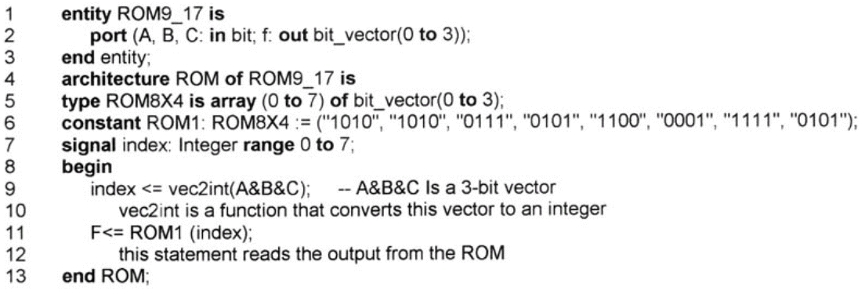
Arrays
Predefined Unconstrained Array Type in VHDL: bit_vector and string
type bit_vector is array (natural range <>) of bit;
type string is array (positive range <>) of character;
Example: VHDL Description of a ROM

Slide 36
VHDL Operators
VHDL Operators
Low Priority High
binary logical operators: and or nand nor xor xnor
relational operators: = /= < <= > >=
shift operators: sll srl sla sra rol ror
adding operators: + - & (concatenation)
unary sign operators: + -
multiplying operators: * / mod rem
miscellaneous operators: not abs **
Operator Precedence: Order of Evaluation
not A or B and not C & D
((not A) or B) and ((not) C & D)
Relational Operators
If A=5, B=4, C=3
(A>=B) and (B<=C) evaluates to FALSE

Slide 37
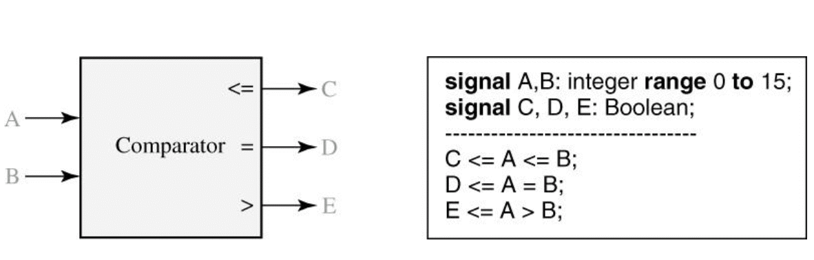
VHDL Operators
Example of Relational Operator - Comparator for Integers

Slide 38
VHDL Operators
Shift Operators – shift or rotate a bit_vector
Example: A is an 8-bit vector equal to “10010101”
A sll 2 is “01010100” (shift left logical, filled with ‘0’)
A srl 3 is “00010010” (shift right logical, filled with ‘0’)
A sla 3 is “10101111: (shift left arithmetic, filled with rightmost bit)
A sra 2 is “11100101” (shift right arithmetic, filled with leftmost bit)
A rol 3 is “10101100” (rotate left)
A ror 5 is “10101100” (rotate right)
Shifting Using Concatenation Operator – Shift right arithmetic two places
A(7)&A(7)&A(7 downto 2) = ‘1’&’1’&”1000101” = “11100101”

Slide 39
Packages and Libraries
Packages and Libraries – Frequently used functions and components
Packages Declaration Form
Package declaration
package package-name is
package declarations
end [package][package-name];
Optional package body
package body package-name is
package body declarations
end [package body][package-name];

Slide 40
Packages and Libraries
bit_pack package (compiled library name: BITLIB)
- includes components and functions (inside CD-ROM attached)
Example: Nor2 gate
Component Declaration for Nor2
component Nor2
port (A1,A2: in bit; Z: out bit);
end component;
--2-input NOR gate
entity Nor2 is
port (A1,A2: in bit; Z: out bit);
end Nor2;
architecture concur of Nor2 is
begin
Z<=not(A1 or A2) after 10ns;
end concur;

Slide 41
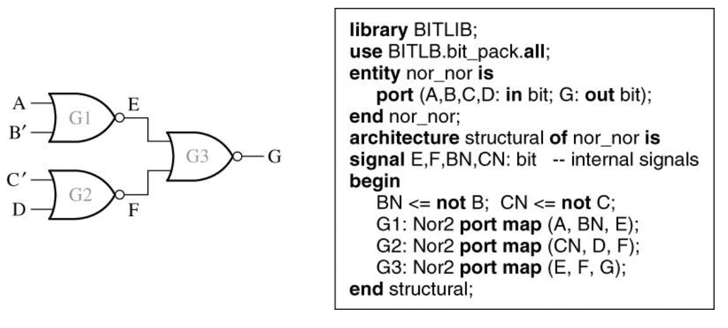
Packages and Libraries
To access components and functions within a package requires a library and a use.
libraray BITLIB;
use BITLIB.bit_pack.all;
use BITLIB.bit_pack.Nor2;
NOR-NOR Circuit and Structural VHDL Code Using Library Components

Slide 42
IEEE Standard Logic
IEEE-1164 standard logic
type std_logic is ( 'U', -- uninitialized
'X', -- strong drive, unknown logic value
'0', -- strong drive, logic zero
'1', -- strong drive, logic one
'Z', -- high impedance
'W', -- weak drive, unknown logic value
'L', -- weak drive, logic zero
'H', -- weak drive, logic one
'-' -- unspecified (don’t care)
);

Slide 43
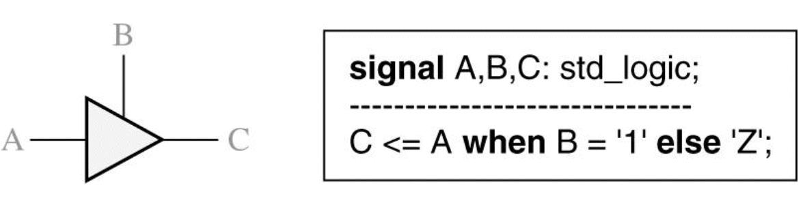
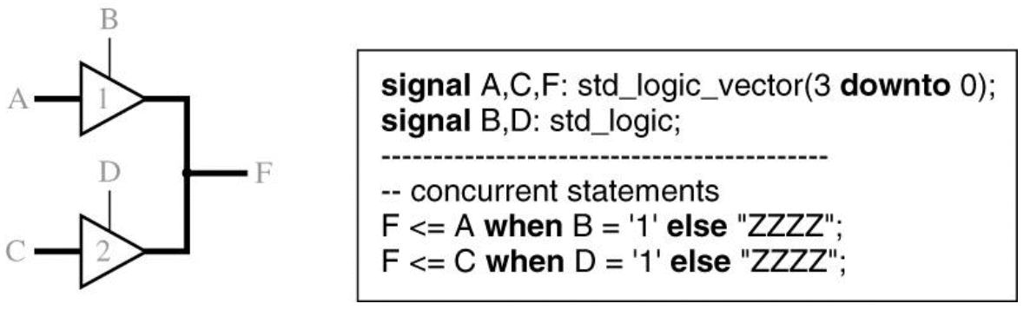
IEEE Standard Logic
IEEE standard 1164 defines a std_logic type of nine values
U, X, 0, 1, Z, W, L, H, -
Tri-state Buffer
Tri-state Buffers Driving a Bus

Slide 44
IEEE Standard Logic
To use signals of type std_logic and std_logic_vector
library ieee;
use ieee.std_logic_1164.all;

Slide 45
IEEE Standard Logic
std_logic_vector
One dimensional array of std_logic signals
Index starts with 0
-- library declaration
library IEEE;
use IEEE.std_logic_1164.all;
--entity
entity quad_and_gates is
port(A3, A2, A1, A0: in std_logic;
B3, B2, B1, B0: in std_logic;
C3, C2, C1, C0: out std_logic);
end quad_and_gates;
--architecture
architecture my_vector of quad_and_gates is
begin
C3 <= A3 and B3; -- hard way
C2 <= A2 and B2;
C1 <= A1 and B1;
C0 <= A0 and B0;
end my_vector;
A3
C3
B3
A2
C2
B2
A1
C1
B1
A0
C0
B0

Slide 46
IEEE Standard Logic
std_logic_vector
One dimensional array of std_logic signals
Index starts with 0
-- library declaration
library IEEE;
use IEEE.std_logic_1164.all;
--entity
entity quad_and_gates is
port(A, B: in std_logic_vector (3 downto 0);
C: out std_logic_vector (3 downto 0));
end quad_and_gates;
--architecture
architecture my_vector of quad_and_gates is
begin
C <= A and B; -- easy way
end my_vector;
A(3)
C(3)
B(3)
A(2)
C(2)
B(2)
A(1)
C(1)
B(1)
A(0)
C(0)
B(0)

Slide 47
Compilation and Simulation of VHDL Code
Compilation, Simulation, and Synthesis of VHDL Code

Slide 48
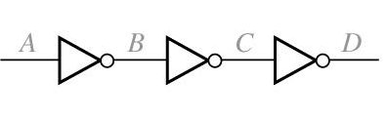
Compilation and Simulation of VHDL Code
Simulation of VHDL Code
B <= not A;
C <= not B;
D <= not C after 5 ns;
ns delta | A B C D
0 +0 3 +0 3 +1 3 +2 8 +0 | 0 1 0 1 1 1 0 1 1 0 0 1 1 0 1 1 1 0 1 0

Slide 49


